Slide 1
TrevorC2
Information Security Inc.

Slide 2
Contents
About TrevorC2
Testing Environment
Topology
How TrevorC2 Works?
Installing TrevorC2
Using TrevorC2
Countermeasures
References

Slide 3
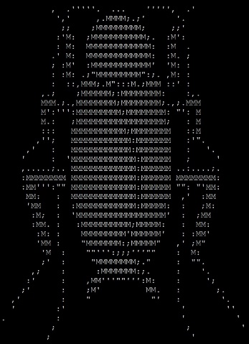
About TrevorC2
TrevorC2 is a client/server model for masking command and control through a normally browsable website
Detection becomes much harder as time intervals are different and does not use POST requests for data exfil

Slide 4
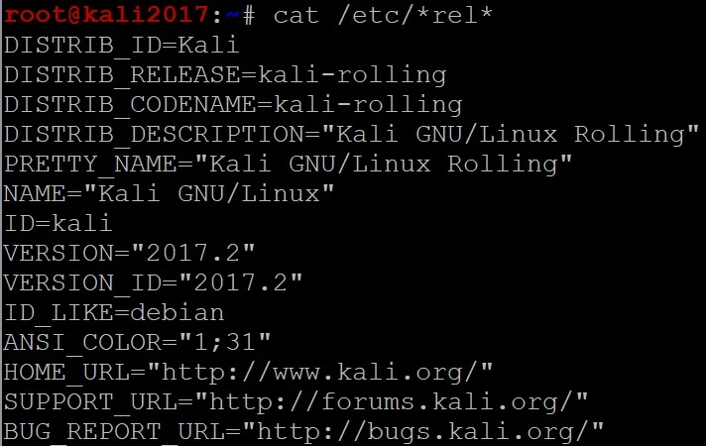
Testing Environment
Kali Linux 2017

Slide 5
Topology
TrevorC2 testing topology
------------ ------------- -----------
| | | Layer3 | | |
| Server | === | Device | === | Client |
| | | | | |
--------------- ------------- ------------
Kali Linux 2017 Cisco Kali Linux 2017
IP 192.168.10.12 192.168.86.87,192.168.86.88

Slide 6
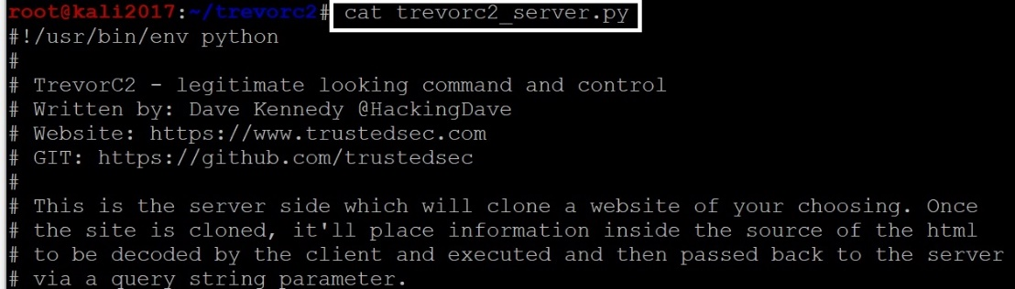
How TrevorC2 Works?
There are two components to TrevorC2 - the client and the server
The Server -> This will create a clone of the website which you will using for the operation and start a server. This looks like the legitimate website and can be viewed by anyone. But the parameters are hidden inside the source which will have the instructions for the client

Slide 7
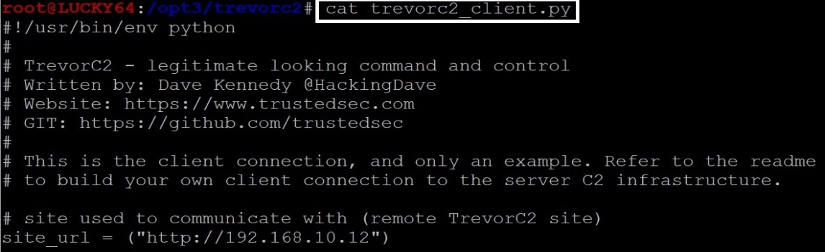
How TrevorC2 Works?
There are two components to TrevorC2 - the client and the server
The Client -> Reaches the server (the cloned website), parse the code, read the parameters and instructions from the webpage, run the command and put the result back in base64 encoded query string to the website

Slide 8
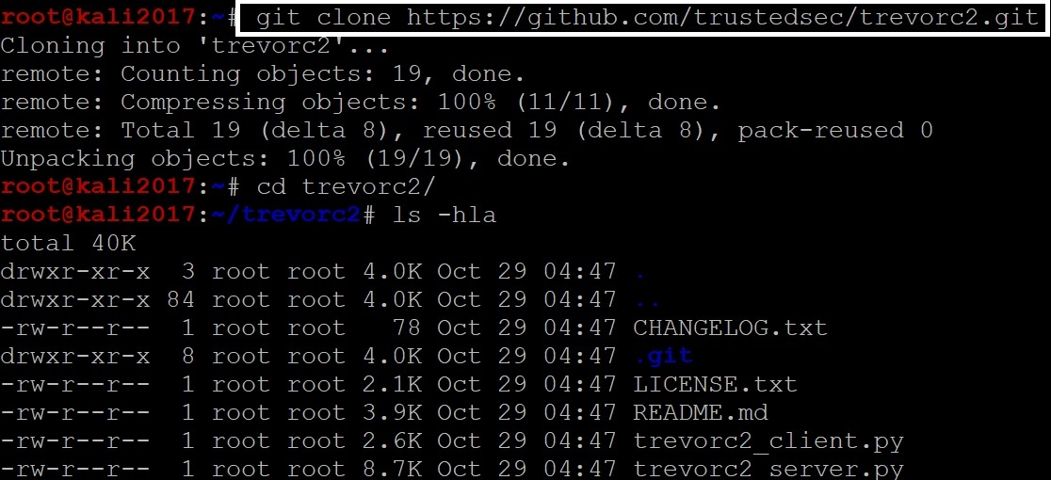
Installing TrevorC2
Clone the GitHub repository

Slide 9
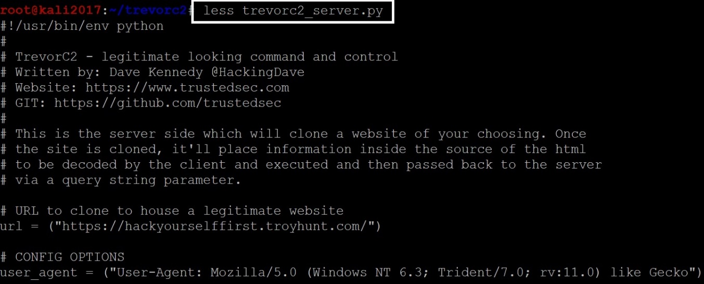
Using TrevorC2
Server: Change the configuring options and the website to be cloned

Slide 10
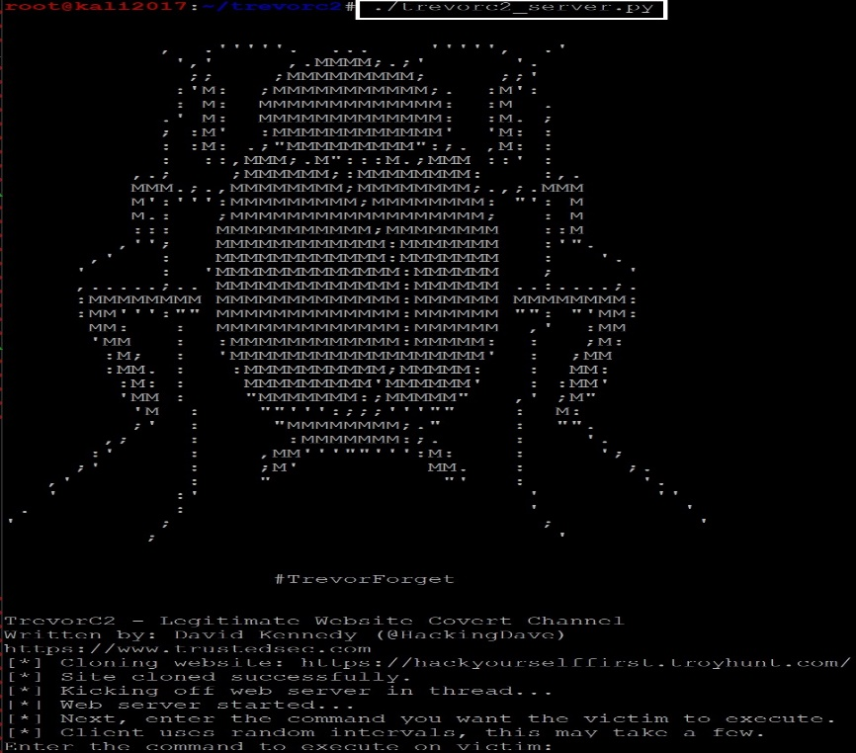
Using TrevorC2
Running the server

Slide 11
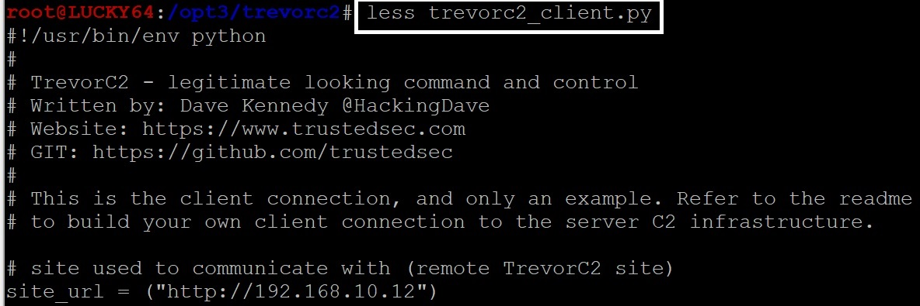
Using TrevorC2
Client: Change the configuration and system you want it to communicate back to.

Slide 12
Using TrevorC2
Running the client

Slide 13
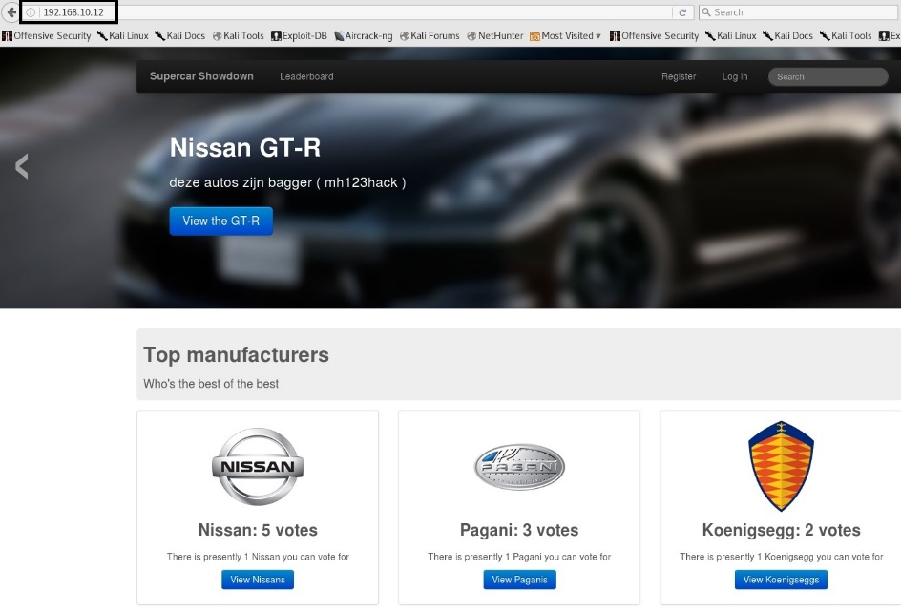
Using TrevorC2
Accessing the server from the client, it looks like an legitimate website

Slide 14
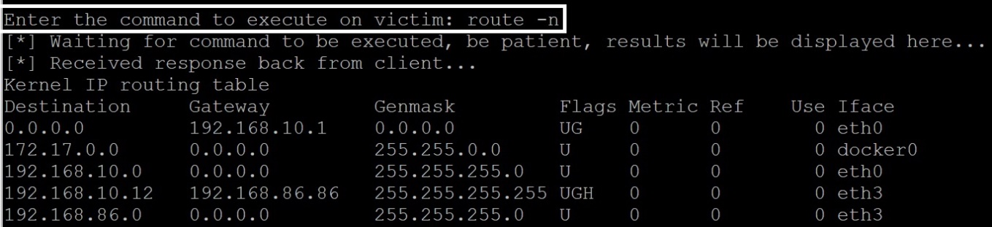
Using TrevorC2
Execute a command on the client machine (compromised machine) from the server

Slide 15
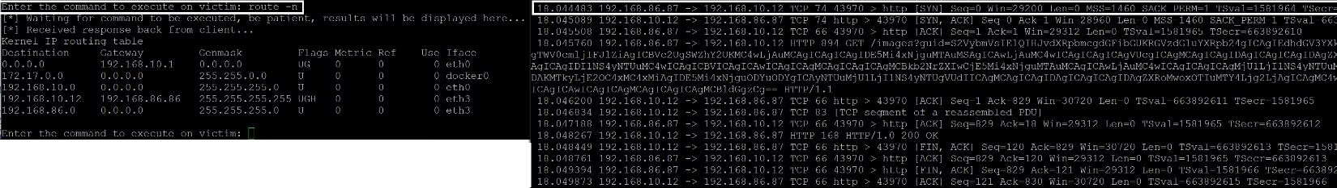
Using TrevorC2
Inspecting the network traffic using tshark when the command is executed, nothing suspicious

Slide 16
Countermeasures
Use NTA
Inspect the Network traffic and look for periodic HTTP communication and suspicious URIs (Base64 encoded)
Look for suspicious processes on the server and client machines

Slide 17
References
GitHub
https://github.com/trustedsec/trevorc2
Kali Linux
https://www.kali.org/downloads/

