Slide 1
Transportation model: an introduction in GAMS
erwin@amsterdamoptimization.com

Slide 2
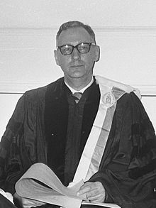

Transportation Model
There is a deep connection with economic theory.
Economists call this model: Koopmans-Hitchcock Model.
Tjalle Koopmans received the 1975 Nobel price in economics (with Kantorovich).
Model 1 in the GAMS model library is a version of the transportation model in the 1963 George Dantzig book (originally a RAND report).
Paul Samuelson noticed the connection between the transportation LP problem and the concept of spatial equilibrium.
Samuelson won the Nobel price in 1970.
Samuelson, Paul A. “Spatial Price Equilibrium and Linear Programming.” The American Economic Review 42, no. 3 (1952)

Slide 3
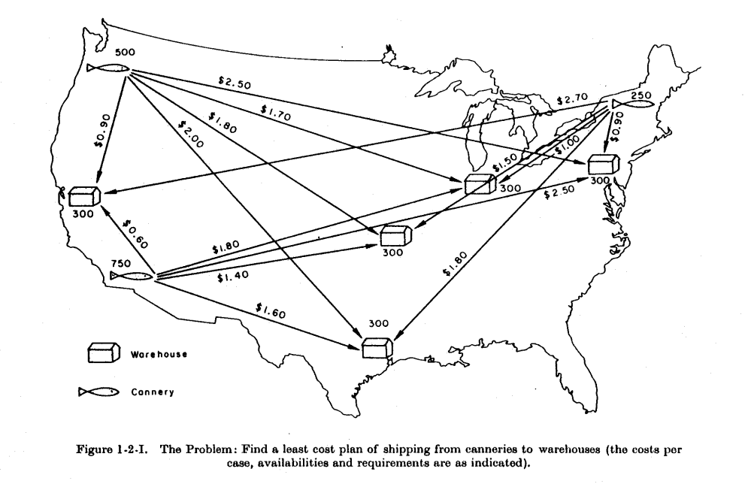
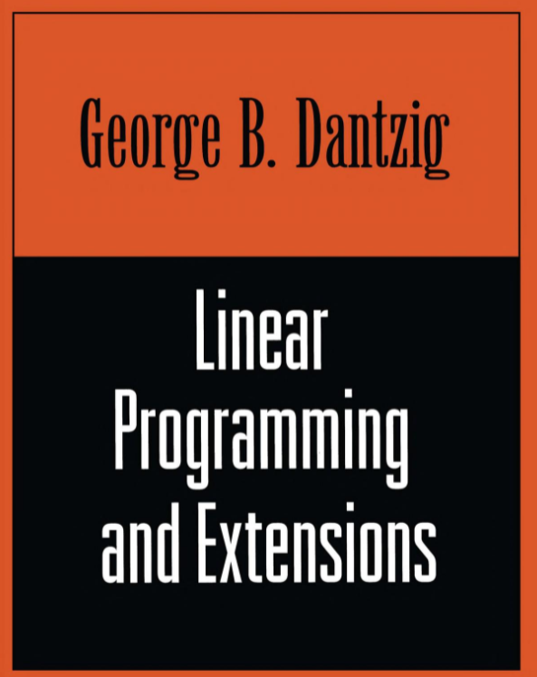
This picture is from the Dantzig book. The LP model is based on a smaller version discussed later in the book. The GAMS data is slightly different (maybe to make the solution degenerate).

Slide 4
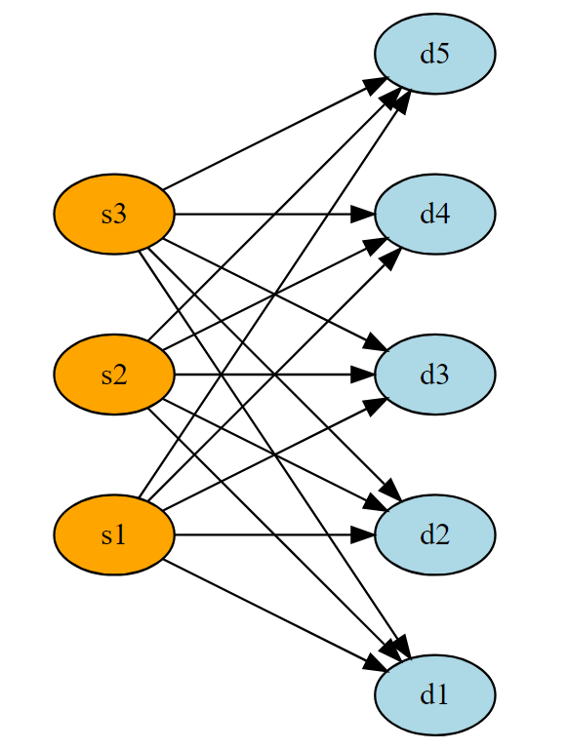
Transportation model as network problem or LP.
Bipartite Graph
Network problems have the property that each variable occurs exactly twice in the constraint matrix.
Supply nodes
Demand nodes

Slide 5

Model TRNSPORT from the model library, part 1
Set i 'canning plants' / seattle, san-diego / j 'markets' / new-york, chicago, topeka /; Parameter a(i) 'capacity of plant i in cases' / seattle 350 san-diego 600 / b(j) 'demand at market j in cases' / new-york 325 chicago 300 topeka 275 /; Table d(i,j) 'distance in thousands of miles' new-york chicago topeka seattle 2.5 1.7 1.8 san-diego 2.5 1.8 1.4; Scalar f 'freight in dollars per case per thousand miles' / 90 /; Parameter c(i,j) 'transport cost in thousands of dollars per case'; c(i,j) = f*d(i,j)/1000;
Set elements are strings
(limit: 63 chars)
Order not important (2) Domain checked (3) should use better names than a,b
Domain checking ensures
referential integrity
Explanatory text is not ignored (like comments)
Excel, CSV files are popular external data sources
Parallel assignment
Don’t use loops

Slide 6
Model TRNSPORT from the model library, part 2
Default: variables are free
Variable x(i,j) 'shipment quantities in cases' z 'total transportation costs in thousands of dollars'; Positive Variable x;
Equation cost 'define objective function' supply(i) 'observe supply limit at plant i' demand(j) 'satisfy demand at market j'; cost.. z =e= sum((i,j), c(i,j)*x(i,j)); supply(i).. sum(j, x(i,j)) =l= a(i); demand(j).. sum(i, x(i,j)) =g= b(j); Model transport / all /; solve transport using lp minimizing z; display x.l, x.m;
Blocks of variables
Blocks of equations
A model is collection of equations
GAMS uses an objective variable instead of an objection function
Calls external solver
.L: level, .M: marginal

Slide 7
Listing file has a lot of information
Compilation output
Source listing
Useful to help with some syntax errors
Execution time output
Output of DISPLAY statements
Output related to SOLVE statements
Model generation
Equation listing
Debug leads/lags
For non-linear models, Jacobian elements are shown
Column listing
Where does a variable appear?
Model statistics
Size of model
Solver messages
S O L V E S U M M A R Y
Always check if solver succeeded
Model and Solver status
Solution listing
LO,L,UP,M
Number of variables and equations. Don’t forget that number of nonzero elements is also very important for sparse solvers!
Often users wonder about strange results without first checking the model and solver status

Slide 8
Exercises
Run the model and study the listing file.
Make a typo in one of the labels (set elements), and see how GAMS reacts.
Change the demand in NY to 400: b('new-york') = 400; (note that an element must be quoted). What happens?
Add check: abort$(totalDemand>totalSupply+0.0001) "Too much demand"; If we pass this check, the model should be feasible.
Change demand in NY back to 325.
Pure network models have two non-zero elements in each column. Check the column listing for variable x. To view more columns in the column listing, add option limcol = 100; to the model. Notes:
the objective does not count
the default value for limcol is 3
a solver will typically substitute out the objective variable, and create an objective function.

Slide 9
LP,Marginals,Basis,EPS
Marginals
duals for equations:
reduced cost for variables:
This is like a dual for
Indicates: how much can obj change when bound/rhs changes
A marginal with value EPS means: numerically zero but this row/column is non-basic
Nerdy: Dual degeneracy (i.e. we can have multiple solutions)
See optional slides at end of this deck
Special values in GAMS: EPS, INF, -INF, NA, UNDF

Slide 10
Duals: how much can obj change
Duals (marginal) of an equation indicates how much an objective can change when the rhs is increased.
Let’s increase the demand in NY by 1. The obj can change by 0.225:
---- EQU demand satisfy demand at market j
LOWER LEVEL UPPER MARGINAL
new-york 325.0000 325.0000 +INF 0.2250
chicago 300.0000 300.0000 +INF 0.1530
topeka 275.0000 275.0000 +INF 0.1260
---- 118 PARAMETER dualcheck increase demand of NYC by one unit
demand dual obj
before 325.000 0.225 153.675
after 326.000 153.900
diff 1.000 0.225
I.e. our marginal cost is 0.225. So we would want to charge NY at least 0.225 to meet this extra demand.

Slide 11
Duals: how much can obj change (cont’d)
parameter dualcheck(*,*) 'increase demand of NYC by one unit'; solve transport using lp minimizing z; dualcheck('before','demand') = b('new-york'); dualcheck('before','dual') = demand.m('new-york'); dualcheck('before','obj') = z.l; b('new-york') = b('new-york') + 1; solve transport using lp minimizing z; dualcheck('after','demand') = b('new-york'); dualcheck('after','obj') = z.l; dualcheck('diff','demand') = b('new-york') - dualcheck('before','demand'); dualcheck('diff','obj') = z.l - dualcheck('before','obj'); display dualcheck;
Output is on previous slide

Slide 12
Exercises
What happens if we increase the demand in NY by 10 or 100.
Add abort$(transport.modelstat <> %modelstat.optimal%) "Model was not solved to optimality"; to alert about problems.
Using the original NY demand of 325, would it make sense to increase capacity somewhere? (hint: look at the duals)

Slide 13
Exercise
Make problem large by duplication
Without inventing new data we can form:
This can be viewed as a block-diagonal structure:
c
c
c
A
b
A
b
set k /k1*k10/;
Try with 10, 100, 1000. These LPs should solve very fast
Adding an index to a symbol happens a lot in practical modeling (for many reasons)
A
b

Slide 14
What is a basis?
Optional
Let m be the number of equations and n be the number of variables in out LP model.
In each Simplex iteration, n columns are temporarily fixed to one of their bounds. The remaining m columns form a square system which can be solved using linear algebra.
We say: there are m rows/columns that are basic and n rows/columns that are non-basic.
n
m slacks
The m basic rows/columns have a value between their bounds and have a zero marginal (dual or reduced cost).
The n non-basic rows/columns are at one of the bounds and have a non-zero or EPS marginal.(*)
A
-I
b
m
=
B
X_{b}
b
Exercise (use the listing file):
What is m,n in our transportation model?
Count the number of basic and non-basic rows/columns.
Check that non-basic rows/columns are at their bound.
m basic columns form a square linear system
m
=
m
* There is also something called superbasic. This is non-basic but between bounds. This is beyond our scope.

Slide 15
Optional
Basis status (concluded from marginal)
LOWER LEVEL UPPER MARGINAL
---- EQU cost . . . 1.0000 NON-BASIC AT LOWERBOUND
cost define objective function
---- EQU supply observe supply limit at plant i
LOWER LEVEL UPPER MARGINAL
seattle -INF 350.0000 350.0000 EPS NON-BASIC AT UPPERBOUND
san-diego -INF 550.0000 600.0000 . BASIC
---- EQU demand satisfy demand at market j
LOWER LEVEL UPPER MARGINAL
new-york 325.0000 325.0000 +INF 0.2250 NON-BASIC AT LOWERBOUND
chicago 300.0000 300.0000 +INF 0.1530 NON-BASIC AT LOWERBOUND
topeka 275.0000 275.0000 +INF 0.1260 NON-BASIC AT LOWERBOUND
---- VAR x shipment quantities in cases
LOWER LEVEL UPPER MARGINAL
seattle .new-york . 50.0000 +INF . BASIC
seattle .chicago . 300.0000 +INF . BASIC
seattle .topeka . . +INF 0.0360 NON-BASIC AT LOWERBOUND
san-diego.new-york . 275.0000 +INF . BASIC
san-diego.chicago . . +INF 0.0090 NON-BASIC AT LOWERBOUND
san-diego.topeka . 275.0000 +INF . BASIC
LOWER LEVEL UPPER MARGINAL
---- VAR z -INF 153.6750 +INF . BASIC
m=6 (equs)
n=7 (vars)
Basics: 6
Non-Basics: 7

Slide 16
Recognize an optimal LP solution
Optional
The optimality conditions for an LP can be summarized as:
The solution must be feasible
The signs of the marginals must be:
If non-optimal GAMS will flag this:
Level | Minimization | Maximization
At Lower | ≥ 0 | ≤ 0
At Upper | ≤ 0 | ≥ 0
---- VAR x shipment quantities in cases
LOWER LEVEL UPPER MARGINAL
seattle .new-york . . +INF -0.0360 NOPT
seattle .chicago . 300.0000 +INF .
seattle .topeka . 50.0000 +INF .
san-diego.new-york . 325.0000 +INF .
san-diego.chicago . . +INF 0.0450
san-diego.topeka . 225.0000 +INF .

Slide 17
EPS in solution
Optional
A marginal=EPS means:
Numerically zero but non-basic
This means dual degeneracy (multiple optimal bases)
Note that different bases may only differ in marginals
All levels may stay the same
There is also something called primal degeneracy
This means: a basic variable is at its bound

Slide 18
Dual model
Optional
Primal
Dual
Exercise
Implement the dual model.
Compare results from primal.
Ʇ means “with dual:”
The signs on the duals are the optimality conditions
Slight complication: trnsport has no unique optimal solution.

Slide 19
Compare Results
Optional
Primal Model | Dual Model
VARIABLE z.L = 153.675 | VARIABLE zdual.L = 153.675
---- 173 VARIABLE x.L shipment quantities in cases new-york chicago topeka seattle 50.000 300.000 san-diego 275.000 275.000 | ---- 173 EQUATION e.M dual constraint new-york chicago topeka seattle 50.000 300.000 san-diego 275.000 275.000
---- 173 EQUATION supply.M observe supply limit at plant i seattle EPS | ---- 173 VARIABLE u.L dual of supply ( ALL 0.000 )
---- 173 EQUATION demand.M satisfy demand at market j new-york 0.225, chicago 0.153, topeka 0.126 | ---- 173 VARIABLE v.L dual of demand new-york 0.225, chicago 0.153, topeka 0.126

Slide 20
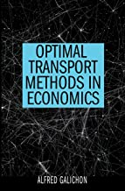
Notes
There are specialized algorithms for the transportation model.
E.g.: Bertsekas, Dimitri P., and David A. Castanon. "The auction algorithm for the transportation problem." Annals of Operations Research 20.1 (1989): 67-96.
A more general version of this model is known as “optimal transport”. Highly mathematical. Our transportation model is a special discrete case (but often used to solve these models).

