Slide 1
Network models in GAMS
erwin@amsterdamoptimization.com

Slide 2
Network models in GAMS
Goal: develop simple random network models:
Shortest Path
Min-Cost Flow
Note that transportation model discussed before is an example of a (bipartite) network with supply and demand nodes.
I focus on directed graphs. Directed graphs are more prevalent, and are also easier to deal with.
I will also talk a bit about exporting data for visualization.
Accompanying GAMS model: network.gms

Slide 3
Network topology
n is a 1-dim static set
Can be used as domain (e.g. for a)
a is a 2-dim dynamic set
Alternative: use different sets for source and destination nodes: set i /node1*node50/ j /node1*node50/ a(i,j)
Note: a(n,n) is diagonal when used outside declarations.
$ is the “such-that” operator
set n 'nodes' /node1*node50/ a(n,n) 'arcs' ; alias (n,i,j); * sparse random network a(i,j)$(uniform(0,1)<0.05) = yes; display n,a;
Alternative: a(i,j) = uniform(0,1)<0.05;

Slide 4
Random number generator.
GAMS uses a (platform independent) pseudo random generator, so runs are reproducible.
Set seed to generate other sequence.
Option seed = 12345;
execseed = 12345;
If you insist on a new sequence each time:
execseed = 1+gmillisec(jnow);

Slide 5
Exercises
Rerun the network generation code using different seeds
How would one find out the default initial seed (3141)
Verify the difference between:
a(i,j)$(uniform(0,1)<0.05) = yes;
a(n,n)$(uniform(0,1)<0.05) = yes;
Use set a(i,j) 'arcs'; instead of set a(n,n) 'arcs’;
This means reordering the declarations a bit
A better display can be achieved with: option a:0:0:8; display a;
You may need to set a wider pagewidth
Command line parameter pw=200

Slide 6

What is the number of arcs?
scalar numarcs 'number of arcs'; numarcs = sum((i,j)$a(i,j),1); numarcs = sum(a(i,j),1); numarcs = sum(a,1); numarcs = card(a); display numarcs;
Approx 5% of $n^{2}, i.e.$ 125
We need to count number of elements in a
This can be evaluated in different ways
---- 63 PARAMETER numarcs = 134.000 number of arcs

Slide 7
Summary: In/Out-degree
degree(n,'in-degree') = sum(a(i,n),1); degree(n,'out-degree') = sum(a(n,i),1);
degree('min','in-degree') = smin(n,degree(n,'in-degree')); degree('min','out-degree') = smin(n,degree(n,'out-degree')); degree('max','in-degree') = smax(n,degree(n,'in-degree')); degree('max','out-degree') = smax(n,degree(n,'out-degree'));
---- 72 PARAMETER degree in- and out-degree
in-degree out-degree
node1 1.000
node2 4.000 3.000
node3 4.000 2.000
node4 1.000 5.000
node5 3.000 4.000
node6 1.000 4.000
node7 4.000
node8 3.000
node9 3.000 3.000
node10 1.000 3.000
. . .
node49 4.000 3.000
node50 3.000 2.000
max 7.000 6.000
n
in-degree=3
out-degree=2
GAMS Sparsity Rule
Zero and does not exist is the same.
Why is min row missing?

Slide 8
Exercises
Why is row with "min" missing in the output?
Try using an expression like: EPS+smin(n,degree(n,'in’))
EPS values are usually converted to zeros when exported
Add a row for “average in- and out-degree”
Explain the results
This is equal to card(a)/card(n)
Add a colum for “degree” where: degree = in-degree+out-degree.

Slide 9
Diagonal
Outside declarations using (n,n) indicates the diagonal.
For shortest path/min-cost flow models we usually don’t mind these self-loops: if costs (lengths) are positive, it is never profitable to use them.
* do we have diagonal elements? set diagonal(n) 'diagonal elements'; diagonal(n) = a(n,n); display diagonal; abort$card(diagonal) "Diagonal is not empty";
Otherwise remove diagonal elements by: a(n,n) = no;
---- 96 SET diagonal diagonal elements
node35
---- 97 Diagonal is not empty
**** Exec Error at line 97: Execution halted: abort$1 'Diagonal is not empty'

Slide 10
Export to Python
Optional
embeddedCode Python: import pickle nodes = list(gams.get('n')) arcs = list(gams.get('a')) coord = list(gams.get('coord')) data = {'nodes':nodes, 'arcs':arcs, 'coord':coord} pickle.dump(data,open('%picklefile%', 'wb')) endEmbeddedCode
Data representation
nodes: ['node1', 'node2', 'node3’,…]
arcs: [('node1', 'node44'), ('node2', 'node9’),…]
coord:[(('node1’, 'x’),11.6), (('node1’, ‘y’),84.3),…]
Export data
import pickle import networkx as nx data = pickle.load(open('%picklefile%', 'rb')) DG = nx.DiGraph() DG.add_nodes_from(data['nodes']) DG.add_edges_from(data['arcs']) print(DG)
GAMS will substitute out %picklefile% for a file name
Splitting code in two parts makes it easier to debug.
Import into Python script

Slide 11
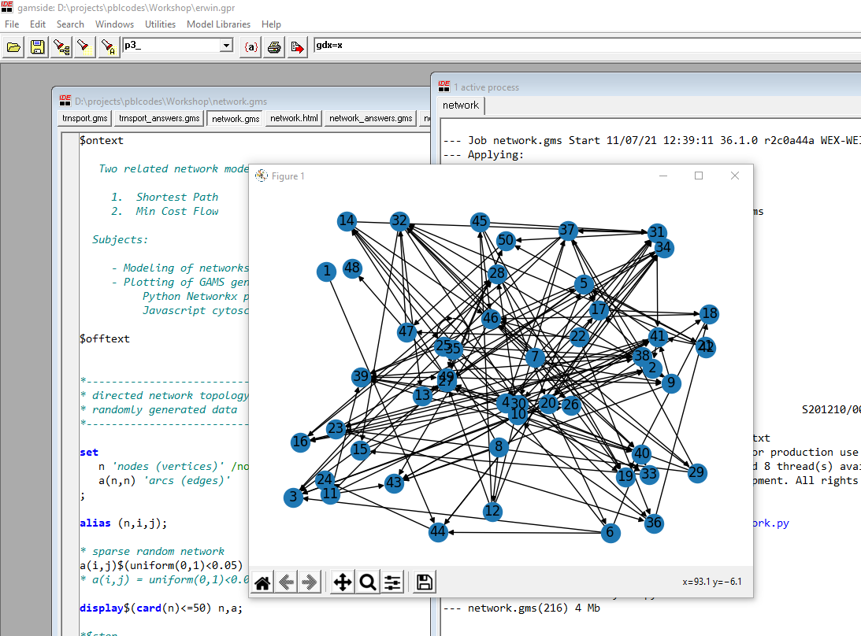
Running GAMS model with Python code
Optional
Nodes are shown as 1,2,…
We also generate random coordinates in GAMS
A little bit of work to transform them from a GAMS datastructure (sparse) to a dict suited for networkx
GAMS pauses until you close the window

Slide 12
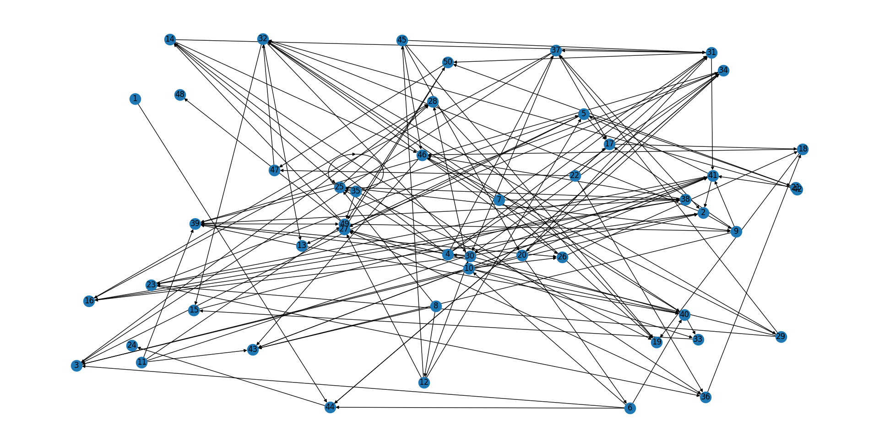
Plot using networkx
End:
Node 50
Start: Node 1
Node 35 has a self-loop

Slide 13
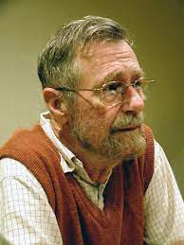
Shortest Path Problem
In our example model, length/cost is just the Euclidean distance between nodes
But can be anything. Assume they are positive.
Instead of using an shortest path algorithm (Dijkstra) we use an LP formulation
Edsger Wiebe Dijkstra
These vectors are extremely sparse.
GAMS will only store the nonzero elements.

Slide 14
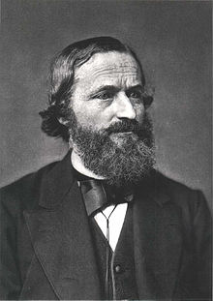
The solution is automatically integer, so we can use continuous variables (LP) instead of binary variables (MIP).
The node-balance equation sums over sparse network topology.
A.k.a. flow-conservation or Kirchoff equations.
We can combine the inflow and outflow vectors into one vector.
Gustav Kirchoff
Inflow
Flow to other nodes
n
Flow from other nodes
Outflow

Slide 15
parameters inflow(n) 'exogenous inflow at node' / node1 1.0 / outflow(n) 'exogenous outflow at node' / node50 1.0 / ; positive variable f(i,j) 'flow from node i -> node j'; variable totalLength 'objective: minimize'; equations nodeBalance(n) 'kirchoff equations' objective 'minimize' ;
objective.. totalLength =e= sum(a,length(a)*f(a)); nodeBalance(n).. sum(a(i,n), f(a)) + inflow(n) =e= sum(a(n,j), f(a)) + outflow(n); model shortestPath /all/; solve shortestPath using lp minimizing totalLength; display f.l;
Size: |n|+1 equations, |a|+1 variables
Only variables occurring in equations count!
---- 147 VARIABLE f.L flow from node i -> node j
node20 node31 node34 node44 node50
node1 1.000
node20 1.000
node31 1.000
node34 1.000
node44 1.000
Declaration: |n| x |n| flow variables

Slide 16
Form path (not so easy)
sets step /step1*step50/ path(step,n) 'easier to read than f' ; singleton set cur(i) 'current node'; cur('node1') = yes; * while we have a current node loop(step$card(cur), * record current node path(step,cur) = yes; * current node := next node cur(j) = f.l(cur,j)>0.5; * to debug add this * display cur; ); option path:0:0:1; display path;
---- 171 SET path easier to read than f
step1.node1
step2.node44
step3.node34
step4.node20
step5.node31
step6.node50
Note:
In GAMS we cannot have something like [node1,node44,node34,node20,node31,node50] The ordering of nodes is predetermined by /node1*node50/
Exercise: write this piece of GAMS code without the use of singleton sets.

Slide 17
Generate HTML/Javascript
To make a browser-based plot in we can generate HTML/Javascript from the GAMS model.
In this example, I used the PUT facility to write the data file (javascript code).
Then some HTML/Javascript was used generate the plot.
Javascript network package: cytoscape.js

Slide 18
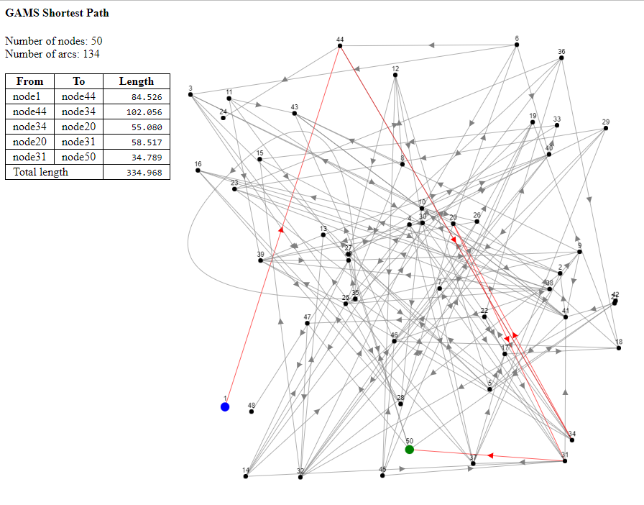
HTML + JS document

Slide 19
Min-Cost Flow LP
It is easy to generalize the Shortest Path LP model to a more generic Min-Cost Flow LP model.
Allow multiple Supply and Demand Nodes
These have a nonzero inflow or outflow
The remaining nodes are transshipment nodes
The lengths become costs
Capacity limits on the arcs
f.up(a) = capacity(a);
Simple bound instead of full-blown constraint
This may split a flow to different paths

Slide 20
Naming conventions in models
Meaningful long names vs cryptic short names
I try to use the following scheme:
Short names for symbols that are used a lot
Long names for symbols that are used only a few times
“Huffman encoding of names”
This strikes a balance between too much clutter and having to look up the meaning of a symbol
Try to follow conventions
x should not be the name of a set
i should not be the name of a variable
https://en.wikipedia.org/wiki/Huffman_coding

Slide 21
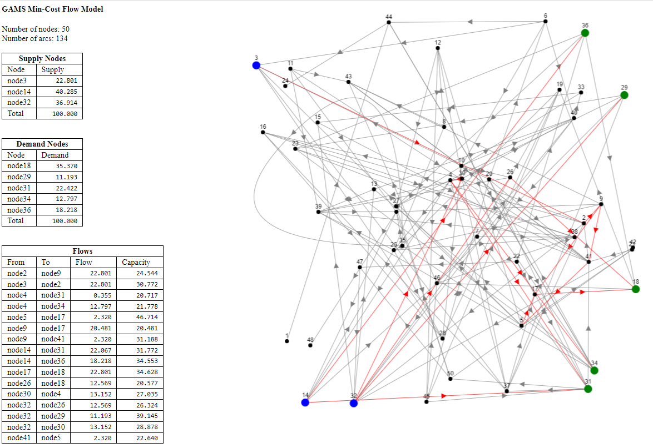
Exercises
Adapt the HTML/Javascript code to report the Min-Cost Flow solution.
Implement the trnsport.gms model as a min-cost flow problem.
Example output for Min-Cost Flow LP

