Slide 1
Application of Machine Learning to Many-Body Quantum Dynamics
Alev Orfi
Supervisor: Bill Coish

Slide 2
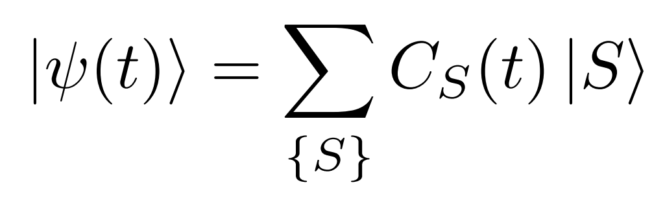
Many-Body Quantum Systems
Feb 2020
lkxgm

Slide 3
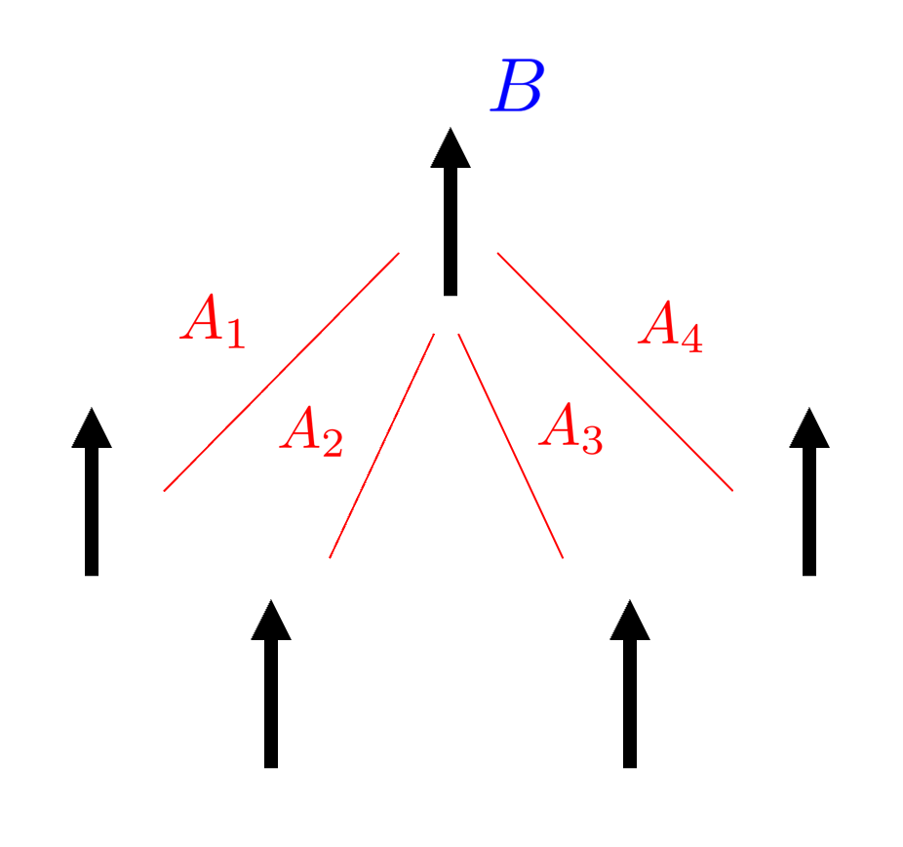
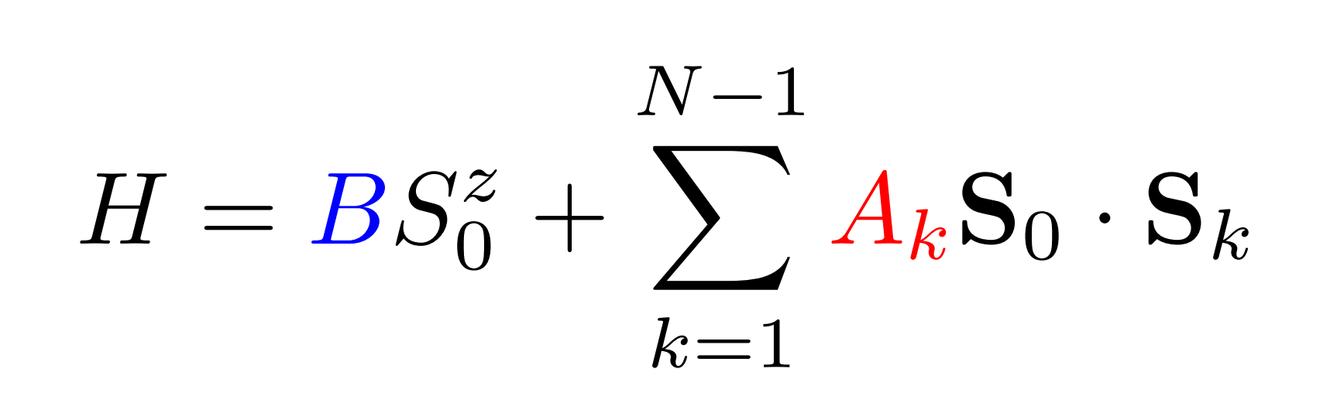
Central Spin Model
Feb 2020
Decoherance of spin quantum computers
BSC model of superconductivy

Slide 4
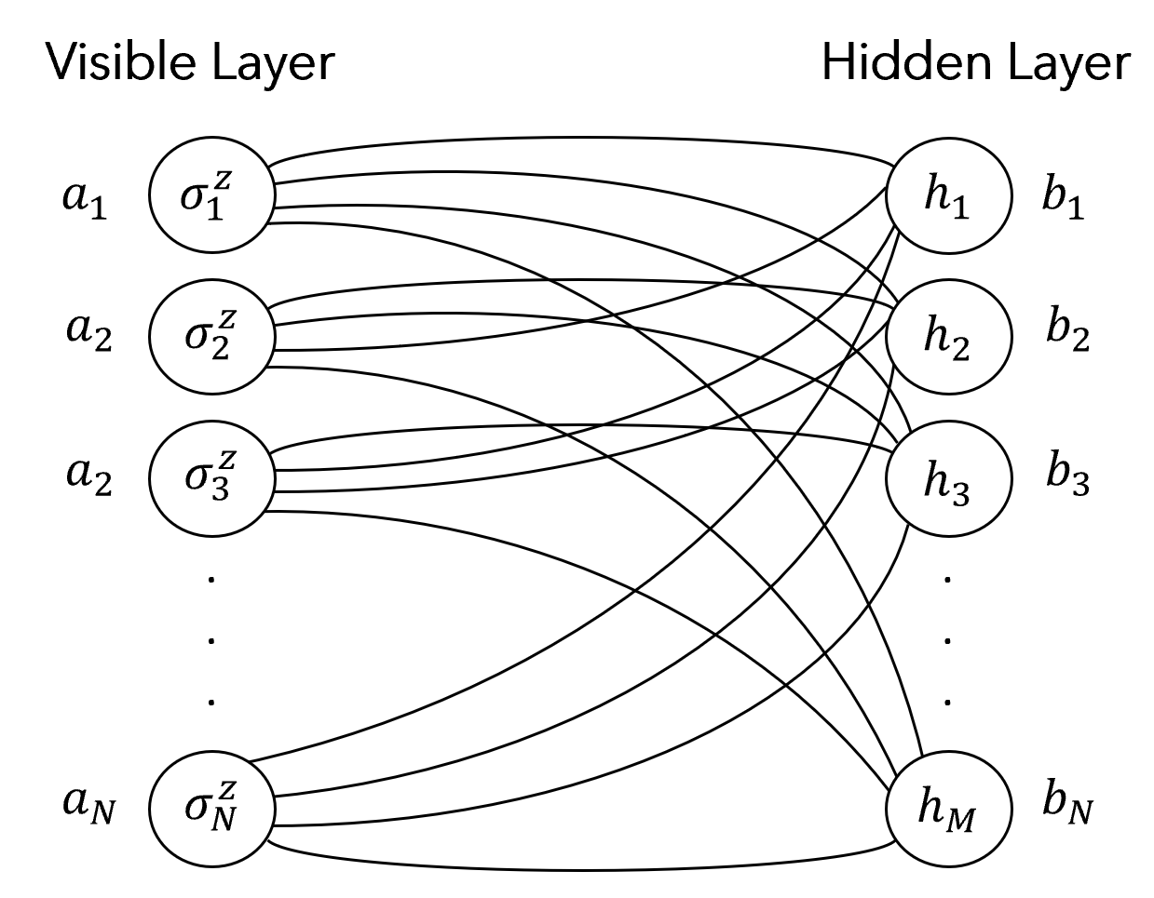
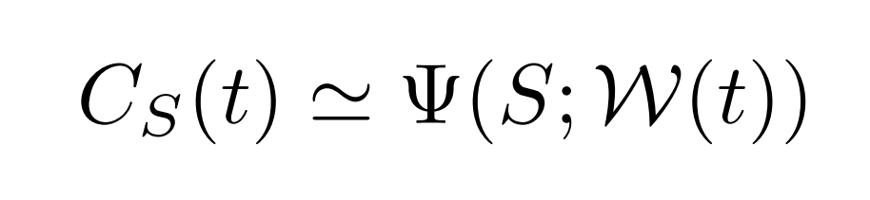
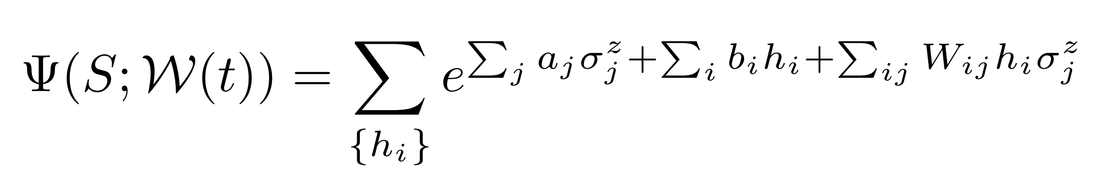


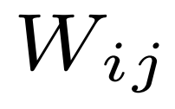
Restricted Boltzmann Machine
Feb 2020
(N elements)
Model Parameters:
(M elements)
(N×M elements)
Notes:
Reduced the number of needed parameters, a,b,W

Slide 5
Ground State Determination
Feb 2020
Notes:
Variational qm, minimize

Slide 6
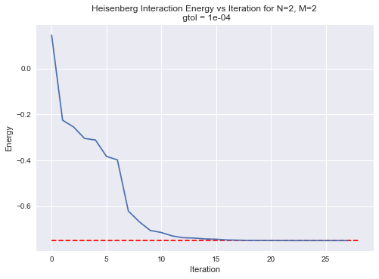
Initial Results
Feb 2020

