Slide 1
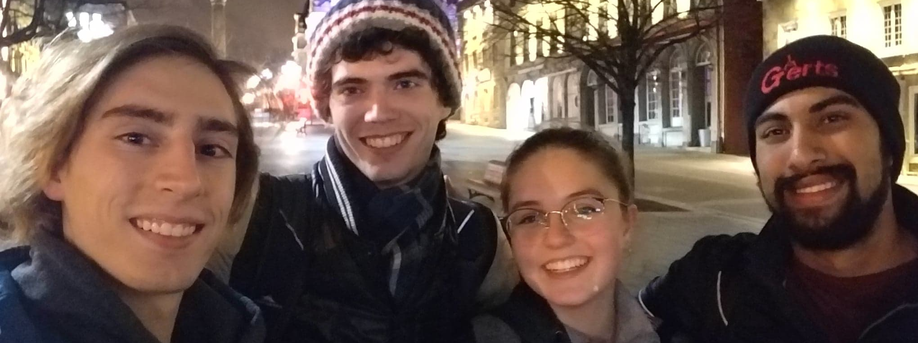
Entro.py Immuneural Network
Asheesh Momi, Alev Orfi, Louis Richez, Andres Ross

Slide 2
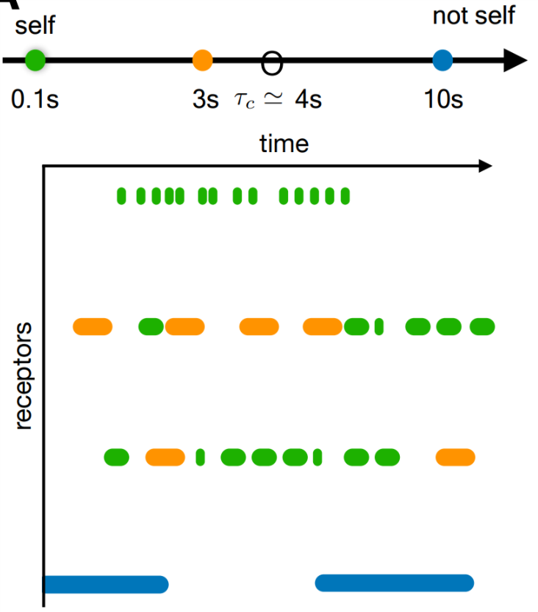
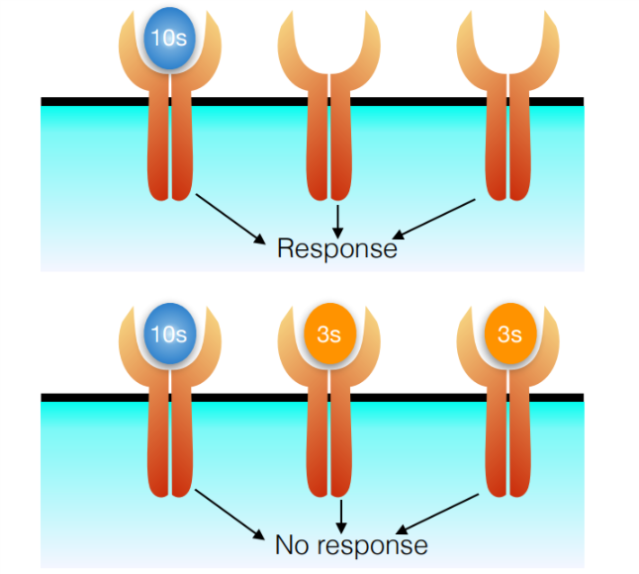
Ligand antagonism
Notes:
Asheesh: This is where we talk about the basics of ligand binding, and how the introduction of antagonist disrupts immune response

Slide 3
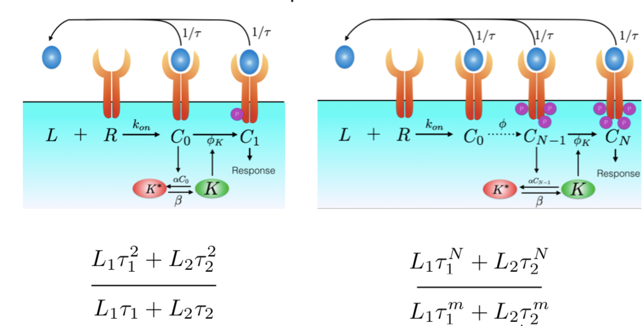
Notes:
Asheesh: This is what evolution has evolved. When a ligand binds many reversible phosphorylation steps each of which contributes to the immune response creates a non linearity that removes the peterbutations that create this system.

Slide 4
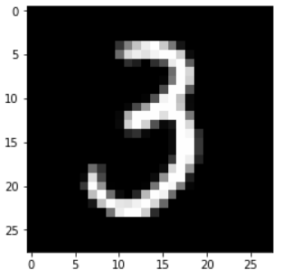
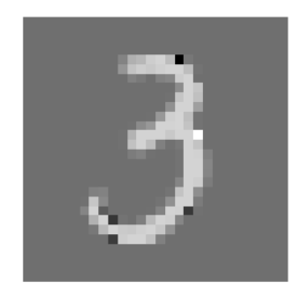
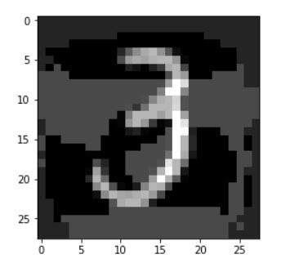
Adversarial Perturbations
Original
Gradient Sign Method
Mixing Method
Notes:
Louis:
-MNIST data set of hand drawn digits → Convenient and commonplace, large sample size, low dimensional image and enables binary classification
-Define adversarial perturbations → designed to misclassify
-Introduce two types of adversarial perturbation
-Simple mixing method, make 3’s look more like 7s and and 7’s more like 3’s. Again, really easy
-Gradient sign method
-Compute gradient of score function
-Perturb the pixels that have the greatest effect on score in the direction that lowers score

Slide 5
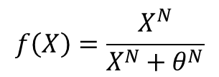
non-linear Preprocessing
X^{N}
$$f\left(X\right)=\frac{X^{N}}{X^{N}+θ^{N}}$$

Slide 6
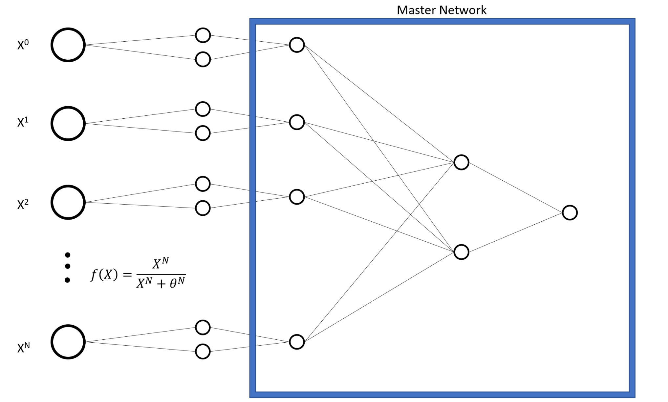
Stacked Model

Slide 7
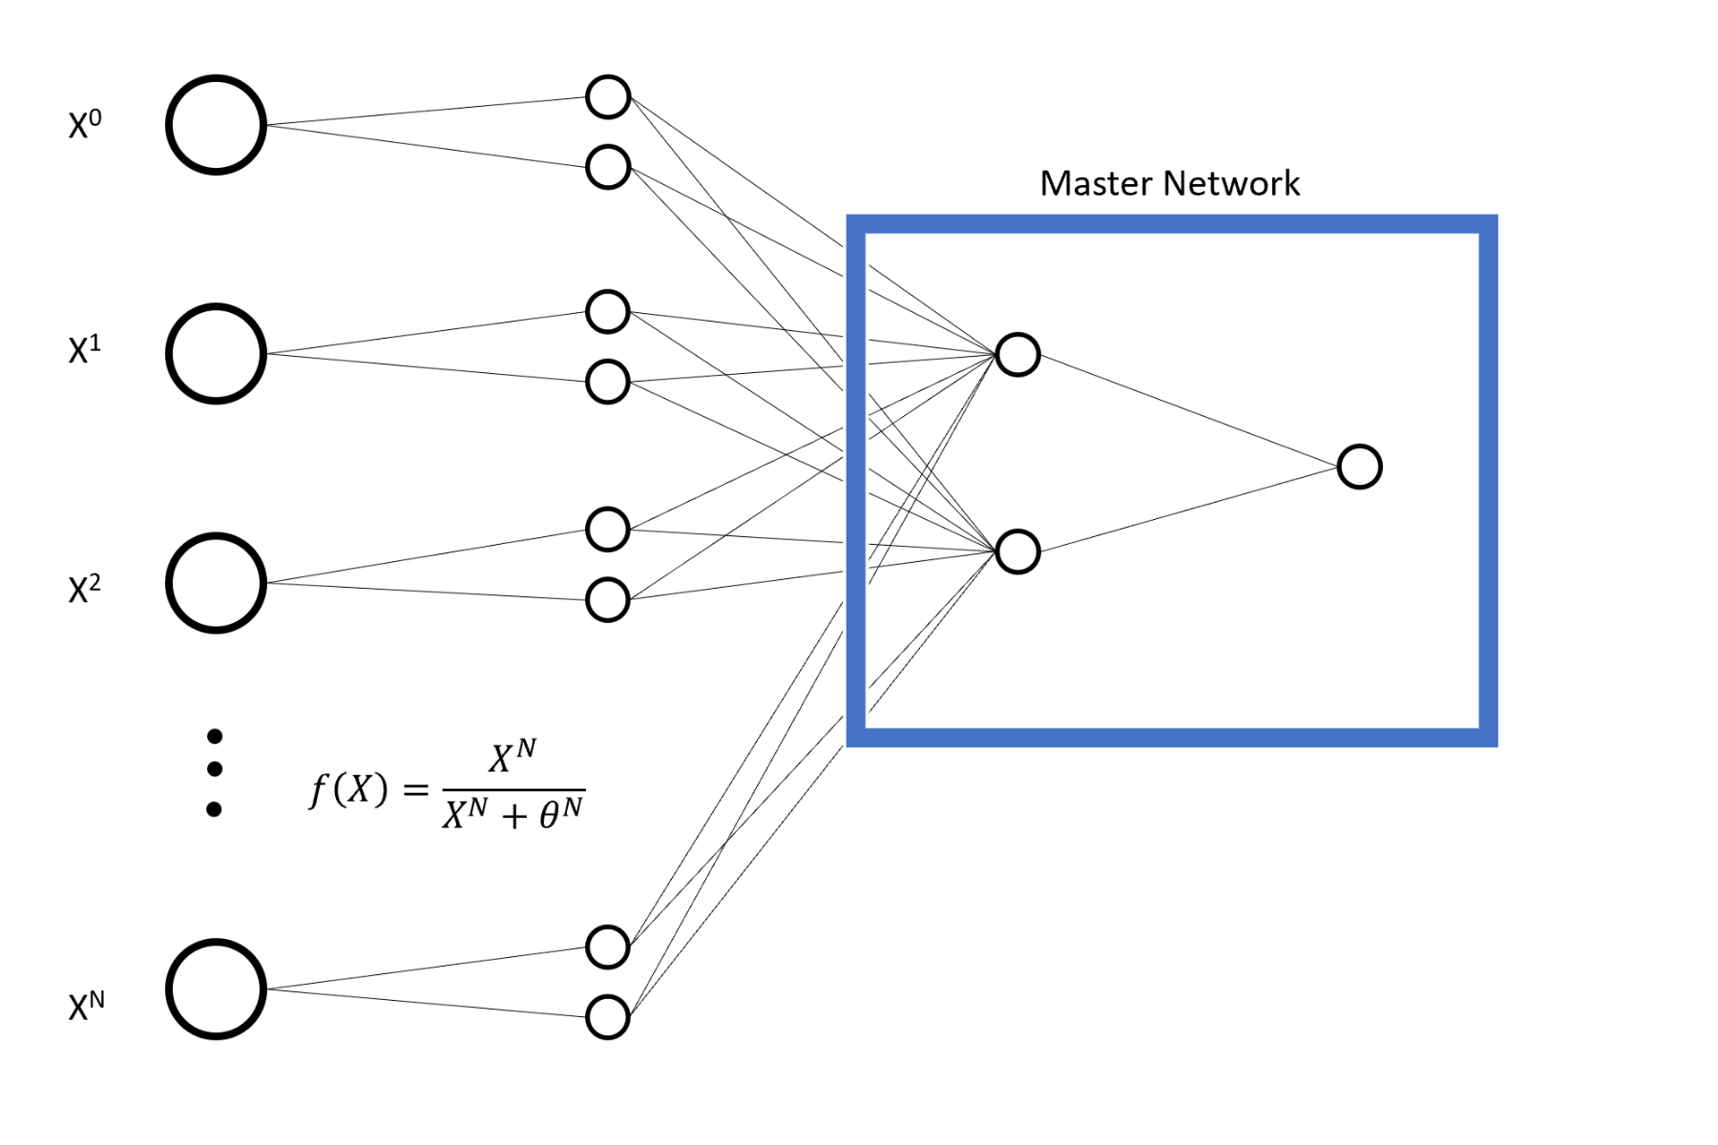
Hidden Layer Feed in Method

Slide 8
Results
Mixing Method
Gradient Sign Method
Notes:
Andres

Slide 9
Alternative Data Set

Slide 10

Future Work
Logarithmic activation function
Perturb in direction of boundary
Test different data sets
Sleeping

Slide 11
Works cited
François & Altan-Bonnet (2016) J. Stat. Phys.
Rademaker, Bengio & François (2018) Fooling the classifier: Ligand antagonism and adversarial examples
Special thanks to Thomas Rademaker!
Notes:
Thomas

