Slide 1
SQL ETL Project
Aldo Orozco - aldo.orozco.g@gmail.com

Slide 2
AGENDA
Project Description
Data Model
Data Location
Workflows
Orchestration Interface
Getting Started
Limitations
Demo
Future Work
Q&A

Slide 3
Project Description
SQL ETL system that generates reports off multiple sources
Data sources:
B2B - Transactional system where companies sell to customers [Manually created, Generated]
Welog - Logs representing web server activity in combined format [Generated]
Ip2geo - Table with ip number ranges mapping to countries [Downloaded]
Output data:
Reports in readable format (CSV)

Slide 4
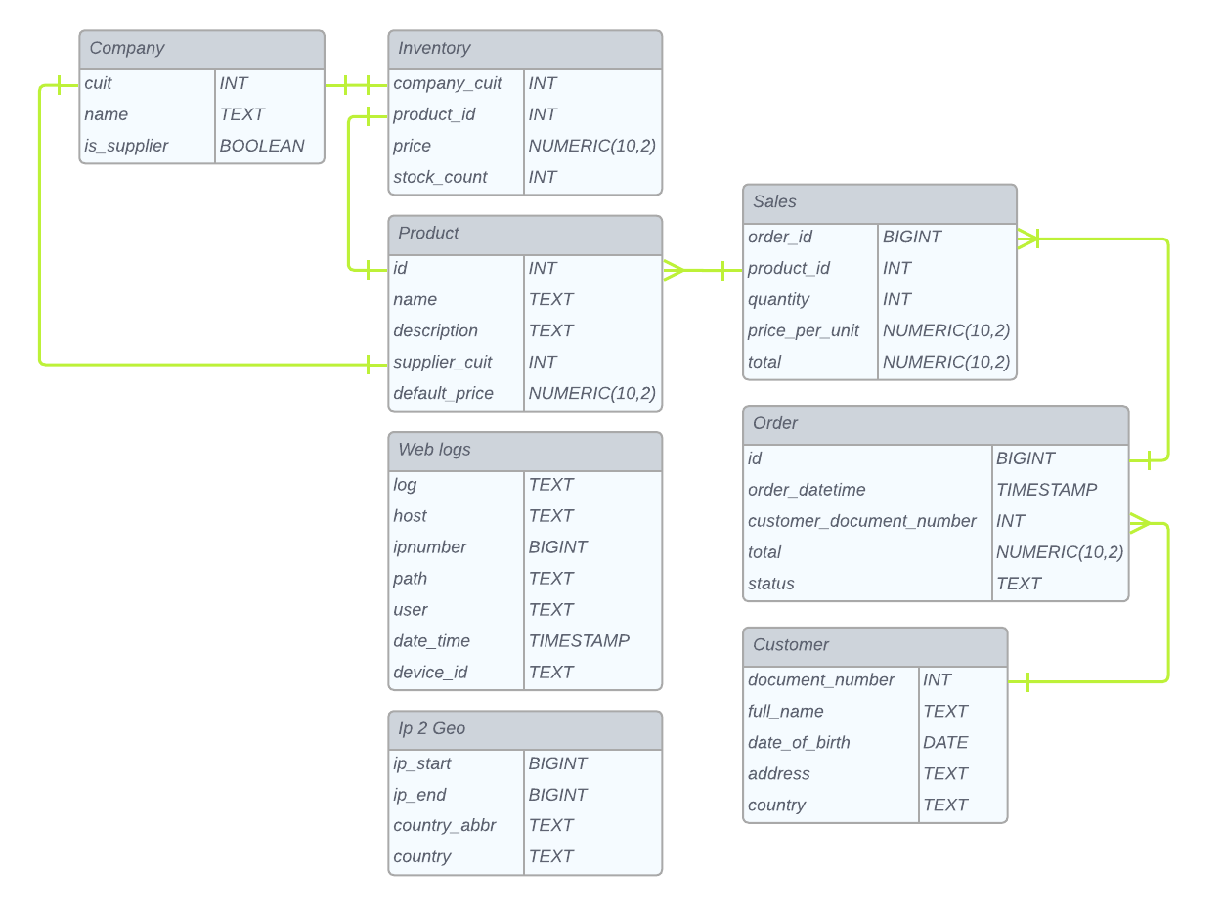
Data Model

Slide 5
Data Location
Data can also be found in postgres. The table name is identical to the model name
Sources (Data Lake/Warehouse)
B2B / Ip2geo: sources/(data|ddl)/<model>.(csv|sql)
Web logs: apache-logs/
Destination (Datamart / Reports)
reports/<report_name>/date=<execution_date>/report.csv

Slide 6
Workflows / DAGs
Located under [dags]
b2b - Creates and populates b2b tables, plus generates orders
ip2geo - Creates and populates the ip2geo table
weblog - Generates traces in combined log format, and loads them into the data lake
monthly-sales - B2B sales displayed monthly for the last year
popular-devices - Top N popular devices for B2B clients
popular-products - Most popular products in the country from which most users log into

Slide 7
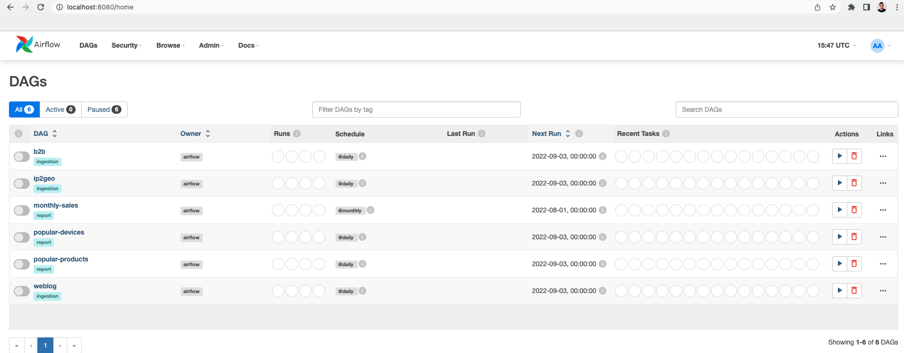
Orchestration Interface
DAGs
Cadence

Slide 8







Getting Started
docker compose up -d
DETAILS IN THE README

Slide 9
Limitations
Lack of real-world data.
Data in CSV format for human readability. Binary formats (e.g., Avro, Parquet) would help improve performance.
Single point of failure, as all containers run on the same host.
Although ETLs and DAGs use highly-scalable tools, they are not as performant, given the 1 container limitation.

Slide 10
DEMO

Slide 11
Future Work
Use a Cloud Provider (e.g., GCP, AWS)
Managed SQL instances for the ORM
Data warehouse to store aggregations and report data.
Apache Airflow either on Kubernetes or managed service (e.g., Composer, MWAA).
Apache Spark either on Kubernetes or managed service (e.g., Dataproc, EMR).
Robust data quality checks using Great Expectations on Airflow.
Weblog streaming ingestion either through Spark Streaming or Apache Kafka

Slide 12
Q&A

