Slide 1

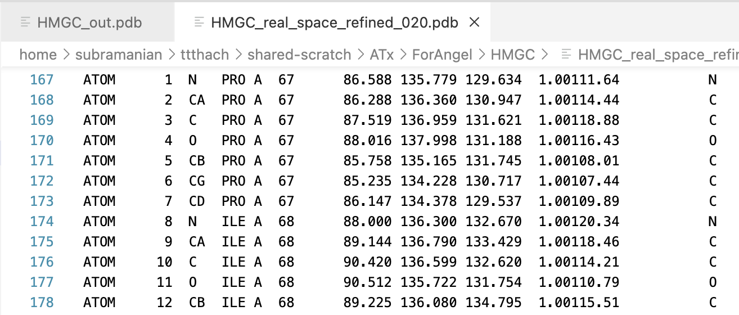
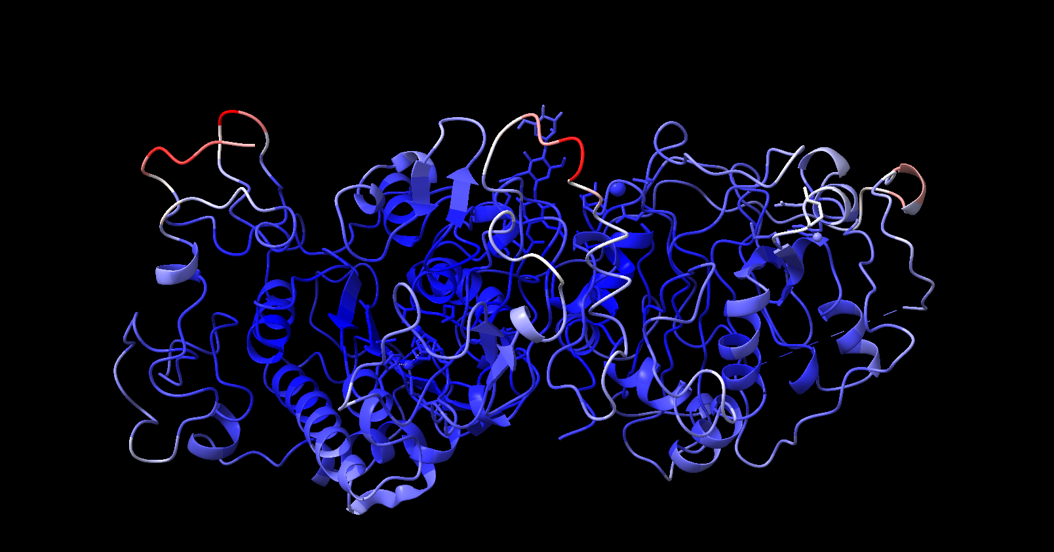
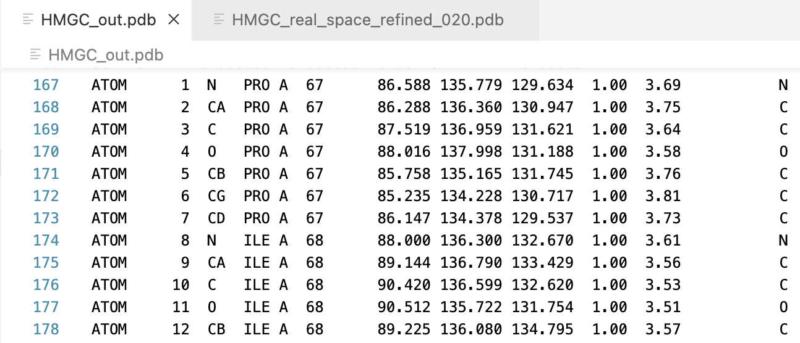


Mapping Local Resolution To Coordinates
Angel Ortiz¹, Ramaswamy Subramanian²
Abstract
Results
Example
We developed a Python script to enhance structural biology analysis by mapping local resolution from cryo-EM local resolution maps to modeled coordinates. The project involved processing Protein Data Bank (PDB) and Electron Microscopy Map (MRC) files to generate a new PDB file that includes local resolution in the B-factor column.
The script addresses the need for easy access to local resolution information, which is crucial for understanding how good the model is in a given region of the cryo-EM density maps. Researchers can more accurately interpret structural data and improve understanding by integrating this data directly into PDB files. Most users of PDB files, do not know to understand density maps.
Our approach involves parsing the input PDB and MRC files, calculating the local resolution at each coordinate, and appending this information to output a new PDB file. This new file format integrates seamlessly with existing visualization and analysis tools, facilitating precise and informative structural interpretations.
Preliminary tests demonstrate that our script efficiently processes large datasets and accurately reflects local resolution variations. This tool promises to be a valuable asset for the structural biology community.
This is the final result. Once the script is running it will automatically download a PDB file to the device that has the local resolution values in the B-factor column. When the file is open it will take you to ChimeraX from which you will then go to the “Molecule Display” tab and then click the “b-factor” under the coloring tab.
I successfully mapped local resolution to coordinates efficiently. The image on the top is an example of an input PDB file, and the image on the bottom is an example of the output after processing.
B-factor
Overview
Why:
Most users of structural data are not structural biologists. Therefore, there should be an easy way to assess the quality of a model in different parts of the structure. Higher-resolution maps enable better modeling. A quick method to visualize a model and distinguish high-confidence areas from low-confidence ones is highly beneficial.
Methods:
I developed a Python Script that utilized KDTree for efficient spatial searches. This script modifies values in the B-factor column based on the local resolution density values within a user-specified radius. Next, we aimed to calculate the correlation coefficient between refined B-factors and local resolution values. This will help us determine if the real-space refined B-values accurately represent local resolution.
Local Resolution
Future Work
Future work will focus on optimizing the script to handle large datasets and perform calculations using two-half maps. Additionally, we plan to develop this script into an extension for PyMOL/ChimeraX. This integration will allow to utilize the tool directly within these applications eliminating the need to visit a separate website.
The tool provides easy mapping of local resolution to coordinates for experts. The software will be available in google.colab
For users of structural biology coordinates from cryo-EM maps, coloring by local resolution quickly shows the confidence of the structure in different regions.
Acknowledgements

