Slide 1
ㅋㄹ
ㅅㅂ
Sequelize.js
models
Pug
routes
App.js

Slide 2
user
id | name | alias | passwd | phone
primary key
전부다 NOT NULL

Slide 3
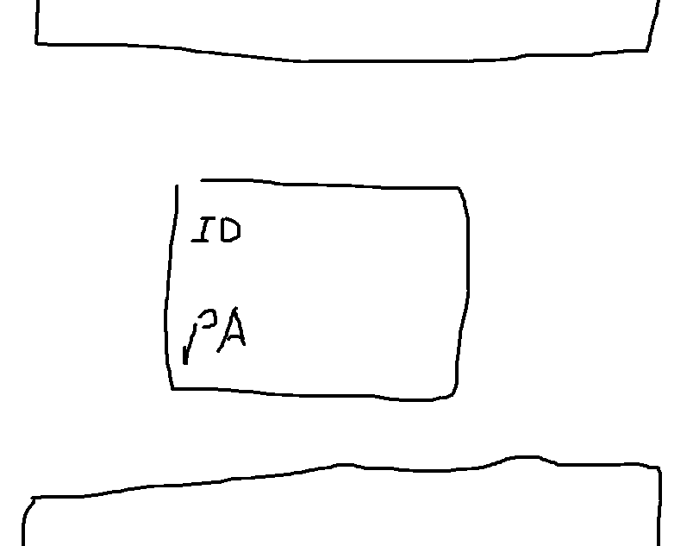

Slide 4
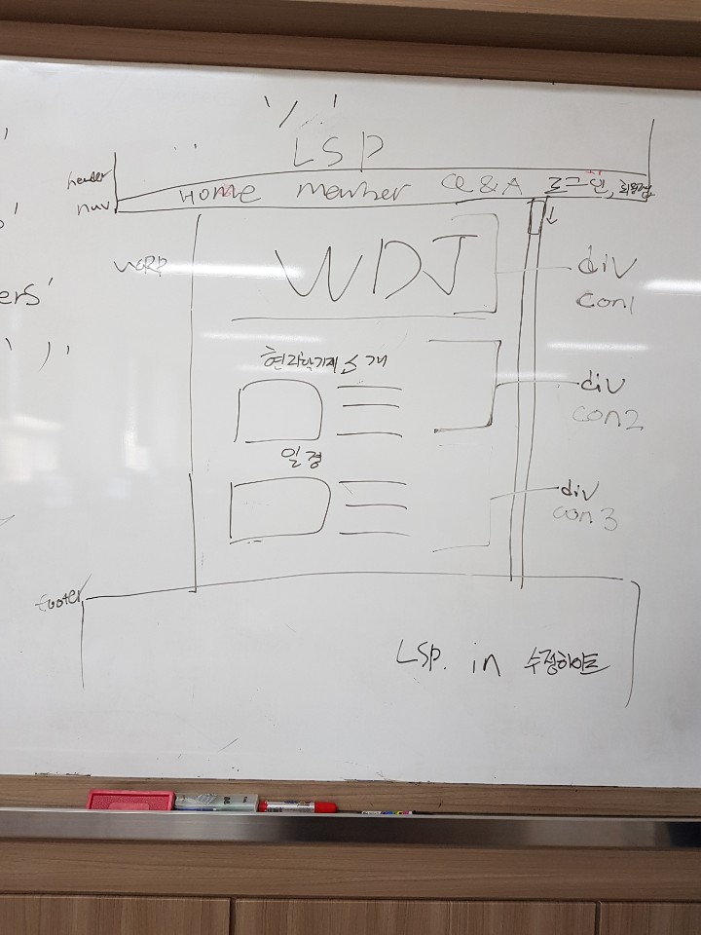

Slide 5
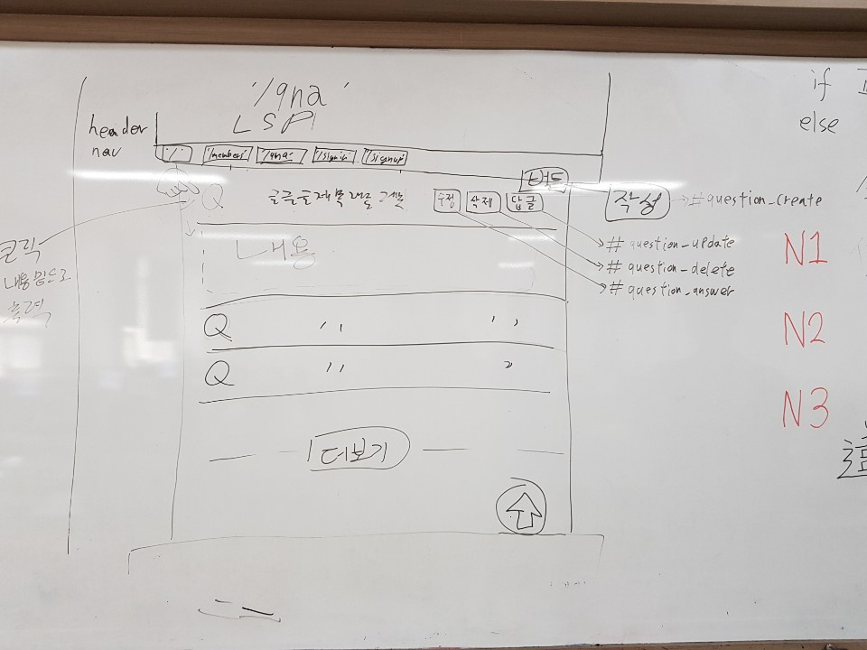

Slide 6
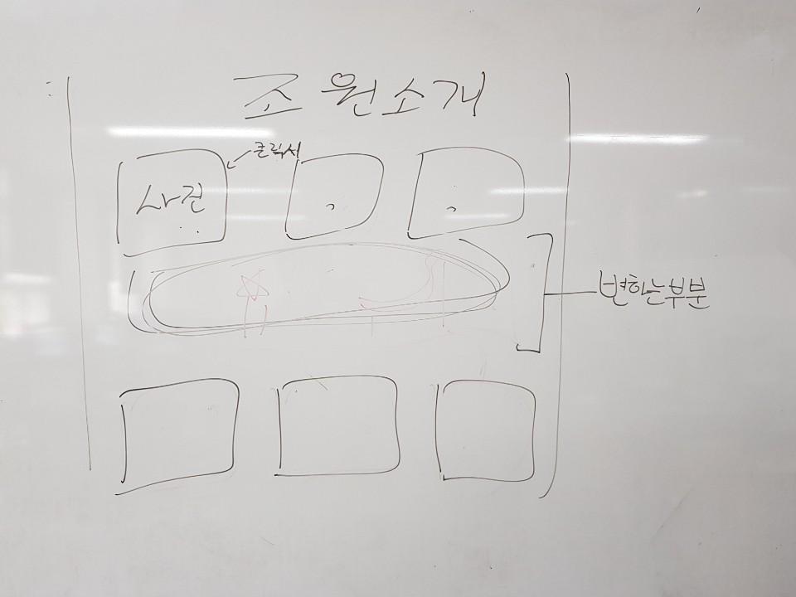

Slide 7
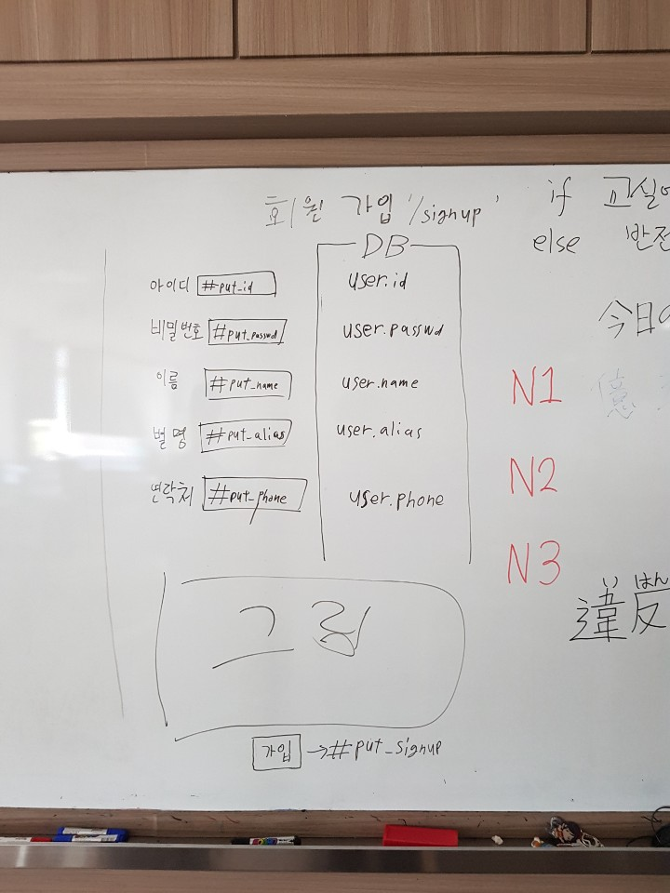

Slide 8
