Slide 1

bioinformatics.ca
bioinformaticsdotca.github.io

Slide 2
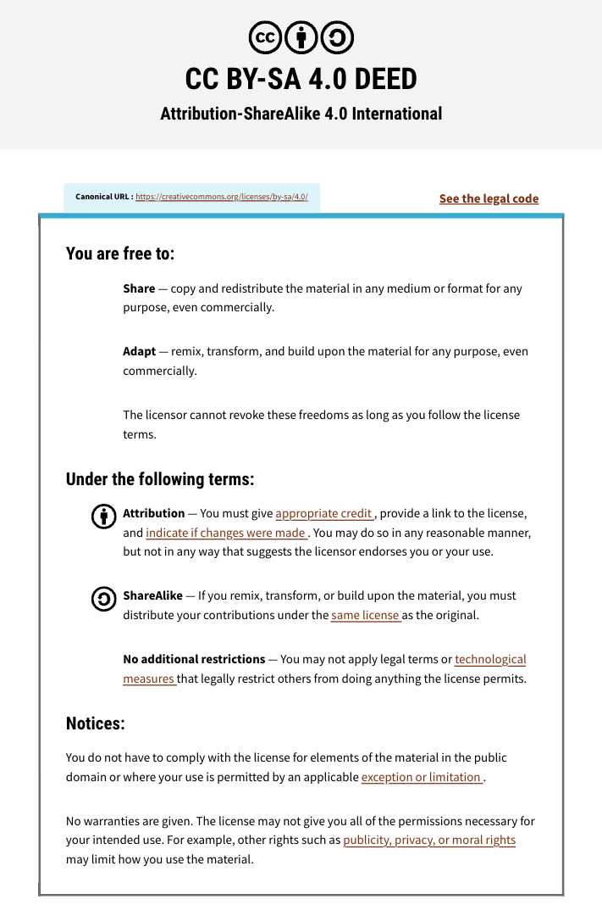

Slide 3



Module 5: RMarkdown & Quarto
Adrien Osakwe
INTRODUCTION TO R
October 1st-2nd, 2025

Slide 4
Learning Objectives
Understand the different file formats for R code
Distinguish the situations in which to use
R scripts
RMarkdown or Quarto documents
Familiarize yourselves with the output formats attainable from notebook-based files

Slide 5
Outline
RMarkdown and Quarto
Notebook vs. Scripts
Developing automated reports
Webpage for documentation
Closing Remarks

Slide 6
Communicating Results
Scripts are lightweight and easy to get started with
BUT what if you need to share results with someone?
Need to extract plots and tables
Compile into a report to share
Need to repeat step 1. if the data changes
Have to ensure the plots in your report are from the exact same code

Slide 7
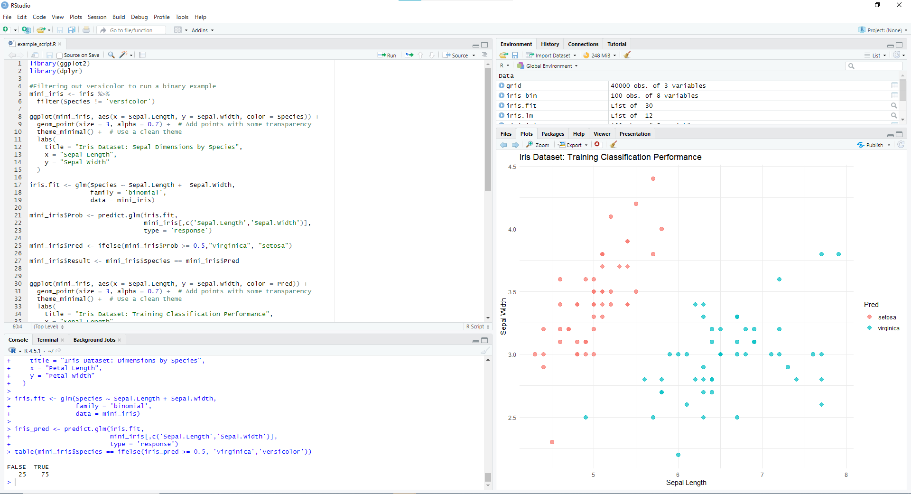
Communicating Results

Slide 8
Communicating Results
May want to combine your code with detailed descriptions
Incorporate math notation for modelling tasks
Explain process behind pipeline
Want to ensure the flow of your analysis and results
→ R Notebooks
Text block #1
Code Block # 1
Plot #1
+
+
Text block #2
Code Block #2
Text block #3

Slide 9
Notebook Interface for R
Enables incorporation of code and results into readable text
Rmarkdown & Quarto
Jupyter Notebook
Facilitates reproducible workflows
Notebook
Text block #1
Code Block # 1
Plot #1
Text block #2
Code Block #2
Text block #3

Slide 10
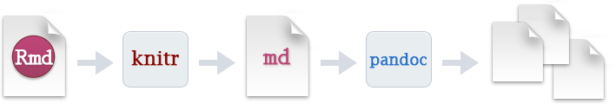
RMarkdown
Source: Posit Co.

Slide 11
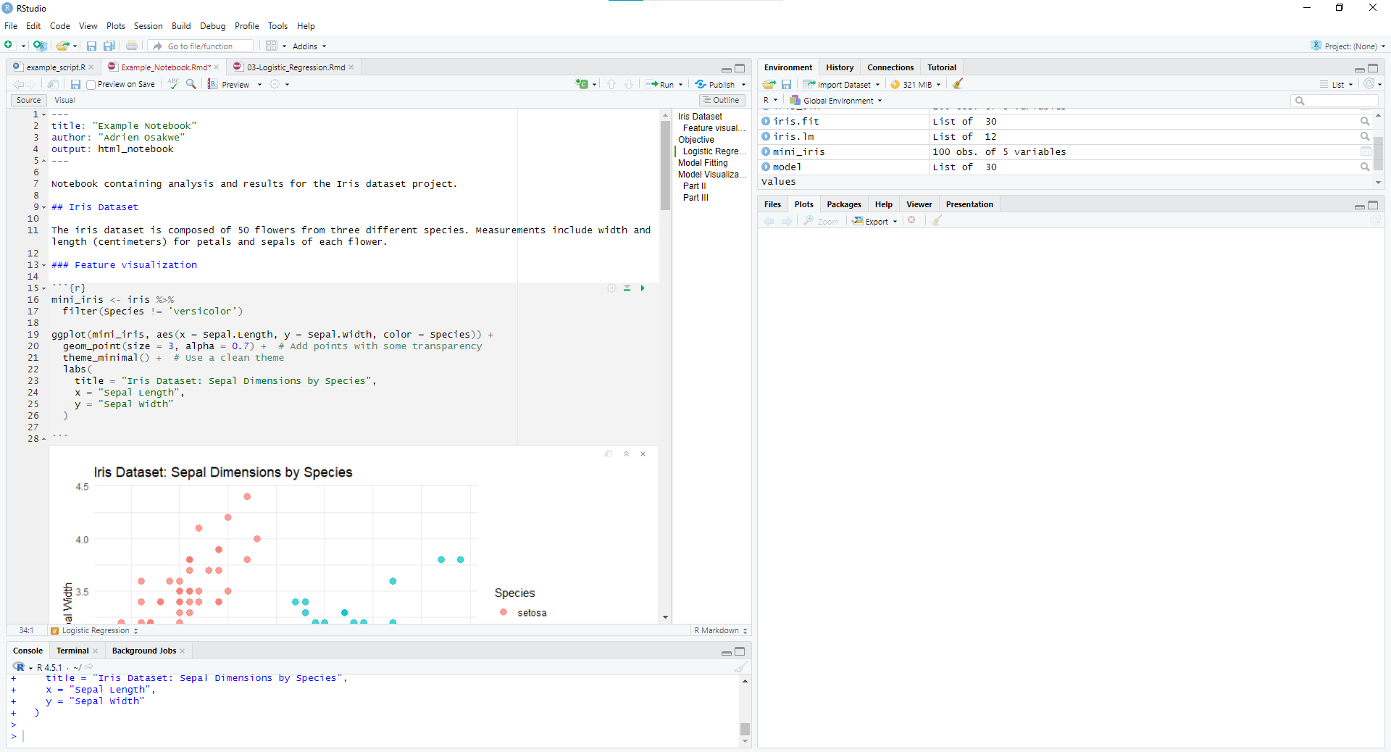
Notebook Interface for R

Slide 12
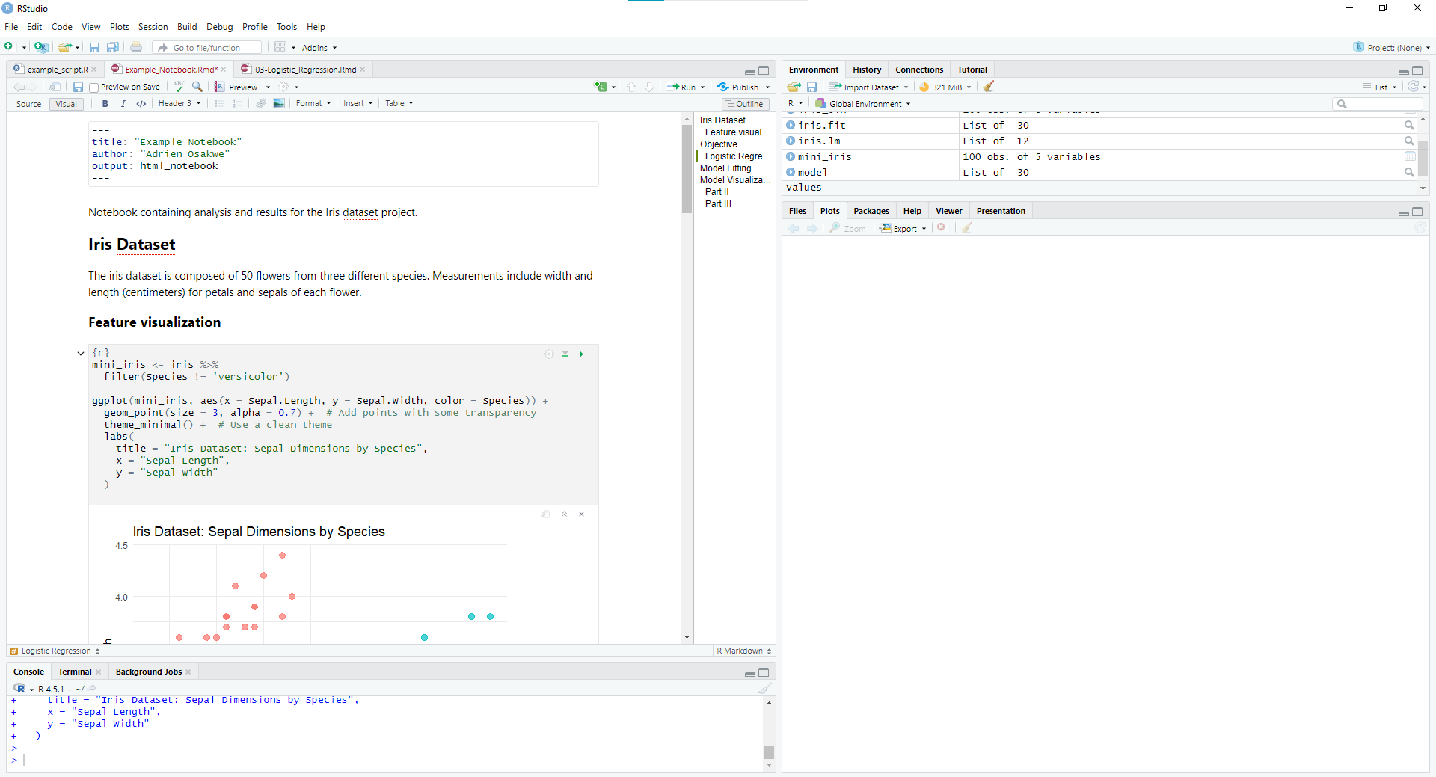
Notebook Interface for R

Slide 13
Scripts vs. Notebook
Scripts
Notebook
Great for contained utilities and pipelines
Storing functions to call elsewhere
Complete processing pipeline
Used when focus is Input/Output
Great for documenting pipeline
Combining results with code
Used when focus is the procedure

Slide 14
Activity: Example Notebook

Slide 15
Quarto
Improved version of Rmarkdown
Supports Python, R, Julia and Observable
Compatible with Jupyter notebook and markdown files

Slide 16
Activity: Create and automate an analysis report

Slide 17
Websites
Sometimes you may want to compile multiple notebooks
Compile all analyses for a study
Compile all documentation for a software package
Host a lab webpage

Slide 18
Activity: Create a Webpage

Slide 19
Create a Webpage
Click the Project Icon and select ‘New Project’
Select ‘Quarto Website’ and choose a directory and project name
Explore the core contents of a Quarto webpage
YAML file (_quarto.yml)
Landing page (index.qmd)
CSS Styles (styles.css)
Additional page (about.qmd)

Slide 20
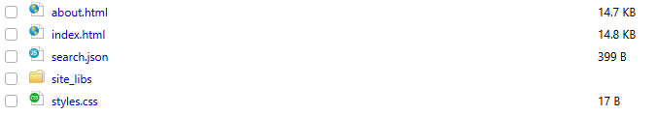
Create a Webpage
Go to the Index.qmd file and hit ‘Render’
After rendering is complete, your browser should automatically open to the webpage.
If it does not, open the _site/ folder and open the ‘index.html’ file

Slide 21
Create a Webpage
Change the author, title
Add new pages
Consider adding the reports we worked on to the folder!
Add a sear
Change the theme
Change the output folder

Slide 22
Closing Remarks
Scripts are great for
Automating a finalised pipeline
Only interested in the output
Rmarkdown and Quarto documents facilitate documentation of analysis protocols and easily integrate results
Adding both to your toolkit will help yield more efficient and reproducible analyses

Slide 23








Coffee Break & Networking Session
Workshop Sponsors

