Slide 1
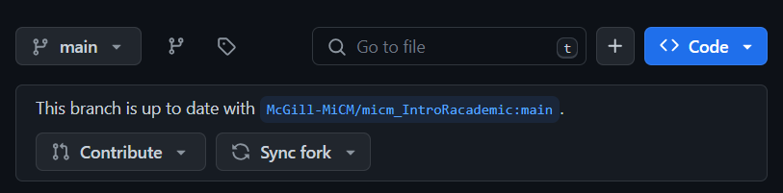
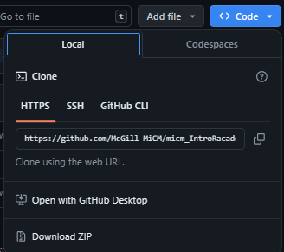
Download Workshop Materials
Go to https://github.com/aosakwe/MiCM_BayesianInference

Slide 2
Bayesian Inference in R
Workshop Lead: Adrien Osakwe
Date: August 16, 2024

Slide 3



Mission statement: deliver quality workshops designed to help biomedical researchers develop the skills they need to succeed.
Location: 550 Sherbrooke Street, Montreal, Quebec
Scan the QR code to sign up
for our mailing list
Contact: workshop-micm@mcgill.ca

Slide 4

Fall Schedule Coming Soon!
https://www.mcgill.ca/micm/training/workshops-series

Slide 5
Acknowledgements
MATH559 (David Stephens)
Bayesian Inference 2019 (Ville Hyvönen & Topias Tolonen)

Slide 6
1
2
3
Review Basic
Probability & Calculus
Prior & Posterior Distributions
Bayesian Models
4
5
Posterior Approximation
Closing Remarks

Slide 7
Review – Probability & Calculus (Maximum Likelihood)

Slide 8
Thumbtack Problem
Flipping a thumbtack has two outcomes:
Lands facing UP (1 or Success)
Lands facing DOWN (0 or Failure)
Goal: using notions from probability to determine the rate of successes θ
Can model this scenario with the Bernouilli (1 trial) or Binomial (n trials) distributions

Slide 9
Statistical Assumptions
Usually, we assume observations are identically and independently distributed (iid)
In practice, this is often violated
Instead, we assume that our observations are in an infinitely exchangeable sequence
Can then assume conditional independence
Given a specific parametrization, our observations are independent
De Finetti Representation

Slide 10

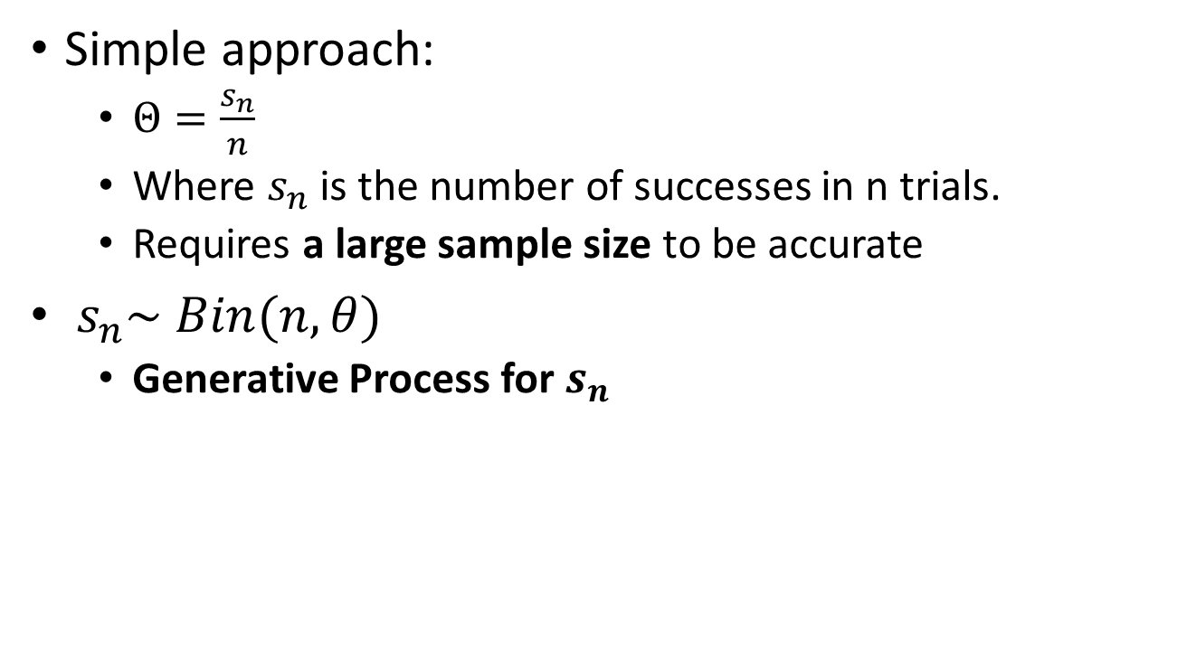
Thumbtack Problem
Simple approach:
$Θ=\frac{s_{n}}{n}$
Where $s_{n}$ is the number of successes in n trials.
Requires a large sample size to be accurate
$s_{n}\sim Bin(n,θ)$
Generative Process for $s_{n}$
Binomial Probability Mass Function – Our Likelihood

Slide 11

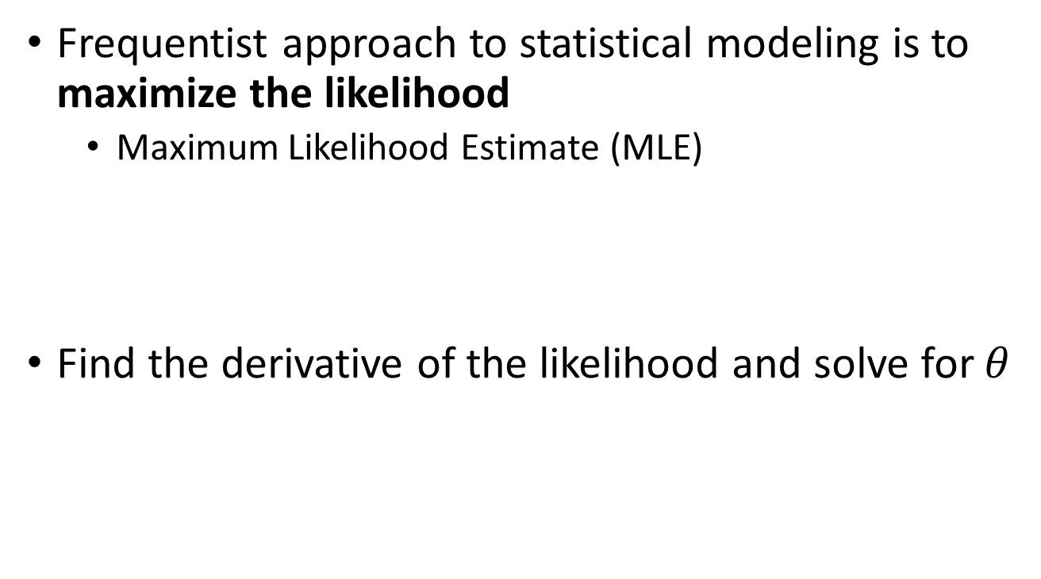
Maximum Likelihood
Frequentist approach to statistical modeling is to maximize the likelihood
Maximum Likelihood Estimate (MLE)
Find the derivative of the likelihood and solve for $θ$

Slide 12
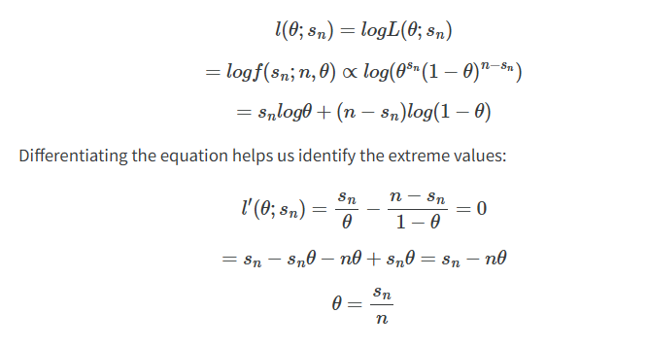
Maximum Likelihood

Slide 13
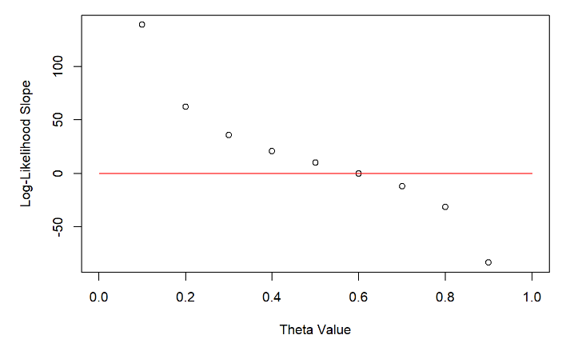
Visualizing MLE

Slide 14
Practice (MLE_Review.qmd)

Slide 15
Confidence in MLE
Currently, our frequentist approach does not allow us to estimate our confidence
Can calculate MLE for multiple data sets
Estimate standard error in MLE
BUT! Sometimes we don’t have enough data sets!
What can we do instead?

Slide 16
Problems with MLE Approach
Can’t incorporate prior knowledge
Not always ideal when data is scarce
May not have time to run multiple studies (p-values)
Can resolve these issues with Bayesian statistics

Slide 17
Prior & Posterior Distributions

Slide 18
Equivalent problem
REF: AGGTTCGT
Patient: AGTTTCGA
The model we looked at could also be used for predicting mutation rate
If we treat our genome as an infinitely exchangeable sequence, we can see each nucleotide as a trial/observation
Now we can use MLE to determine the mutation rate

Slide 19
Why use a prior?
Allows us to treat the parameters as a random variable
Can assign confidence in parameter estimate
Can incorporate prior knowledge
Previous studies could inform us on the distribution of our parameter
Improves reliability when using few samples

Slide 20
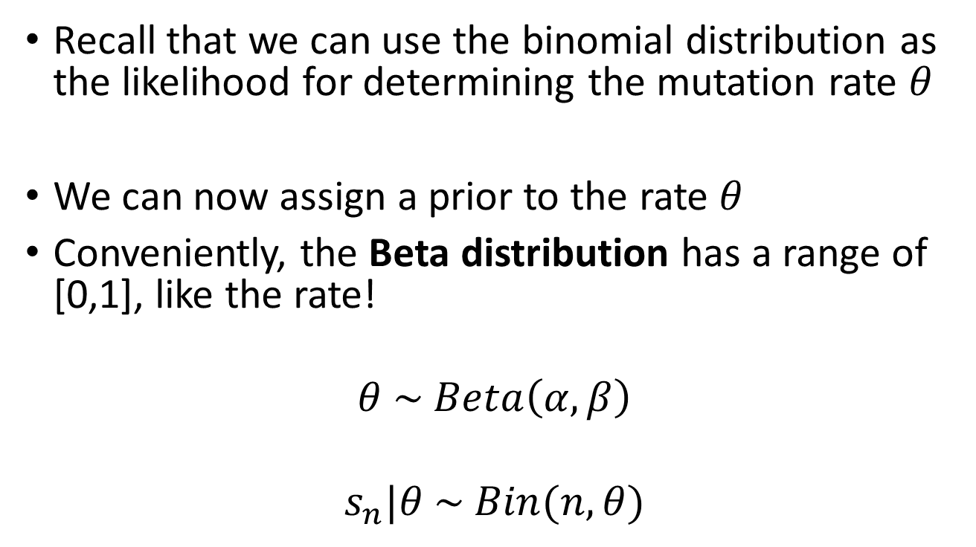
Mutation Rate Problem
Recall that we can use the binomial distribution as the likelihood for determining the mutation rate $θ$
We can now assign a prior to the rate $θ$
Conveniently, the Beta distribution has a range of [0,1], like the rate!
$$θ \sim Beta\left(α,β\right)$$
$$s_{n}|θ \sim Bin(n,θ)$$

Slide 21
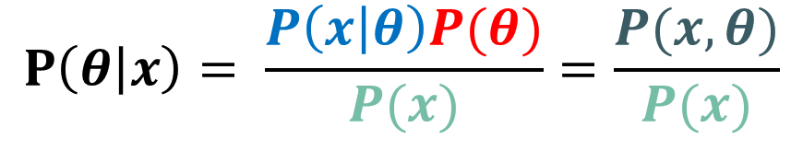
Bayes’ Theorem
Un-normalized Posterior
Likelihood
Prior
$$P\left(θ | x\right)= \frac{P\left(x | θ\right)P(θ)}{P(x)}=\frac{P(x,θ)}{P(x)}$$
Posterior
Marginal Likelihood
(Evidence)

Slide 22
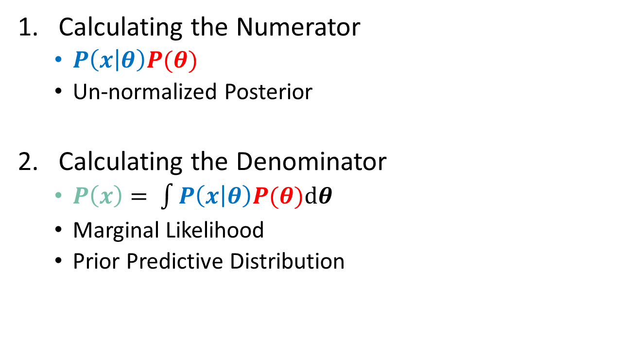
Defining our posterior
Calculating the Numerator
$P\left(x | θ\right)P(θ)$
Un-normalized Posterior
Calculating the Denominator
$P\left(x\right)= \int{P\left(x | θ\right)P(θ)\text{d}θ}$
Marginal Likelihood
Prior Predictive Distribution

Slide 23
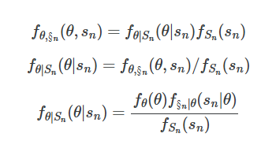

Prior Predictive Distribution
Need a way to predict observations prior to collecting data
Marginal Likelihood
$$\int{P\left(x | θ\right)P(θ)\text{d}θ}=P\left(x\right)$$

Slide 24
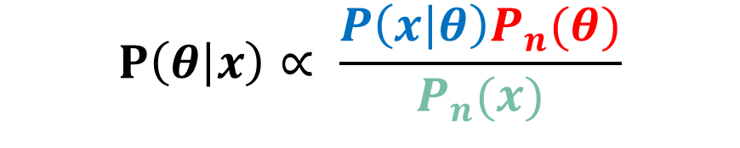
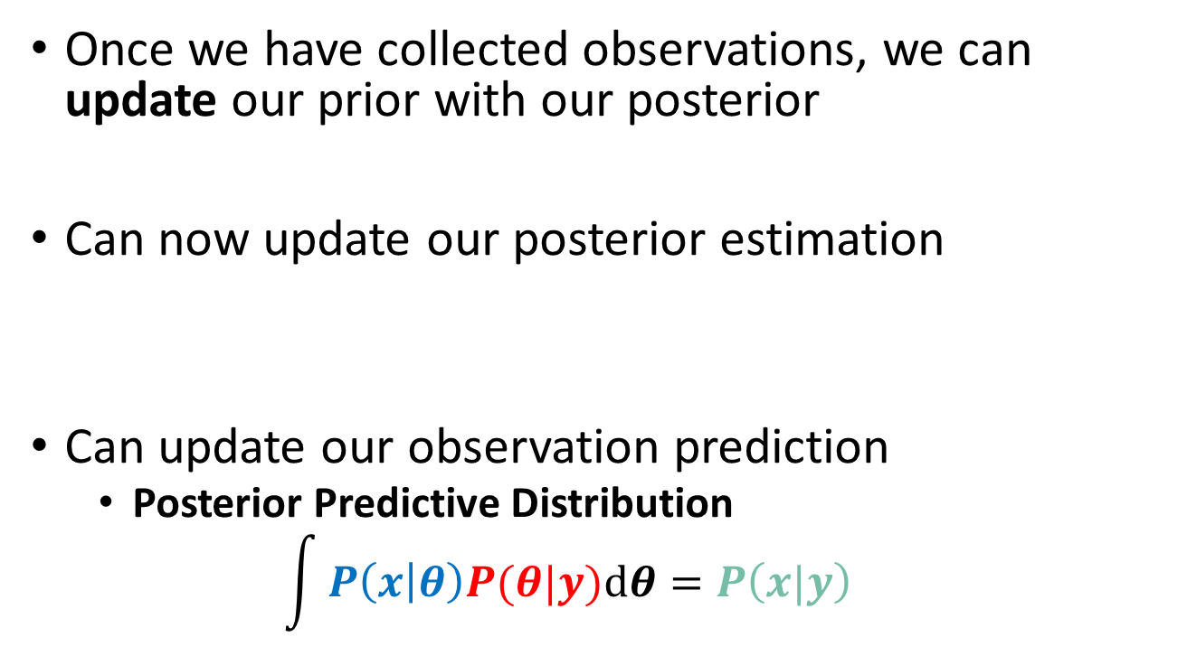
Updated Prior
Once we have collected observations, we can update our prior with our posterior
Can now update our posterior estimation
Can update our observation prediction
Posterior Predictive Distribution
$$\int{P\left(x | θ\right)P(θ|y)\text{d}θ}=P\left(x|y\right)$$
$$P\left(θ | x\right)∝ \frac{P\left(x | θ\right)P_{n}(θ)}{P_{n}(x)}$$

Slide 25
Conjugate Distributions
Why did we get a closed-form solution?
Beta distribution is a conjugate prior for the Binomial distribution
Hence, posterior is always a Beta distribution
Can express distribution in terms of sufficient statistics
Makes concept of updating the prior intuitive

Slide 26
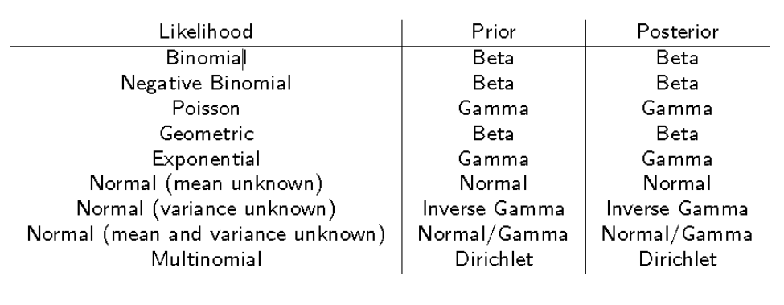
Examples of Conjugate Distributions
Nasim Zolaktaf 2016 (UBC)

Slide 27
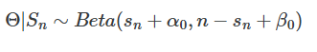
Sufficient Statistics
Sufficient statistics are population-level metrics which can replace observation-level metrics
Don’t need to keep track of which individuals have mutations – just need to know how many mutations occurred in the population
Useful for Polygenic risk scores or Fine-mapping!!

Slide 28
Practice (Bayesian_Intro.qmd)

Slide 29
Choosing a Prior
Informative Prior
Expert Knowledge
Data-driven approach
Non-Informative Prior
Uniform (bounded)
Jeffrey’s Prior (unbounded)

Slide 30
Credible Intervals
Why use an uninformative prior at all?
Let’s you leverage Bayesian model properties
Posterior Predictive Distribution
Iterative updating of prior
Credible Intervals
Confidence intervals

Slide 31
Bayesian Models

Slide 32

Linear Regression
$$y_{i }\sim Normal(μ_{i}{,σ}^{2})$$
$$μ_{i}=Xβ= \sum_{p=1}^{P}{x_{i,p}β_{p}}$$

Slide 33
Regularized Linear Regression
Change the Prior!
Normal with smaller variance
Previous estimates centered at 0
Laplace Prior

Slide 34

Generalized Linear Models
Simple extensions of the linear regression framework
Logistic Regression
Poisson Regression
Requires a likelihood from the Exponential Family and a link function
$$μ_{i}=Xβ= \sum_{p=1}^{P}{x_{i,p}β_{p}}$$

Slide 35
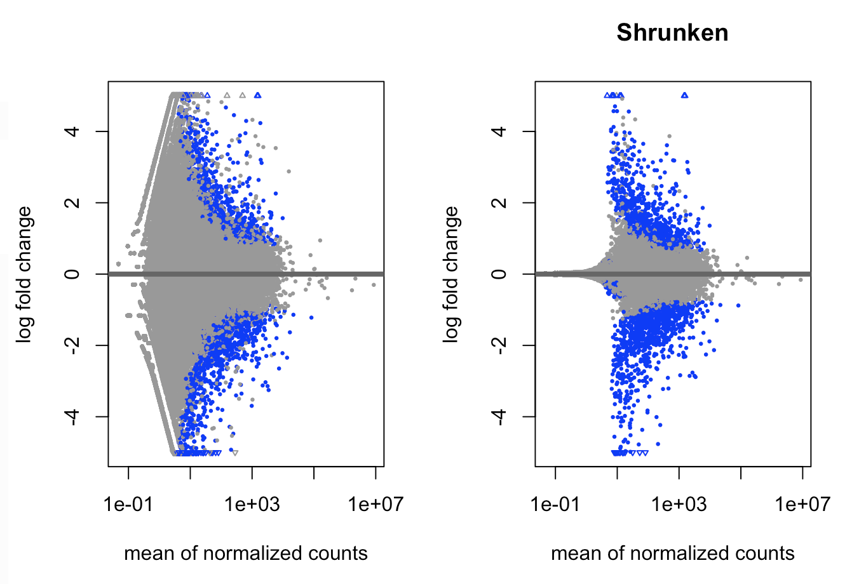
DESeq2 Log-fold Change Shrinkage
Love, M. I., Huber, W. & Anders, S. Genome Biology 15, doi:10.1186/s13059-014-0550-8 (2014).

Slide 36
Practice (Bayesian_Models.qmd)

Slide 37
Posterior Approximation

Slide 38
Intractable Posteriors
Many interesting model designs have complex posteriors
Intractable or too expensive to compute
Need a way to approximate the posterior
Large portion of statistical learning is devoted to this

Slide 39
Simple Approaches
Sampling Methods
Grid Approximation
Monte Carlo
Importance Sampling
Rejection Sampling
Optimal Importance Sampling
Markov Chain Monte Carlo

Slide 40
Markov Chain Monte Carlo
Gibbs Sampling
Requires conditional posteriors
Metropolis-Hastings Sampling
Only requires numerator and suggestion/acceptance procedure/criteria

Slide 41
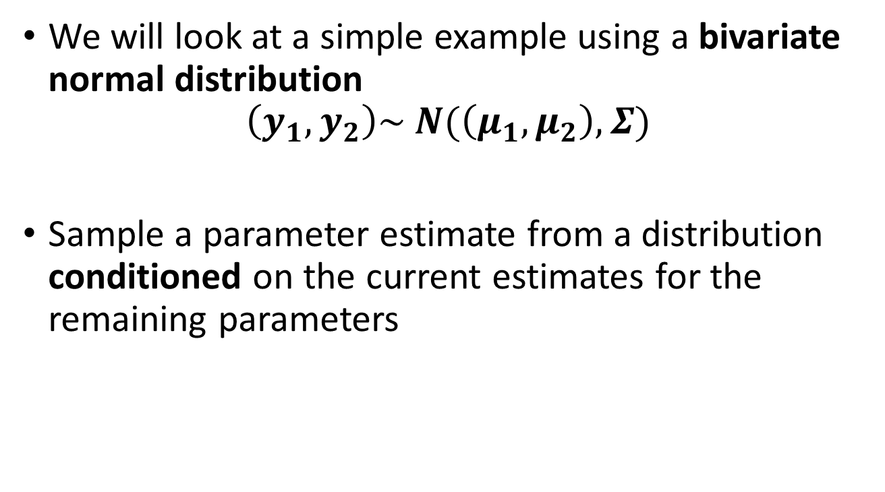
Gibbs Sampling
We will look at a simple example using a bivariate normal distribution
$$\left(y_{1},y_{2}\right)\sim N(\left(μ_{1},μ_{2}\right),Σ)$$
Sample a parameter estimate from a distribution conditioned on the current estimates for the remaining parameters

Slide 42
Gibbs Sampling (Bivariate Normal)

Slide 43
Practice (Posterior_Approximation.qmd)

Slide 44



Thank you for attending!
1
2
3
Scan the QR code to confirm you attended today’s workshop.
Fill out the feedback survey in the next 72h.
Get recognition for this workshop on your
co-curricular record.

