Slide 1
Pathfinding Algorithms for Bugs
Lucas Philipp Adrien Osakwe

Slide 2
Basis
Based on Head direction, turning frequency/direction and position:
Can we infer a navigation strategy for the bugs?
Are the appetitive and avoidance strategies exact opposites?

Slide 3
Method
Based on the preferential index analysis last week, we felt it was easier to infer the strategy by focusing on the control, EA and high GA treatment groups

Slide 4
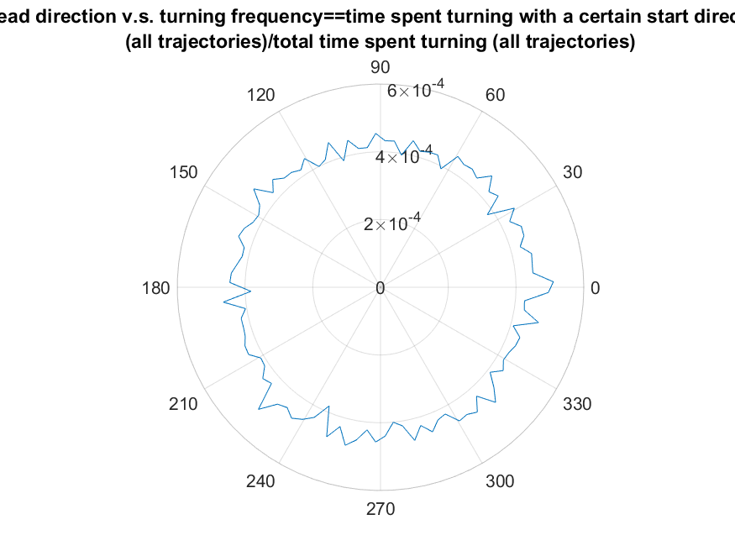
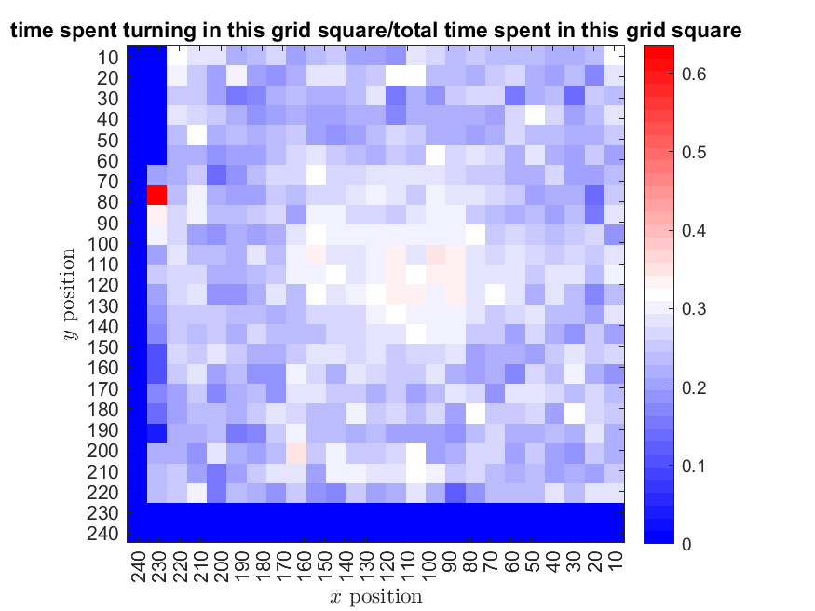
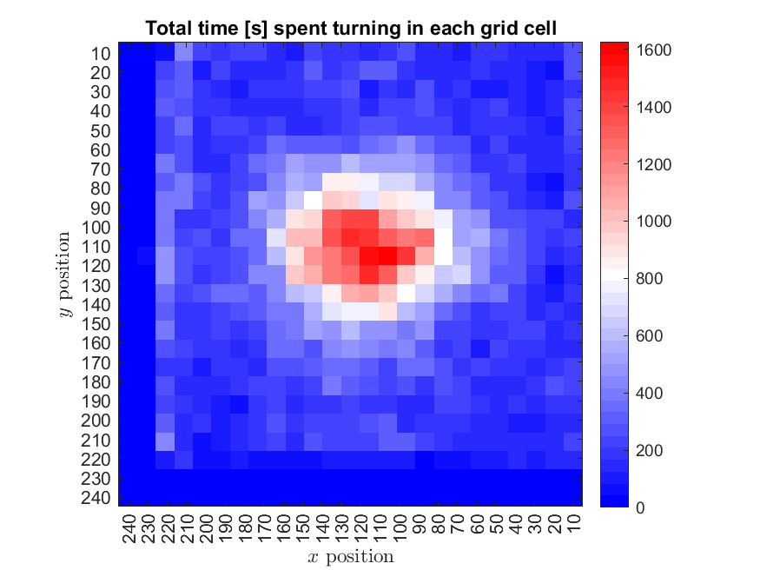
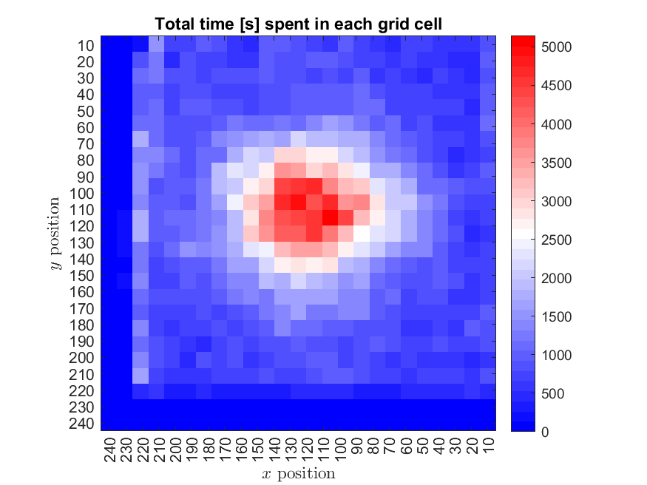
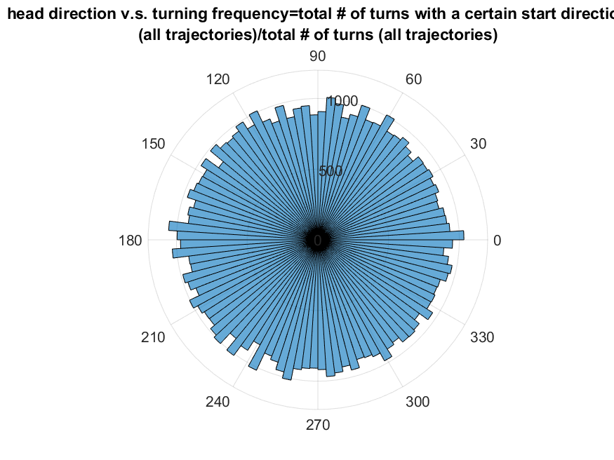
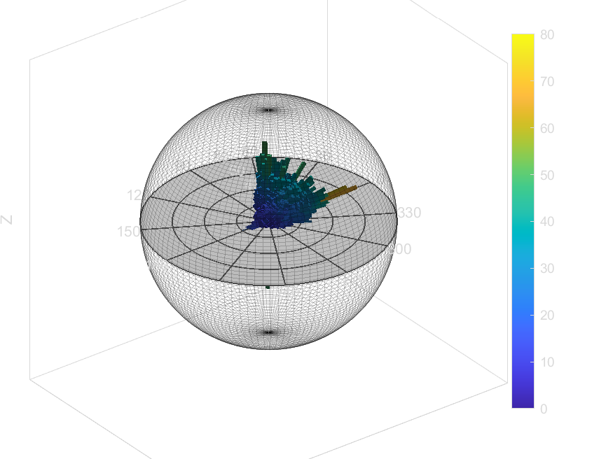
Control (H2O)

Slide 5
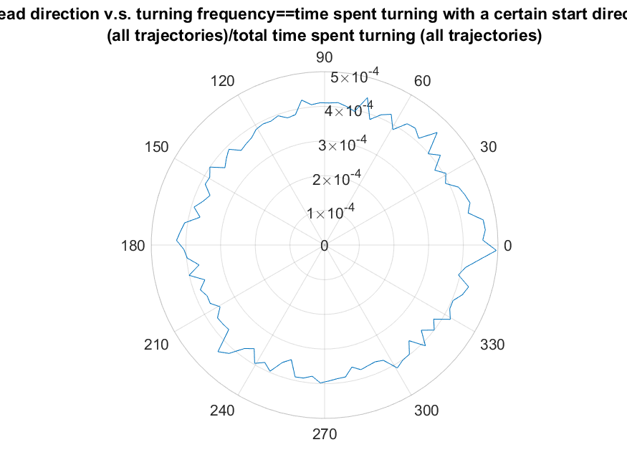
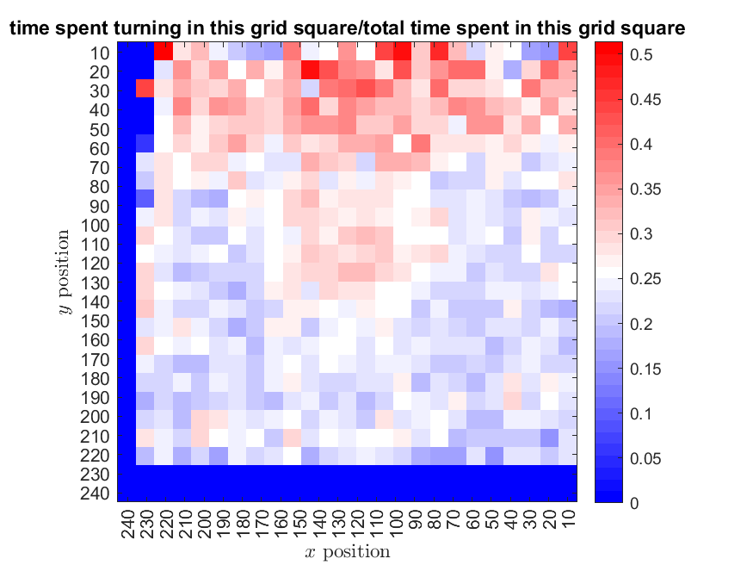
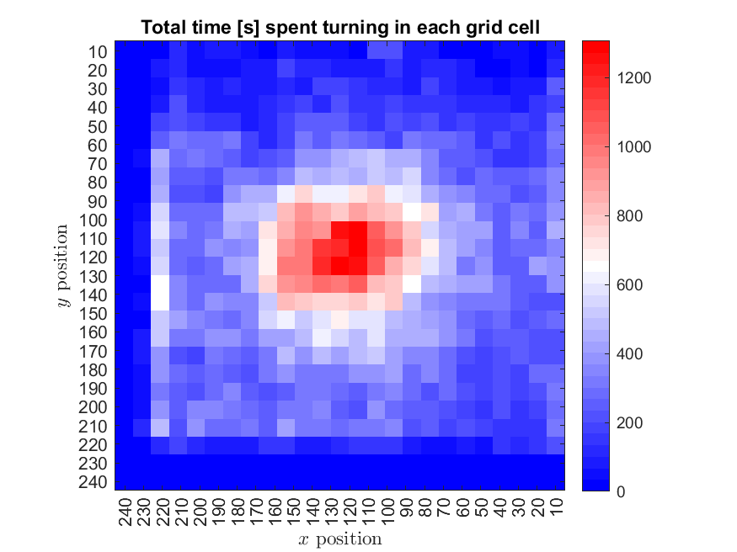
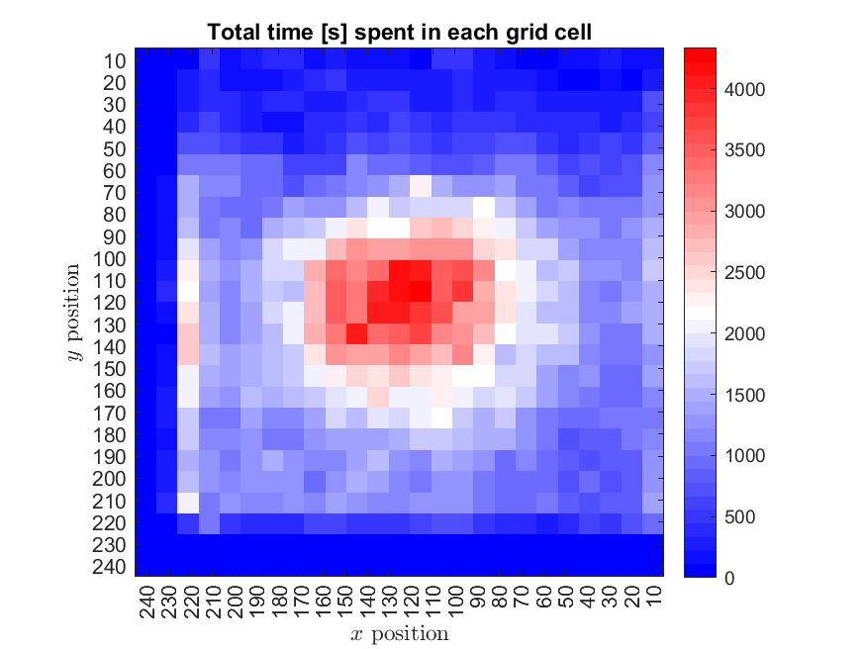
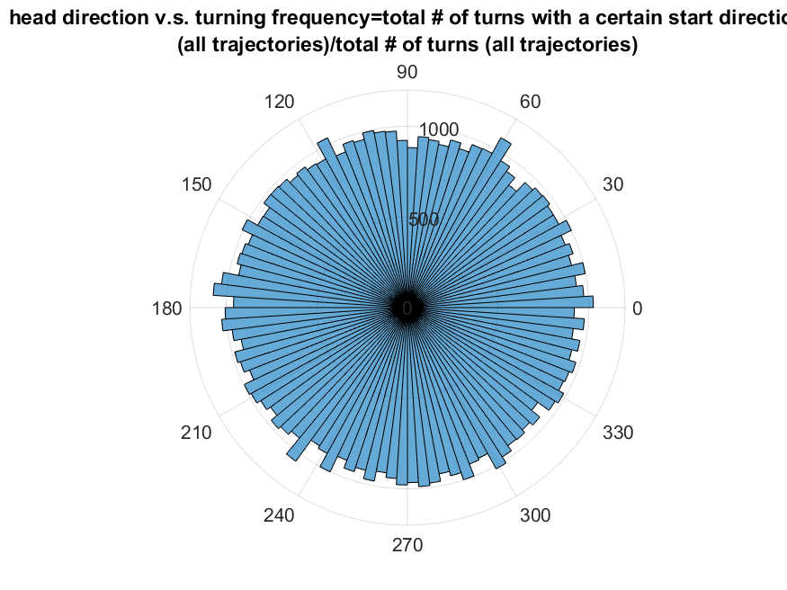
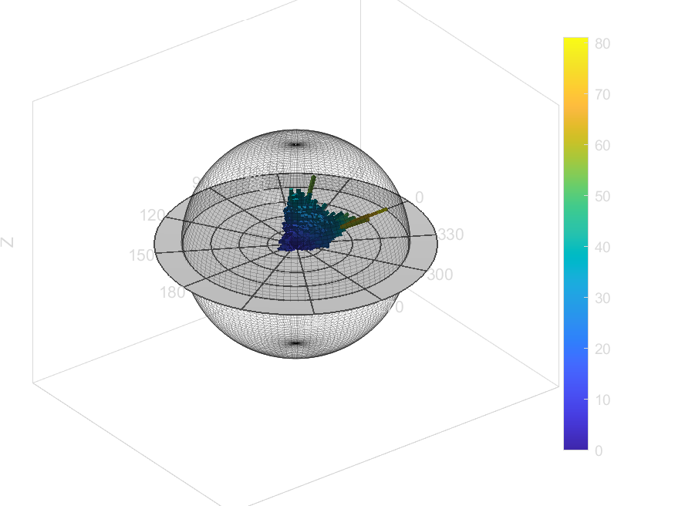
GA High

Slide 6
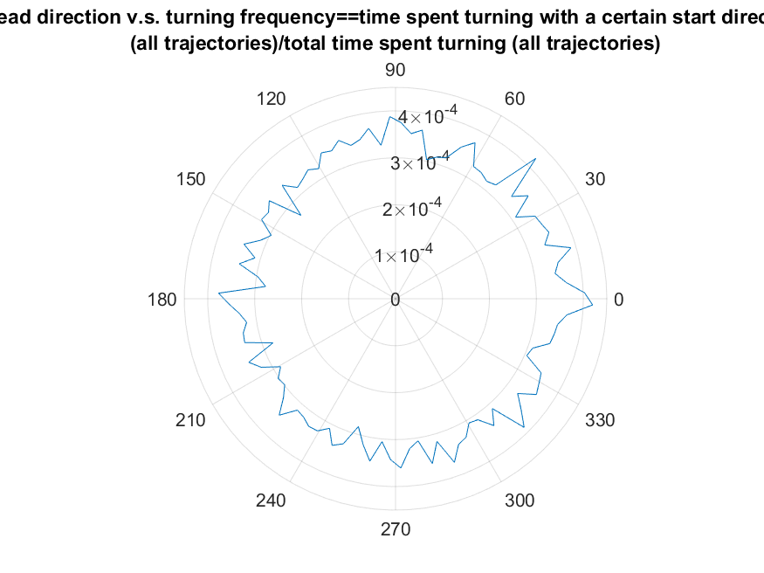
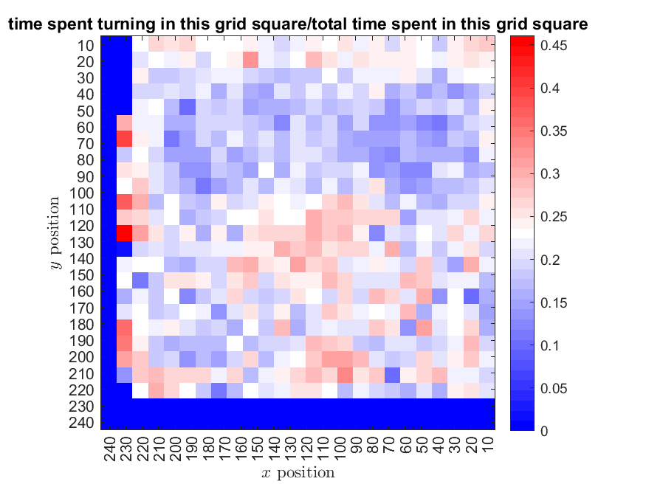
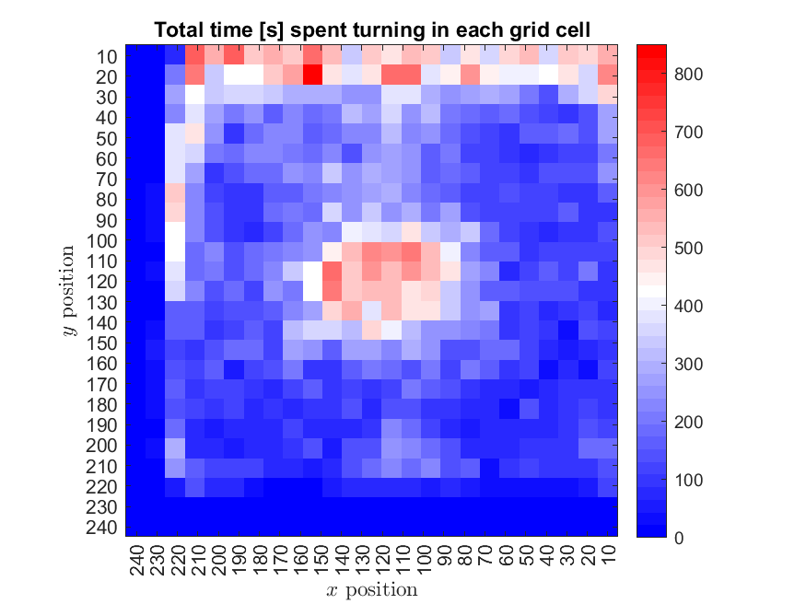
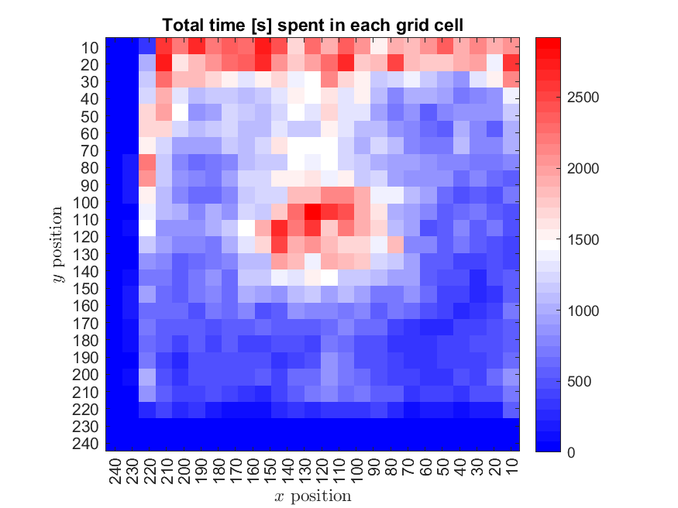
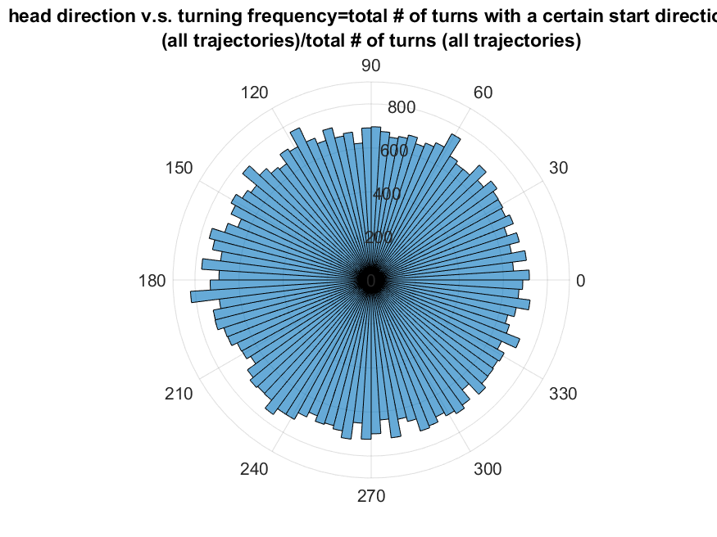
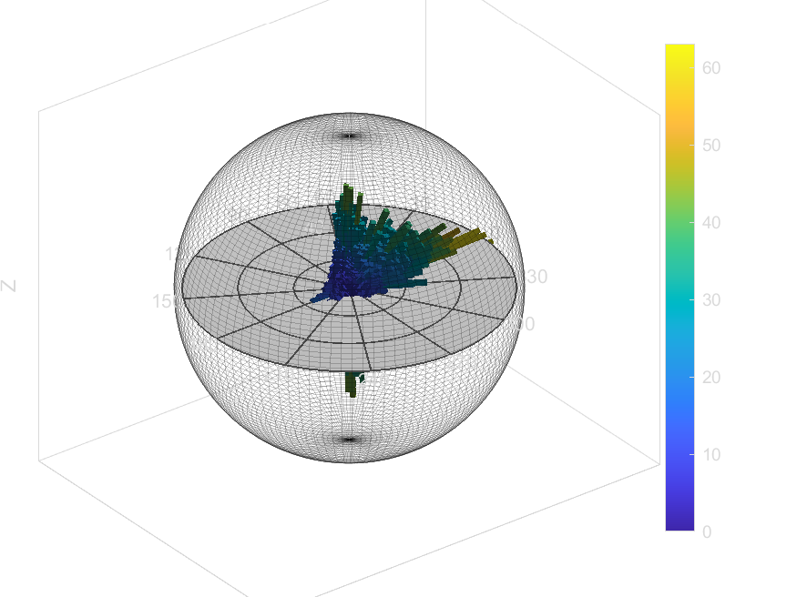
Results EA

Slide 7
Total time spent
Control
High GA
EA

Slide 8
Time spent Turning
Control
High GA
EA

Slide 9
Proportion of time spent turning
Control
High GA
EA

