Slide 1
Computer Vision: intro
@ Andrey Osetrov, 2021

Slide 2
Basic definition
Computer vision - is an interdisciplinary scientific field that deals with how computers can gain high-level understanding from digital images or videos *
* - https://en.wikipedia.org/wiki/Computer_vision

Slide 3
Sub-fields examples
Image classification
Object detection
Object tracking
Semantic segmentation
Human pose estimation
Scene recognition
Image restoration

Slide 4
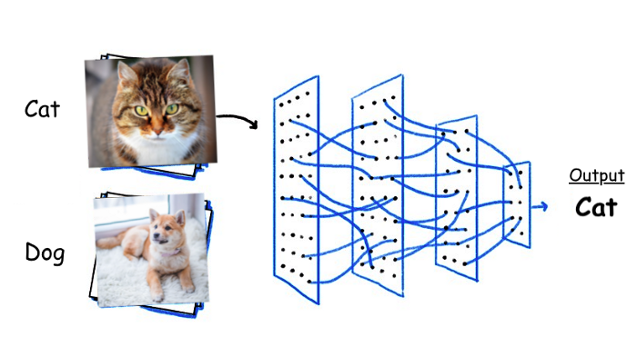
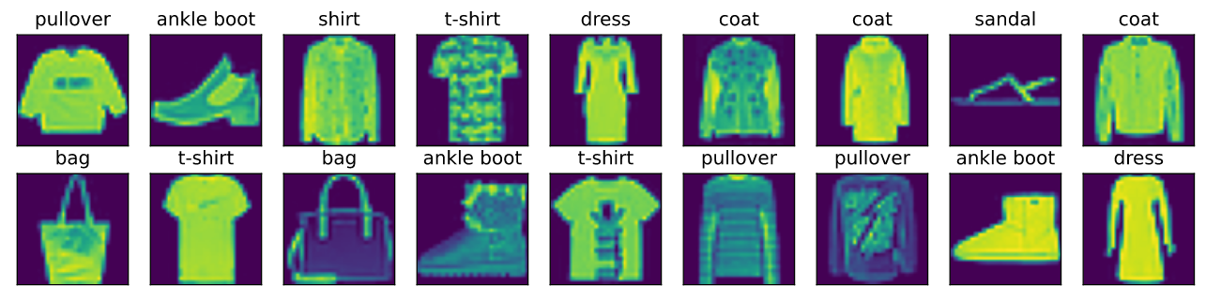
Image classification
* - https://towardsdatascience.com/10-papers-you-should-read-to-understand-image-classification-in-the-deep-learning-era-4b9d792f45a7
** - https://d2l.ai/chapter_linear-networks/image-classification-dataset.html

Slide 5
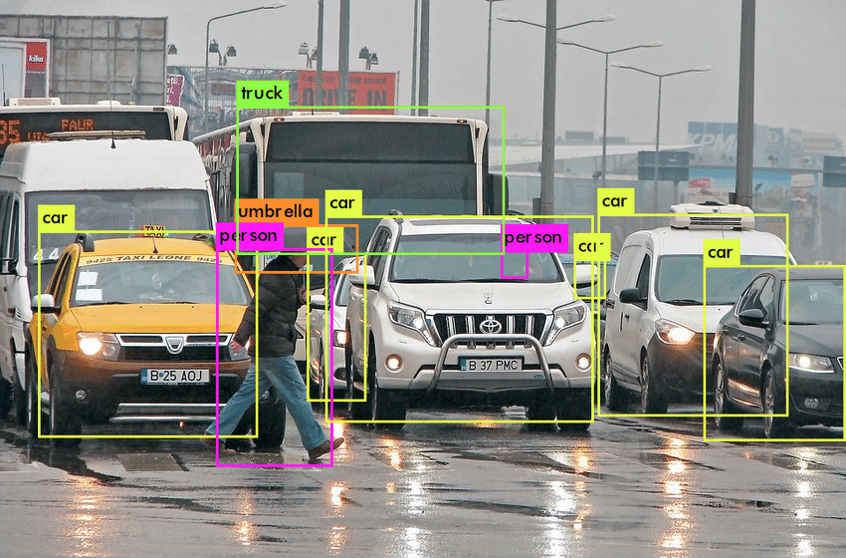
Object detection
* - https://www.researchgate.net/figure/Object-detection-in-a-dense-scene_fig4_329217107

Slide 6
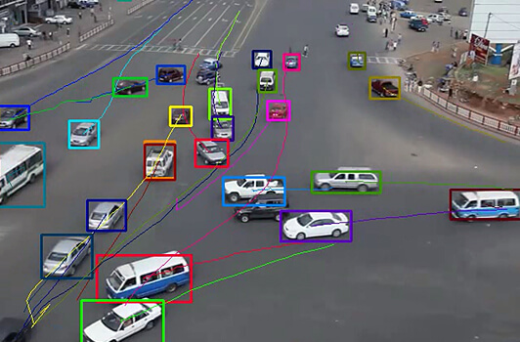
Object tracking
* - https://aidetic.in/blog/2020/10/05/object-tracking-in-videos-introduction-and-common-techniques/

Slide 7
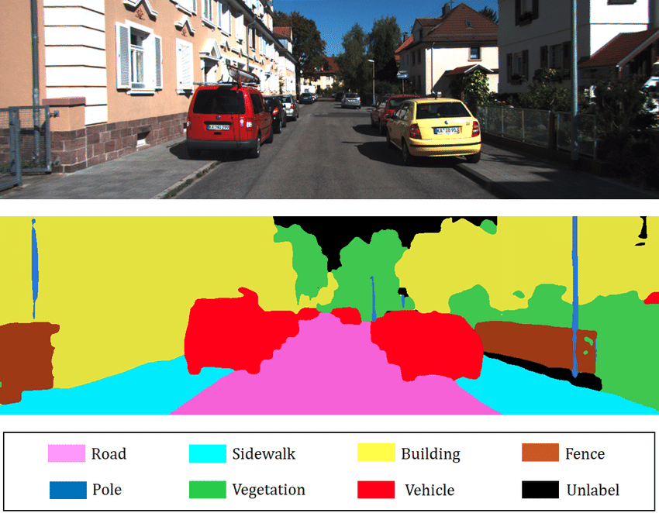
Semantic segmentation
* - https://www.researchgate.net/figure/Example-of-2D-semantic-segmentation-Top-input-image-Bottom-prediction_fig3_326875064

Slide 8
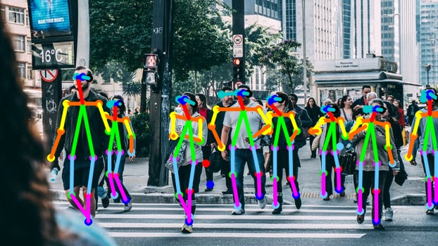
Human pose estimation
* - https://blog.usejournal.com/3d-human-pose-estimation-ce1259979306

Slide 9
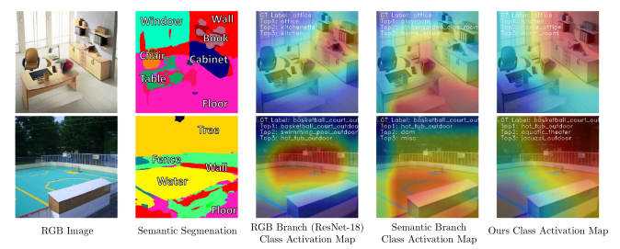
Scene recognition
* - https://www.groundai.com/project/semantic-aware-scene-recognition/1

Slide 10
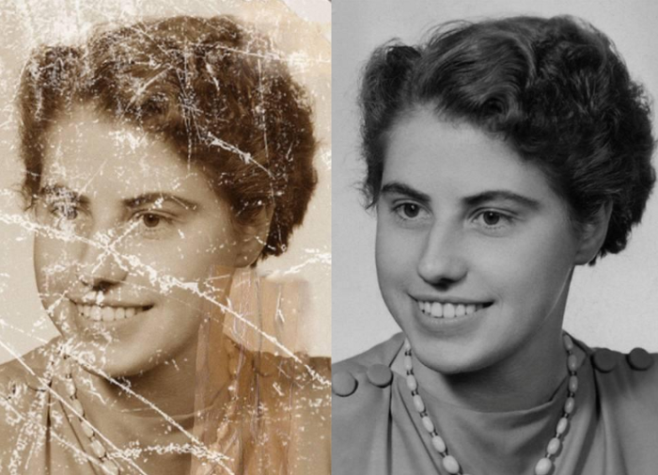
Image restoration
* - https://towardsdatascience.com/how-to-perform-image-restoration-absolutely-dataset-free-d08da1a1e96d

Slide 11
Let’s make our hands dirty now ...

Slide 12
Contacts
LI: https://www.linkedin.com/in/andrey-osetrov-phd/
GitHub: https://github.com/aosetrov/AI_Workshop_Computer_Vision_Tools

