Slide 1









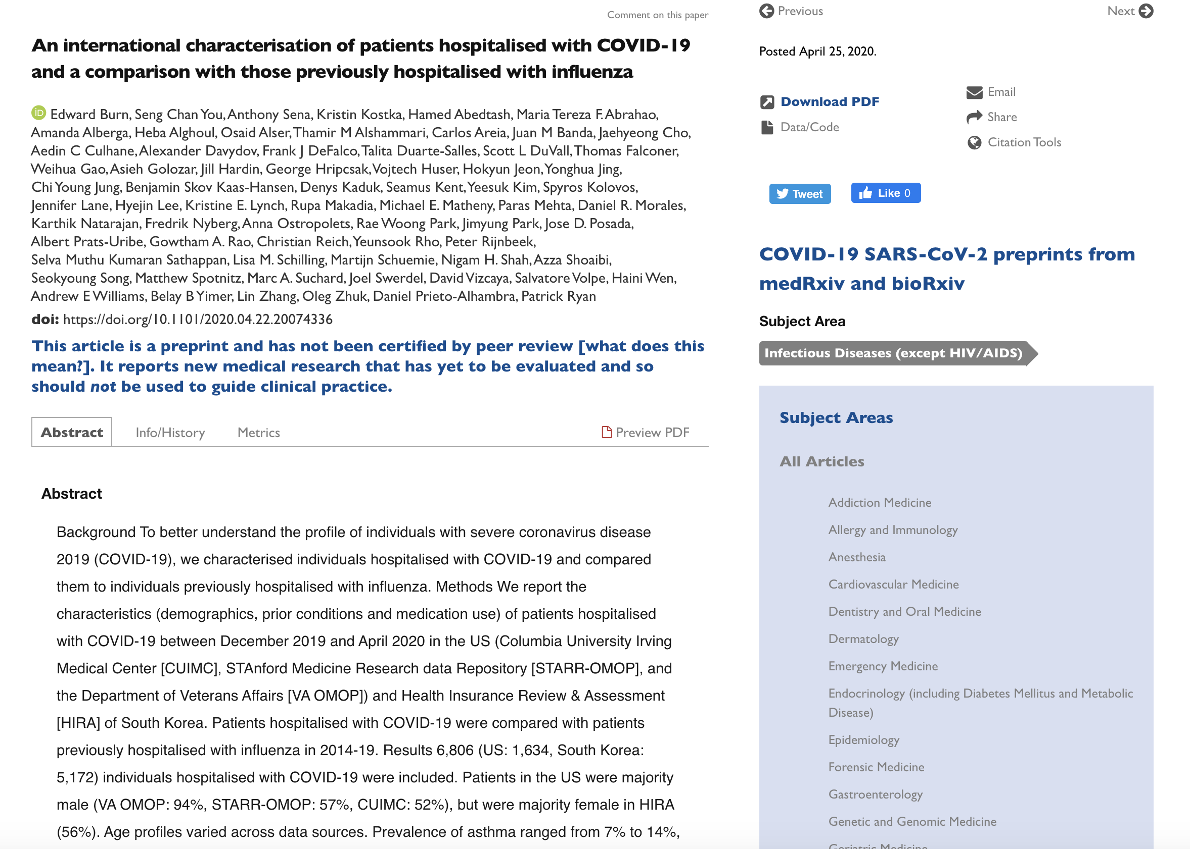











Characterizing Health Associated Risks, and Your Baseline Disease In SARS-COV-2 (CHARYBDIS)
Objectives: 1) Describe the baseline demographic, clinical characteristics, treatments and outcomes of interest among individuals tested for SARS-CoV-2 and/or diagnosed with COVID-19 overall and stratified by sex, age and specific comorbidities; 2) Describe characteristics and outcomes of hospitalized influenza patients between September 2017 and April 2018 compared to the COVID-19 population.
Data Sources: OHDSI studies around COVID-19 currently leverage datasets from Asia, Europe and North America. We are actively looking for data partners to join the journey! 1 IRB / 1 Study Package = Dozens of studies & papers that will be submitted for peer review!
#OHDSICOVID19
COVID-19 Collaborators
Study Topics: COVID-19 and …
OHDSI research into COVID-19 has generated many studies, including two currently in the peer-review process. Our baseline characterization of hospitalized COVID-19 patients is available
on MedRxiv.
• Asthma
• Cancer
• Cardiac Outcomes
• Chronic Kidney Disease
• COPD
• Elderly
• End-Stage Renal Disease
• Gender Differences
• Heart Disease
• Hepatitis C
• HIV infection
• Hypertension
• Immune Disorders
• Obesity
• Pediatrics
• Pregnant Women
• Testing
• Tuberculosis
• Type 2 Diabetes
… And more!
www.ohdsi.org/Covid-19-Updates

