Slide 1
Ethics of Artificial Intelligence and Machine Learning
Anthony Ostuni

Slide 2
Introductions
About me
Discussion-based class, so try to get to know those around you!
Notes:
Introduce self : undergrad, math/cs, Ta in the past for CMSC250, taught course last semester

Slide 3
Course Topics
Data Privacy
Transparency
Fairness
Bias
Automated Military Systems
Future of Labor
Consciousness and Rights
Control / Singularity
Unequal Access
Interaction / Affections
Artificial Creativity
** Topics subject to change

Slide 4
Course purpose
Software developers and tech companies increasingly in a policy-making role
Those in policy roles often out of touch with current technology
Think recent tech-related court hearings
Technology = moral benefit?

Slide 5
prerequisites
Interest in the subject!
No background of machine learning or artificial intelligence expected

Slide 6

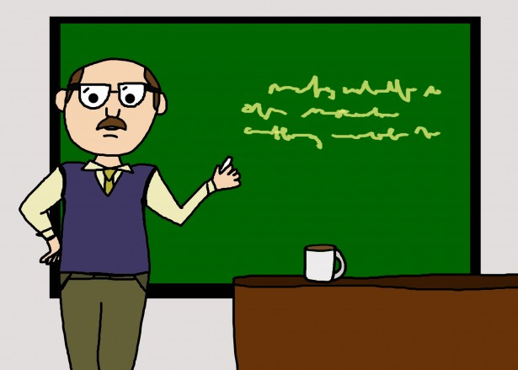


Course Structure
Notes:
Before class: readings and short answer questions
Beginning of class: short lecture
Main part of class: group discussion

Slide 7
Absence policy
If you already know you will miss a particular class, EMAIL ME
Excused absences will be given an alternative assignment
Unexcused absences will lose participation points

Slide 8
Major assignments
Paper 1
Paper 2
ML / AI Guideline Creation

Slide 9
plagiarism
The following are ALL examples of plagiarism or academic dishonesty and will NOT be tolerated.
Copying information (even if reworded) from an external source without citation
Resubmitting an assignment you’ve written for another course without permission (even if modified)
Allowing others to copy your work
If you have any questions about what constitutes plagiarism, do not hesitate to ask!

Slide 10
Grading
Assignment | Percentage
Weekly Short-Answer Questions | 10%
Participation | 30%
First Paper | 25%
Second Paper | 25%
ML / AI Guidelines | 10%
Letter grade breakdowns on syllabus

Slide 11
Miscellaneous
Readings and questions will be found on course webpage and submitted on ELMS
You are responsible for everything on course syllabus: https://github.com/aostuni/Ethics-of-AI-ML/blob/master/README.md
Second time offered → feedback!
Contact at aostuni@umd.edu with [CMSC389V] in subject line
You MUST have a working camera and microphone for discussions

Slide 12
Discussion Rules
Keep Zoom video on
No tolerance for name calling, verbal attacks, sarcasm, or similar
Goal is to generate greater understanding about different topics
Focus on both sharing views and listening to others’ views
Center on the topic / ideas, not the individuals
It is ok to disagree with one another (just please do so respectfully)
Everyone is expected to share
Full Rules: http://www.uvm.edu/~pass/tignor/filmseries_files/groundrules.pdf

Slide 13
Ethics
Definition?
“well-founded standards of right and wrong that prescribe what humans ought to do, usually in terms of rights, obligations, benefits to society, fairness, or specific virtues.”
https://www.scu.edu/ethics/ethics-resources/ethical-decision-making/what-is-ethics/
What is it not?
Religion → while often intertwined, ethics applies to more than just religious people
Law → laws may disagree with what is considered ethical (ex: slavery)
Feelings → possible to “do what is right” but feel uncomfortable doing so

Slide 14
Machine learning / artificial intelligence
Artificial Intelligence
Data
Create Model
Predict
Machine Learning

Slide 15
Questions?

