Slide 1
Fairness III
Anthony Ostuni

Slide 2
Readings
Discussions on the pros and cons of autonomous weapons
Perspectives from tech leaders as well as politicians

Slide 3
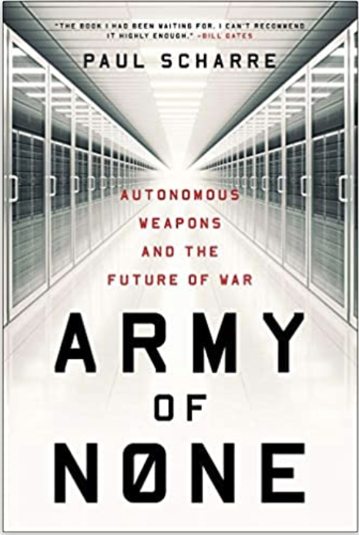
Book recommendation

Slide 4
Pareto curves
Named for the Italian economist Vilfredo Pareto
A way of visualizing choices of models to determine accuracy / fairness trade off
The curve itself, called the Pareto Boundary, contains the most ideal models

Slide 5
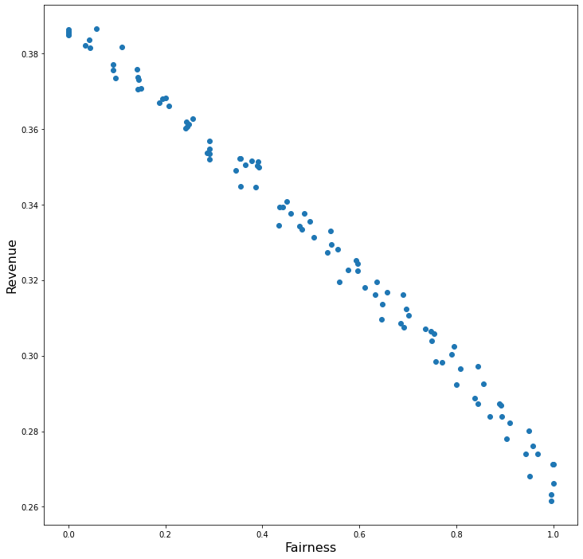
Pareto Curve example

Slide 6
Objection?
It may initially appear to be too rigid an idea, but consider the alternative

Slide 7
Suggested Questions
What role, if any, should machine learning and artificial intelligence play in warfare?
How do we ensure such weapons do not overstep that role?
Is such technology inevitable?
If (or when) such advanced weapons come to exist, they will likely dramatically change how armed conflicts occur / how wars are fought. How do you believe these changes will be?
Where does the responsibility lie for keeping such weapons within a reasonable limit? Politicians? Technology and weapons companies? Other?
Do you foresee any unintended consequences arising as a result of such technology? Which ones in particular?
What is the tradeoff between protecting the lives of soldiers and preventing inhumane or unnecessary actions by artificial entities?

