Slide 1
Singularity, Control, and Unintended Consequences
Anthony Ostuni

Slide 2
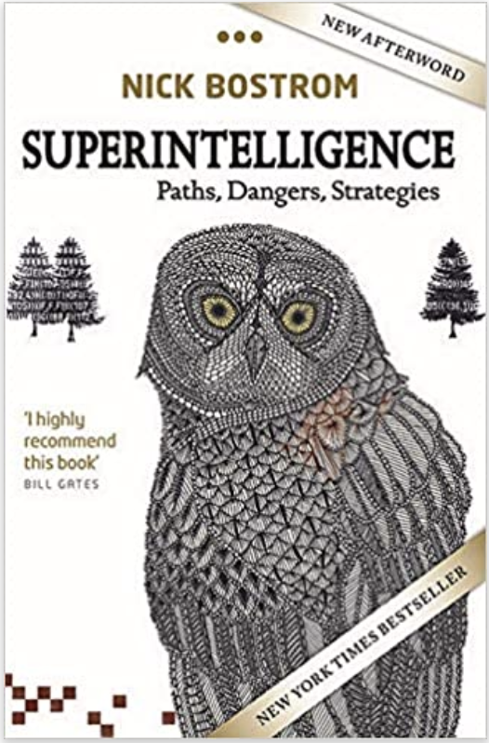
Readings
An introduction to concerns related to superintelligent AI by Nick Bostrom

Slide 3
Fear
AI develops better AI
Developing AI is a cognitive task
AI is now more intelligent

Slide 4
Skepticism
“There's a big difference between intelligence and sentience. There could be a race of killer robots in the far future, but I don’t work on not turning AI evil today for the same reason I don't worry about the problem of overpopulation on the planet Mars.”
Andrew Ng, founder of deeplearning.ai

Slide 5
Exponential growth
Assuming AI intelligence grows exponentially, there is still no guarantee of run-away AI, or an intelligence explosion
Think of bank interest payments

Slide 6
Suggested Questions
What do you believe is the most effective way to get an artificial intelligent agent to behave inline with our values?
How would you address the fact that there is a vast diversity of values within the human population?
If you were to explicitly provide such an agent with a command, how would you verify that all relevant details were provided to prevent unintentional consequences?
Do you agree with Bostrom on (a) the inability to keep AI contained and (b) the value of the control problem?
Do you believe it would even be possible to solve the control problem before we know substantial information about what form such a superintelligent AI agent will take?
How long do you think it will be (if ever) before we develop AI that could be considered superintelligent?

