Slide 1
Ethics of Artificial Intelligence and Machine Learning
Anthony Ostuni

Slide 2
Course Topics
Data Privacy
Transparency
Fairness
Bias
Automated Military Systems
Future of Labor
Consciousness and Rights
Control / Singularity
Unequal Access
Interaction / Affections
Artificial Creativity
** Topics subject to change

Slide 3
Course purpose
Software developers and tech companies increasingly in a policy-making role
Those in policy roles often out of touch with current technology
(Think Facebook hearing)
Technology = moral benefit?

Slide 4
Introductions
About me
Discussion-based class, so try to get to know those around you!
Name Papers
Notes:
Introduce self first: undergrad, math/cs, Ta in the past for CMSC250

Slide 5
prerequisites
Interest in the subject!
No background of machine learning or artificial intelligence expected

Slide 6

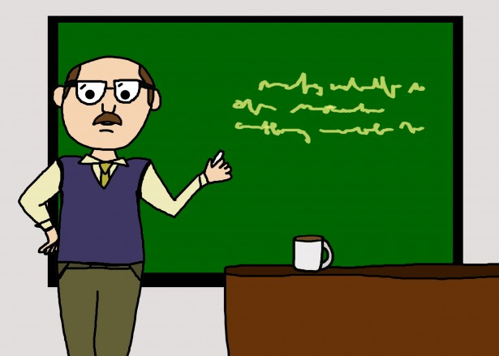


Course Structure

Slide 7
Absence policy
If you already know you will miss a particular class, EMAIL ME
Excused absences will be given an alternative assignment
Unexcused absences will lose participation points

Slide 8
Major assignments
Paper 1
Paper 2
ML / AI Guideline Creation

Slide 9
Grading
Assignment | Percentage
Weekly Short-Answer Questions | 10%
Participation | 30%
First Paper | 25%
Second Paper | 25%
ML / AI Guidelines | 10%

Slide 10
Miscellaneous
Readings and questions will be found on course webpage and submitted on ELMS
You are responsible for everything on course syllabus: https://github.com/aostuni/Ethics-of-AI-ML/blob/master/README.md
First time offered → feedback!
Contact at aostuni@umd.edu with [CMSC389V] in subject

Slide 11
Discussion Rules
No tolerance for name calling, verbal (or physical but gosh I hope not) attacks, sarcasm, or similar
Goal is to generate greater understanding about different topics
Focus on both sharing views and listening to others’ views
Center on the topic / ideas, not the individuals
It is ok to disagree with one another (just please do so respectfully)
Everyone is expected to share
Full Rules: http://www.uvm.edu/~pass/tignor/filmseries_files/groundrules.pdf

Slide 12
Ethics
Definition?
“well-founded standards of right and wrong that prescribe what humans ought to do, usually in terms of rights, obligations, benefits to society, fairness, or specific virtues.”
https://www.scu.edu/ethics/ethics-resources/ethical-decision-making/what-is-ethics/
What is it not?
Religion → while often intertwined, ethics applies to more than just religious people
Law → laws may disagree with what is considered ethical (ex: slavery)
Feelings → possible to “do what is right” but feel uncomfortable doing so

Slide 13
Machine learning / artificial intelligence
Artificial Intelligence
Data
Create Model
Predict
Machine Learning

