Slide 1

Using Neural Networks to Classify 3D Scans of Museum Artifacts
Capstone Project in Machine Learning, 2021
Alvaro Ortiz Troncoso
https://www.epfl.ch/

Slide 2
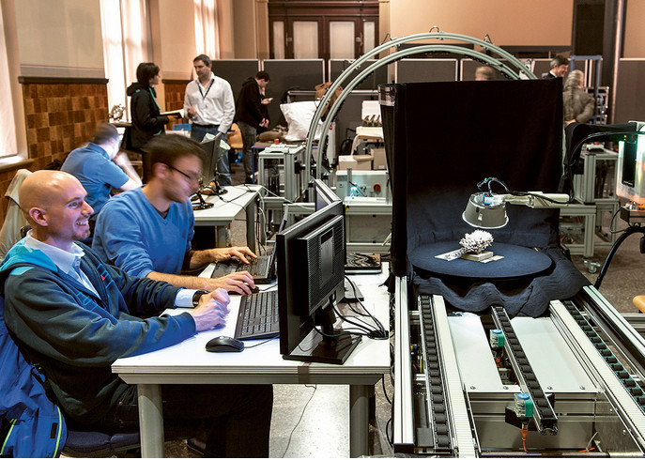
3D-digitalization of archaeological or natural history artifacts
Automated 3D scanning at Museum für Naturkunde Berlin, using the
CultLab3D system developed by Fraunhofer institute (Photo: Carola Radke, MfN)

Slide 3
3D-digitalization of archaeological or natural history artifacts
Until 2021
Digitizing an artifact can take several hours
(including post-processing), therefore
digitization reserved for
the most prestigious items in the collection
After 2021
Cost-efficient and timely mass-digitization of
all
the artifacts in a collection
(Fraunhofer IGD, MfN)

Slide 4
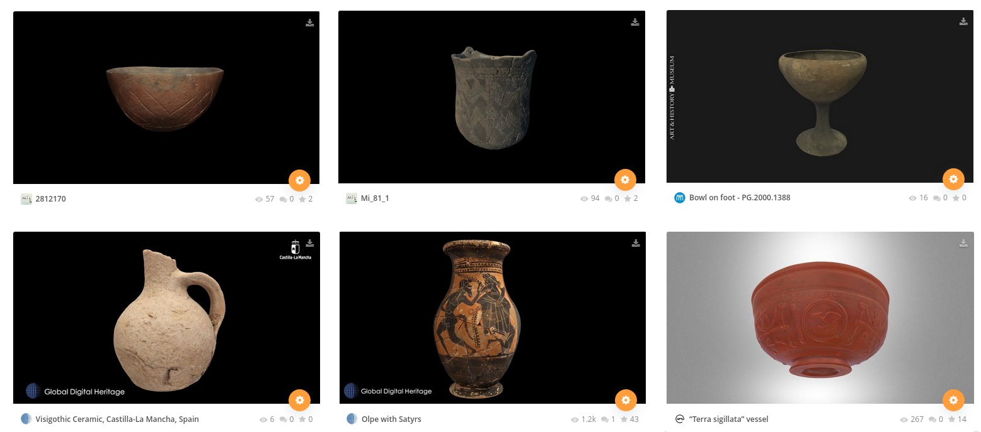
Data overview
Various types of pots in the data set: Neolithic LBK vessel, Neolithic SBK mortar, Bronze Age bowl
on foot, Iron Age -Visigoth- bottle, Greek Jug, Roman cup (screenshot from the Sketchfab website).

