Slide 1
Computer assisted methods for topic modeling and their applications in bibliometrics
Rationale
Our floor does not have a constant publication record
Original idea
With some help, I could do research on bibliometrics and publish.
So I contacted the Open University university in Holland to ask for help.
OK, but…
The university agreed to help me, on condition that I submit a PhD proposal.
So our collaboration is formalized and my advisors get a benefit from their work.
Still, the main plan is to publish, PhD comes second.

Slide 2
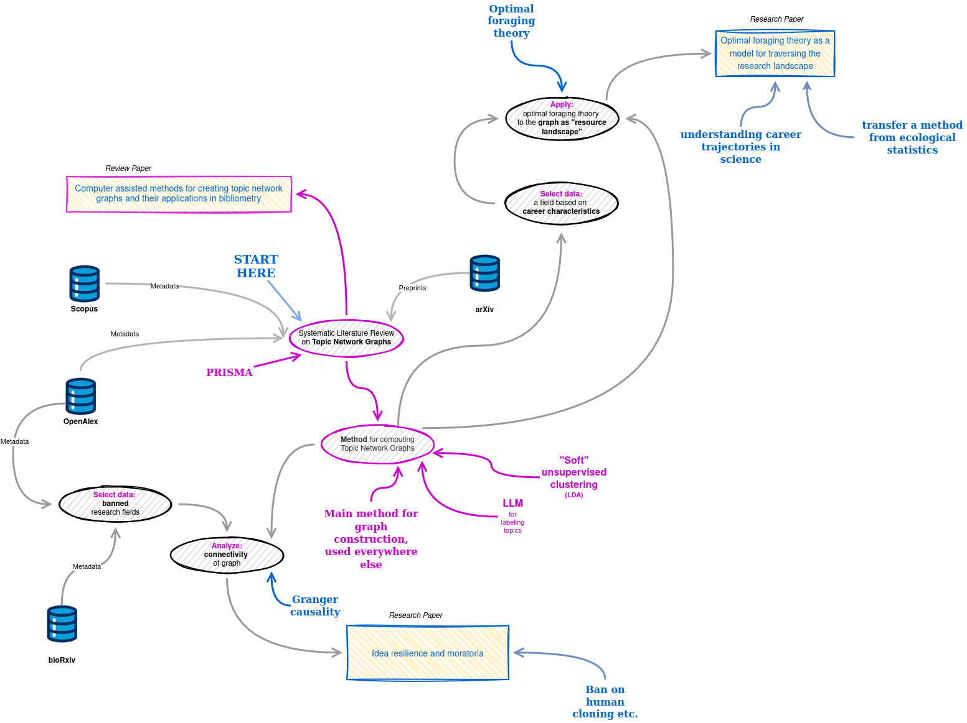
Plan:
1x Review paper
2x Research papers
+2 (at least) papers or
conference presentations
All papers are re-using common
Data sources
Methods
Tools

Slide 3
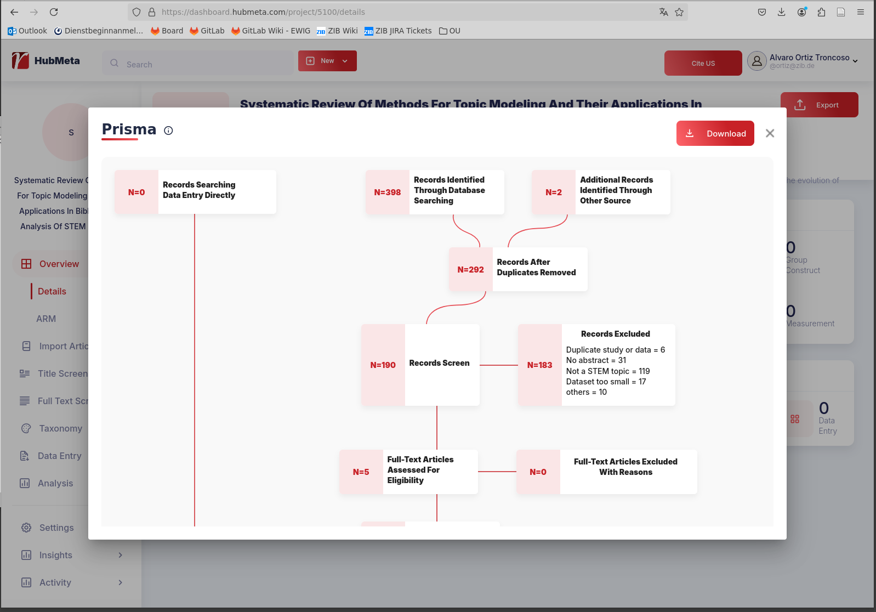
Literature review
A systematic literature review on topic modelling is being conducted using tools
that implement the PRISMA method.
http://hubmeta.com

Slide 4
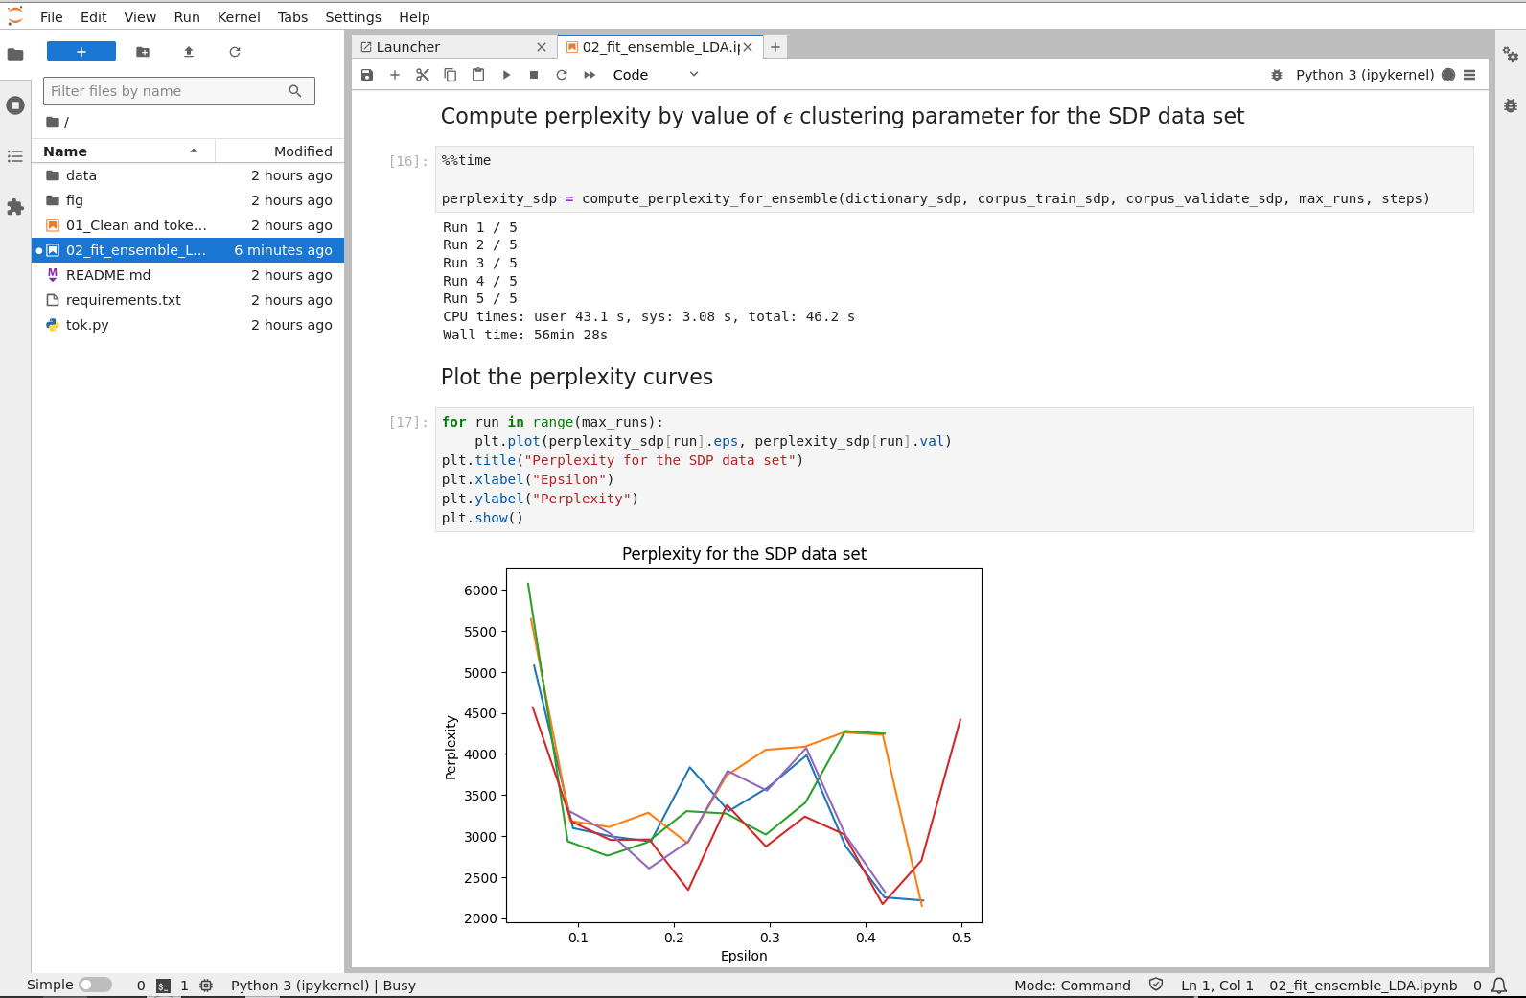
Topic modelling
Topic models are computed using LDA
Alternative to explore: use BERT
Where to run Jupyter notebooks on the KOBV infrastructure?
Currently on kobv-fan01
What about gtc-gpu201?
https://github.com/aot29/arxiv_exploratory/
https://github.com/aot29/openalex_exploratory/

Slide 5
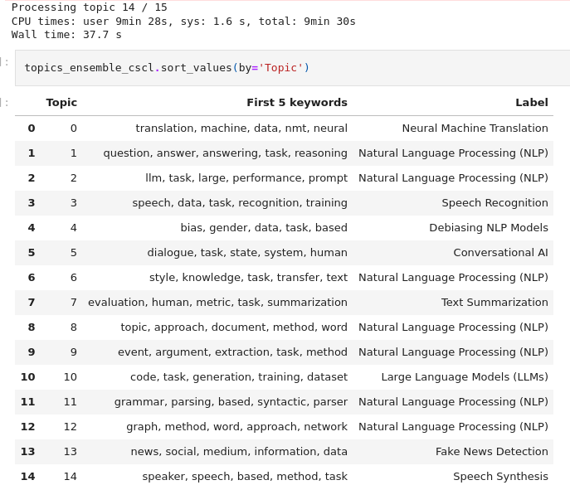
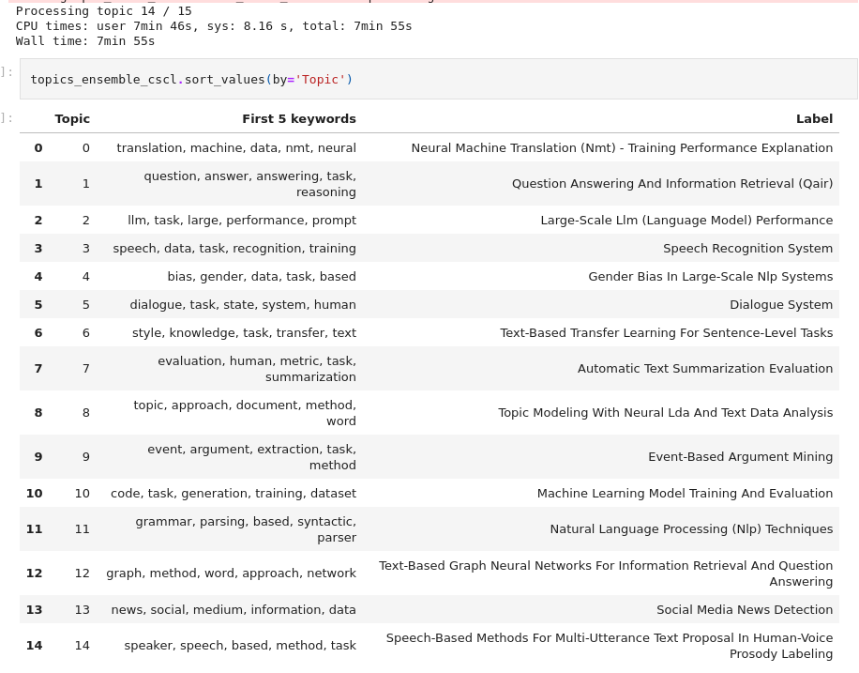
Naming the topics using LLM
You are an AI assistant specialised in Natural Language Processing.
What short, concise and human-readable label best describes the topic
characterised by these terms: {terms}? Output only the label"
LlaMa: fast but inaccurate
Mistral: more precise, but also much slower

Slide 6
Where to go from here?
Collaborate with my advisors / co-authors from the Open University in Holland
Research questions:
What is the current state of topic modeling, in terms of techniques and applications?
What temporal patterns describe the trajectories of scientists' careers?
Which interactions exist between idea resilience and moratoria in science?
Find a way to compare the Topic Graph and the Citation Graph
Further research questions are currently being examined for feasibility

