Slide 1
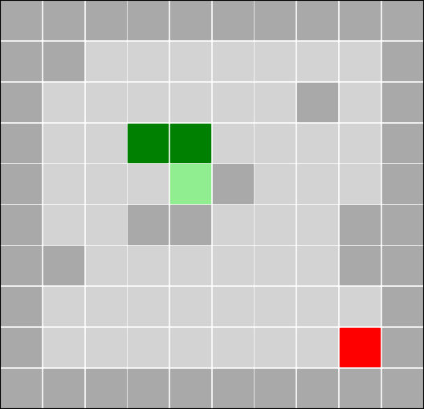
REINFORCEMENT LEARNING / PROJECT REPORT
Snake DQN
TensorFlow to PyTorch
CNN v17.1 · obstacle boards
400,000 training iterations
Actual policy recording
DTE-2502 · GA2
01 / 15
Notes:
This is my Snake DQN project for DTE-2502. I replaced the TensorFlow agent with PyTorch while keeping the existing game and model configuration. I will show how the implementation works, what happened over four hundred thousand training iterations, and why I kept an earlier checkpoint.

Slide 2
02 / SNAKE DQN
Project roadmap
01
The task
Game, observations, rewards
02
The implementation
CNN, PyTorch, DQN update
03
The evidence
Training, checkpoints, policy
DTE-2502 · GA2
02 / 15
Notes:
I will start with the Snake task and the information the agent receives. Then I will walk through the network and the PyTorch training loop. The last part compares the training history, checkpoint evaluations, and a recorded game that exposes a remaining weakness.

Slide 3
03 / SNAKE DQN
Port the agent, keep the game
Keep
Replace / adapt
SnakeNumpy environment
Obstacle-board collection
NumPy replay buffer + utilities
DQN agent → torch.nn.Module
Training + checkpoint workflow
Evaluation + policy rendering
Starting point: DragonWarrior15/snake-rl
DTE-2502 · GA2
03 / 15
Notes:
The task was a framework migration, not a new Snake game. I reused the environment, obstacle boards, replay buffer, and game utilities from DragonWarrior15's repository. The main change is the DQN agent, with training, checkpoint loading, evaluation, and visualization adapted around it.

Slide 4
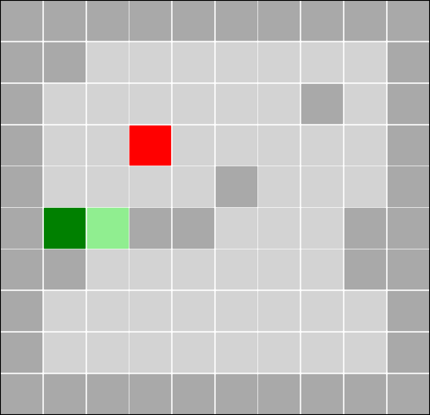
04 / SNAKE DQN
What the agent sees and earns
0 Empty
FOOD
1 Body
+1
2 Head
3 Food
COLLISION
−1
4 Wall / obstacle
NORMAL STEP
0
10 × 10 × 2 frames
Actions: right / up / left / down. Reverse direction is masked.
DTE-2502 · GA2
04 / 15
Notes:
The input contains two ten-by-ten board frames. Cells encode empty space, body, head, food, and walls or obstacles. Food gives plus one, a collision minus one, and ordinary movement zero. Four directions are available, but the environment mask only blocks an immediate reverse turn.

Slide 5
05 / SNAKE DQN
One DQN training iteration
Observe
Choose
Store
Learn
→
→
→
128 parallel games
CNN → mask → ε-greedy
Transitions → replay
Batch → loss → update
Collect experience → sample past experience → improve action values
Target network supplies the next-state estimate; online network receives gradients.
DTE-2502 · GA2
05 / 15
Notes:
Each iteration collects experience from the parallel games and stores the transitions. The online CNN estimates four action values. Epsilon controls exploration among allowed directions. A random replay batch then updates the online network, while a separate target network supplies the next-state values.

Slide 6
06 / SNAKE DQN
CNN v17.1: two frames to four values
Input
Conv 1
Conv 2
Conv 3
2 × 10 × 10
16 × 10 × 10
32 × 8 × 8
64 × 4 × 4
Two board frames
3 × 3 · same
3 × 3 · valid
5 × 5 · valid
Flatten 1,024
→
Dense 64
→
4 Q-values
ReLU after each convolution and the hidden dense layer. Linear output.
DTE-2502 · GA2
06 / 15
Notes:
The network follows version seventeen point one. Three convolution layers turn the two input frames into sixty-four four-by-four feature maps. Flattening gives one thousand twenty-four features, followed by sixty-four hidden units and four linear outputs. These outputs are action values, not action probabilities.

Slide 7
07 / SNAKE DQN
TensorFlow to PyTorch
agent.py / input preparation
Keras layers → nn.Module
predict → no_grad()
train call → backward() + step()
H5 files → one .pt checkpoint
normalized = board.astype(np.float32) / 4.0
tensor = torch.from_numpy(normalized)
tensor = tensor.permute(0, 3, 1, 2).contiguous()
NHWC → NCHW
Loading uses map_location; checkpoint includes online, target and optimizer states.
DTE-2502 · GA2
07 / 15
Notes:
The conversion required more than replacing layer names. I divide board values by four and move channels to the PyTorch position. Inference uses no-grad, while training explicitly runs backward and the optimizer step. One checkpoint stores online, target, and optimizer states for device-aware loading.

Slide 8
08 / SNAKE DQN
Replay memory + direction masking
REPLAY CAPACITY
What “legal” means here
80,000 transitions
Immediate reverse: blocked
Wall collision: still possible
Body collision: still possible
RANDOM MINIBATCH
64 transitions
(s, a, r, s′, done, next_mask)
The same mask is used for acting and bootstrapping.
DTE-2502 · GA2
08 / 15
Notes:
The replay buffer holds eighty thousand transitions, including the next state's direction mask. Training samples sixty-four at a time. Masking is applied both when choosing actions and when calculating targets. Importantly, allowed does not mean safe: the mask prevents reversing, but does not remove wall or body collisions.

Slide 9
09 / SNAKE DQN
Learning from the next state
y = r + γ (1 − done) max Qtarget(s′, a′)
a′ ranges over the allowed next directions
Terminal?
Online update
Target copy
Use immediate reward only
Executed action target changes
Every 500 iterations
Mean Huber loss · RMSprop · gradient norm clipped at 10
DTE-2502 · GA2
09 / 15
Notes:
The Bellman target combines immediate reward with discounted future value from the target network. A terminal transition removes that future term. Only the executed action's target is replaced. I use mean Huber loss, clip gradient norm at ten, and copy online weights to the target every five hundred iterations.

Slide 10
10 / SNAKE DQN
The run configuration
PARALLEL ENVIRONMENTS
BATCH SIZE
DISCOUNT γ
128
64
0.99
RMSPROP LEARNING RATE
EXPLORATION ε
TARGET SYNC
0.0005
1.0 → 0.01
Every 500
1 optimizer update / iteration · ε × 0.97 per logging interval · replay refilled on resume
DTE-2502 · GA2
10 / 15
Notes:
Training uses one hundred twenty-eight parallel environments and one optimization update per iteration. Gamma is point nine nine, and RMSprop uses a learning rate of point zero zero zero five. Epsilon drops from one to point zero one. Resuming restores model and optimizer states, but refills the replay buffer.

Slide 11
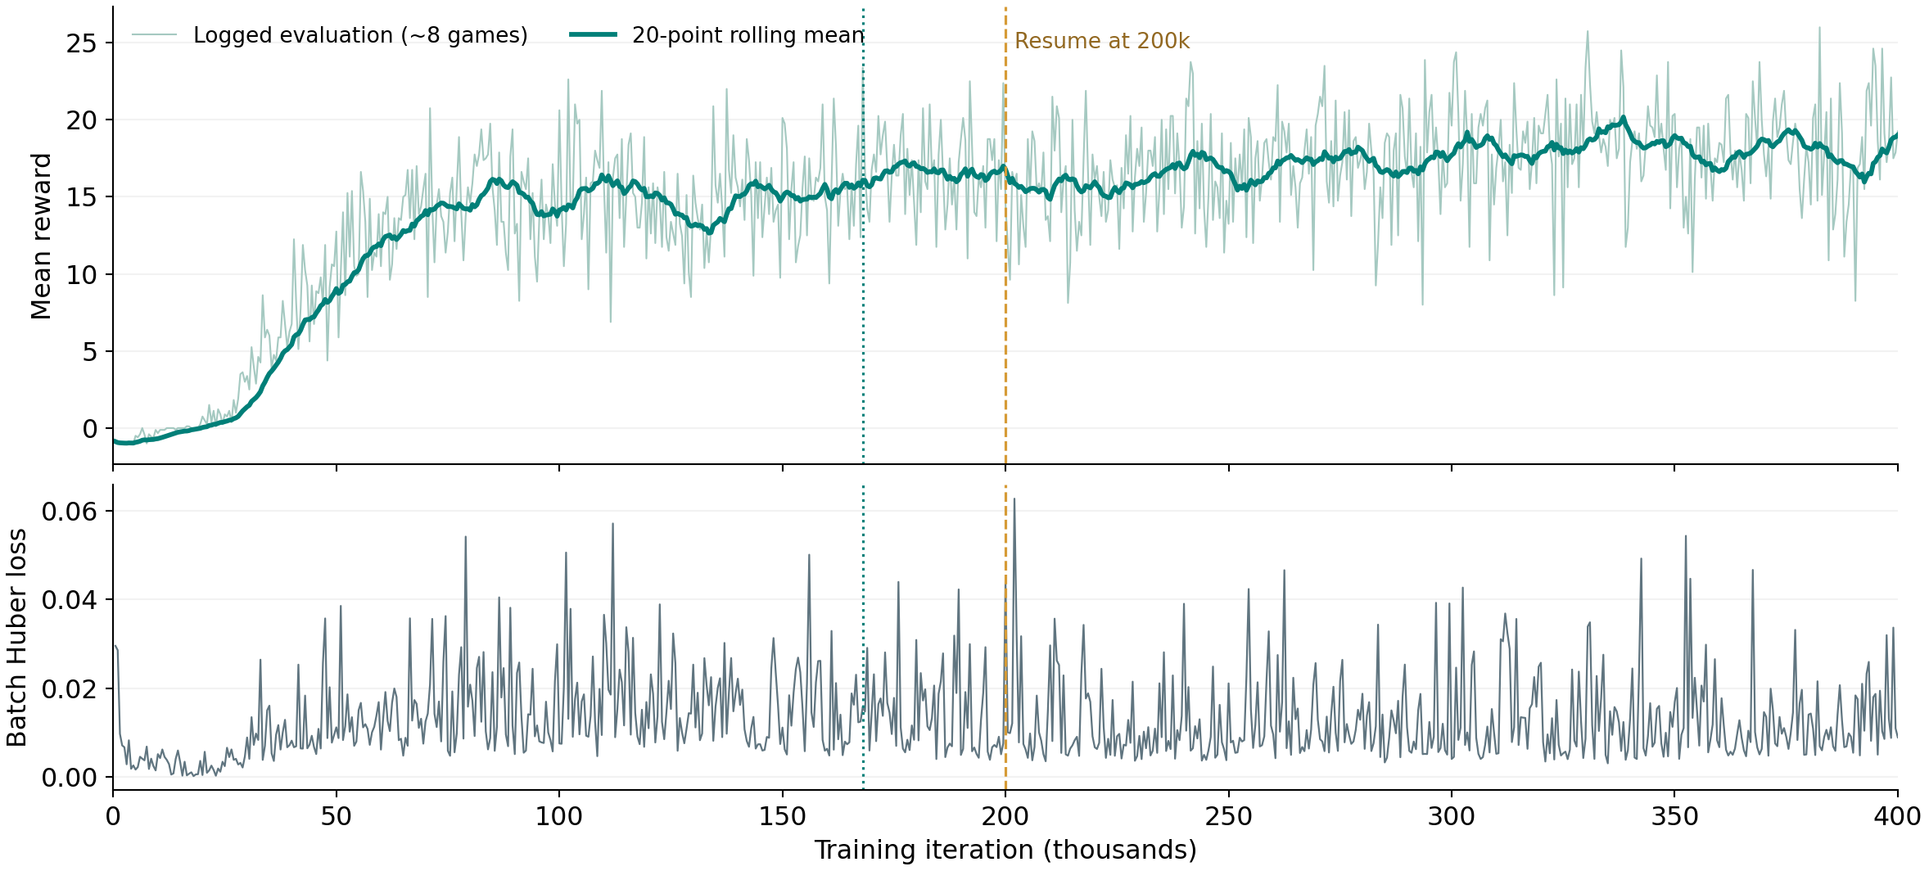
11 / SNAKE DQN
400,000 iterations: the full history
0–200k: 21:08 | 200k–400k: 22:07 | Training loops: 43:15
Source: model_logs/v17.1.csv · small logged evaluations, not 100-game checkpoint tests
DTE-2502 · GA2
11 / 15
Notes:
The full history covers four hundred thousand iterations. The first half took twenty-one minutes eight seconds, and continuation took twenty-two minutes seven seconds. Logged rewards fluctuate, even after learning improves. These are small evaluations of about eight games, not the larger checkpoint comparisons on the next slide.

Slide 12
12 / SNAKE DQN
Which checkpoint did I keep?
Checkpoint
Games
Mean reward
Mean length
168,000 · kept
100
17.89
20.89
382,500
100
17.79
20.79
400,000
101 actual
16.00
19.00
Selected among evaluated candidates — not a global-best claim.
Seed 42 · greedy evaluation · same obstacle-board setup
No held-out board split; small differences do not establish statistical superiority.
DTE-2502 · GA2
12 / 15
Notes:
Among the evaluated candidates, I retained iteration one hundred sixty-eight thousand: reward seventeen point eight nine over one hundred games. The later candidate was close, while the final model was lower over one hundred one completed games. These share the project's obstacle setup; they are not an unseen-map generalization test.

Slide 13
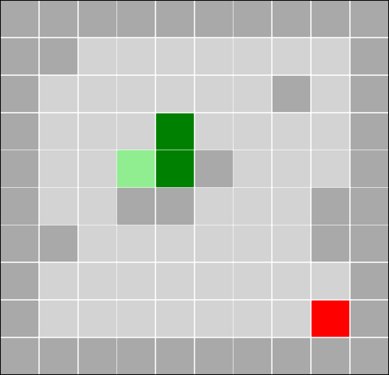
13 / SNAKE DQN
A recorded policy, including its weakness
Step 0 · score 0
Step 133 · score 1
Step 266 · score 1
Same recording, later frames: local cycling without another food reward.
DTE-2502 · GA2
13 / 15
Notes:
These frames come from the existing final-policy recording, not a staged example. The snake has eaten one food item by step one hundred thirty-three, but the score is still one at step two hundred sixty-six. That repeated local movement shows why one recording cannot establish a reliable policy.

Slide 14
14 / SNAKE DQN
What took care — and what remains
Implementation details
Policy limits
Tensor layout must match the CNN
Direction masks must reach TD targets
NumPy reset scalar conversion needed fixing
Sparse rewards can leave local loops
More iterations did not beat the kept candidate
Next test: separate obstacle-board split
A correct training loop is not the same as a consistently strong policy.
DTE-2502 · GA2
14 / 15
Notes:
Three details mattered in practice: matching tensor layout, preserving direction masking, and handling NumPy reset compatibility. The remaining problem is behavioral: sparse rewards allow movement without finding more food. Longer training did not improve the evaluated candidates enough to replace the earlier model, so a separate board split would be useful next.

Slide 15
Thank you
Questions?
Snake DQN · PyTorch v17.1
Next question: how well does it transfer to separate obstacle boards?
DTE-2502 · GA2
15 / 15
Notes:
Thank you for listening. I can walk through the PyTorch update, explain the checkpoint comparison, or show more of the recorded game. The question I would investigate next is whether the same policy still performs well on a separate set of obstacle boards. I am happy to take questions.

