Slide 1
CONCEPTUAL DESIGN
Research Lab Management System Project

Slide 2
As stated in the deliverables, the conceptual design is developed progressively. The initial slides present the main attributes, while subsequent versions progressively introduce additional relations and entities.

Slide 3
People
p_Id
name
Approval
Person
ISA
academic_enrollment
phone_num
report_to
Student
Employee
Supervised_by
ISA
academic
non_academic
ISA
ISA
faculty
administrative
Technical_staff

Slide 4
Laboratories, Equipments Units & models
l_Id
name
Attached_to
p_Id
name
approval
Person
laboratory
academic_enrollment
ISA
phone_num
report_to
I
I
I
I
Student
Employee
location
hosts
Supervised_by
ISA
academic
non_academic
Supervised_by
Store_model_id
portability
eqU_id
ISA
ISA
Correspond_to
faculty
administrative
Technical_staff
Equipment_model
Equipment_units

Slide 5
Research Projects, budgets
l_Id
name
Attached_to
p_Id
name
approval
Person
play
Role
laboratory
project_code
location
academic_enrollment
ISA
phone_num
hosts
report_to
Associated_to
use_
simultaneously
Student
Employee
Research_project
Store_model_id
portability
Supervised_by
Supervised_by
eqU_id
ISA
Correspond_to
Equipment_model
Equipment_units
academic
non_academic
ISA
ISA
bg_line
manage
faculty
administrative
Technical_staff
budget
Funded by

Slide 6
Reservations
l_Id
name
Attached_to
p_Id
name
approval
play
Role
laboratory
Person
project_code
location
academic_enrollment
ISA
phone_num
Associated_to
hosts
report_to
Student
Employee
Research_project
Store_model_id
portability
Supervised_by
Supervised_by
eqU_id
ISA
Correspond_to
make
Equipment_model
Equipment_units
academic
non_academic
ISA
ISA
bg_line
manage
faculty
administrative
Technical_staff
budget
Funded by
Assign
include
Reservation

Slide 7
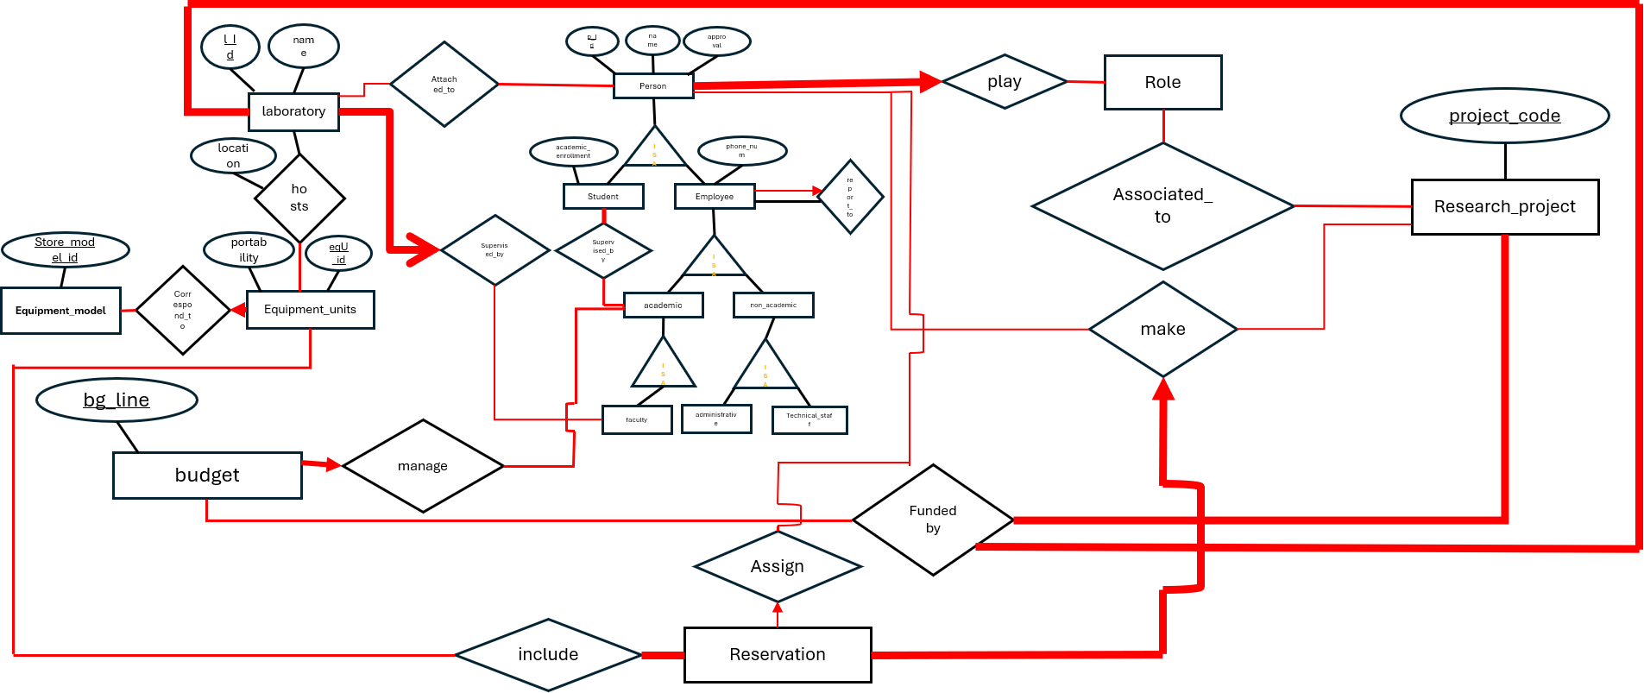
title
code
Certifications and Authorizations
Issue_date
exp_date
certification
Held_By
require

Slide 8
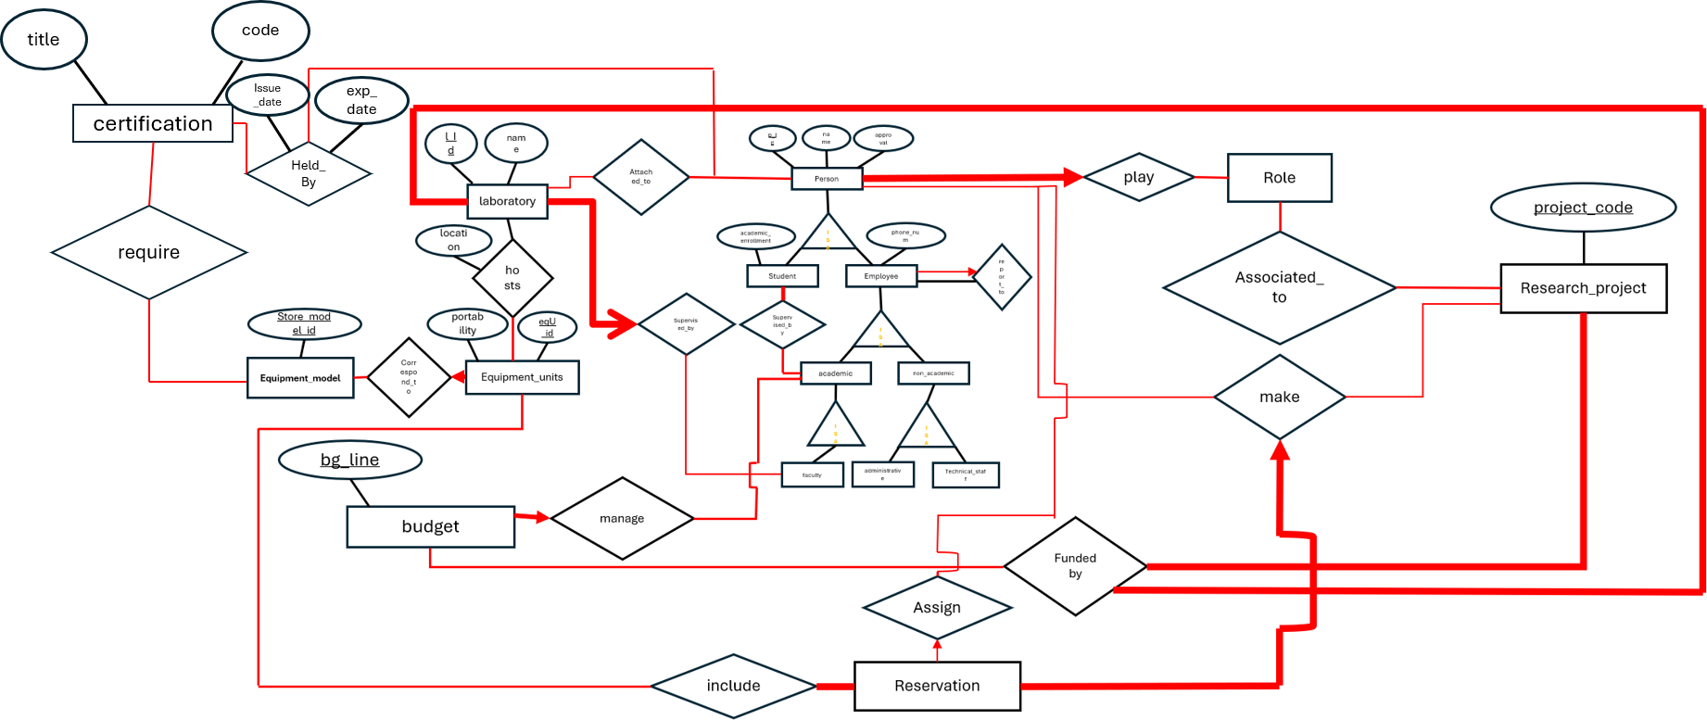
Maintenance & Calibration
Carry_out
start
I
I
I
I
maintenance
date
I
I
I
I
Belongs_to
calibration

Slide 9
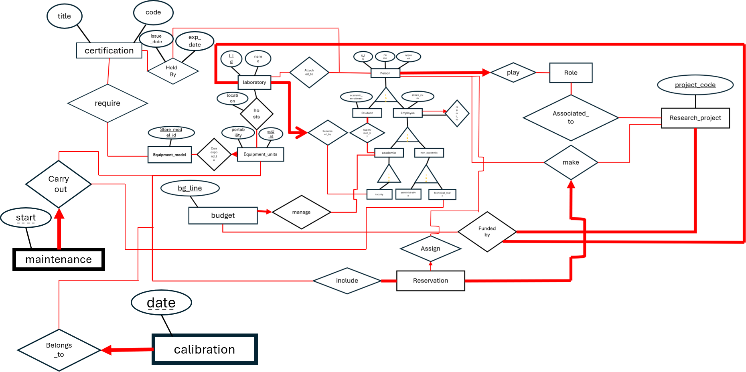
Consumables
Con_Id
Sup_Id
name
name
quantity
Restock_date
purchase
suppliers
use
consumables
supply
Quantity_used
consume

Slide 10
Affiliation
Approuval
End
Start
First_name
Email
Last_name
P_Id
Person

Slide 11
Academic_enrollement
“Student” Inherits from Person :
First_name , last_name, p_Id, Affiliation, Approuval, Email, End, Start.
Student

Slide 12
Phone_number
Position
“Employee” Inherits from Person :
First_name , last_name, p_Id, Affiliation, Approuval, Email, End, Start.
Office_space
Employee

Slide 13
Building
Discipline
L_Id
Name
Room_number
Laboratory

Slide 14
End-date
Project_code
Status
Start-date
Title
Research_project

Slide 15
Money_granted
Budget_end_date
Budgetary_line
Budget_start_date
Amount_disbursed
Budget

Slide 16
Comercial_name
Model_Id
Required_Environment
Manifacturer
Category
Special_training
Equipment_model

Slide 17
Acquisition_date
Purchase_cost
Serial_number
Operational_status
Portability
Equipment_unit

Slide 18
location
I
I
I
I
I
Hosts

Slide 19
Issuing_Authority
Safety_level
code
title
Validity_period
Certification

Slide 20
Issue_date
Expiration_date
Result
Held_by

Slide 21
End
Submisson_times_stamp
Res_Id
Start
Purpose
Status
Reservation

Slide 22
Cost
Description
Start
I
I
I
I
Outcome
Type
End
Maintenance

Slide 23
Result
Next_Due_Date
Type
Date
I
I
I
I
Calibration

Slide 24
Level
Name
Con_Id
Unit_of_measure
Reorder_threshold
Consumables

Slide 25
Name
Phone_number
Email
Sup_Id
Suppliers

Slide 26
Quantity
Restock_Date
Use

Slide 27
Quantity_used
Consume

