Slide 1



Project_Disasters
View in Power BI
Last data refresh:
7/27/2024 11:29:50 PM UTC
Downloaded at:
7/28/2024 12:57:55 AM UTC

Slide 2
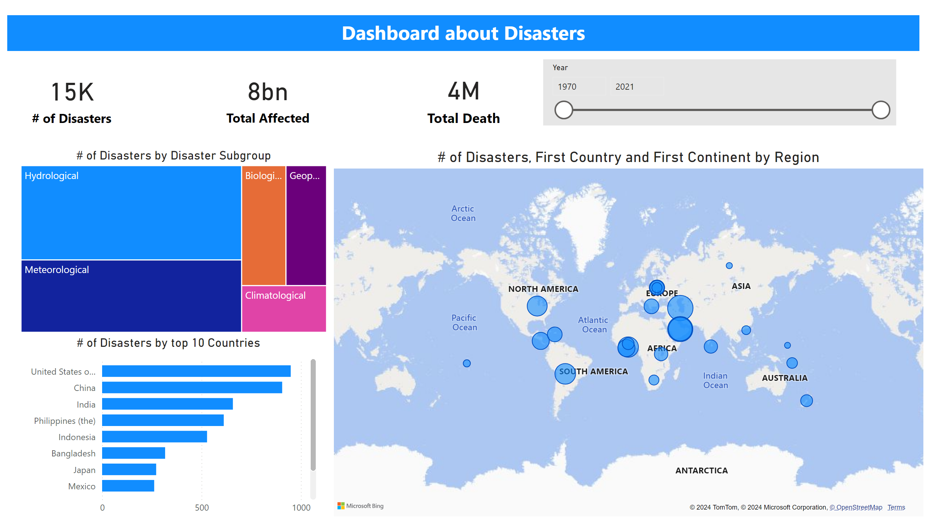
Page 1
Notes:
card
No alt text provided
card
No alt text provided
card
No alt text provided
treemap
No alt text provided
map
No alt text provided
# of Disasters by top 10 Countries
No alt text provided
slicer
No alt text provided
textbox
No alt text provided

Slide 3
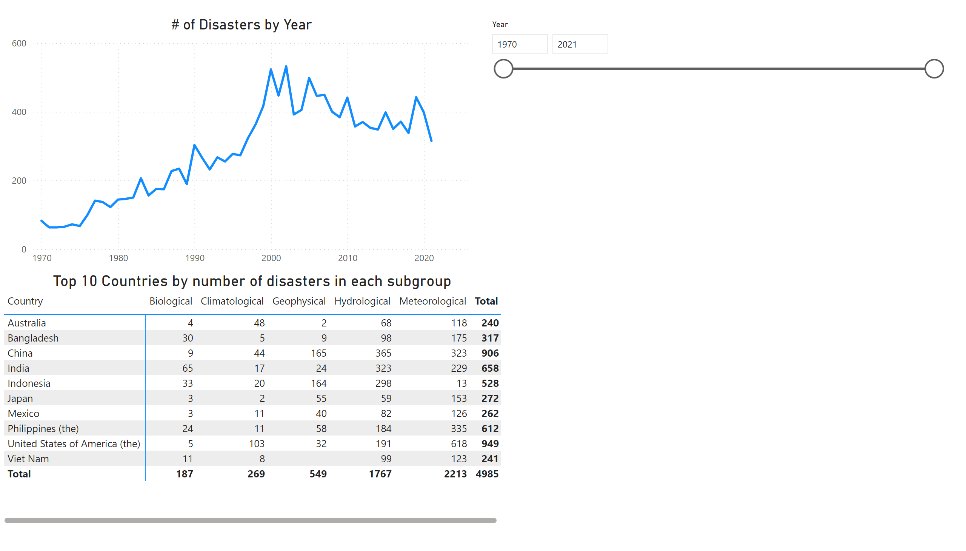
Page 2
Notes:
lineChart
No alt text provided
Top 10 Countries by number of disasters in each subgroup
No alt text provided
slicer
No alt text provided

