Slide 1
California Zoning
Aoun Lutfi

Slide 2
Problem
Develop zones types in the state of California to help classify areas based on housing and venue features

Slide 3
Data
Housing Data from the state of California, which includes the following features:
longitude
latitude
housing median age
total rooms
total bedrooms
population
households
median income
median house value
ocean proximity
Nearby venues for each longitude and latitude pair.
One hot coded, with a count of each venue type for each zone.

Slide 4
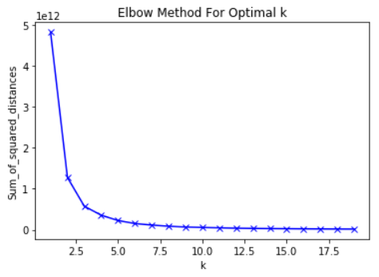
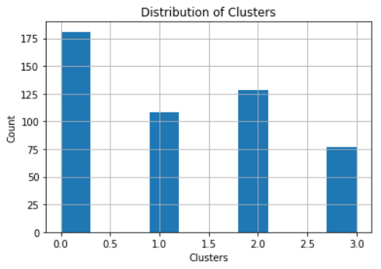
Clustering
K-Means Clustering
Optimal Number of clusters is 4

Slide 5
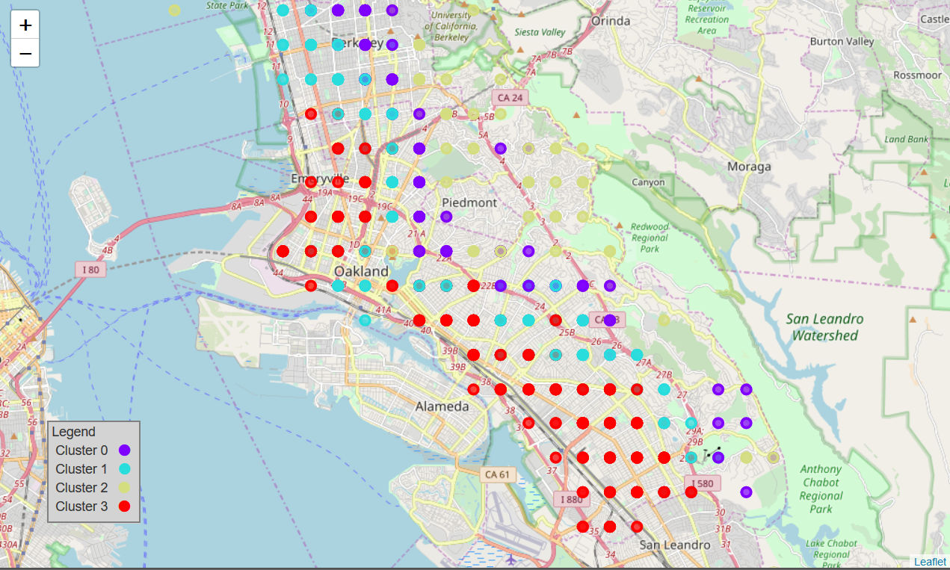
Cluster Map

Slide 6
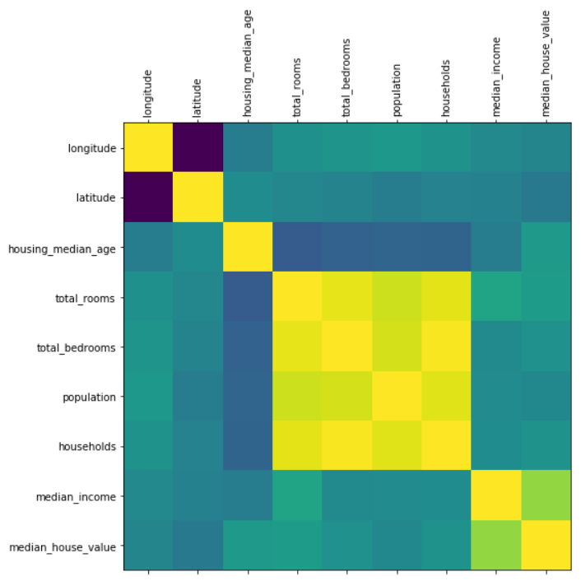
Correlation Matrix
Top Features
Housing Data Correlation
Feature | Correlation with Clusters
median_house_value | 0.751223
median_income | 0.565441
Latitude | 0.471349
total_rooms | 0.230474
Sushi Restaurant | 0.220535
Gift Shop | 0.204207
Trail | 0.195111
Pool | 0.189966
Bagel Shop | 0.185673
Food | -0.215834
Outdoors & Recreation | -0.140647
Nail Salon | -0.132775

Slide 7
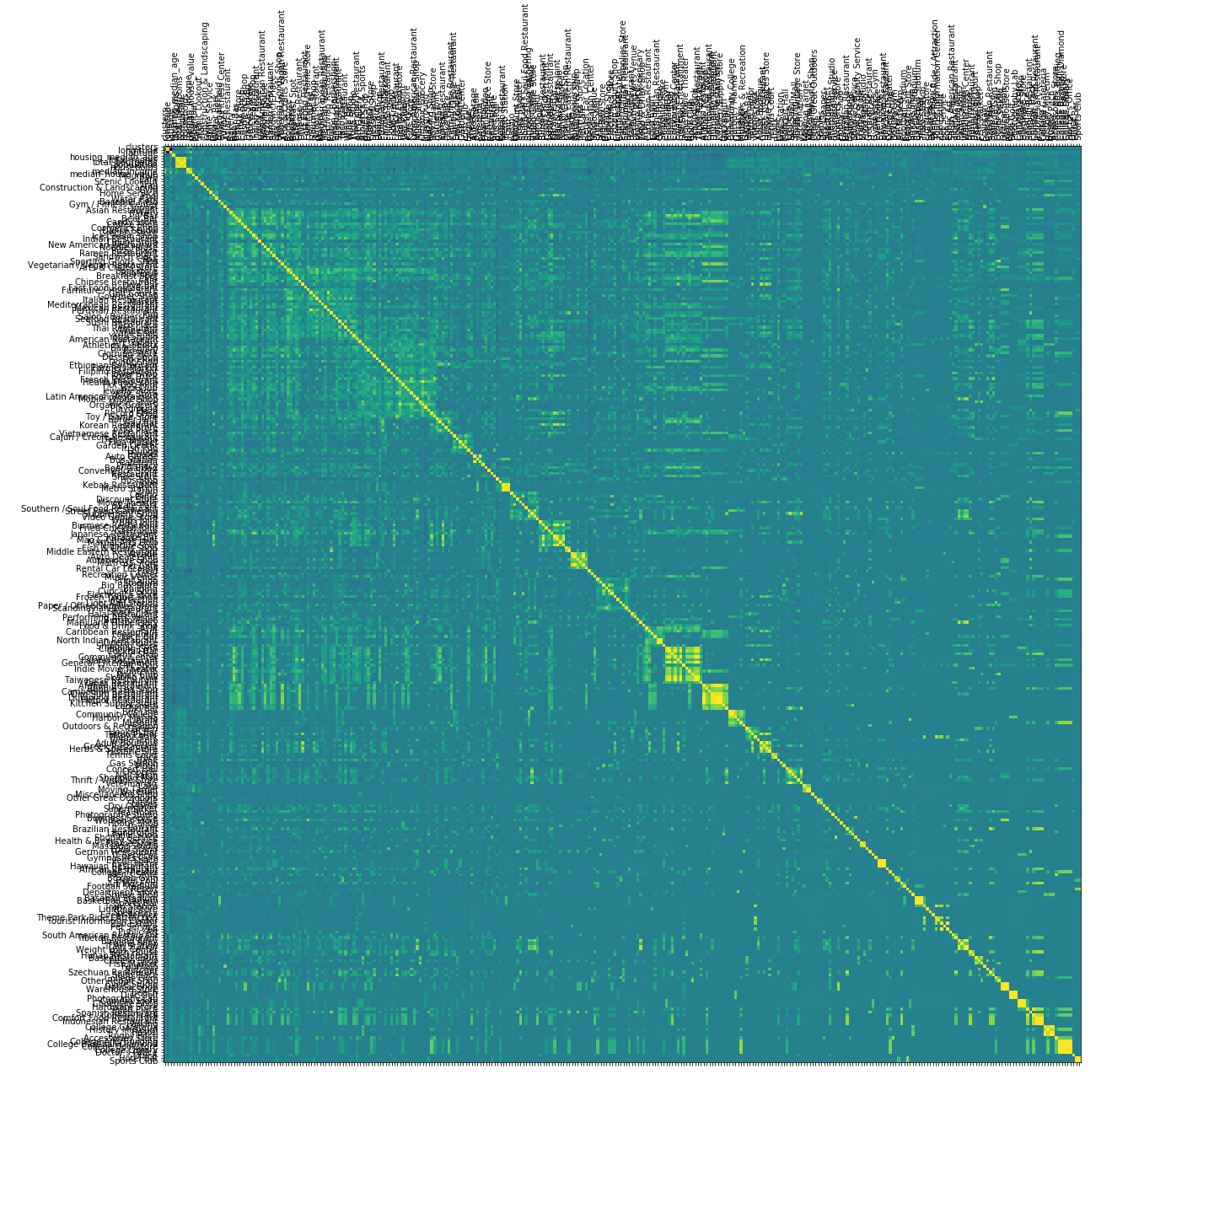
Correlation Matrix
Shows the correlation across all features.

