Slide 1



Slide 2

SAGE - as an acronym for Simple and Adaptative Graphic Engine - is a lightweight JavaScript graphic engine that allows "non-enlightened-to-3D" developers (most known as Web Developers) to embed rich 3D scenes all over the Internet.
Built on an Open Source architecture, it offers additional modules support and provides a community shared repository.

Slide 3
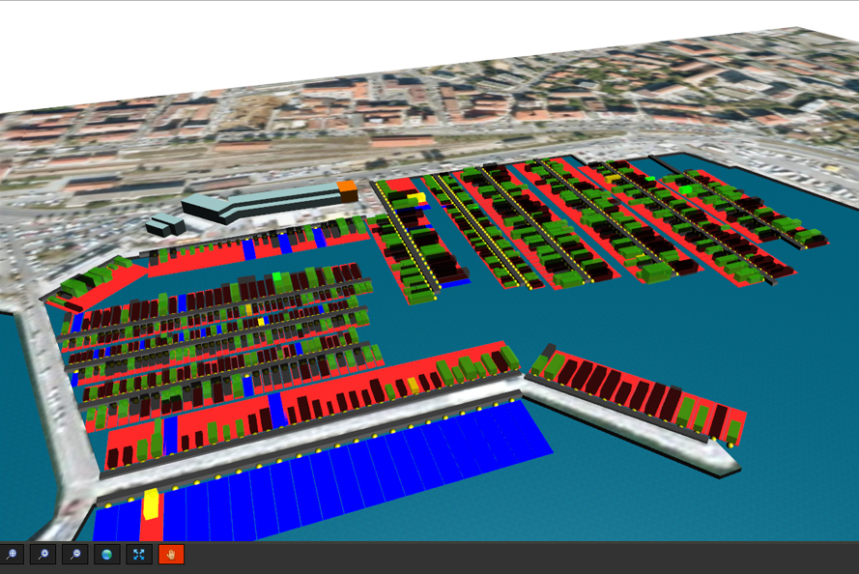
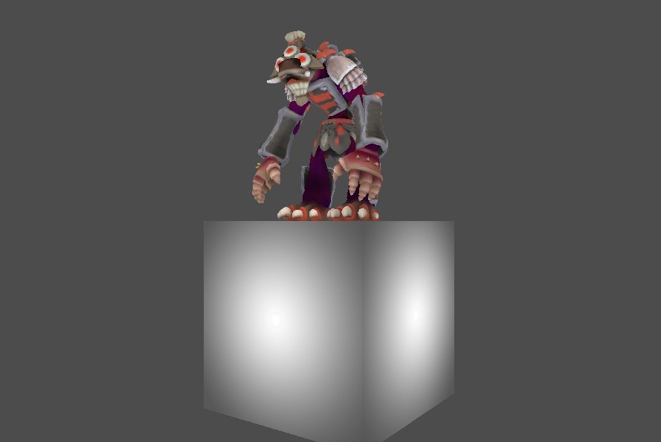
Amahani Demo
Magelan 3D Web App

