Slide 1

Critical Role: a social media analysis
Steven Ruzzin and Ashton Vega

Slide 2
Critical Role background
What is Dungeons and Dragons?
Who is Critical Role?
How are they relevant?

Slide 3
Data Identification and collection
Method
Python, Gephi, and Spyder, Questionnaire
Source
Twitter, Questionnaire
Description
Tweets (time/scope), Network Data,

Slide 4
Business Problem & Approach
What would an online streaming episode-based show need? What would be useful?
Which characters are most prevalent
Which characters are most liked
Who is most active on twitter
Can twitter be used to accurately reflect an episode

Slide 5
Data Analysis tools
Cleaning
Processing
Word Frequency/Wordcloud
Sentiment Analysis
Topic Modeling
Network Analysis

Slide 6
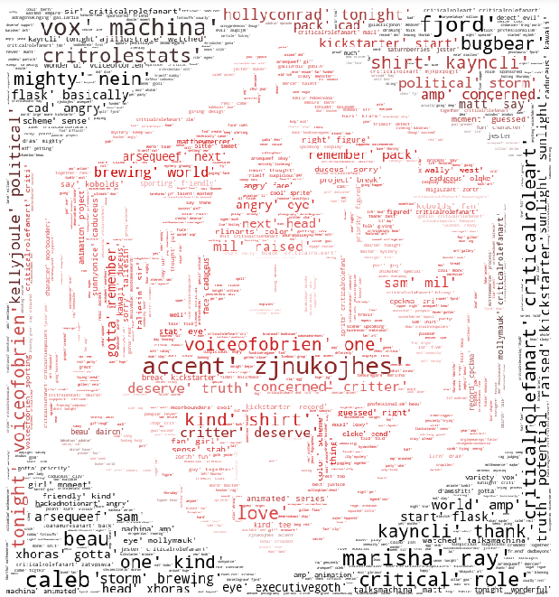
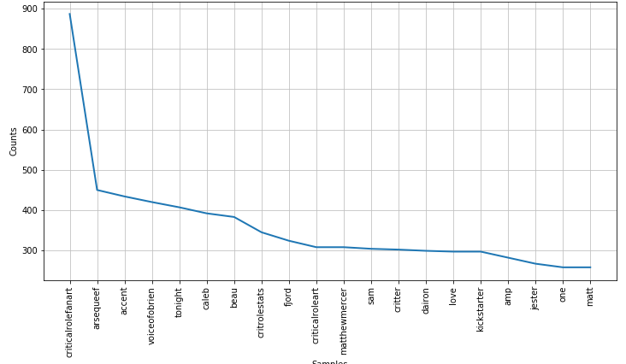
Word frequency and Wordcloud

Slide 7

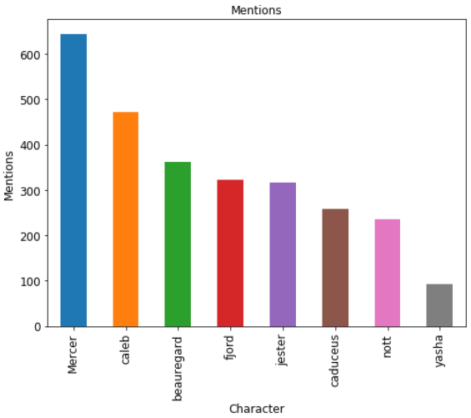
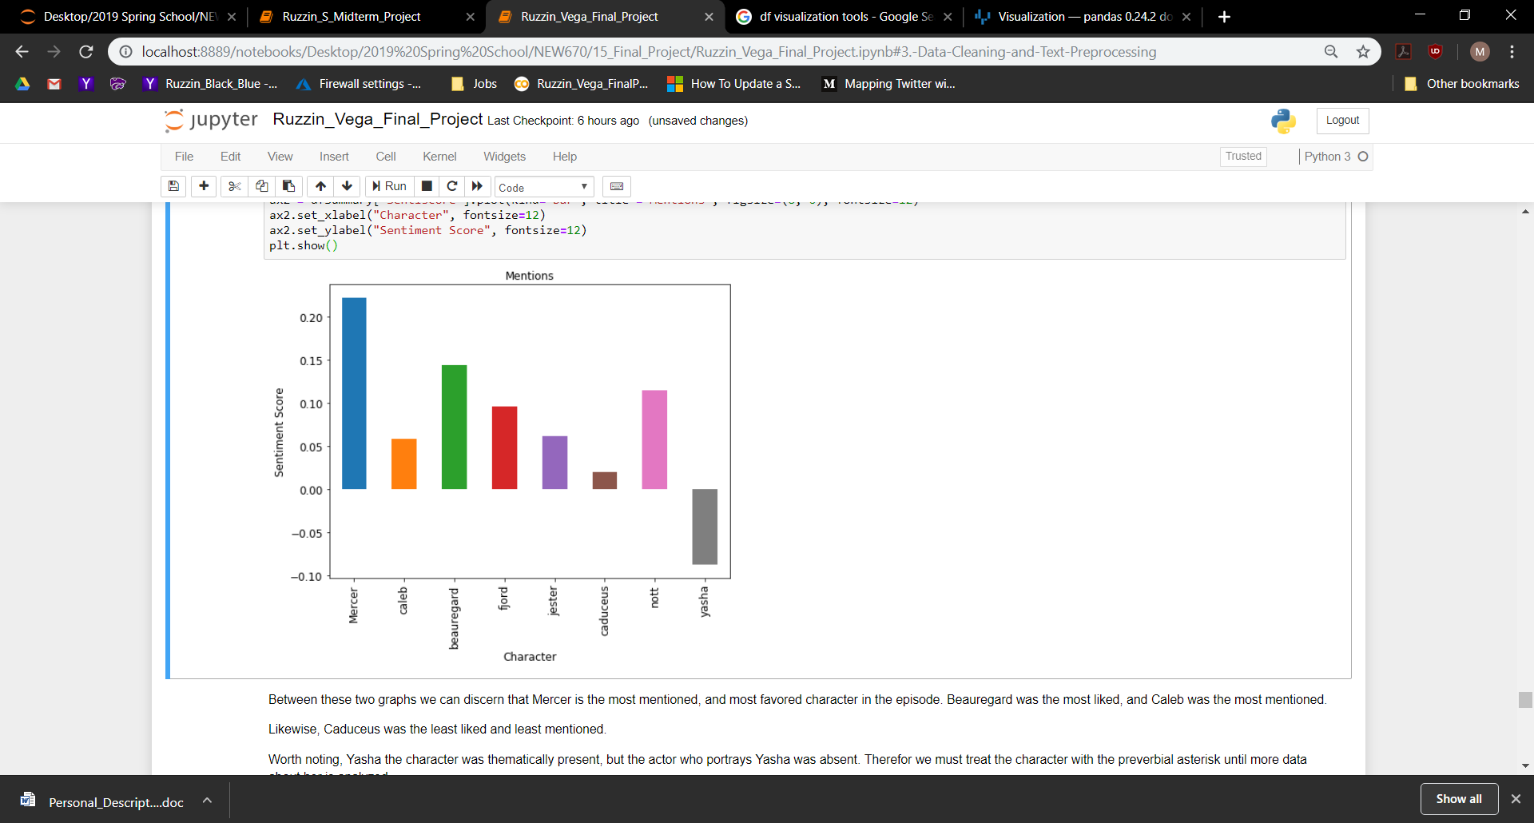
Slide 3 - Findings / Results
Character Sentiment
Character Frequency
User Tweet Count
User Tweets
KatWaterflame 234
Wally_Wests 190
CritRoleStats 180
CritRoleFanart 81
vonnie_bee 75
KyleWithAnN 75
WagonAgeOregons 74
otdderamin 66
Maihel 59
Drgnfly42 54

Slide 8
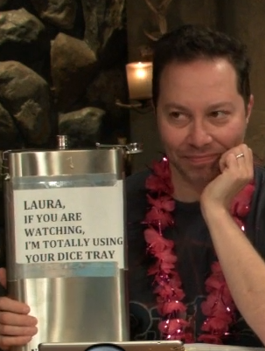
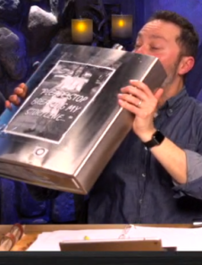
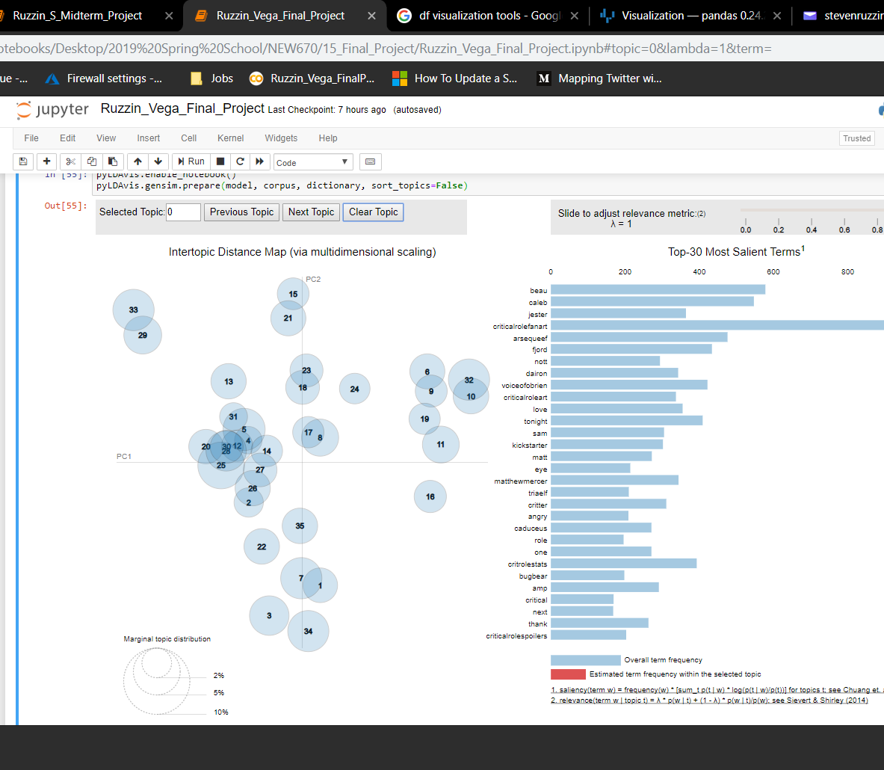
Topic Modeling
Relevant Topics:
Topic0: Caleb's pretending to be bad at accents
Topic2: Sam's Giant Flask
Topic6: The Armless Goblin
Topic8: The Vox Machina Kickstarter
Topic10: Beau's level-up with Dairon
Topic12: Fjord talks with a bugbear
Topic13: The name of the character group

Slide 9
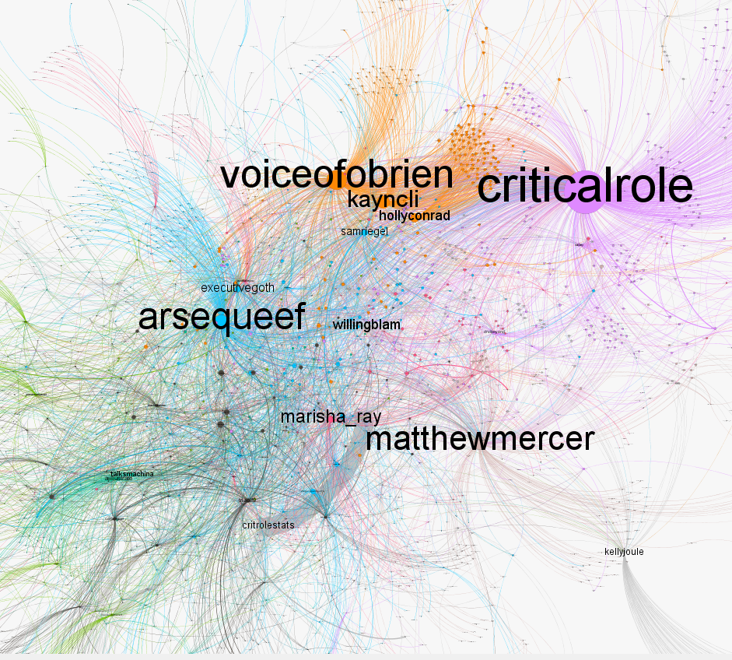
Network Analysis
Most important twitter handles → How do they relate?
CriticalRole
Voiceofobrien
Arsequeef
MatthewMercer
Kayncli
HollyConrad
Willingblam
Marisha_ray
Executivegoth
Samriegel

Slide 10
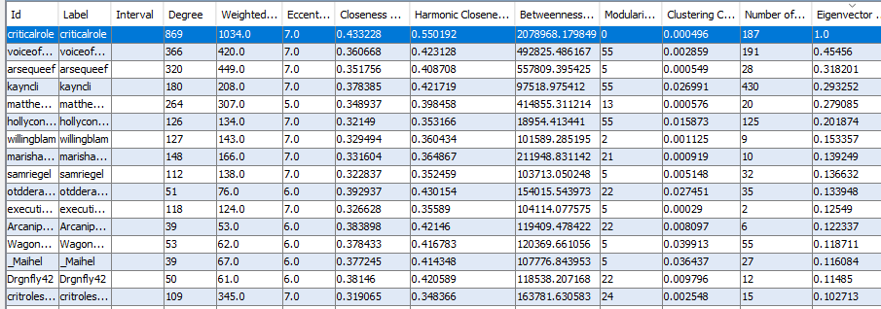
Node & Network-Level Metrics
Values listed in the table to the right → sorted by Eigenvector Centrality
Key/Interesting findings

Slide 11
Conclusions
Questionnaire Results reinforce data results
Mercer the most popular and mentioned
Sentiment and Frequency suggest Beau, Fjord, Nott, and Caleb as most marketable characters
Topic Modeling found several topics that were in the episode
Network Analysis showed…
Limitations/possibilities

Slide 12
Honor Code
S. Ruzzin - On my honor, as a student, I have neither given nor received unauthorized aid on this academic work.
A. Vega - On my honor, as a student, I have neither given nor received unauthorized aid on this academic work.

