Slide 1

Design Strategies for Phones, Tablets, & Desktops
Anthony Overkamp | Engage Software

Slide 2

Thank you to our Platinum Sponsors, and of course our organizers
Queen City DotNetNuke Users Group

Slide 3
Overview
mobile strategy
separate site vs responsive design
responsive web design
Notes:
This discussion is more about the "why" then the "how"

Slide 4


Slide 5
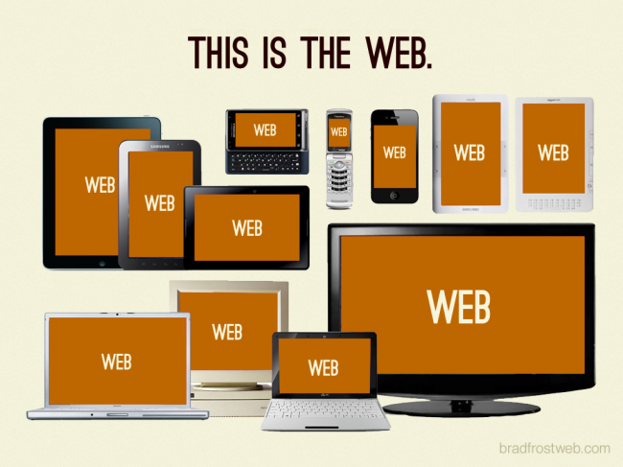

Slide 6


Slide 7
Mobile Strategy

Slide 8
It’s our responsibility to ask the questions
Why?
What’s this project about?
Who’s it for?
What’s in it for the users?
Why a website?
Why an app?
Why do anything at all?
Notes:
Focus! pinpoint what really matters to our users and our businesses. Every product feature, every line of copy, every included script needs to have purpose and needs to be relevant to a growing number of contexts. We need to deliver strong, focused user experiences. Shedding dead weight frees us up to develop core features and content that users really want. And from a user perspective, focused sites and apps offer clarity, faster page loads, and streamlined user experience.

Slide 9

Flow Like water
“If you put water into a cup, it becomes the cup. You put water into a bottle and it becomes the bottle. You put it in a teapot, it becomes the teapot. ”
-Bruce Lee
Notes:
Style flexibly. Understand user context. Take advantage of device capabilities. All these things will help us make the content flow and fill any container, just like water.

Slide 10
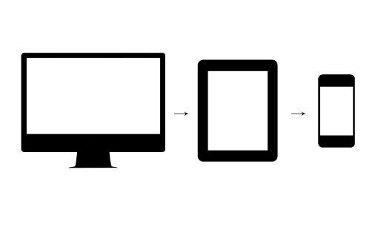
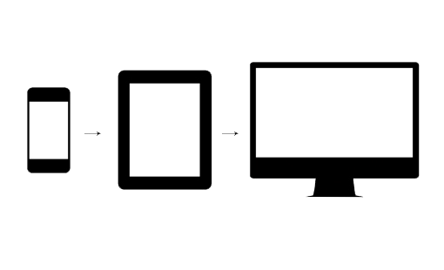
Graceful Degradation vs Progressive Enhancement
Degradation scales back and gradually removes content or features to deal with constraints
Enhancement adds or enhances design for larger platforms with fewer constraints
Notes:
We need to take progressive enhancement further and apply it to things as basic as screen size, bandwidth, JavaScript support, and performance. By abandoning comfortable assumptions, thinking mobile first, and building up a core experience, we’re able to create a solid foundation that can support more platforms while optimizing for the best browsers and devices.

Slide 11
Separate site vs Responsive design

Slide 12
Separate mobile site (vs) Responsive site
may serve your target better
budget, or spring board to new responsive design
speed (faster development)
more focused and specific experience
one content to rule them all (write, edit, manage content all in one place)
future friendly (flexible, easy to maintain and innovate from)
less bloat, less chance a misdirected urls, less chance for failure
forces focus on content, the "what" rather than the "how"

Slide 13
responsive web design

Slide 14
We can't compete with the pace of technology
Fragmenting our content across different "device-optimized" experiences is not a total solution

Slide 15
Research needs of client and their target (what kind of devices will they reach?)
Changes design and development approach (more integrated)
Takes more time, but serves more needs
Accessibility is in the spotlight
Content strategy is very important

Slide 16
Positives (vs) Negatives
more ready for future devices
works well for current devices
cleaner and more precise
more accessible and scalable
more time consuming up front
not all content is really needed on all devices (involves strategy)
implementation is still green, the methods are still growing
redesign & changes can be challenging

Slide 17
Conclusion
Plan to serve up your content, no matter the container or device.
Two approaches, but more importantly, we need to weigh in on who are your users, and their needs.
Responsive design is a new option to consider strongly- lots of pros and cons to weigh carefully against your strategy

Slide 18



Recommended Reading
The Elements of Content Strategy by Erin Kissane
Responsive Web Design by Ethan Marcotte
Mobile First by Luke Wroblewski
http://www.alistapart.com
http://bradfrostweb.com

Slide 19


