Slide 1
Crime Incidents vs. Income Data Exploration and Analysis
Ash Issam
DSC 530

Slide 2
Project analysis slide 6
There is a general understanding that there is higher crime in poorer neighborhoods.
Does this mean that people with lower household incomes are more victimized by crime?
Hypothesis
Hypothesis) People who have lower household incomes are the victims of more crime

Slide 3
Project analysis slide 8
Candidate Variables
Crime Incidents
Age
Total Crime Incidents that the survey respondent says that have been a victim of)
Age of the high school respondent
Household Income
Gender
Reported Household Income in the survey
Gender of the respondent
Location
Whether the respondent is in a rural or urban location
SOURCE
National Crime Victimization Survey

Slide 4
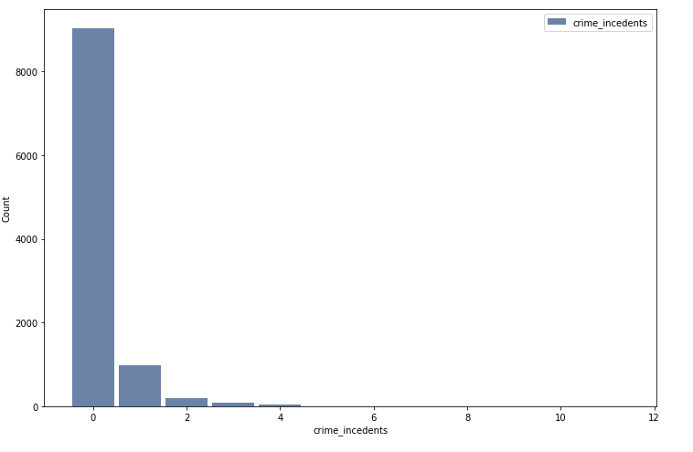
Project analysis slide 5
Crime Victimizations Histogram
Mean
Mode
Standard Deviation
0.05
0
0.3

Slide 5
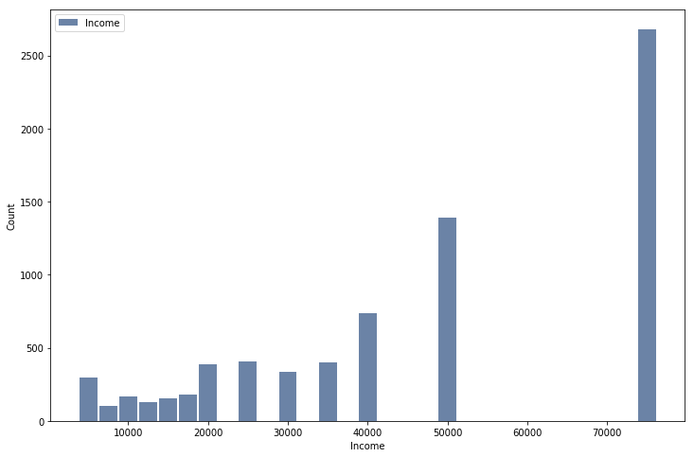
Project analysis slide 5
Household Income Histogram
Mean
Mode
Standard Deviation
47,918
75,000
23,764

Slide 6
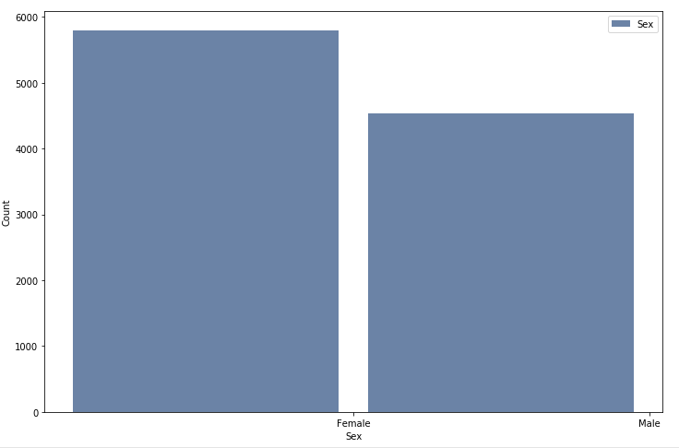
Project analysis slide 5
Gender Histogram
Mean
Mode
Standard Deviation
NA
Female
NA

Slide 7
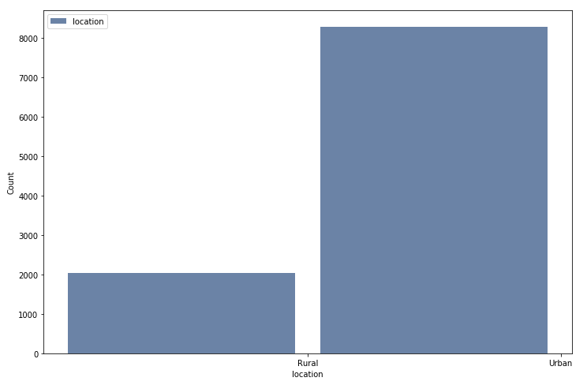
Project analysis slide 5
Location Histogram
Mean
Mode
Standard Deviation
NA
Urban
NA

Slide 8
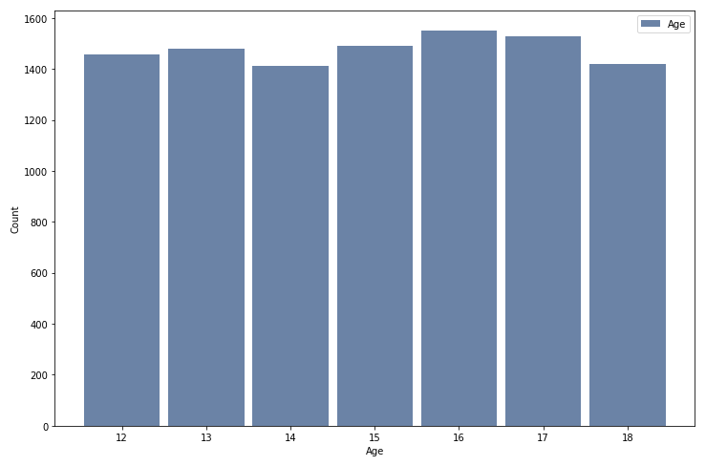
Project analysis slide 5
Age Histogram
Mean
Mode
Standard Deviation
14.9
16
1.98

Slide 9
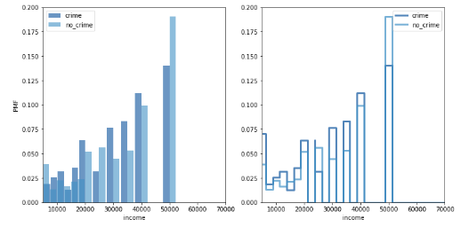
Project analysis slide 10
PMF Of Household Income with crime and no crime
No clear pattern but it does seem that the amount of respondents with crime is higher than without any crime at the $20,000-$40,000 household income level

Slide 10
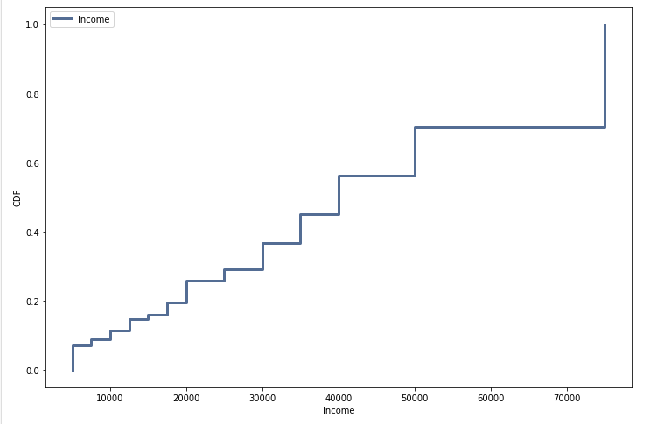
Project analysis slide 10
CDF Of Household Income
As we saw in the distribution about 50% of the respondents are under $45,000 household income

Slide 11
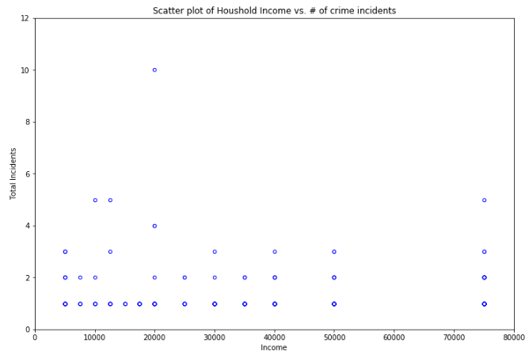
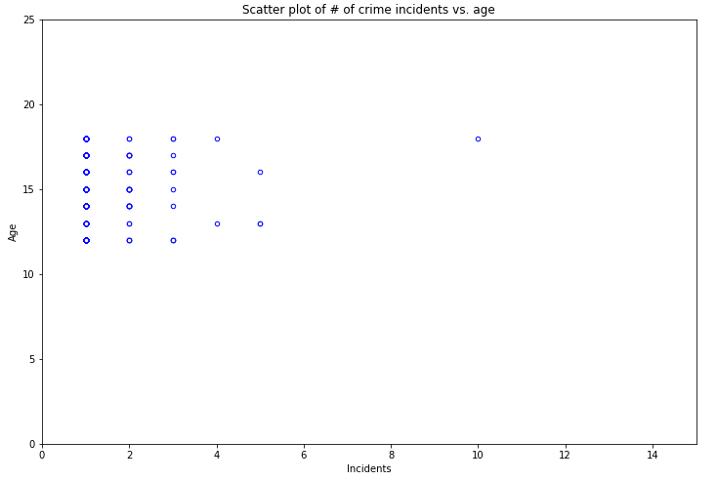
Project analysis slide 10
Scatter Plots
Pearson’s Correlation 0.09
Spearman’s Correlation:-0.06
Pearson’s Correlation 0.02
Spearman’s Correlation:-0.02
These graphs illustrate the relationship between Income and Crime, and income and age.
Both the Pearson’s correlation and the Spearman’s Correlation are clearly really weak correlation with none of the values even close to +-1

Slide 12
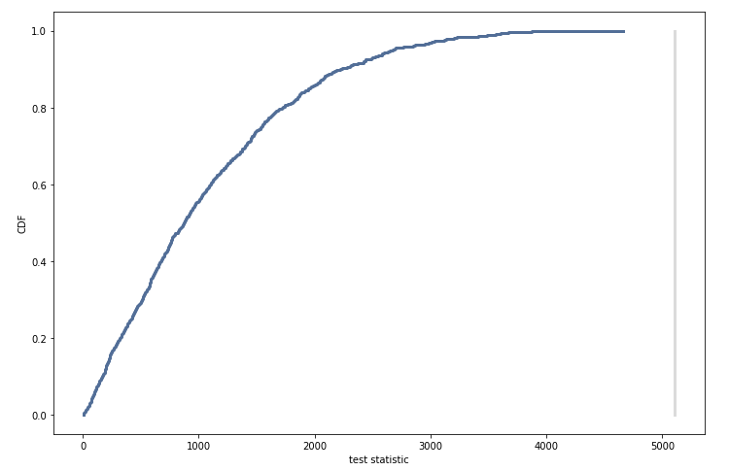
Project analysis slide 10
Hypothesis Testing
This test looks at whether there is a true difference between incomes with crime and without crime in our survey. The CDF does not intersect our line and it means there is not a true difference in this survey.

Slide 13
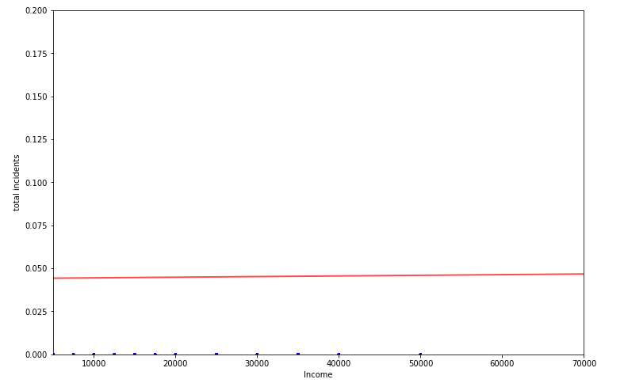
Project analysis slide 8
Regressions
Regression Plot
Regression Results
Output | Value
Intercept | 0.0411
Crime Coefficient | 421
P value for Crime Coefficient | 0.687
R-Squared | 0.0
The result suggests that for every 1 additional crime incident income goes up by $421. This regression is clearly not significant and income is not at all explained by the number of crime incidents in the survey data. The P value is well above .05 and the R-Squared suggests that none of the variation in income is explained by crime incidents. This goes along with the hypothesis testing and the weak correlation.

