Slide 1
Lecture 21
Dispersive medium: Group velocity, Energy Density, Energy velocity

Slide 2
Which speed of light?
1.4
1.5
1.2
n>1
1
1
0.8
n<1
0.6
0.4
0.5
0.2
c
0
0
0
0
0.5
1
1.5
Each frequency has its own refractive index and there therefore its own phase velocity
Plane monochromatic wave starts at infinity and ends at infinity –carries no information

Slide 3
Modulated waves
E
E_{ω}
z
ω₀
ω
Spectrum
Consider modulated light –superposition of two monochromatic waves
E_{ω}
E
Z
ω₁
ω₂
ω
Slow envelope carries information
Slow envelope
fast
Velocity of the envelope –group velocity

Slide 4
Wave packets
In general, the information is being carried by the “wave packets”, i.e. superposition of many plane waves.
If the frequencies are close to each other

Slide 5
Gaussian wave packets
Consider a Gaussian packet of plane waves
Let us see how the packet looks in time domain
envelope
carrier
Linearize the dispersion
Group velocity
Envelope
Add and subtract
Temporal spread
The envelope of the Gaussian packet (bit) preserves its shape and moves with the group velocity

Slide 6
Gaussian Packets
Poynting vector is
S(z,t)
For non-Gaussian pulses
Notice that
and since
Bit stream in the “return to zero” RZ format
This is the uncertainty relation in optics
-between the coordinate and wave vector
You cannot define both of them at the same time
1
0
1
1
0
1
1
1
0
Minimum spread of the pulse

Slide 7
Group velocity dispersion
What if the spectrum of the signal is wide – then we need to include the second derivative
GVD
ω
ω₀
k₀
k
Dispersion length
Make a full square

Slide 8
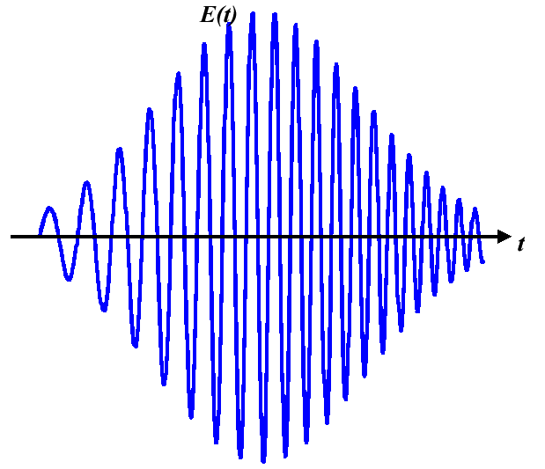
Chirped pulses
Introduce pulse width
The pulse remains Gaussian but the width of it increases with distance.
At one dispersion length it increases by a factor of 2^{1/2}
Find instant frequency
C-chirp parameter

Slide 9
Group velocity vs. Phase velocity
1.5
In the region of normal dispersion the group velocity is always less than c and phase velocity
1
0.5
c
0
0
0.5
1
1.5
Group index

Slide 10
Energy in the dispersive medium
Consider a dispersive material
In the region with ε_{r}<0 (as in metal) we can still have evanescent wave, but what is the energy density?
This makes very little sense – the energy just cannot be negative!
What is wrong? Remember that the expression has been taken from the electrostatics –why should it work at large frequencies?

Slide 11
Poynting vector and rate of energy change
The rate of power transfer from electro-magnetic field to the medium is
Use the Maxwell’s equation
use
use
In general, the energy is only defined relative to some “zero” level hence it is only the change of energy that matters
In the absence of losses (J=0)
In the dispersive medium the dielectric constant is a function of frequency and therefore it is time-dependent and cannot be taken out of the derivative
Rate of change of magnetic energy is
Rate of change of electric energy is

Slide 12
What is electrical energy in the dispersive medium?
Go to frequency domain
Assume some isotropic medium (scalars) and the electromagnetic wave that has finite spectrum
δα
t
ω₀
ω
Envelope:
Now find the derivative of the displacement
For a reasonably narrow range of frequencies δα

Slide 13
What is electrical energy in the dispersive medium?
The only time-dependent term
small
Take all the terms that do not depend on α out of the integrals
Take the inverse Fourier transform and use the fact that
Time averaging over δt>>1/ω₀ (but δt <<1/δα) gives
0
1/2

Slide 14
Energy density in the dispersive medium
Note that even we have a very long time duration and the wave is nearly monochromatic it all stands
In the presence of the dispersion region the electric energy density is
So, here is our answer
Non-dispersive
contribution
Dispersive
Contribution
Example – consider the case of metal
The energy density is obviously positive!
But what is the physical, microscopic picture?
What is
The energy density is the density of kinetic energy of carriers

Slide 15
Energy density in the non-dispersive medium
Time averaged energy density:
This expression is taken from electrostatics
Since
Assume the Lorentz oscillator model
On the microscopic level
ion
ion
+
+
electron cloud
electron cloud
t=0
t=T/4
Each dipole contributes time-averaged energy
“vacuum contribution”
“dipole contribution”
Each electron has both potential (t=0,T/2…) and kinetic (t=T/4,3T/4… energies. Are they properly taken into account?

Slide 16
Dipole potential energy
According to the expression for the non-dispersive medium, each dipole contributes time-averaged energy
Use Lorentz model
The “Spring extension” is
Potential energy of the “spring”
If we are far from the resonance we may assume
Now everything almost makes sense, but what happens close to the resonance?
The unaccounted resonant part of potential energy –it becomes significant only when ω approaches resonance
“static part”
“dynamic part”

Slide 17
Kinetic Energy
“Spring extension”
Velocity
Our dipole is not only a capacitor, but also an inductor (that is why it has resonant frequency)
Kinetic energy
Kinetic energy becomes significant only near the resonance, i.e. in the dispersive region.
In fact, kinetic energy is exactly equal to the “dynamic” part of the potential energy
Total energy of the oscillating dipole

Slide 18
The expression for the total energy
Total energy of the oscillating dipole
Therefore, the total average electrical energy density with dynamic contribution
Re-work the “dynamic term”
“vacuum contribution”
“dipole static
contribution”
“dipole dynamic
contribution”
Exactly the same result as before,
but now we have the microscopic physical picture of it

Slide 19
Energy velocity
Rework the expression for the total energy density
Since
The power flow is
Therefore the energy velocity is
The energy is moving with the group velocity

