Slide 1
Lecture 22
Light Propagation in anisotropic medium

Slide 2
Waves and Fields in the Isotropic medium
Isotropic medium
x
E
D
χ and ε are both scalars
Poynting vector
B
H
k
Model of isotropic medium
y
S
z
e-cloud
K_{x}
K_{y}
Medium’s response does not depend on the direction of applied field

Slide 3
Anisotropic medium
E
P
Medium’s response depends on the direction of applied field
e-cloud
apply
K_{x}
Equations of motion
r
K_{y}
Motion of electron is not parallel with the force
Resonant frequencies
Harmonic field

Slide 4
Susceptibility tensor
y
In general system of co-ordinates
x
e-cloud
K_{x}
Polarization is not collinear with electric field
P
K_{y}
E
Introduce tensor (matrix) of susceptibility
Tensor of dielectric constant

Slide 5
Waves and Fields in the Anisotropic medium
x
D
χ and ε are both tensors
E
P
90°
Displacement is not collinear with electric field
H
k
E,P, and D vectors are all in the xz plane
y
B
S
Poynting vector
z
k, and S vectors are in the xz plane and are not collinear –phase and energy do not propagate in the same direction

Slide 6
Index Ellipsoid
For any tensor it is possible to choose the coordinate system in such a way that it becomes diagonal –this system of coordinates is called principal system and is related to crystal symmetry
x
z
y
Introduce the index ellipsoid as
n_{x}
x
n_{z}
z
n_{y}
y

Slide 7
Uniaxial and biaxial crystals
n
x
(1) Isotropic medium
n
z
n
y
Dielectric constant is a scalar and the index ellipsoid is a sphere
(2)Uniaxial Crystals
ordinary refractive index
extraordinary refractive index
Ellipsoid of revolution
Z-optical axis
(2a) Positive Crystals
(2a) Negative Crystals
n_{o}
x
n_{o}
x
“football”
“muffin”
n_{e}
n_{e}
z
n_{o}
z
n_{o}
y
y

Slide 8
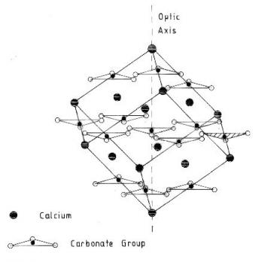
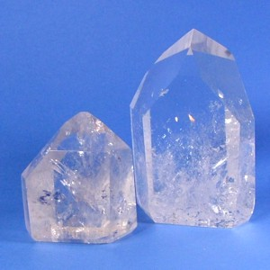
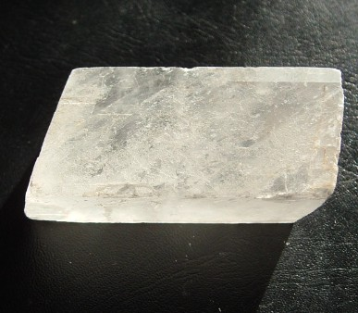
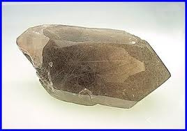
Uniaxial and biaxial crystals (2)
(2a) Positive Crystals
(2a) Negative Crystals
Quartz (SiO₂) n_{o}=1.5427 n_{e}=1.5518
Calcite (CaCO₃) n_{o} =1.6629, n_{e} =1.4885
Rutile (TiO₂ ) n_{o} =2.616, n_{e} =2.903
Sodium Nitrate (NaNO₃) n_{o}=1.5854 n_{e}=1. 3369
(3) Biaxial crystals

Slide 9
Wave equation in uniaxial crystals
y
D
E
Outer Product
β
90°
x
Vector k is in yz plane
90°
B,H
β-walk-off angle
90°
θ
k
z
β
S
Optical Axis
In anisotropic medium

Slide 10
Wave equation in uniaxial crystals
This is our wave equation for vector E, or, rather 3 equations for its 3 projections
This equation has non-trivial solution if the determinant of the matrix is equal to 0
Characteristic, or dispersion, equation for the 3 components of wavevector k
In uniaxial crystals we can assume k_{x}=0 without the loss of generality

Slide 11
Ordinary and extra-ordinary waves
k_{x}=0
Wave equation
splits into two equations that must be satisfied simultaneously
Ordinary wave
Extraordinary wave
Ordinary wave –polarized along x –normal to optical axis
Therefore, only the trivial solution

Slide 12
Ordinary waves
y
k_{x}=0
B,H
D
x
D||E
E
90°
θ
k
z
S
k||S
Optical Axis
No walk-off
Notice that in ordinary wave electric field is normal to wave-vector

Slide 13
Extra-ordinary waves
Nontrivial solution –determinant is equal to 0
Dispersion Equation
Divide by
Polar coordinates
k_{y}
k_{e}
Let us find polarization of the extraordinary wave
(we know that it is in yz plane…but what is the angle?
It is not simple because E is not normal to k
k
k_{o}
θ
k_{z}

Slide 14
Extra-ordinary waves (2)
k_{y}
k_{e}
k
k_{o}
θ
k_{z}
D
y
E
S
x
walk-off angle
k
β
φ
θ
H,B
z
Special cases
In these 2 cases E⊥k and there is no walk-off

Slide 15
Normal surface
Refractive index of the ordinary wave
Refractive index of the extraordinary wave
Graphic solution:
For the ordinary wave plot sphere
For the extra-ordinary wave plot ellipsoid
Draw direction k – intersections are the two indices
y
k
n_{ord}
n_{ext}
y
k
x
n_{ord}
SiO₂
n_{ext}
x
θ
n_{o}
CaCO₃
z
θ
n_{o}
z
Normal surface for positive crystal –a sphere inside a muffin
Normal surface for negative crystal –a football inside a sphere
n_{e}
n_{e}

Slide 16
Two Special Cases
The sphere and ellipsoid touch each other at θ=0;
(1) θ=0; n_{ext}= n_{ord} = n_{o} Light propagates parallel to the optical axis, therefore no matter how it is polarized the index is n_{o}
y
E_{ext}
n_{o}
x
no walk-off
E_{ord}
z
k S
n_{o}
(1) θ=π/2; n_{ext}= n_{e}; n_{ord} = n_{o} Light propagates normal to the optical axis, therefore there are two possible directions of polarization – either normal to axis(ordinary) or parallel to it (extraordinary)
y
k S
x
n_{e}
Again no walk-off
E_{ord}
E_{ext}
z
n_{o}

Slide 17
Finding the indices
The most simple way to find the ordinary and extra-ordinary indices
Consider index ellipsoid
Plot direction of wavevector
x
n_{o}
x'
Intersection of the plane normal to k and index ellipsoid is ellipse with half-axes n_{o}and n_{ext}(θ)
D_{ext}
D_{ord}
n_{e}
θ
z
n_{o}
y
k
n_{ext}(θ)
x'
Two half-axes are two indices and also directions of D vectors
D_{ext}
D_{ord}
n_{o}
y

Slide 18
Phase and group velocities
k_{y}
k_{e}
v_{g}
Normal surface equation can be written as
v_{p}
k
k_{o}
k_{z}
Equation of the surface of constant frequency (isofreqeuncy surface) –all points have the same frequency
Phase velocity
Group velocity
This vector is normal to the surface of constant frequency
The group velocity is different from the phase velocity (both magnitude and direction) just because of birefringence, even if the medium is not dispersive

Slide 19
Energy velocity
Here we assume that dielectric constant is not dispersive, and still we shall get that energy velocity is equal to group velocity
Energy density is
Poynting vector is
Maxwell’s equations
If frequency changes by small amount δω then all other variable, except ε and μ also change, so we differentiate Maxwell’s equations
Perform scalar multiplication
Use
and
Since tensors ε and μ are symmetric
and

Slide 20
Energy velocity
Energy density is
Poynting vector is
Maxwell’s equations
(1)
(2)
Subtract (1) from (2)
We are left with
S
Energy moves with the group velocity!

Slide 21
Double refraction at the boundary
Snell’s law
θ_{i}
n₁
Optical axis
Index depends on polarization which depends on transmission angle that depends on index….-nonlinear transcendental equation (can be solved iteratively)
θ_{t}
n₂( )
Graphic solution for uniaxial crystals -easy

Slide 22
Double refraction at the boundary
Expect two separate solutions –ordinary and extraordinary draw the intersections of normal surfaces with the plane of incidence.
θ_{i}
n₁
k_{i}
k_{o}
Ordinary
Extraordinary
k_{o}
θ_{to}
θ_{te}
k_{e}
k_{ext}(θ_{te})
Snell’s law
Intersection with the ordinary normal surface yields ordinary wavevector
Optical axis
n₂( )
Intersection with the extra ordinary normal surface yields extraordinary wavevector
Normal to the surface will give us direction of group velocity and energy flow – ray vector
The situation is more complicated when it comes to determining Fresnel coefficients because outside we have s and p waves and inside ordinary and extraordinary waves – two different systems of coordinates – hence there are no two independent solutions for reflectivity and transmission – solution is an elliptically polarized wave

Slide 23
Special cases
θ_{i}
(A) Optical axis is in the interface plane and plane of incidence
s-wave outside becomes ordinary inside
k_{o}
k_{e}
p-wave outside becomes extraordinary inside
Optical axis
Notice that p wave is bent less (ray vector is what you see)
θ_{i}
(B) Optical axis is normal to the interface
s-wave becomes ordinary inside
k_{o}
p-wave becomes extraordinary inside
k_{e}
Notice that p wave is bent more (ray vector is what you see)
Optical axis

Slide 24
Special cases
θ_{i}
(C) Optical axis is normal to the plane of incidence
s-wave becomes extraordinary inside
k_{o}
p-wave becomes ordinary inside
k_{e}
Optical axis
No walk-off
(D)Normal incidence and Optical axis is in the plane of figure
s-wave becomes ordinary inside
k_{o}
p-wave becomes extraordinary inside
Since angle of incidence is 0 both waves have ther k-vectors along the normal
But the ray vector of e-wave is directed away from the normal –double refraction!
Optical axis

Slide 25

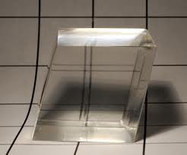
Double refraction

Slide 26





Polarized light and double refraction for navigation
Light coming from the sun is polarized in the plane normal to the light ray
Light scattered forward is not polarized
Light scattered at 90 degrees is vertically polarized
Light scattered at arbitrary angle is partially polarized

Slide 27
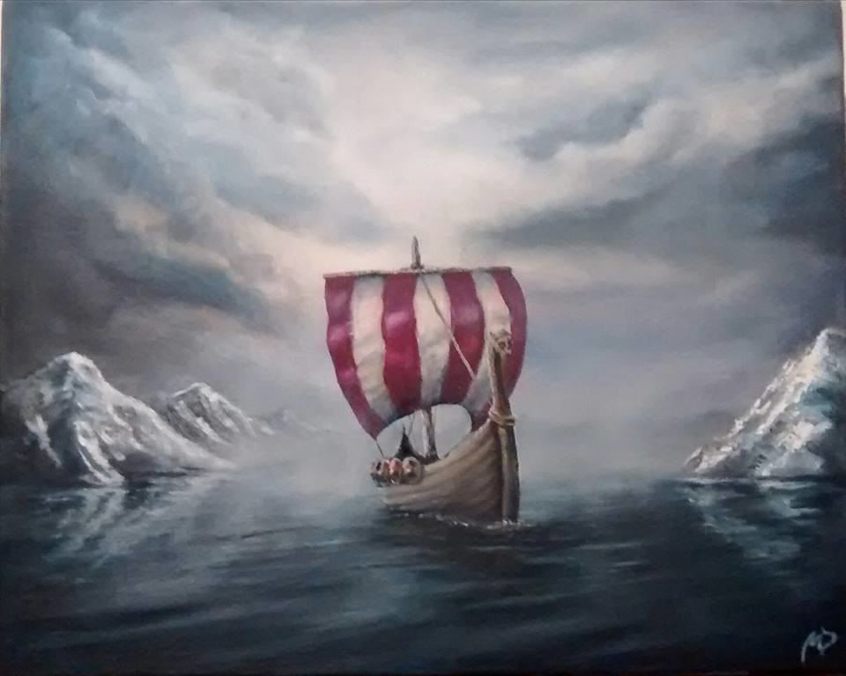
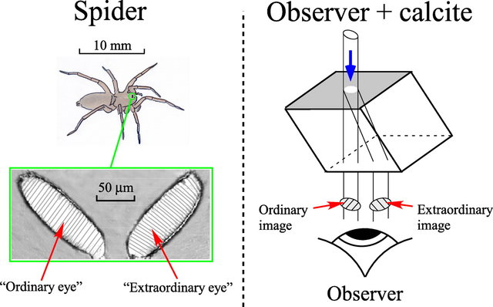
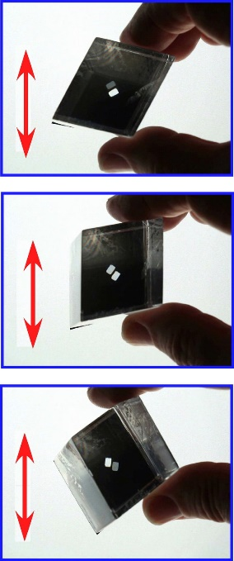

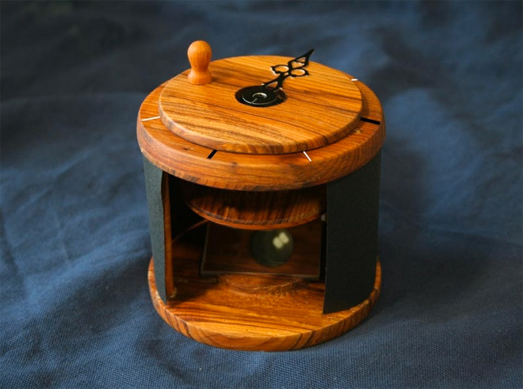
Polarized light and double refraction for navigation
Use calcite – Icelandic Spar to obtain a double image of some object , typically an aperture
Viking ship – the sky is very cloudy but for navigation one needs to fins the exact position of sun
In general, because the scattered sunlight coming from the sky is partially polarized two images have different brightness, but when the direction normal to the face of the crystal points to the sun, the incoming line is not polarized and two images have equal brightness.
10’th Century!
Replica of the Vikings’ device

