Slide 1
Lecture 23
Polarization Optics

Slide 2
Jones Vectors
y
E
Represent electric field for a given direction of a ray vector s
as a column vector
E_{y}
x
E_{x}
S
Or better in a normalized form
z
Jones vector with generally complex components
Linearly polarized light
Horizontally polarized
Vertically polarized
y
y
y
θ
x
x
x

Slide 3
Circular Polarization
y
-
+
E₀
Consider the wave that can be described as
E_{y}
x
E₀-real
E_{x}
“-” wave rotates clockwise –right circularly polarized
S
“+” wave rotates counterclockwise –left circularly polarized
z
Right polarized light
Left polarized light
Relation between circular and linear polarizations
y
y
x
x
Orthogonality

Slide 4
Elliptical Polarization
y
-
E_{oy}
+
E
Consider the wave that can be described as
E_{y}
E_{ox}
E₀-real
x
E_{x}
S
Jones vector
z
Here we have half-axes oriented along x and y
More generally the axes can be rotated by angle Ψ
y'
y
-
+
E
x'
Ψ
x

Slide 5
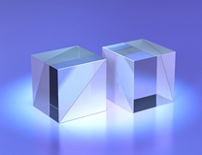
Producing polarized light using Fresnel reflection
Using Brewster angle
Good for high power lasers
If we create a stack of thin layers that have a Brewster angle corresponding to 45 degrees incidence angle
Polarizing beamsplitter cube

Slide 6
Wire polarizers
Consider wire grid polarizer in microwaves
E_{y}
a<<λ
Vertical conductivity is much larger than a horizontal one. In other words, imaginary part of vertical dielectric constant is larger than the horizontal one. Vertically polarized component interacts with electrons in wires and gets absorbed, while the horizontal component passes “unmolested”
θ
E_{x}
E_{x}
z
The polarizer can be characterized by the Jones matrix
Apply it to the arbitrary linearly polarized light

Slide 7
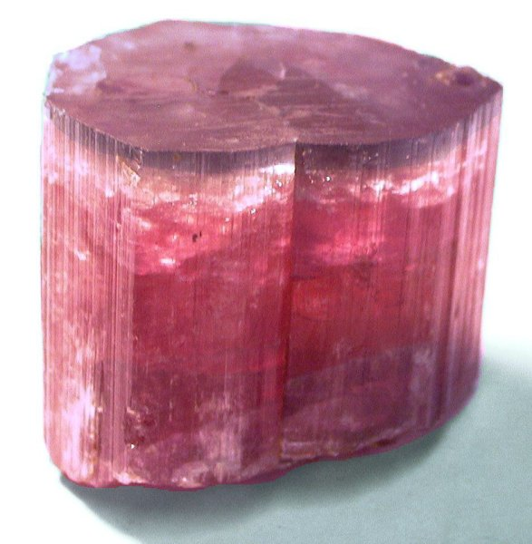
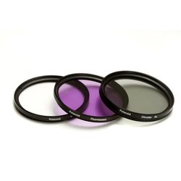
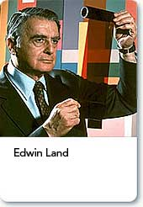
Tourmaline, Polaroid film, and other Dichroic polarizers
In optical range we need very thin sub-wavelength wires –look for the material with a natural fibrous structure
Tourmaline contains Al₂O₃, B₂O₃, and SiO₂
Polaroid – long chains of hydrocarbons with iodine supplying electrons that can move along these long chains
1909-1991

Slide 8
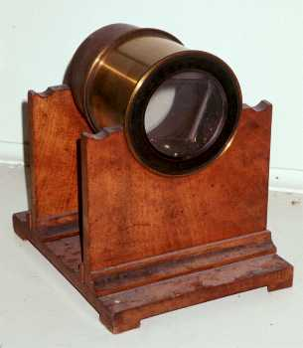
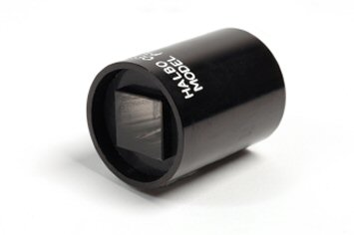
Polarizers based on double refraction and total internal reflection
(1) Nicol Prism
CaCO₃ (n_{o}=1.658; n_{e}=1.486)
O.A.
Extraordinary ray goes through
68°
Ordinary ray is TIR’d and then absorbed
Canada Balsam n=1.55
Problems: narrow field of view, light is partially elliptically polarized due to inclined face
(2) Glan Thompson Prism
O.A.
Field of view is larger but the polarizer is quite long

Slide 9
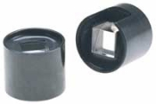
Polarizers based on double refraction and total internal reflection
(3) Glan-Foucault (or Glan Air) Prism
CaCO₃ (n_{o}=1.658; n_{e}=1.486)
Use calcite-air interface
Critical angle for the ordinary ray
θ
O.A.
Critical angle for the extraordinary ray
Need apex angle
Typically θ=39°
Advantage –small size and good aspect ratio
Disadvantage –narrow field of view ~8°

Slide 10
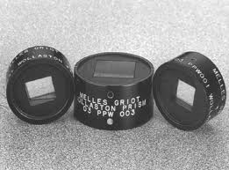
More polarizers
(4) Wollaston Prism
O.A.
No air gap – different orientation
O.A.
Horizontally-polarized ray – from high ordinary index into low extraordinary index
Vertically-polarized ray – from low extraordinary index into high ordinary index

Slide 11

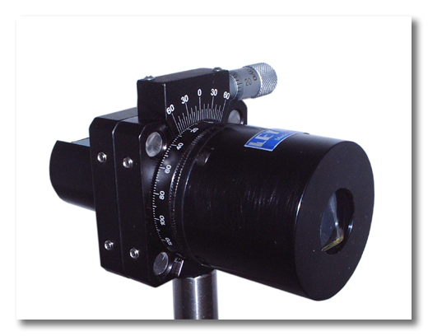
Malus law
Consider two polarizers whose directions of polarization are rotated by angle θ (without loss of generality we assume the first polarizer to produce horizontally polarized light
θ
Étienne-Louis Malus (1775-1812)
Total matrix
Assuming that the input light is not polarized
Variable laser attenuator- two polarizers, one of which is rotated

Slide 12
Retardation plates
Retardation plates are phase-shifting devices capable of turning linearly polarized light into circular/elliptical one and vice versa. To take advantage of maximum birefringence the optical axis us parallel to the face
s
s-slow axis (larger refractive index)
z
f-fast axis (smaller refractive index)
f
Phase retardation for the slow component
d
Phase retardation for the fast component
If the incoming light has polarization state
The output polarization state is

Slide 13
Half and Quarter Waveplates
Jones Matrix
(A) Half-wavelength plate
Reverses phases of s and f components
(B) Quarter-wavelength plate
Introduces 90 degrees shift between s and f components

Slide 14
Rotated Waveplates
Jones Matrix describes Retardation plate in s-f coordinates but we need to use it in x-y coordinates, rotated by an angle Ψ
To transform Jones vector from x-y system to s-f system use rotation matrix
y
E
f
s
Ψ
x
Similarly
Consider retardation plate in x-y coordinates

Slide 15
Waveplates rotated by 45 degrees
Consider Plate rotated by 45 degrees
y
s
45°
z
x
f
d
Consider retardation plate in x-y coordinates

Slide 16
Half Waveplates rotated by 45 degrees
y
Consider λ/2 Plate rotated by 45 degrees
s
45°
z
x
f
λ/2
Consider horizontally polarized input wave
Polarization is rotated 90 degrees
y
Consider circularly polarized input wave
s
45°
z
x
f
Helicity is reversed
λ/2

Slide 17
Quarter Wave Plates rotated by 45 degrees
y
Consider λ/4 Plate rotated by 45 degrees
s
45°
z
x
f
λ/4
Consider horizontally polarized input wave
Linearly polarized light becomes circularly polarized
y
Consider circularly polarized input wave
s
45°
z
x
f
Circularly polarized light becomes linearly polarized
λ/4

Slide 18
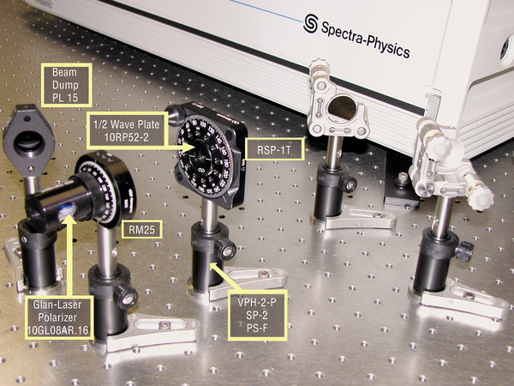
Variable optical attenuator based on rotating HWP
y
Consider a HWP rotated by an arbitrary angle ψ relative to horizontal axis
s
ψ
z
x
f
d
Place the wave plate between two horizontal polarizers
So the transmittance is proportional to

Slide 19
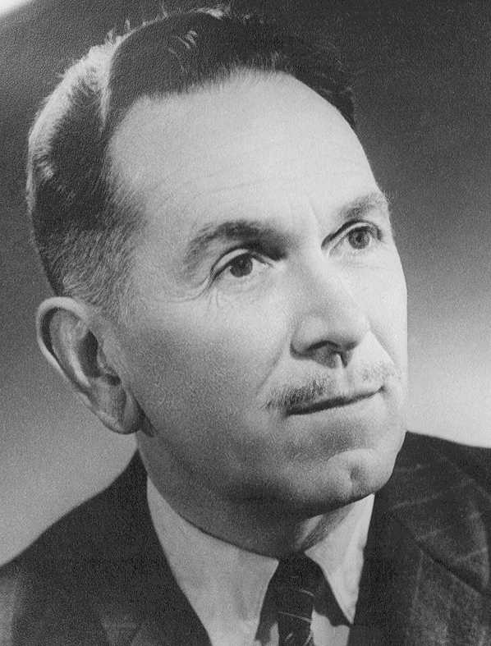
Lyot filter
Consider a transmission spectrum of a retardation plate of N-th order designed to be a Full WP for the wavelength λ₀ placed between two polarizers and rotated 45 degrees.
Jones matrix is
Transmission is
Let us make a sequence
Filter combines narrow pass band with wide free spectral range (FSR)
Filter can be tuned electrically
d
2d
4d
2^{m}d
Transmission is a product of transmissions of stages
BERNARD LYOT
1897–1952

Slide 20
Šolc Filter
Consider a HWP rotated by an arbitrary angle ψ relative to horizontal axis
y
E_{out}
s
ψ
θ
θ₁
x
z
f
Incoming light is polarized at angle θ
λ/2
Output field is
y
Polarization rotated by the angle
E_{out}
f
θ₁
s
E_{in}
ψ
Polarization direction is “reflected” from the fast axis
θ
x

Slide 21
Šolc Filter
y
s
ψ
s
x
ψ
s
-ψ
s
f
ψ
z
-ψ
f
f
λ/2
s
-ψ
s
f
f
N pairs of HWP’s rotated alternatively by +ψ and -ψ relative to the horizontal axis
f
If we start with horizontally polarized light here is how its polarization rotates:
after the 1st plate θ₁=2ψ
after the 2nd plate θ₂=-4ψ
after the 3nd plate θ₂=6ψ
…..
after the N^{th} plate θ_{N}=(-1)^{N-1} 2Nψ=-π/2
Light is now vertically polarized!
+ψ
-ψ

Slide 22
Šolc Filter
For different wavelength HWP is not HWP,
Transmission
N=20
N=10
Frequency λ₀/ λ

Slide 23
Polarization controllers
In order to transform one elliptical polarization to another one need to control two independent parameters in Jones vector – relative amplitude and phase
In principle two birefringent elements can do the job, but usually one uses a combination of 3 elements QWP followed by HWP followed by another QWPThe plates, and hence directions of s and f axes can rotate.
λ/4
λ/2
λ/4
The first QWP transforms elliptical polarization into linear
The HQP rotates linear polarization
The second QWP (if necessary) transform linear polarization into another elliptical

Slide 24
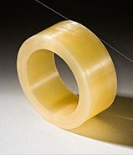
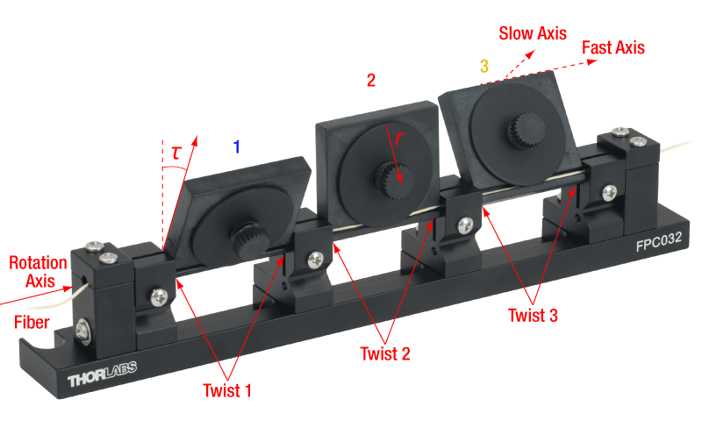

Birefringence in optical fibers
When optical fiber is bent the cylindrical symmetry is no longer maintained and the fiber becomes birefringent with two orthogonal modes propagating corresponding to slow and fast waves in the crystal
s
f
Therefore, fiber coil can serve as waveplates .
3 paddles (or “bat ear”) polarization controller .

Slide 25
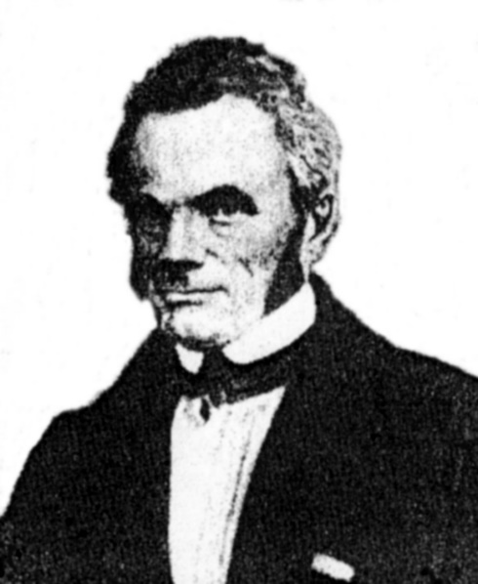
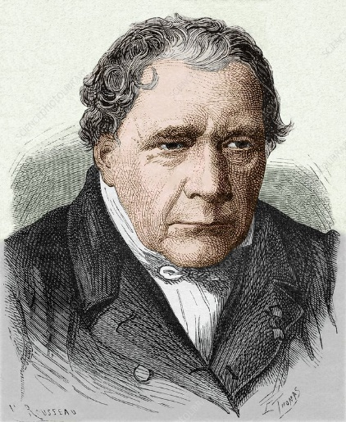
Babinet and Soleil Compensators
They are essentially variable waveplates and can be N=1 order without being too thin
d1
d1
d2
d2
Jean-Baptiste-François
Soleil 1798-1878
Jacques Babinet
1794-1872

Slide 26
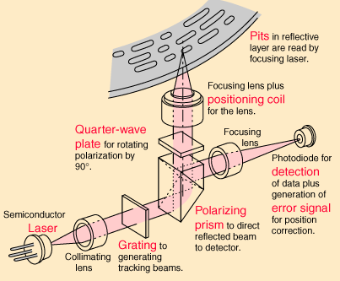
Optical Isolation
One wants to direct all the reflected light onto the detector and keep it from the laser itself (parasitic feedback)
Laser is linearly polarized
Detector
After one pass through λ/4 plate
Reflector –changes left to right
Laser
H
Since when we go back y changes sign
H
V
λ/4
After the second pass through λ/4 plate
L
R
Two passes through λ/4 are equivalent to one pass through λ/2
Ref

Slide 27
Anti-Glare Screen
Consider now the situation when the incoming light is not polarized
V
All the straight light gets absorbed
λ/4
Ref
R
L
H
Faceplate
What about the unpolarized light that is emitted ?
Emitting layer
Randomly-polarized light is still randomly polarized after λ/4
λ/4
H
One half of power comes out
Faceplate

Slide 28


3D Movie
Consider combination of P_{H}=polarizer and l/4 plate with axes rotated 45 degrees relative to horizontal axis.
L
λ/4
If we come with right circularly-polarized light
R
If we come with left circularly-polarized light
What if we rotate the whole assembly around z –axis (head tilt)?
Same matrix M – right polarized light still goes through while left polarized light gets blocked

Slide 29
Polarizing microscope
Often the object is perfectly transparent but has index variations and birefringent. Then one can “see” the changes in phase
Analyzer
If the axes of object are aligned with XY
s
Object on the rotating stage
f
If the axes of object are rotated 45°
Polarizer
Object is visible when illuminated with unpolarized light
Illumination
the light intensity is proportional to
Anisotropy is often caused by strain

Slide 30
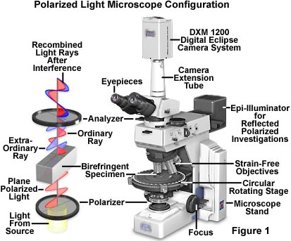
Polarizing microscope
We can sense the phase (index) changes by probing phase in two orthogonal polarizations and then interfering two rays

Slide 31
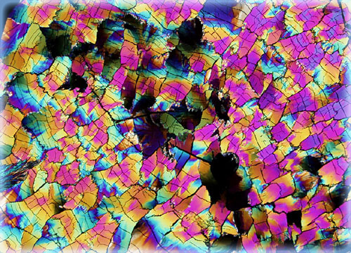

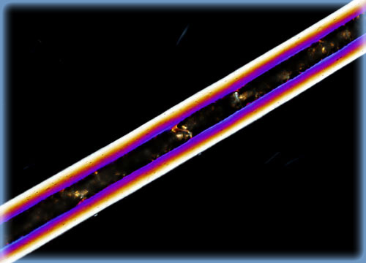
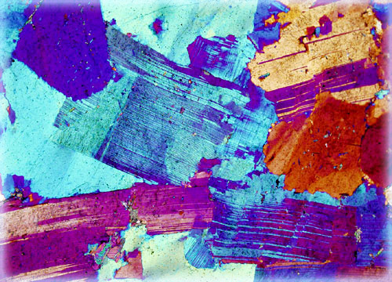
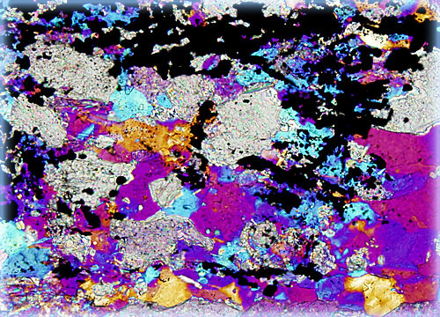
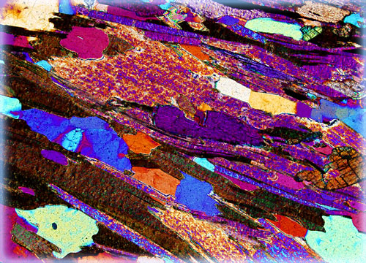
Polarizing microscope Images
Cholesterol
Vitamin E
Dog hair
Granite
Marble
Mica

