Slide 1
Lecture 27
2nd Order Nonlinear Optics

Slide 2
Potential without inversion symmetry
The electron cloud is shifted
Electron sees different environments on the left and on the right
U(x)
The potential is asymmetric – cannot be represented by even order curve
0
x
The next order approximation
-U₀
The new equation of motion is

Slide 3
Two tone field
E(t)
Let us solve equation of motion in the presence of two AC fields
We shall look for a solution
linear
second harmonic (SHG)
sum (SFG) and difference (DFG)
DC (OR –optical rectification)
We dropped higher order terms

Slide 4
Second order susceptibilities
Combine the terms of the same time dependence
Linear motion at optical frequency
SHG
SFG
DFG
OR
Therefore, in the response of the media we have polarization terms
Second order susceptibility
SHG coefficient

Slide 5
Special cases
Consider SFG or DFG when
This is of course nonlinear susceptibility responsible for electro-optic effect and is equal to the nonlinear responsibility responsible for the optical rectification (reciprocity). Both OR and EO effect also include motion of ions so those susceptibilities can be quite different from the SFG and DFG when all three frequencies are in optical range.
SHG is a special case of SFG when
Although SFG and SHG coefficients have different frequency dependences, for the nearly degenerate SFG when frequencies are close one has
Similarly for nearly degenerate DFG when
With that, the third rank tensor of nonlinear coefficients d can be introduced
or
Re-write outer product as 1x6 vector

Slide 6
Tensor of nonlinear susceptibility
For different materials the coefficients are different.
Vis
Mid IR
Vis, Near IR
UV
Blue
Near IR

Slide 7
Transmission windows of nonlinear crystals
Lasers

Slide 8
χ⁽²⁾ order of magnitude
a₀
U(x)
0
x
The nonlinear terms become comparable to linear terms when the electron is about to ionize –break the bond
Therefore
-U₀
Far from any resonances,
“intrinsic” or “atomic” field that binds the electron
Alternatively
The deeper is the potential well the larger is resonant frequency , although we cannot really establish the exact dependence. So, overall as increases and thus the transparency region expands the nonlinear susceptibility decreases dramatically. That is why in UV region it is only a few pm/V and in IR can be easily 100’s of pm/V

Slide 9
SHG efficiency
d
Fundamental wave
SH wave
z
Slow variable amplitudes on the wavelength scale
Nonlinear polarization at 2ω
Displacement at 2ω
Wave equation for SH wave
Dot multiply by
Effective SHG coefficient
Substitute
Δkz -phase mismatch

Slide 10
Solution for non-depleted pump
d
Assume the pump E₁ is not depleted (constant)
Solution
0
L
z
Power density
SHG relative efficiency (W⁻¹)
SHG efficiency
Example LiNbO₃
Assume
Coherence length “free” wave and “induced” (polarization) wave get out of phase

Slide 11
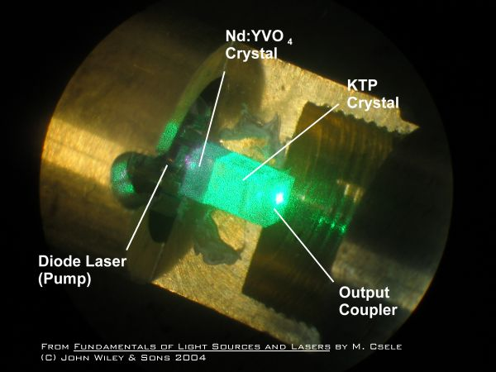
Need for phase matching
Assume
Efficiency
Δk (cm⁻¹)
Need to use birefringence and match for positive crystal
or for negative crystal

Slide 12
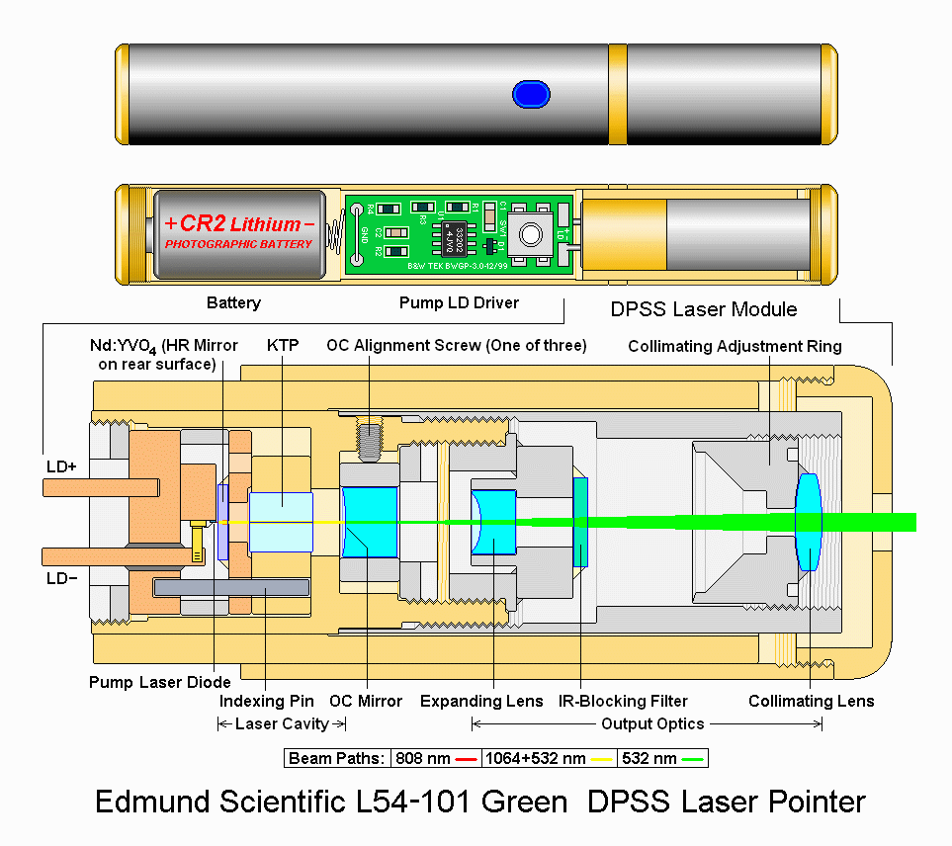
Green laser pointer

Slide 13
Phase matching in a birefringent crystal
Consider KDP
Consider index ellipsoid
x
D^{2ω}
x'
n_{o}
x'
n_{ext}(θ)
D_{ext}
Phase matching angle
n_{e}
D_{ord}
n_{o}
D^{ω}
z
y
n_{o}
θ_{m}
y
k
β
S₁
S₂
L_{max}
Walk-off angle
S₁
w
β
S₂
Suppose the pump beam is has a diameter
Maximum propagation length is which is quite short
So-called critical phase matching
Noncritical phase matching can be done using temperature

Slide 14
Effective SHG coefficient and acceptance angle
Since the only non-zero SHG coefficients in KDP are d₁₄=d_{xzy} and d₃₆=d_{zxy} we need the fundamental (pump) wave have two projections and maximize E_{x}E_{y} product by choosing the polarization at 45 degrees to axis x
x
D^{2ω}
n_{o}
x'
Then
n_{e}
Neglect walk off
E^{ω}
z
n_{o}
θ_{m}
β
k
S₁
y
S₂
Problem is a relatively narrow range of acceptance angle for phase matching
For L=1cm we are constrained to

Slide 15
Noncritical phase-matching
E_{2ω}
OA
E_{ω}
Now for L=1cm we are constrained to
S₂
which is quite an improvement.
S₁
k
Type II phase-matching
Fundamental wave contains both ordinary and extraordinary components
E_{2ω}
E_{ω}
Phase matching condition
OA
k

Slide 16
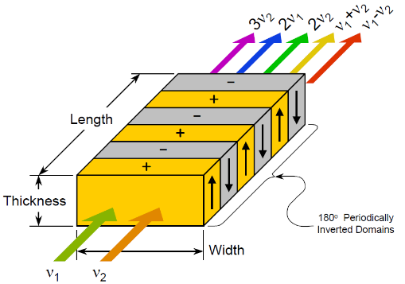
Quasi-phase matching (QPM)
j is immaterial
“discretize”
Maximum is at
SHG coefficient has a sign that can be reversed
Effective SHG coefficient
PPLN-periodically modulated lithium niobate

Slide 17
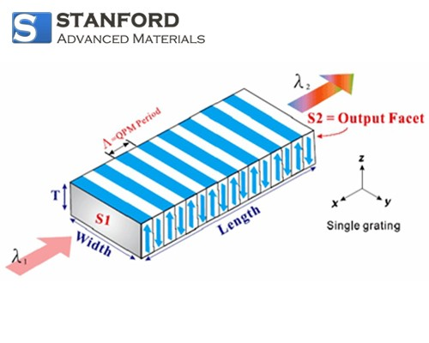
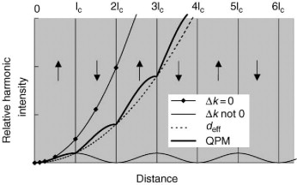
SHG in PPLN
We can use the largest nonlinear coefficient d₃₃
Period of poling is
d(x)
Λ
x
is square wave
Use Fourier series
Equation:
Matching momenta
k_{2ω}
k_{ω}
k_{ω}
2π/Λ
Grating supplies the momentum

Slide 18
3 wave interaction
d
Three propagating waves
signal
idler
pump
0
L
SHG terms are not phase matched and therefore neglected
small
z
Nonlinear polarization
Substitute into the wave equation, neglect second derivatives, and equate the terms with the same temporal dependence
Introduce
signal
idler
pump
Power densities
Photon flux densities
Introduce

Slide 19
Photon number balance
Coupling coefficient
units
Let us find change in photon fluxes
This shows quantum character of interaction – the signal and idler photon combine into a single pump photon ,and, vice versa, pump photon splits into signal and idler photons
So, we have Manley-Rowe relation
which is also a power conservation

Slide 20
SHG with pump depletion
If
are real
or
Power is conserved
Input photon flux
Since try
Output saturates at 100% efficiency

Slide 21
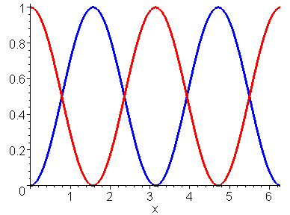
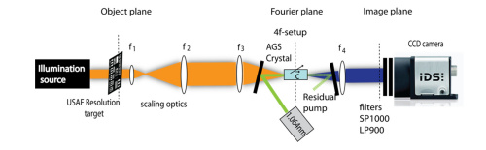
Frequency upconversion
k₃
k₁
k₂
Δk
We want to convert light of IR frequency ω₁ into the light of visible frequency ω₃ with the help of pump ω₂= ω₃ – ω₁ . Assume that pump E₂ is not depleted and Δk=0
N₁
N₃
Typically, a₃(0)=0
100% conversion at L=π/2γ
γz

Slide 22
Parametric down conversion and amplification
Loss
terms
Look for the solution
Consider the case with undepleted pump
Characteristic equation
As long as γ>Δk solution is
real exponential
Assume phase matching Δk=0
Assume N_{i} (0)=0
Photon fluxes
Both signal and idler get amplified
N_{s}
Note that
N_{i}
For γz>>1

Slide 23
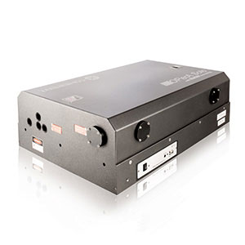
Optical parametric amplifier (OPA)
Parametric gain is rather weak
_{PPLN}
γ~1/cm
Therefore it is preferable to make an oscillator out of it
E_{s}
E_{i}
E_{p}
R₂
R₁

Slide 24
Optical parametric oscillator (OPO)
E_{s}
Write the relation between input and output signal and idler fields as a matrix
E_{i}
E_{p}
R₂
R₁
L
z
0
Consider the round trip pass for signal and idler
If after one round trip the fields are the same then one has a steady oscillation condition and the gain is the threshold gain
Here reflectivities are diagonal matrices
Nontrivial solution only if determinant is zero

Slide 25
OPO threshold
Double-resonant OPO, round trip loss
If ,
_{PPLN}
Threshold pump power density
Low threshold but unstable
Single-resonant OPO, round trip loss
If ,
Still works and is stable
S
Pump
Signal
Idler signal starts from 0
Idler
0
L

Slide 26
OPO Conversion Efficiency
N
Circulating signal photon flux N_{s} is constant
but the pump gets depleted. Neglect loss α
Pump
Signal
Boundary condition:
Idler
0
L
Solution:
The flux of idler photons exiting the cavity
The flux of signal photons exiting the cavity
The signal and idler photons are created and decayed in equal numbers
Use it to find
Conversion efficiency

Slide 27
OPO photon conversion efficiency
(S_{p} /S_{pt})⁻¹
η
x
Very high conversion efficiencies (up to 80%) are possible

Slide 28
OPO Tuning
The phase mismatching
Assume the phase matching is achieved for the degenerate case
What if change some parameter x, say angle, temperature, or period of QPM structure
Let us introduce
Now as we change x phase matching occurs for frequencies
Tuning range increases with decrease in group velocity dispersion

Slide 29
OPO Tuning
The phase mismatching
Assume the phase matching is achieved for the degenerate case
What if change some parameter x, say angle, temperature, or period of QPM structure
For example, angle
Let us introduce
GVD
Now as we change x phase matching occurs for frequencies
For example, angle
signal
Tuning range increases with decrease in group velocity dispersion
idler

Slide 30
Angle phase matching tuning

Slide 31
Temperature tuning

Slide 32
Changing the inversion period for QPM crystals

Slide 33
Pump wavelength tuning

Slide 34
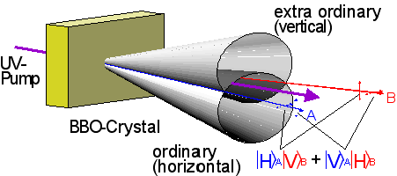
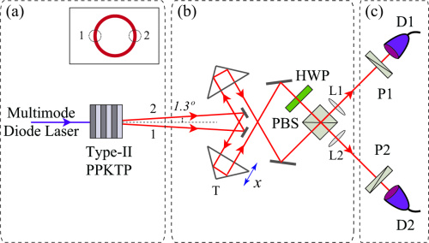
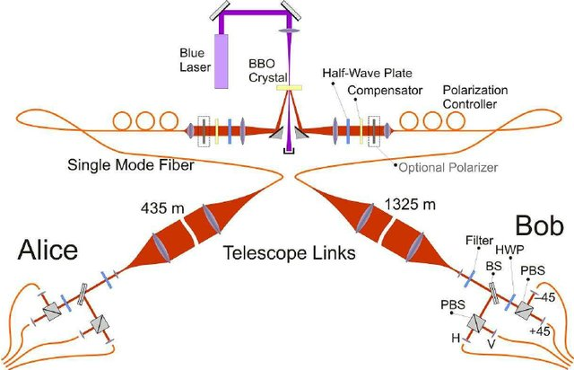
Generation of entangled photons
Spontaneous parametric fluorescence
Quantum key distribution

