Slide 1
Lecture 28
Nonlinear Optics
(third order)

Slide 2
Third order effects
The third (and other odd) order nonlinearities occur in all materials, whether they do have the center of inversion symmetry or not. But there are two different ways in which the material may have a center of symmetry –it allows us to explain different 3rd order effects without quantum mechanics.
(1) Each polarizable entity, (atom, bond, or molecular orbital) has a center of inversion symmetry and is represented by a symmetric potential containing only the even orders of coordinates.
(2) Each polarizable entity, (atom, bond, or molecular orbital) does not have a center of inversion symmetry, but for each “positive” entity there is also a ”negative” entity-so while the individual dipoles at sum and differences frequencies are generated – the second order polarization terms are all zeroes.
U(x)
U(x)
U(x)
0
x
0
0
x
x
-U₀
-U₀
-U₀

Slide 3
Three tone field
Here r(l) is the right (left) entity and
Let us solve equation of motion in the presence of three AC fields
We shall look for a solution
linear
2-nd order
3-rd order
2-nd order
3-rd order
important

Slide 4
Third order susceptibilities I
We already know the first order response
(easy to see that second order polarizations will cancel as )
And second order response
Therefore, in the response of the media we have 3-rd order polarization terms
Third order susceptibilities
1-photon resonance
2-photon resonance
3-photon resonance
Beat frequency
The order makes a difference
Note that and at least at low frequencies

Slide 5
Third order susceptibilities II
Let us solve equation of motion in the presence of three AC fields
Looking for the third order terms
1-photon resonance
3-photon resonance
Both two photon resonance and also beat frequency are absent – but they represent the most important effects – two photon absorption, absorption saturation and nonlinear index.

Slide 6
Order of magnitude
a₀
U(x)
0
x
The nonlinear terms become comparable to linear terms when the electron is about to ionize –break the bond
Therefore
-U₀
Far from any resonances,
“intrinsic” or “atomic” field that binds the electron
Note a very strong dependence on resonance frequency – i.e. on the transparency band width. The materials that are transparent only in IR will have much larger nonlinearity, hence on should avoid comparing apples with oranges
χ⁽³⁾ is a fourth rank tensor

Slide 7
Sum frequency and 3rd harmonic generation
Consider the nonlinear polarization term
For simplicity, consider 3-rd harmonic
No factor of 6 for this case
0
L
Introduce slow variable amplitudes for fundamental and 3rd harmonic
Substituting nonlinear polarization into the wave equation and assuming no fundamental depletion
Assume phase matching

Slide 8
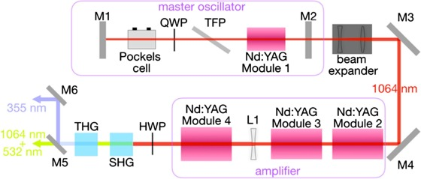
What if we cascade χ⁽²⁾ instead?
χ⁽²⁾
χ⁽²⁾
0
L₁
0
L₂
In the first crystal we generate SH
In the second crystal SF
Compare it with direct process and assume
Cascaded (sequential) process is always far more efficient than direct process

Slide 9
Two photon absorption
Consider and . Also assume - need to include damping
Consider the imaginary part
Lorentzian
Nonlinear polarization
Substitute it into the wave question for slow amplitude
Two photon absorption coefficient
Degenerate case
Solution

Slide 10
Why is it TPA?
Therefore we can write
Photon flux density
Two photons must be absorbed simultaneously to conserve energy
Quantum description of TPA
E₂
ħω₀
ħω₀
ħω₀
ħω₀
ħω₂
ħω₂
“virtual
level”
ħω₁
ħω₁
E₁
0
0
0
0

Slide 11
Order of magnitude
(solid state)
TPA in Si
TPA in Ge-As-Te chalcogenide
glass
TPA absorption in silicon makes it less than ideal material for Si photonics – that is why Si₃N₄ with low TPA in the region of interest is being used

Slide 12
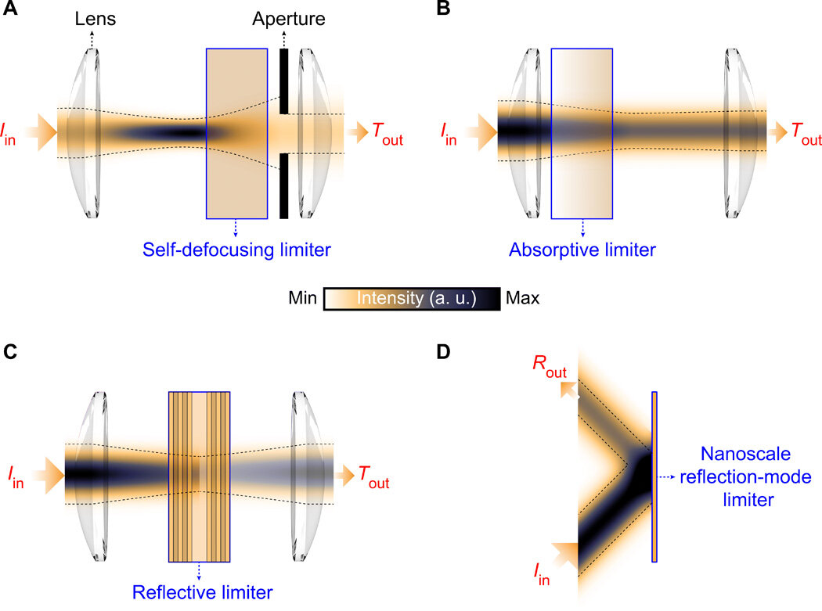
Optical limiting
Used to protect sensitive detector (or eye)
S_{out}
S_{max}
For TPA
S_{in}

Slide 13
Nonlinear phase shift
Now let us look at the real part of . Consider again the degenerate case
There are two physically distinct mechanisms
The first term corresponds to off-resonant TPA – it is just a Lorentzian that peaks in the vicinity of TPA resonance. This term is a nonlinear phase delay, hence nonlinear index
Quantum picture
The energy of 2 photons is not sufficient to ensure permanent absorption – photon energy get transferred to the matter (“ a spring”) but then released back to the photons – after a short delay, i.e. phase shift
ħω₀
ħω₀
ħω₀
,
“virtual
level”
“virtual
level”
ħω₂
ħω₂
ħω₁
ħω₁
0
0
0
ħω₀
ħω₀
ħω₀
ħω₀
ħω₂
“virtual
level”
Δt
ħω₂
ħω₁
ħω₁
0
0
0
0

Slide 14
Nonlinear refractive index
There are two nearly equal contribution to third order polarizations from the ”virtual” TPA processes that depend on which photon gets “absorbed” first
Substitute into the wave equation
New dielectric constant
New refractive index
Roman-not italic!
n₂ is nonlinear refractive index
Degenerate case –only one term
New refractive index
Order of magnitude of n₂
Overall for two fields
Self-phase modulation
Cross-phase modulation

Slide 15
The “other χ⁽³⁾ ”
This term peaks near the linear absorption peak and is usually related to absorption. It usually has negative sign. It can be construed as the result of saturation. In quantum theory, when the atom (or bond) absorbs a photon it is no longer active. As the number of active atoms gets reduced, so does the susceptibility.
ħω₀
ħω₀
Near resonance we can write for the density of active atoms at lower level
ħω₁
ħω₁
0
0
τ -characteristic relaxation time
Optical power density for two waves
As long as is relatively small
Look for a solution
Then the susceptibility will also change

Slide 16
Nonlinear index due to saturation
Nonlinear polarization
beating
saturation
Since
Dispersion of this nonlinear index is quite resonant since both real and especially imaginary part of linear susceptibility are resonant

Slide 17
Dispersion of nonlinear index
n₂
β
n₂
Nonlinear absorption
β
Normally we operate below 0.5 ω₀ – below half-bandgap to avoid TPA
n₂

Slide 18
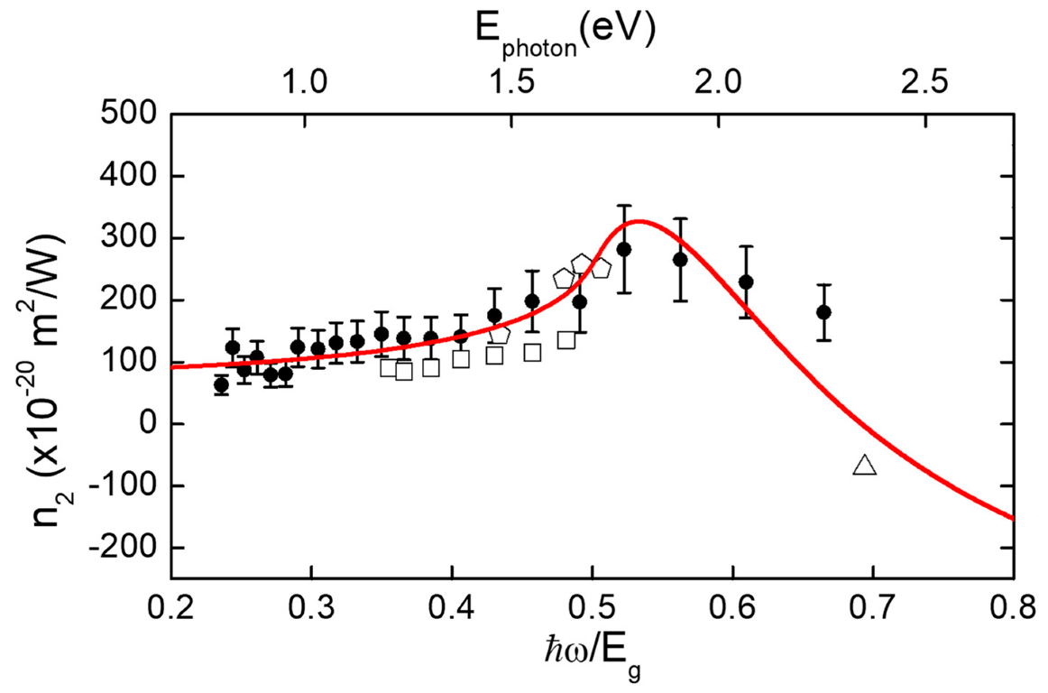
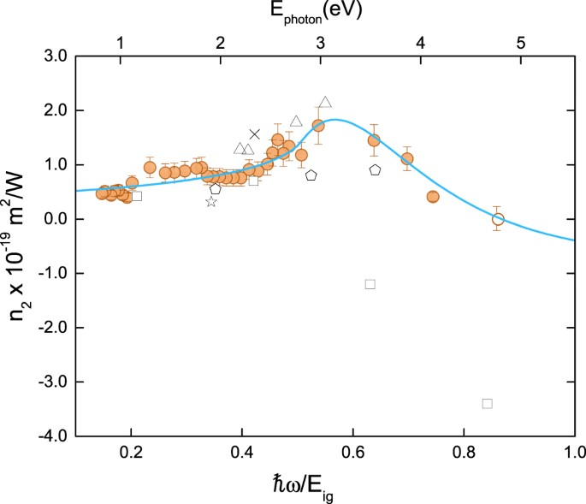
Dispersion of nonlinear index
Si
GaN
Diamond

Slide 19
Table of nonlinear indices

Slide 20
Typical ranges of values of n₂

Slide 21
Four wave mixing
The last two terms present a grating of with period of both refractive index and absorption.
This grating oscillates at frequency . The grating scatters wave
When multiplied by , the third term engenders nonlinear polarization at frequency but the last term generates nonlinear polarization at frequency , Similarly, scattering
off the third term generates polarization at frequency . Those are FWM terms
Similar term occurs in TPA nonlinearity
FWM is a third order parametric process in which two pump photons get transformed into signal and idler. The difference from the second order parametric amplification and generation is that all four photons have comparable energies (frequencies)
Δω
Δω
ω
ω₃
ω₂
ω₁
Idler
Pump
Signal

Slide 22
Phase matching in FWM
n₂
0
L
z
So, assuming no pump depletion
Phase mismatch
k_{p}
k_{p}
Δk
k_{s}
k_{i}
GVD
Coherence length
Assume fused silica
Optical fiber near 1550nm

Slide 23
Coupled wave equations
Parametric gain
Solution
The same as for
the second order parametric amplification
signal
idler
Consider fused Silica optical fiber
But coherence length is 800m so

Slide 24
Wavelength conversion via FWM
L=10km
Pump
Signal
Idler
L=1.5cm

Slide 25
Wavelength conversion via Cross Phase modulation (XPM)

Slide 26
Phase conjugation with degenerate FWM
Two counter propagating pumps
A signal
Nonlinear polarization
will include the term
0
z
L
Since and assuming undepleted equal power pumps
This polarization engenders a new wave, propagating in the reverse direction –z,
The propagation equation for it is
Obviously wave 4 couples back into wave 3
So the coupled equations are

Slide 27
Phase conjugation
solution
Boundary conditions
We are interested in
Both signal and phase conjugate signal get amplified and if oscillation may occur ..
Consider light propagating through the medium with index n(z)
n(z)
Complete time reversal
All the perturbations of index are removed. Dispersion is compensated
0
Signal at 0
Signal at L
Conjugate signal at L
Conjugate signal at 0

Slide 28
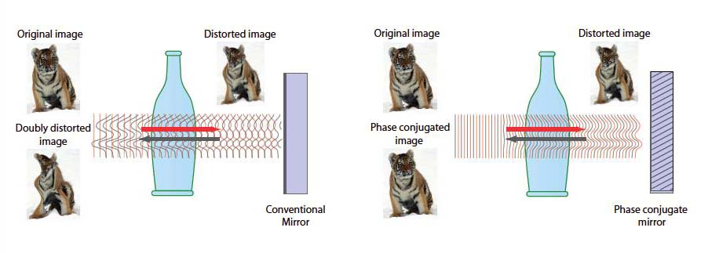
Phase conjugation-applications
PC mirror
Normal mirror
Wave front
diverging
The PC light will travel back and converge light at the source thus cancelling all the aberrations and index changes due to turbulence
Wave front
diverging
PC mirror
Wave front
diverging
Wave front
converging

Slide 29
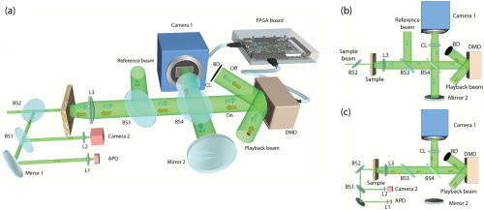
Digital phase conjugation

Slide 30
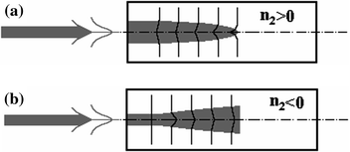
Self-focusing
n(r)-n₀
Gaussian beam
2w₀
n₂
Ray trajectory equation
L
S
2w₀
r

Slide 31
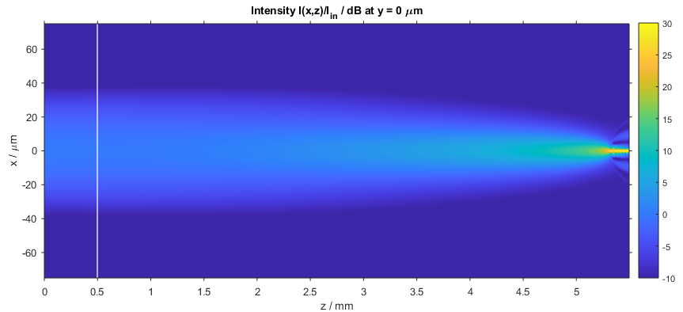
Self trapping
Self-focusing length
2w₀
Self-focusing angle
z
z_{sf}
Diffraction (divergence) angle
Effectively, convergence angle is
Critical power for convergence and eventual trapping

Slide 32
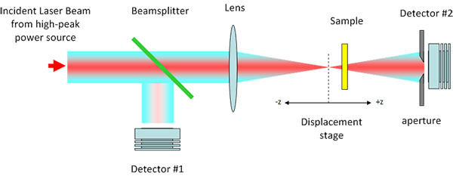
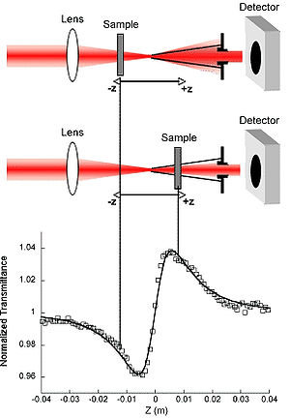
Measurement of n₂ Z-scan

