Slide 1
Lecture 29
Planar and Channel waveguides

Slide 2
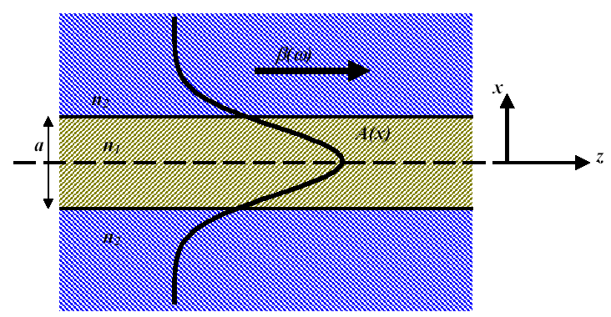
Planar waveguide
Slab waveguide
core
Maxwell equations
cladding
One can have two independent modes
Transverse electric (TE) E_{z} =0
H
E
Transverse magnetic (TM) H_{z} =0
E
H

Slide 3
TE Modes in planar waveguide
H
Substitute into the wave equation
E
Transverse wave vector
Solution
Solution is confined in the region 1 (core) hence k_{x1} is real
Due to symmetry or
So there are two possible solutions inside the core
In the cladding the field decays exponentially
In-plane magnetic field

Slide 4
Eigen modes
Boundary conditions
Even modes
Odd modes
Continuous E_{y}
Continuous H_{z}
Divide
v
Introduce dimensionless variables
Introduce normalized thickness
u
w₂
π/2
π
w₁
3/2 π

Slide 5
TE modes-examples
a=600nm
a=800nm
λ=1550nm
λ=1550nm
TE0
E_{y}
TE0
E_{y}
H_{x}
H_{x}
n_{eff}=1.89
n_{eff}=3.31
H_{z}
H_{z}
SiO₂
Si
SiO₂
SiO₂
Si₃N₄
SiO₂
n₂=1.45
n₁=3.47
n₂=1.45
n₂=1.45
n₁=2.01
n₂=1.45
TE1
E_{y}
n_{eff}=2.83
TE1
E_{y}
n_{eff}=1.57
H_{z}
H_{z}
H_{x}
H_{x}

Slide 6
TM Modes in planar waveguide
E
Inside the core
H
In the cladding
In-plane electric field
Even modes
Odd modes
Continuous H_{y}
Continuous E_{z}
Divide
Normal E-field
Discontinuity at the interface

Slide 7
TM modes –examples
a=600nm
a=800nm
λ=1550nm
λ=1550nm
TM0
H_{y}
TM0
H_{y}
E_{x}
n_{eff}=1.86
E_{x}
n_{eff}=3.24
E_{z}
E_{z}
SiO₂
Si
SiO₂
SiO₂
Si₃N₄
SiO₂
n₂=1.45
n₁=3.47
n₂=1.45
n₂=1.45
n₁=2.01
n₂=1.45
H_{y}
TM1
n_{eff}=1.49
TM1
H_{y}
n_{eff}=1.52
E_{x}
E_{x}
E_{z}
E_{z}

Slide 8
Effective index
Introduce effective index
Dispersion curves
Cut off
Cut off

Slide 9
Group velocity and group index
Group velocity
n₁
TE0
Group index
TM0
Why
TM1
TE1
n₂
n₁
TE0
θ
TE1
n₂
TM1
n₁
n₁k₀
q
θ
TE0
TE1
β
TM0
n₂

Slide 10
Power flow and effective thickness
Consider TE wave
H
E
Power density
Time averaged power density
Since is 90 degrees out of phase with
Power density per unit width
Introduce the effective thickness then
Also introduce confinement factor
t_{eff}
a

Slide 11
Effective thickness and confinement factor
1550nm
Si
SiO₂
n₁=3.47
n₂=1.45
1550nm
a
a/2

Slide 12
Slab waveguide that is not symmetric
Guided mode
n₃ <n₂ cover (often the air)
n₃ <n₂ cover
n₁
n₁
n₂ substrate
n₂ substrate
n₃ <n₂ cover
Substrate mode
n₁
n₂ substrate
Radiating mode
n₃ <n₂ cover
n₁
n₂ substrate

Slide 13
Dispersion in planar waveguide
n₁ω/c
TE2
n₂ω/c
β
Forbidden region
Guided
modes
Substrate
modes
n₃ω/c
TE1
Even the fundamental mode TE0 has a cut-off!
TE0
Radiation
modes
ω

Slide 14
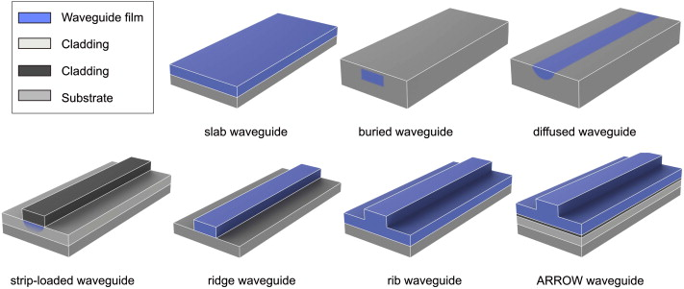
Channel waveguides
anti-resonant reflecting optical waveguide

Slide 15
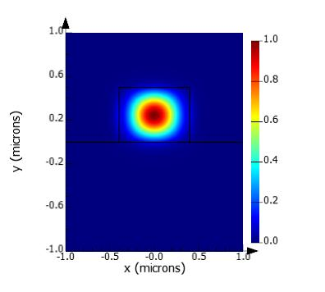
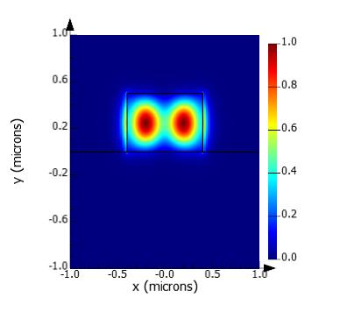
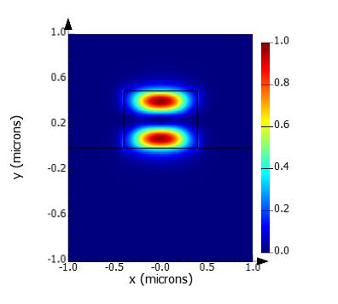
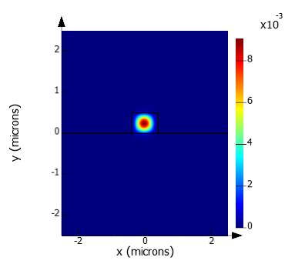


TE Modes in channel waveguides
In Channel waveguides you cannot separate pure “TE” and “TM” modes – there is always a longitudinal component of the field, so “TE” and “TM” simply means “almost horizontal” or “almost vertical” polarization
800nm x 500nm ridge waveguide Si on SiO₂ (1.55um)
TE0
TE01
TE10
|E|
|S|

Slide 16


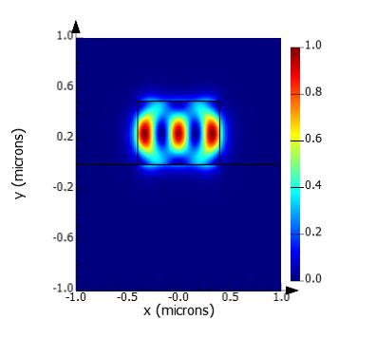


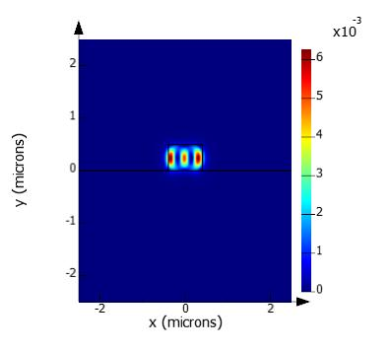
TM Modes in channel waveguides
800nm x 500nm ridge waveguide Si on SiO₂ (1.55um)
TM0
TM01
TM02
|E|
|S|

Slide 17
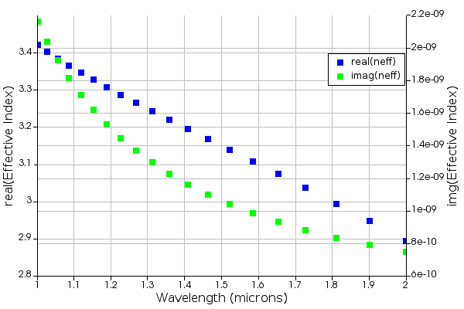
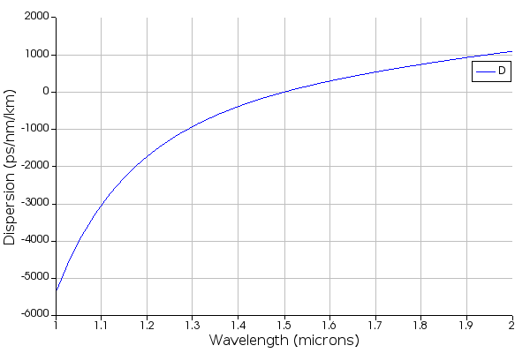
Effective index and GVD
800nm x 500nm ridge waveguide Si on SiO₂ (1.55um) TE0 wave
Zero GVD

Slide 18
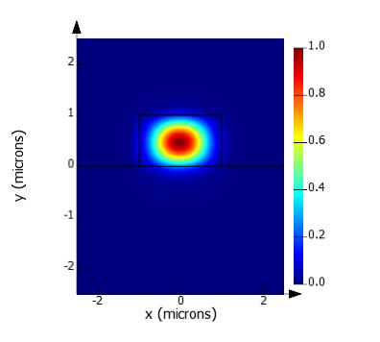
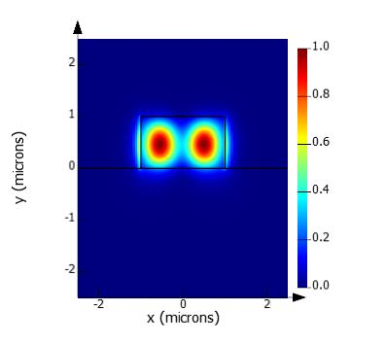
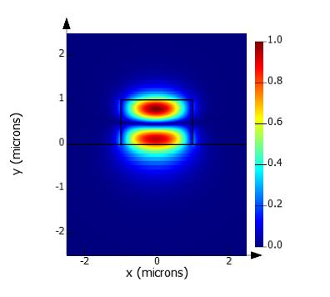
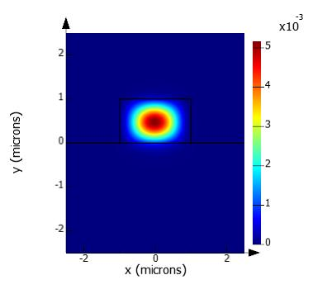
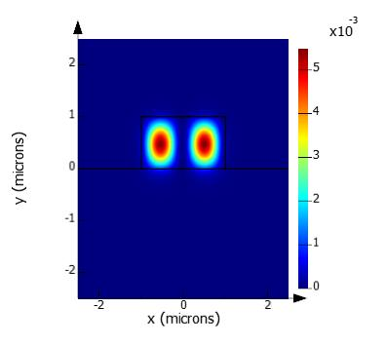
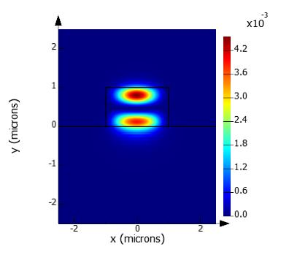
TE Modes in channel waveguides
2000nm x 1000nm ridge waveguide Si₃N₄ on SiO₂ (1.55um)
TE0
TE01
TE10
|E|
|S|

Slide 19

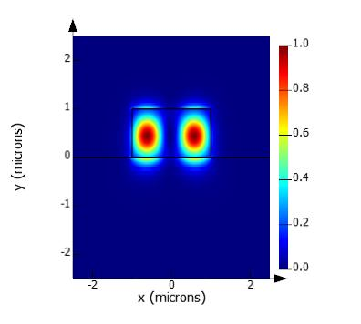


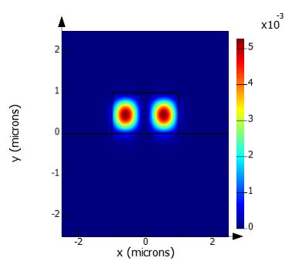

TM Field in channel waveguides
2000nm x 1000nm ridge waveguide Si₃N₄ on SiO₂ (1.55um)
TM0
TM01
TM02
|E|
|S|

Slide 20
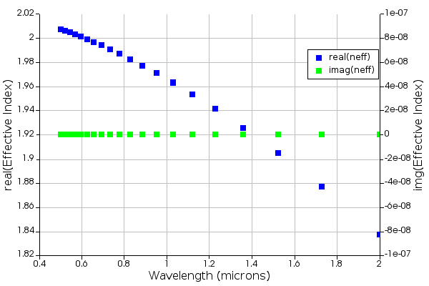
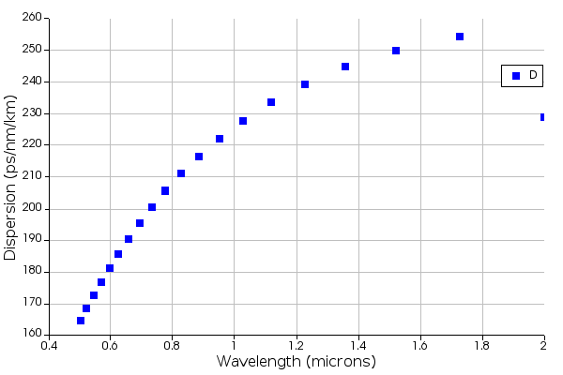
Effective index and GVD
2000nm x 1000nm ridge waveguide Si₃N₄ on SiO₂ (1.55um)
No Zero GVD

Slide 21
Reciprocity and orthogonality
subtract
Conjugate and switch 1 and 2
add up
reciprocity
Consider two modes
Integrate over dxdy

Slide 22
Orthogonality and normalization
Expand fields into the modes
Power along the direction of propagation in each mode
Normalization
Some simplifications
TM wave
Dimensionality
TE wave
In weak waveguides

Slide 23
Reciprocity and time reversal
add
switch 1 and 2
Subtract
reciprocity
Integrate over the volume and use Gauss theorem
(fields vanish at infinity)
Time reversal
If we change simultaneously and the Maxwell’s equations still hold
In complex form take complex conjugate of
Therefore, implementing change does not change all the equations and reciprocity can also be written as

Slide 24
Orthogonality –another look
Power along the direction of propagation
In the absence of loss
This expression should be true for any combination of A’s
Now, what if the wave propagates backward?
Add up

Slide 25
Waveguide with perturbation
n₃
n₁
n₂
subtract
Now consider that dielectric constant is perturbed as
and it should lead to
Integrate over the area of waveguide
TE wave
TM wave

Slide 26
Waveguide with perturbation (amplitude change)
subtract
Now consider that dielectric permittivity is perturbed as
Integrate over the area of waveguide
But
TE wave
TM wave
Obviously, for, say absorption

