Slide 1
Lecture 31
Gratings in Integrated and Fiber Optics

Slide 2
Grating assisted coupler
Additional index perturbation
Λ
z
Important to maximize taking into account orthogonality
The coupled equations for amplitudes
Consider periodic index perturbation with period Λ
Periodic function can be expanded into Fourier series
For “square wave grating”

Slide 3
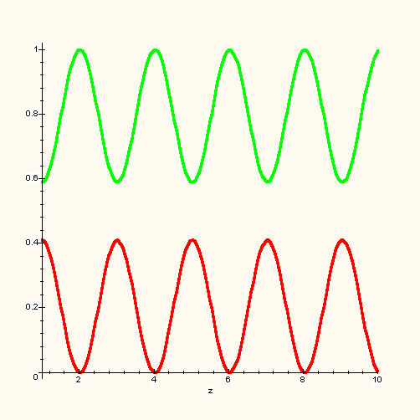
Grating assisted coupling
If Δβ is large all the terms on the RHS will rapidly oscillate and integrate to zero, unless in one of them Δβ ±mK_{g} is small. For the first order resonance the condition is
Solution for P₁(0)=A₀ P₂(0)=0
Beat length
P₁
P₂
z
Phase mismatch is a function of frequency
Let the length be 1/2 beat length at ω₀
Assume perfect match at ω₀
Group index

Slide 4
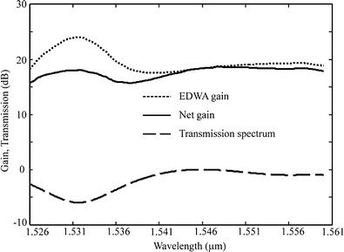
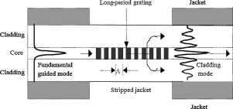
Grating assisted coupling as a filter
Transit times
Same as FSR of MZI – but completely different shape
Long period fiber grating – used in sensors, filters, and gain flatteners

Slide 5
Coupling of counter propagating waves
Wavevector mismatch is 2β
Grating period is Λ
Drop primes
And look for solution
Characteristic equation
As long as

Slide 6
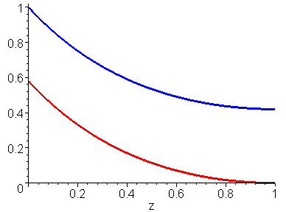
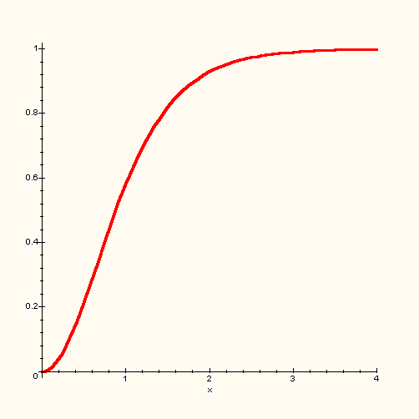
Distributed Bragg reflector
At Bragg frequency ω₀
Constant difference-power conservation
Reflectivity
P₁
R
P₂
κL

Slide 7
DBR Reflectivity spectrum

Slide 8
Reflectivity spectrum
Reflection bandwidth
Typically
κL=1
κL=2
κL=3
κL=5
Distributed Back Reflector (DBR)

Slide 9
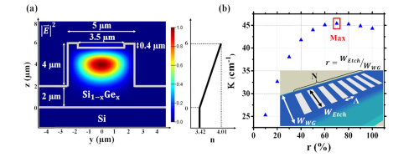
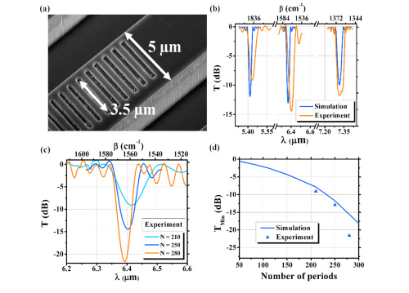
Bragg grating fabrication
Surface corrugation
(Mid Infrared)

Slide 10
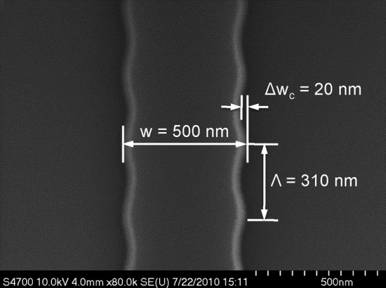
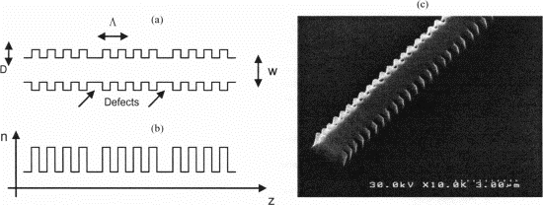
Bragg grating fabrication
Sidewall corrugation
Si
Polymer

Slide 11
Bragg grating fabrication
Low Kappa –narrow spectrum

Slide 12
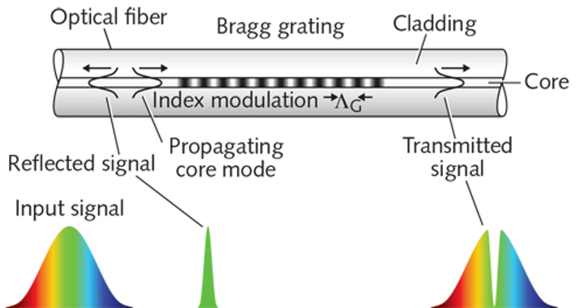
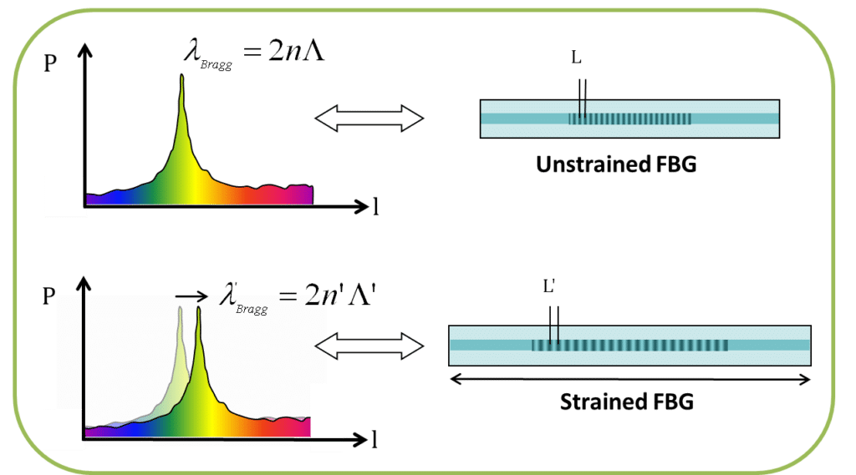
Fiber Bragg gratings
Strain sensor with FBG
Λ
Λ’
Temperature sensor –the same principle – reflection spectrum shifts

Slide 13
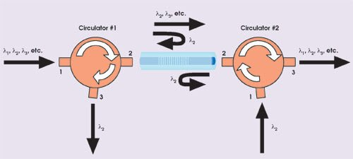
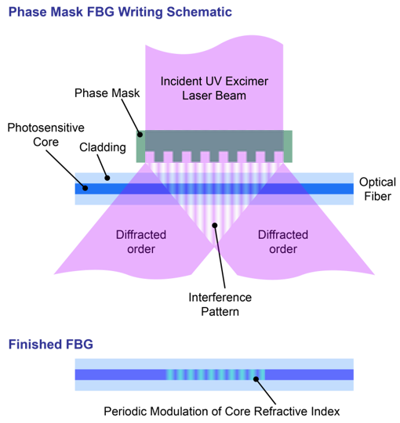
FBG Add Drop Filter

Slide 14
Phase delay of grating
κL=1
κL=3
κL=10
At the reflection band edge
No phase shift at Bragg frequency
For high reflectivity grating

Slide 15
Group delay
Phase delay
Group delay
Black box approach
=
Group delay
Group delay
Effective length

Slide 16
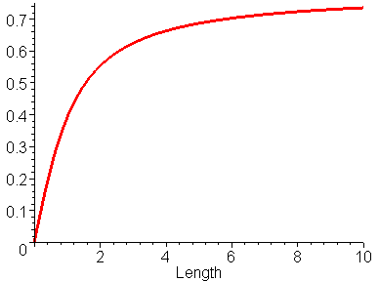
Effective length of DBR
κL=10
For low reflectivity grating
For high reflectivity grating
-
1
L
eff
(units
o
f
κ
)
L
eff

Slide 17
Photonic bandgap
β₁
β₂
Look for the solution as a superposition of forward and reflected waves
unknown
Characteristic equation

Slide 18
Photonic bandgap
unknown
β₁
β₂
Characteristic equation
Bragg wavevector
or
Slow wave near the bandedge

Slide 19
Standing waves
At Bragg resonance
|E₊|²
z
Δn_{eff}
z
|E₋|²
z

Slide 20
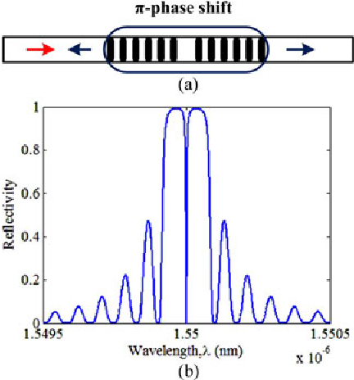
Phase shifted FBG
Essentially a Fabry Perot resonator

Slide 21
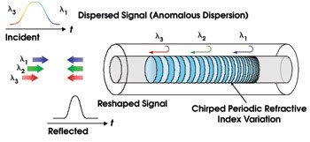
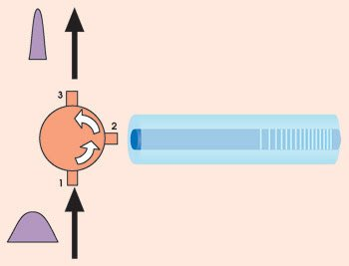
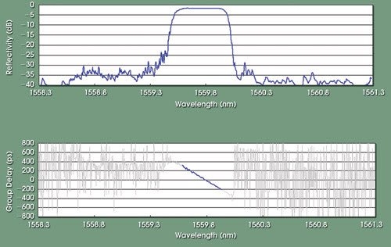
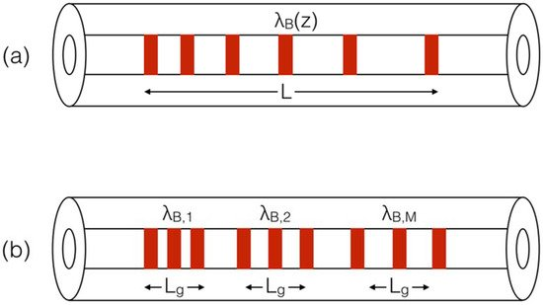
Chirped FBG dispersion compensator
Chirped FBG sensor

Slide 22
Sampled Grating
L_{s}
L_{g}
No grating here
Λ
L_{g}
g
Λ
z
Sampling function
For the un-sampled grating Bragg condition
R
Reflectivity spectrum of long grating
β=n_{eff}ω/c

Slide 23
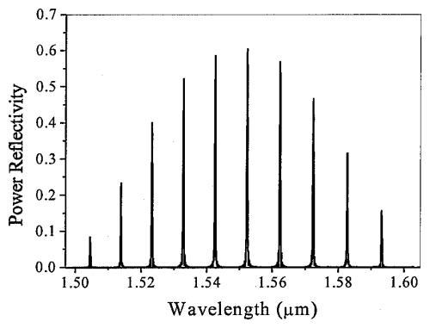
Reflectivity of a sampled grating
High reflectivity for
Reflectivity spectrum of
Sampled grating
δβ_{s}
β=n_{eff}ω/c

Slide 24
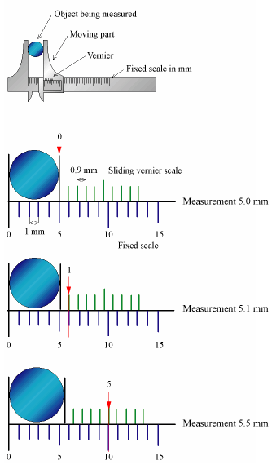
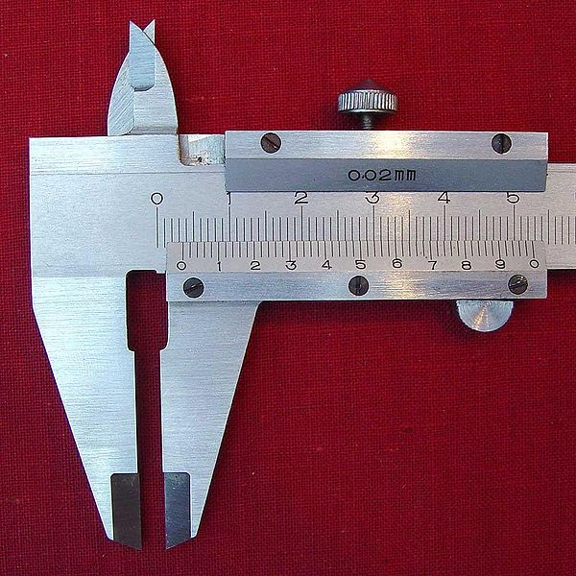
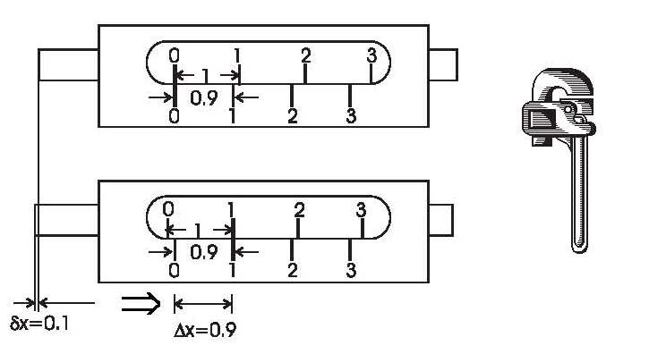
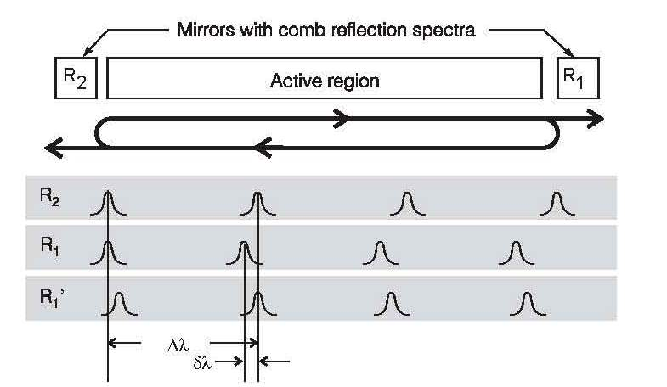
Sampled grating in tunable single mode lasers
Vernier effect
Caliper with a Vernier Scale
Exploiting the Vernier Effect in Lasers

Slide 25
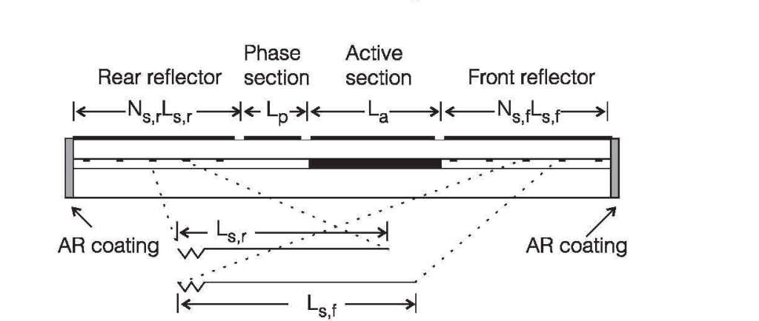
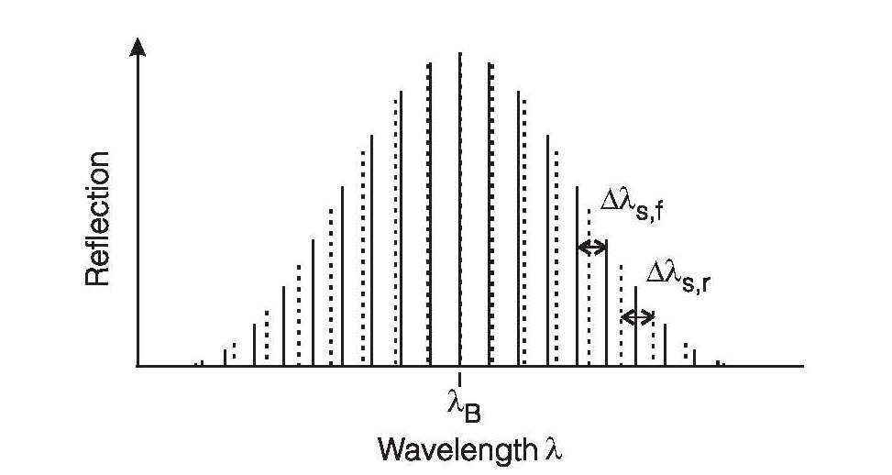
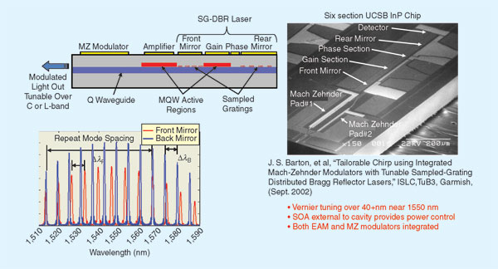
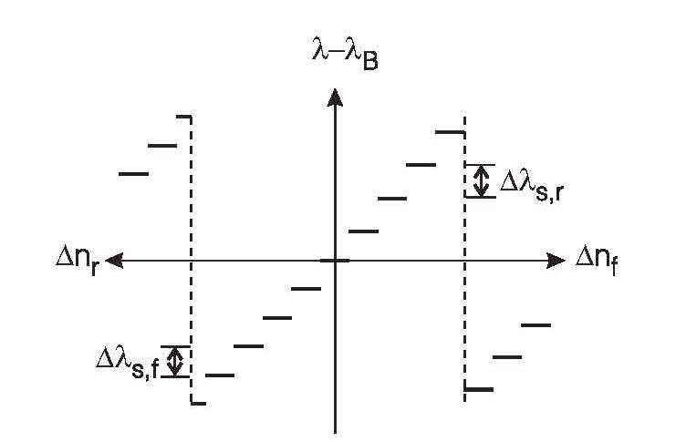
Laser with sampled DBR mirrors
Change index in one of the reflectors
Tuning is discrete

Slide 26
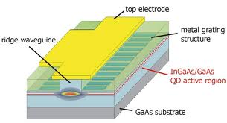
DBR with gain-DFB laser
amplification
threshold
|E|²
z

Slide 27
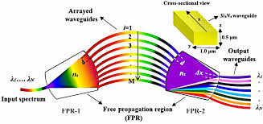
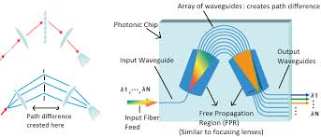
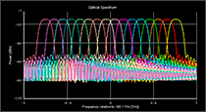
Arrayed waveguide grating

