Slide 1
Lecture 34
Localized SPP

Slide 2
Quasi-Static Regime
Consider the situation when the fields are confined within volume ~a³ and a<<λ₀/n
a
λ₀/n
In free space
In a small volume
Magnetic field becomes vanishingly small when the electric field is confined to sub-wavelength volumes
The field is irrotational, hence one can introduce scalar potential
The only remaining Maxwell’s equation is the Poisson equation for the electrostatics, even though the field and charge are time dependent with optical frequency
In the absence of free charges –Laplace equation

Slide 3
Polarized sphere in the electric field
E₀
External electric field E₀ induces surface charge.
The potential changes.
r
-
ε_{r1}
+
-
+
θ
-
p
+
z
-
a
+
-
+
ε_{r2}
But we also know that potential of a dipole is
If dipole is oriented along z
Therefore
Induced dipole is
Electric field

Slide 4
LSP resonance
-
Induced dipole is
ε_{m}<0
+
-
+
-
p
+
If
even if
-
+
-
+
Self-sustained oscillations!
ε_{d}>0
Therefore
Of course this can happen only at a certain frequency
LSP frequency is
For a non-spherical particle one gets
For a prolate spheroid particle l>1 and for oblate one l<1
l>1
l<1

Slide 5
LSP excitation
E(t)
Near resonance
Introduce polarizability
It is easy to see that this is the solution of equation for a driven oscillator
Simply a collective motion of all carriers inside

Slide 6
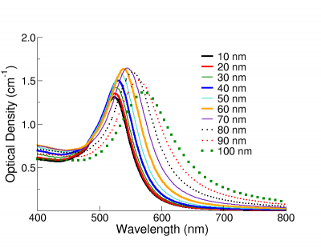
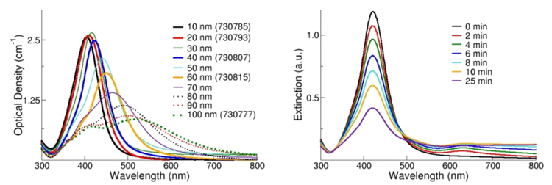
LSP field enhancement near resonance
E(t)
“hot spot”
On resonance, for
The field enhancement and linewidth of extinction spectrum do not depend on the size of nanoparticle (as long as it is sub-wavelength).
Absorption coefficient
Ag
Au

Slide 7

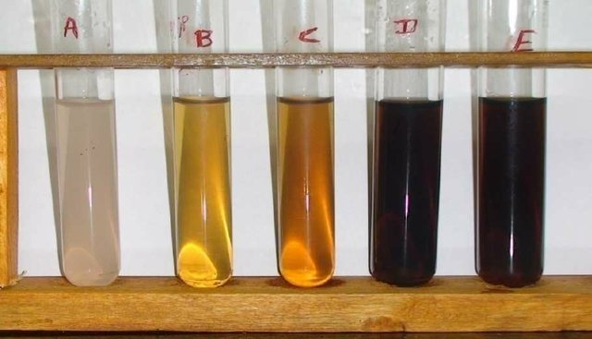
Plasmonic colors
Gold
Color change due to pH variation on biosynthesized silver nanoparticles A: pH 2, B: pH 4, C:pH 6, D:pH 8, E:pH 10 .

Slide 8
Energy in the LSP
Neglect the magnetic field
Energy outside the metal
Energy inside the metal
Total energy
Energy dissipation
The decay rate of LSP is the same as the scattering rate γ in the metal – no matter what is the shape or size of the nanoparticle (as long as a<<λ)

Slide 9
Another way to look at it
Kinetic energy density:
One half of energy is contained in the kinetic motion of carriers (or one can say that energy oscillates between the kinetic energy of carriers and potential energy of the field)
Energy conservation can be written as
from which the LSP resonance condition follows.
Kinetic Inductance -wire
a
Becomes very large for small diameter
Magnetic inductance

Slide 10
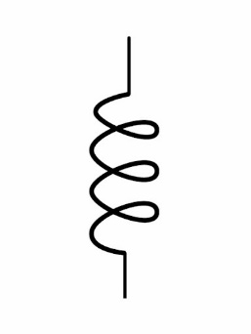
LSP resonance as a circuit
Sphere -Kinetic Inductance
Sphere –Capacitance
a
L_{K}
C
Resonant frequency
Correct value
No size dependence
Magnetic inductance
Resonant frequency
As expected in any resonator

Slide 11
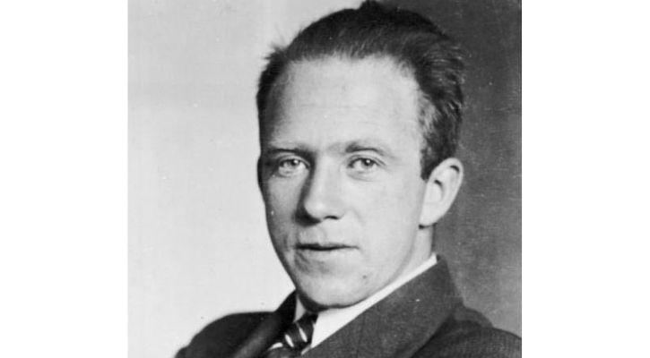
Why do we need metal?
For most of the applications in plasmonics and metamaterials we want to concentrate optical field on sub-wavelength scale…but are prevented by the diffraction limit
It follows directly from the Heisenberg’s uncertainty principle
What if n is not a real number???
To see how we can beat diffraction limit …let us re-derive it from the energy conservation considerations

Slide 12
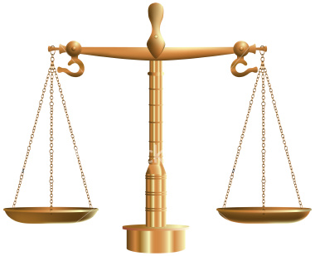
Energy balance in a mode
a
a
λ
λ
ωt=0
ωt=π/2
E
H
Electric Potential”
Energy
Magnetic
“Kinetic”
Energy
Energy oscillates between potential (electric) and kinetic (magnetic)
v
v
U_{E}
U_{M}

Slide 13
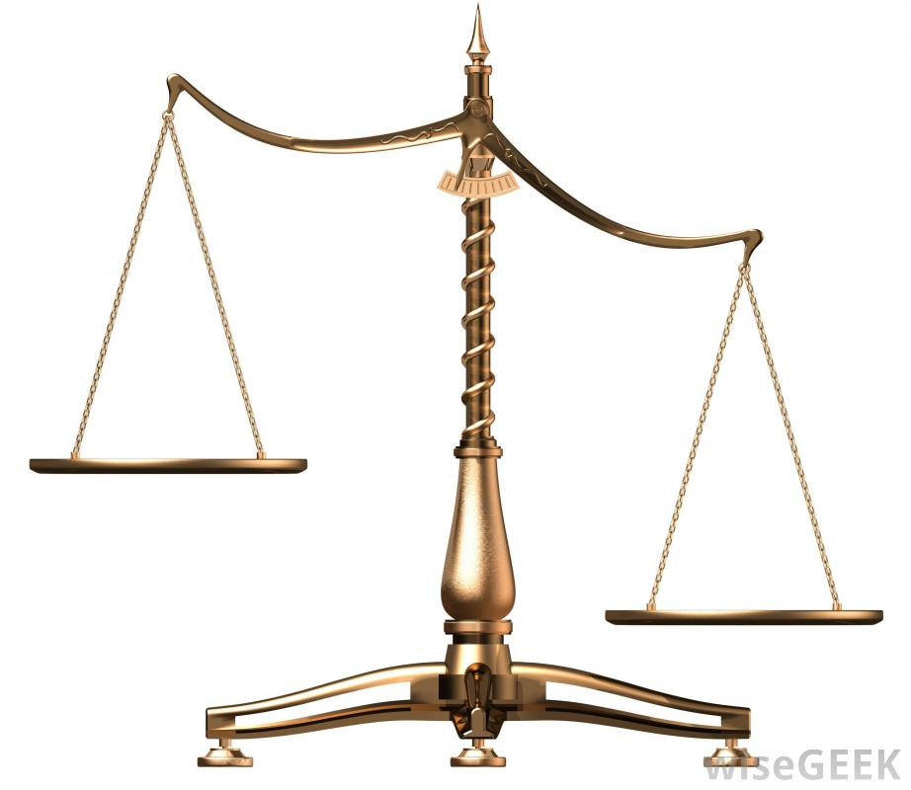
Lack of energy balance in a sub-λ mode
a
a
λ
λ
ωt=0
ωt=π/2
H
E
Electric
“Potential”
Energy
Magnetic
“Kinetic”
Energy
The energy will radiate because it cannot all fit into magnetic energy –this is diffraction limit!
If a<<λ₀/2n there is almost no magnetic field (quasi-static limit) U_{M}<<U_{E} –energy is not conserved
U_{M}
U_{E}

Slide 14
Free carriers restore balance in a sub-λ mode
a
a
λ
λ
ωt=0
+
ωt=π/2
v
+
E
H
+
J
Electric
“Potential”
Energy
Magnetic
“Kinetic”
Energy
True
Kinetic”
Energy of electrons
L_{K}=Kinetic Inductance
(inertia of electrons)
At some frequencies ω₀ the balance is achieved. These frequencies are the the resonant frequencies of the Surface Plasmon Polariton Modes
If a<<λ₀/2n there is almost no magnetic field (quasi-static limit) U_{M}<<U_{E} – hence energy oscillates between electric energy and kinetic energy of free carriers
U_{E}
U_{M}
U_{K}

Slide 15
Success Always comes with the price!
In the sub-wavelength metallic structures (in all three dimensions !) half of the time almost all the energy is stored in kinetic motion of electrons –where it is being lost with the decay rate 2γ of the order of 10¹⁴ s⁻¹. Therefore the rate of energy loss in truly sub-wavelength structure is always of the order of γ.
t=T/4
3
J
2.9
Light line
2.8
“True sub-wavelength SPP”
2.7
Energy (eV)
2.6
2.5
“Long range SPP”
Here sub-wavelength simply means very large wave-vector
a<<λ/2n
2.4
2.3
2.2
0
5
10
15
20
25
Wave number β (relative units)
Notes:
15

Slide 16
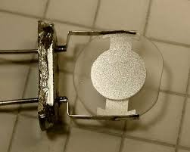
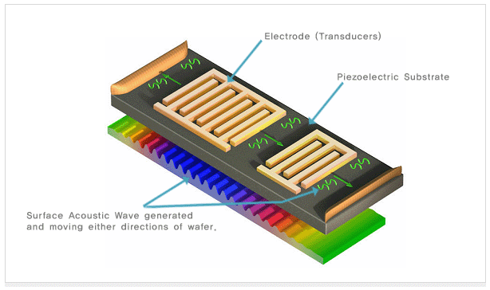
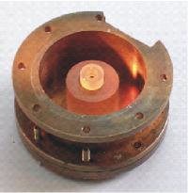
Estimate of effective loss (SRR)
Split Ring Resonator
Q of Drude metal structure actually gets reduced with wavelength and only starts getting better when ω<γ - THz region which is not really optics –and even then LC circuit is not a very high Q resonator!!!!!
optics
That is why high Q resonators in electronics include:
Quartz crystals Q~10⁶
Surface acoustic waves Q~10⁵
λ/2 cavities Q~10³ ….
electronics
Border wavelength ω~γ
(where optics – displacement current and electronics - conductivity current meet
The true sub-wavelength region where kinetic inductance dominates (plasmonics) is inherently lossy and various geometric tricks will not mitigate this loss significantly!
Notes:
16

Slide 17
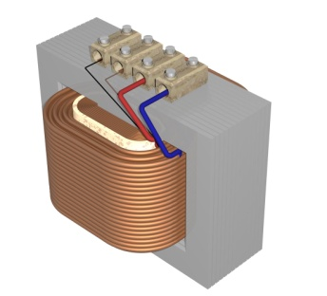
What happens at low frequencies?
If γ>>ω
There is no wavelength dependence!
At low frequencies, where conductivity current dominates magnetic field can be high enough even in the sub-wavelength structures
Of course, a simple example of truly subwavelength low loss structure is an electrical transformer at 50Hz

Slide 18
How does the loss depend on wavelength?
Consider a wire
t
a
a
U_{M}
U_{E}
U_{K}
Kinetic Inductance
Energy stored in the magnetic field (it does
not dissipate)
Energy stored in the kinetic motion of carriers (it dissipates )
Magnetic Inductance
Effective loss rate
The loss rate does not depend on frequency-only the ratio of the critical (smallest) dimension to the plasma wavelength. The loss is reduced for the structures bigger than plasma wavelength. These structures are subwavelength for λ>>λp

Slide 19
Loss vs. size
Effective Loss γ_{eff}/γ
Diameter a/λ_{p}

Slide 20
Plasmonic and loss are inseparable
“True Plasmonic Regime” implies that a significant part of energy s stored in motion of charged carriers. This regime is inherently lossy and should be avoided if possible.
PLASMONICS
“METAL OPTICS”
Conductivity current
Free carriers
ELECTRONICS
At lower frequencies one enters the “metal optics” or “nanoantenna” or “microwave” (which extends into THz and mid-IR) regime where magnetic inductance dominates. This low loss regime is highly desirable
Confinement (1/a)
Reactive (Displacement) current, bound carriers
OPTICS
1/50μm
1/150nm
Frequency (1/λ)

