Slide 1

Introduction to Data Science and Advanced Programming
Lecture 12
Simon Scheidegger

Slide 2
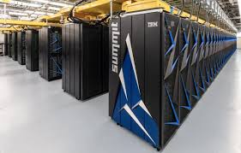
Introduction to parallel and high-performance computing

Slide 3
Scope of today's lecture
The purpose of the next 3 lectures is to give you an introduction to the main approaches to exploit modern parallel and High-Performance Computing (HPC) systems.
→ Intended to provide only a very quick overview of
the extensive and broad topic of parallel computing.
→ Familiarize the big picture, ideas and concepts.
→ Familiarize with the main programming models.
YOU SHOULD START TO THINK PARALLEL

Slide 4
Outline of this introductory lecture
1. Motivation – why should we use parallel programming.
2. Contemporary hardware.
3. Programming Models.

Slide 5
My lecture slides on Git
You will find my lecture notes and example codes here:
https://github.com/sischei/OSM2018
→ Please update regularly your local copy of the
repository

Slide 6
Some Resources
Full standard/API specification:
- http://mpi-forum.org
- http://openmp.org
Tutorials:
- https://computing.llnl.gov/tutorials/mpi/
- https://computing.llnl.gov/tutorials/openMP/
- http://cse-lab.ethz.ch/index.php/teaching/42-teaching/classes/577-hpcsei
Books:
- “Introduction to High Performance Computing for Scientists and Engineers”
Georg Hager, Gerhard Wellein
- “Using Advanced MPI: Modern Features of the Message-Passing Interface”
(Scientific and Engineering Computation) MIT Press, 2014
Gropp, W.; Höfler, T.; Thakur, R. & Lusk, E.

Slide 7
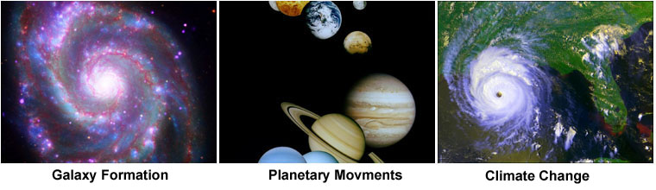
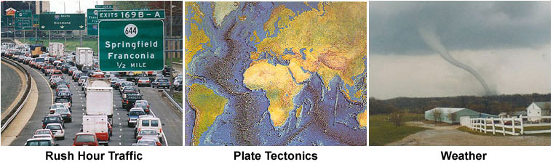
Study complex phenomena
1. Why parallel computing?
- In the natural world, many complex, interrelated events are happening at the same time,
yet within a temporal sequence.
- Interrelated events happen concurrently.
- Compared to serial computing, parallel computing is much better suited for modelling,
simulating and understanding complex, real world phenomena.
-
https://computing.llnl.gov/tutorials/parallel_comp/

Slide 8
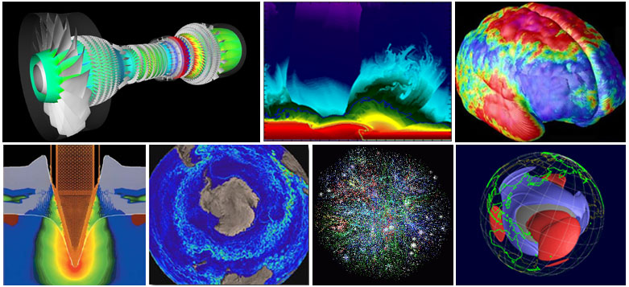
Past: parallel computing = high-end science*
1. Why parallel computing?
*with special-purpose hardware
Parallel computing has been used to model difficult problems in many areas of science and engineering:
Atmosphere, Earth, Environment
Physics - applied, nuclear, particle, condensed matter, high pressure, fusion, photonics
Bioscience, Biotechnology, Genetics, Chemistry, Molecular Sciences
Geology, Seismology Defense, Weapons
...

Slide 9

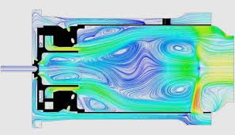
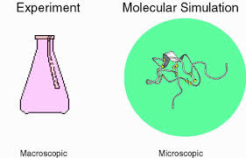

Today: Parallel computing = every day (industry, academia) computing
1. Why parallel computing?
Pharmaceutical design
Data mining
Financial modelling
Advanced graphics, virtual reality
Artificial intelligence/Machine learning
...

Slide 10
Why parallel computing?
1. Why parallel computing?
HPC helps with:
-Huge data
→ Data management in memory
→ Data management on disk
-Complex problems
→ Time consuming algorithms
→ Data mining
→ Visualization
Requires special purpose solutions in terms of:
→ Processors
→ Networks
→ Storage
→ Software
→ Applications

Slide 11
Why parallel computing* (II)
1. Why parallel computing?
Transmission speeds
Speed of a serial computer is directly dependent on how fast data can be moved through hardware. Absolute limits are the speed of light (30cm/ns) and the transition limit of copper wire (9cm/ns). Increased speeds necessitate increasing proximity of processing elements.
Limits of miniaturization
Processor technology is allowing an increasing number of transistors to be placed on a chip. However, even with atomic-level components, a limit will be reached on how small components can be.
Economic limits
It is increasingly expensive to make a single processor faster. Using a larger number of commodity processors to achieve same (or better) performance is less expensive.
Energy limits
Limits imposed by cooling needs for chips and supercomputers.
*List from P. Koumoutsakos

Slide 12
A way out
1. Why parallel computing?
- Current computer architectures are increasingly
relying upon hardware level parallelism.
- Multiple execution units.
- Multi-core.

Slide 13
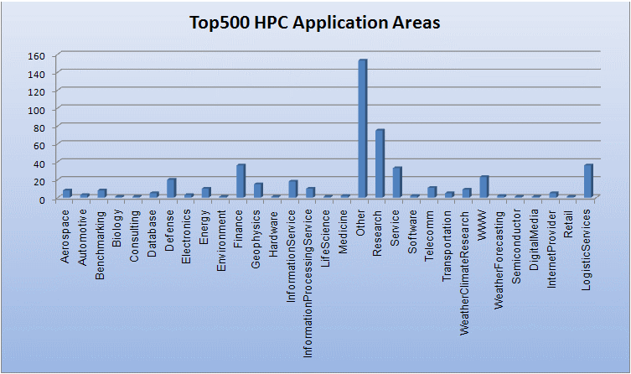
Who and what applies parallel computing?
1. Why parallel computing?
top500.org

Slide 14

Why should YOU parallelize your code?
1. Why parallel computing?
- A single core may be too slow to perform the required task(s) in a “tolerable” amount of time. The definition of “tolerable” certainly varies, but “overnight” is often a reasonable estimate.
-The memory requirements cannot be
met by the amount of memory which
is available on a single “Desktop”.

Slide 15

Heterogeneity in Nature –
Stylized modelling not always possible
1. Why parallel computing?
- Supernova explosions – observable.
- Modelling in 1D:
→ incl. fancy (GR/nuclear) physics.
→ no explosions.
→ only 1D models.
due to lack of compute power
(early 2000's).
- Only recently (last ~5y):
`realistic' 3D models possible to run
on supercomputers
→ resources now available.
→ stylized models not sufficient.
Fig.: February 24, 1987; SN 1987A in the large Magellanic cloud.
Closest SN next to earth since 1604.
Distance from earth: ~50 kpc; ~ 150'000 LY.
1 kpc = 3.08 x 10¹⁹ m, 1 LY = 9.46 x 10¹⁵ m
Progenitor: 20 Msun

Slide 16
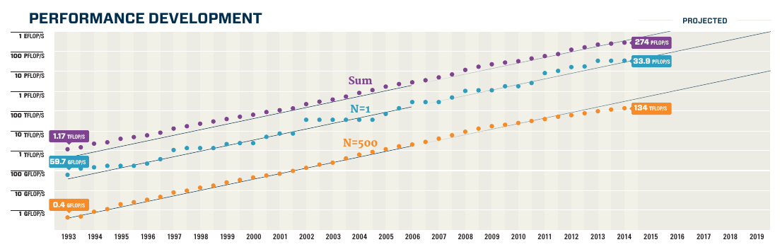
Supercomputers
1. Why parallel computing?
www.top500.org
1995
1995
2000
2005
2010
2015
- HPC “third” pillar of science – nowadays is the dawn of an era
(in physics, chemistry, biology,...,next to experiment and theory).
- `In Silico' experiments.
- Modern Supercomputers (e.g. Piz Daint, Europe's fastest)
25 x 10¹⁵ Flops/Sec. →1 day vs. Laptop: 3500y.

Slide 17
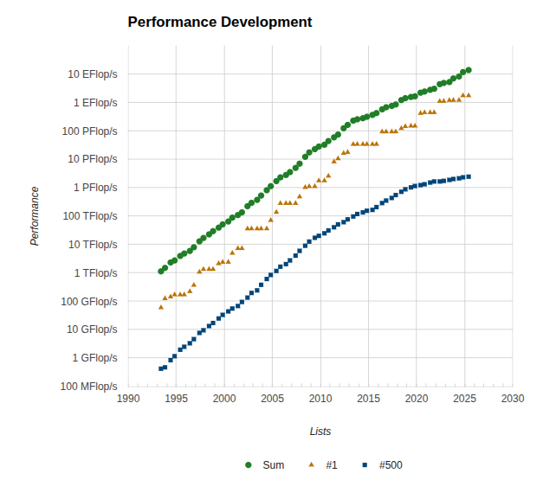
Supercomputers
1. Why parallel computing?
- HPC “third” pillar of science – nowadays is the dawn of an era
(in physics, chemistry, biology,...,next to experiment and theory).
- `In Silico' experiments.
- Modern Supercomputers (e.g. Summit at Oak Ridge National Lab)
1000 x 10¹⁵ Flops/Sec. →1 day vs. Laptop: ~100,000y.

Slide 18
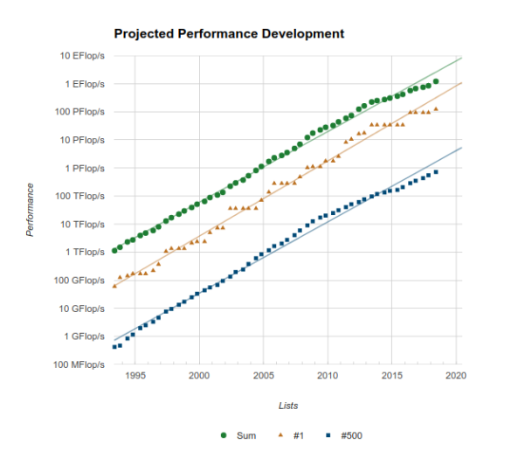
Supercomputers
1. Why parallel computing?
Samsung Galaxy S6: ~34.8 GFLOP/s
→ Move away from stylized models towards “realistically-sized” problems.
→ Creating `good' HPC software can be very difficult...

Slide 19
Supercomputers vs. Smartphone
1. Why parallel computing?
http://pages.experts-exchange.com/processing-power-compared/
www.top500.org
Samsung Galaxy S6: ~34.8 GFLOP/s
1995
1995
2000
2005
2010
2015
→ Move away from stylized models towards “realistically-sized” problems.
→ Creating `good' HPC software can be very difficult...

Slide 20
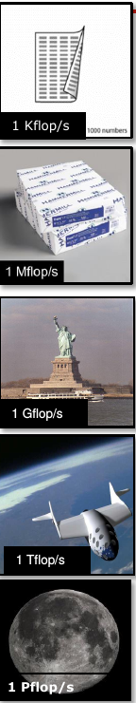
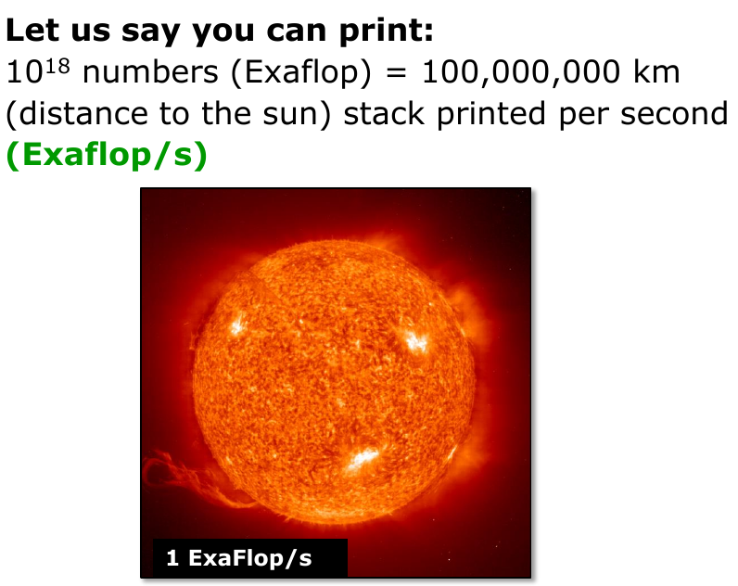
Petascale Computers – How can we tap them?
1. Why parallel computing?
- Modern Supercomputers (Summit, World’s fastest)
200 x 10¹⁵ Flops/Sec. →1 day vs. Laptop: ~30,000y
*Slide adjusted from O. Schenk

Slide 21
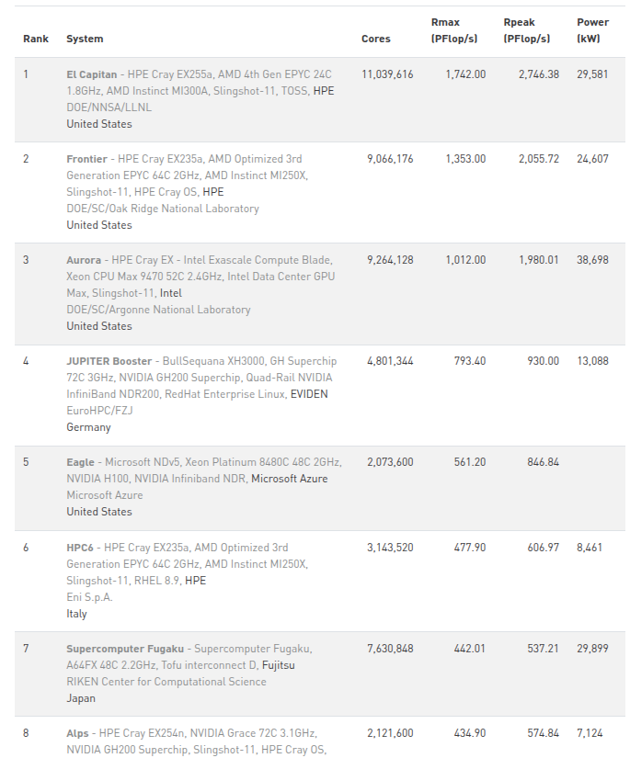
www.top500.org (June 2025)
1. Why parallel computing?

Slide 22
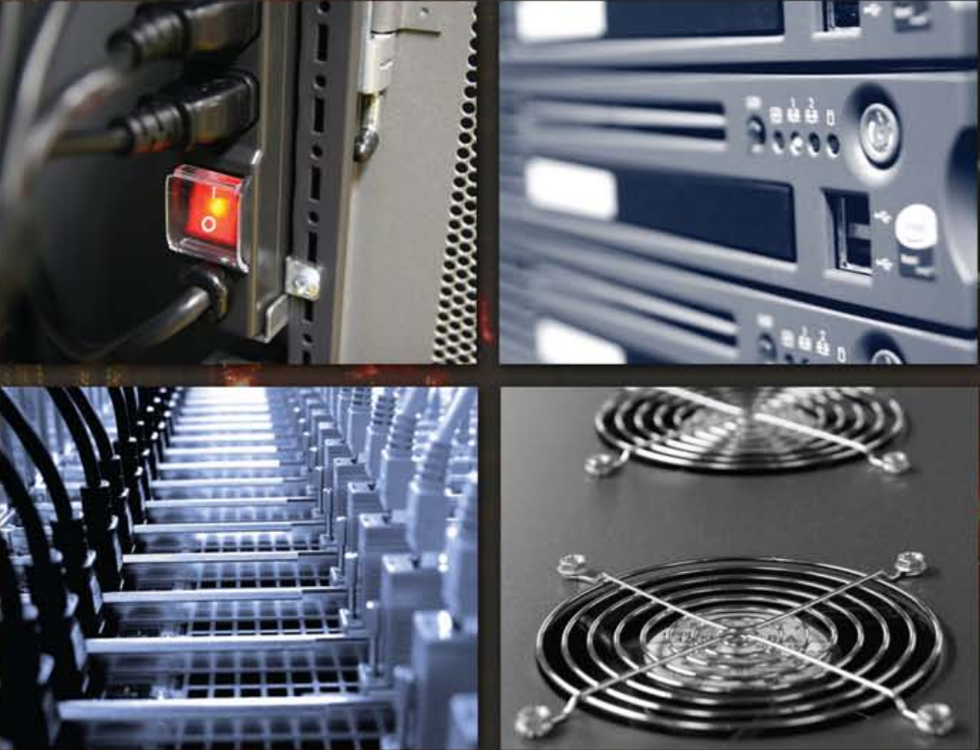
II. Contemporary hardware

Slide 23
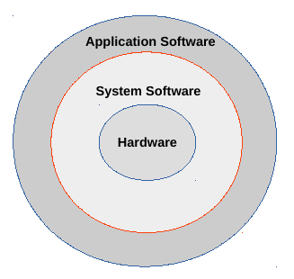
Hardware and how to use it
2. Contemporary hardware
- The hardware can execute only simple low-level instructions (load,...)
- Complex applications (abstract models and their representation as high-
level code) are separated from simple instructions by multiple layers.
- System Software
Operating System:
- I/O operation.
- Storage & memory.
- Protection among concurrent applications.
Compilers:
- Translate from high level language
such as C++ to hardware instructions.

Slide 24
From a programming language to hardware
2. Contemporary hardware
http://cse-lab.ethz.ch/index.php/teaching/42-teaching/classes/577-hpcsei
A computer is a “stupid” device, only understands “on” and “off”.
The symbols for these states are 0 and 1 (binary).
First programmers communicated in 0 and 1.
Later programs where developed to translate from symbolic notation to binary. The first was called “assembly”.
> add A, B (programmer writes in assembly language)
> 1000110010100000 (assembly translates to machine language)
Advanced programming languages are better than Assembly for
→ programmer thinks in a more natural language
→ productivity of software development
→ portability

Slide 25
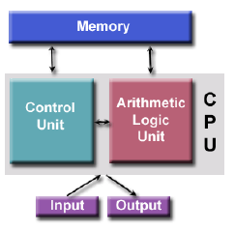
Basics: von Neumann Architecture
2. Contemporary hardware
https://computing.llnl.gov/tutorials/parallel_comp
Virtually all computers have followed this basic design.
Comprised of four main components:
→ Memory, Control Unit, Arithmetic Logic Unit, Input/Output.
Read/write, random access memory is used to store both program instructions and data:
→ Program instructions are coded data which tell the computer to do something.
→ Data is simply information to be used by the program.
Control unit:
→ fetches instructions/data from memory, decodes the instructions and
then sequentially coordinates operations to
accomplish the programmed task.
Arithmetic Unit:
→ performs basic arithmetic operations.
Input/Output
→ interface to the human operator.
→ Many parallel computers follow this basic design, just multiplied in units.
The basic, fundamental architecture remains the same.

Slide 26
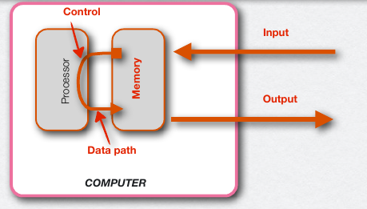
Abstract representation of a computer
2. Contemporary hardware
Five standard components
Input
Output
Memory
Data path
Control
Memory: program and data storage → DRAM chips
Processor: 4). Data path + 5) Control + (cache memory)
Performs arithmetic
operations
Tells the data path memory
and I/O what do do according
to the program
Buffer for DRAM

Slide 27
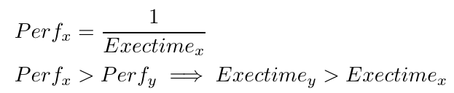

Performance measures
2. Contemporary hardware
- Execution time: time between start and completion of a task.
- Throughput/Bandwidth: total amount of work per elapsed time.
- Performance and execution time:
x is n times faster than y means:

Slide 28
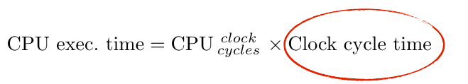
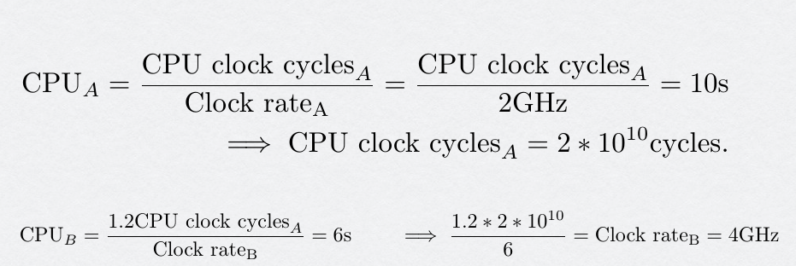
CPU performance and its factors (II)
2. Contemporary hardware
Note: → No reference to the number of instructions (clock cycles) needed by the program
→ 1 /Clock cycle time = Clock rate
Example:
Program runs in 10s on a processor A which has a 2GHz clock rate. How to design a computer B to run this program in 6s? Design consideration: Possible to increase in clock rate but then B will require 1.2 as many clock cycles as A for this program.
Example from http://cse-lab.ethz.ch/index.php/teaching/42-teaching/classes/577-hpcsei

Slide 29
CPU performance and its factors (III)
2. Contemporary hardware
- Compiler generates instructions to execute
- Computer executes these instructions
- Execution time depends on the number of instructions
The number of clock cycles to run a program:
CPU clock cycles = Instructions for a program x Average Clock Cycles Per Instruction (CPI)
Note:
→ CPI provides a way to compare different architectures.
→ Different arithmetic operations may have different numbers of instructions (e.g. x vs. / )

Slide 30
Performance measures (II) – terminology
2. Contemporary hardware
- Wall clock/response/elapsed:
total time (incl. Memory), CPU access, I/O, …, everything.
- CPU execution time:
Processor time spend on a task (system CPU/user CPU – >time)
→ user CPU time: time spend in the program
→ system CPU time: time spend in the operating system
performing tasks on behalf on the
program.

Slide 31
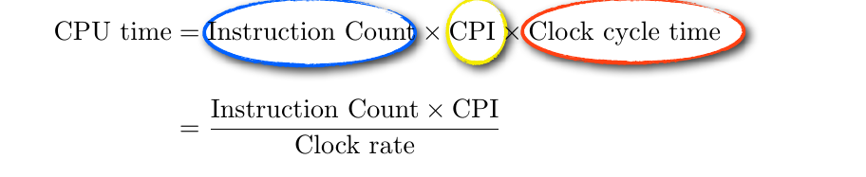
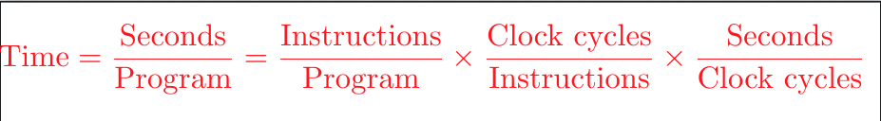
CPU performance equation
2. Contemporary hardware
This expression included the 3 dominant factors that affect performance
Performance is measured in time:
Example from http://cse-lab.ethz.ch/index.php/teaching/42-teaching/classes/577-hpcsei

Slide 32
The free lunch
2. Contemporary hardware
- For a long time speeding up computations was a “free lunch”:
→ the density of the transistors in chips increased,
decreasing the size of integrated circuits.
→ the clock speeds steadily rose, increasing
the number of operations per second (MHz to GHz).
- But the free lunch has been over for a few years now:
→ We are reaching the limitations of transistor density.
→ Increasing clock frequency requires too much power.
→ We used to focus on floating point operations per second.
Now we also think about floating point operations per Watt.

Slide 33
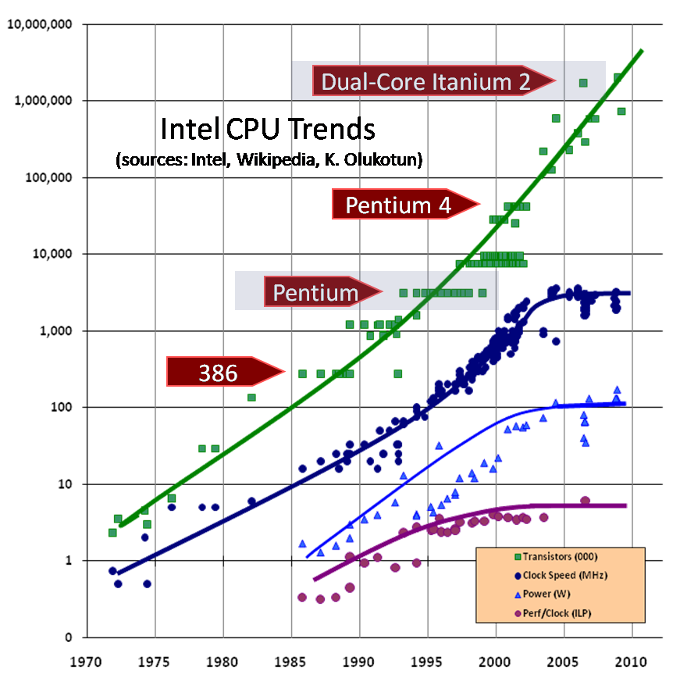
The free lunch is over
2. Contemporary hardware
Clock speed cannot increase
More:
1. heat (too much of it and
too hard to dissipate).
2. current leakage.
3. power consumption
(too high – also memory
must be considered).
Processor performance
doubles every ~18 month:
→ Still true for the number of
transistors.
→ Not true for clock speed
(W ~ f^3 + hardware failures).
→ Not true for memory/storage.

Slide 34
The free lunch is over II*
2. Contemporary hardware
*http://www.gotw.ca/publications/concurrency-ddj.htm (Herb Sutter – tech. evangelist)
“Clock speed isn’t the only measure of performance, or even necessarily a good one, but it’s an instructive one: We’re used to seeing 500MHz CPUs give way to 1GHz CPUs give way to 2GHz CPUs, and so on. Today we’re in the 3GHz range on mainstream computers.”
“If you’re a software developer, chances are that you have already been riding the “free lunch” wave of desktop computer performance. Is your application’s performance borderline for some local operations? “Not to worry,” the conventional (if suspect) wisdom goes; “tomorrow’s processors will have even more throughput, and anyway today’s applications are increasingly throttled by factors other than CPU throughput and memory speed (e.g., they’re often I/O-bound, network-bound, database-bound).” Right?
“Right enough, in the past. But dead wrong for the foreseeable future.
The good news is that processors are going to continue to become more powerful.
The bad news is that, at least in the short term, the growth will come mostly in directions that do not take most current applications along for their customary free ride.”
“But if you want your application to benefit from the continued exponential throughput advances in new processors, it will need to be a well-written concurrent (usually multi-threaded) application. And that’s easier said than done,...”

Slide 35
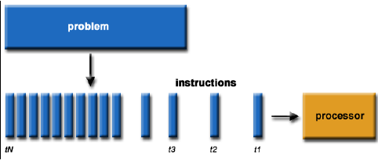
What is parallel computing?
2. Contemporary hardware
Serial Computing:
Traditionally, software has been written for serial computation.
A problem is broken into a discrete series of instructions.
Instructions are executed serially one after another.
Executed on a single processor.
Only one instruction may execute at any moment in time.

Slide 36
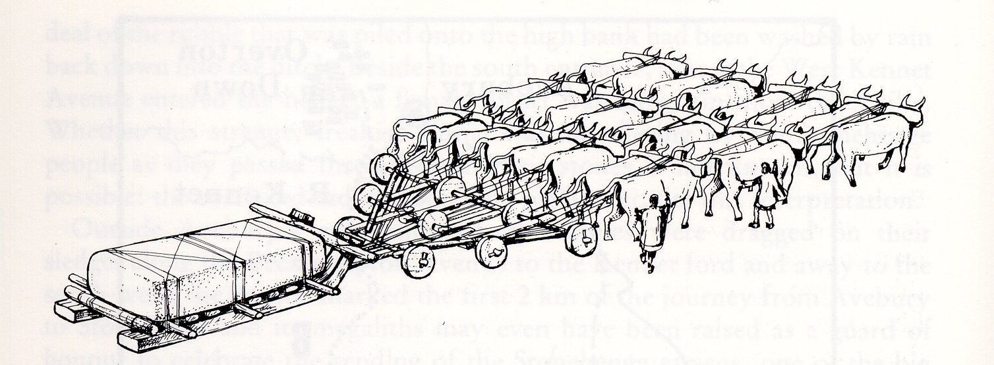
“To pull a bigger wagon, it is easier to add more oxen than to grow a gigantic ox” (Skjellum et al. 1999)
2. Contemporary hardware

Slide 37
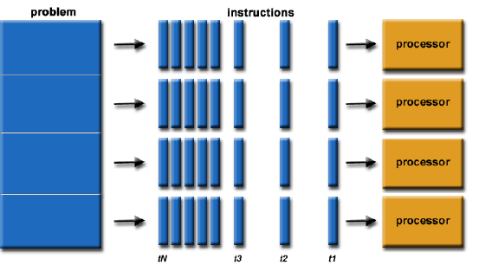
What is parallel computing II?
2. Contemporary hardware
Parallel Computing:
In the simplest sense, parallel computing is the simultaneous use of multiple compute resources to solve a computational problem.
A problem is broken into a discrete series of instructions that can be solved concurrently.
Each part is further broken down to a series of instructions.
Instructions from each part execute simultaneously on different processors.
An overall control/coordination mechanism is employed.

Slide 38
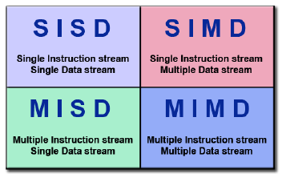
Flynn's Taxonomy
2. Contemporary hardware
https://computing.llnl.gov/tutorials/parallel_comp
There are different ways to classify parallel computers.
One of the most commonly used (since 1966) is Flynn's Taxonomy.
It distinguishes multi­processor computer architectures according to how they can be classified along the two independent dimensions of Instruction Stream and Data Stream.
Each of these dimensions can have only one of two possible states: Single or Multiple.

Slide 39
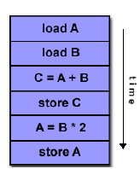
Single Instruction, Single Data (SISD)
2. Contemporary hardware
A serial (non-­parallel) computer.
Single Instruction:
→ Only one instruction stream is being acted on by the CPU
during any one clock cycle.
Single Data:
→ Only one data stream is being used as input
during any one clock cycle.
This is the oldest type of computer.
Examples: single processor/core PCs.

Slide 40
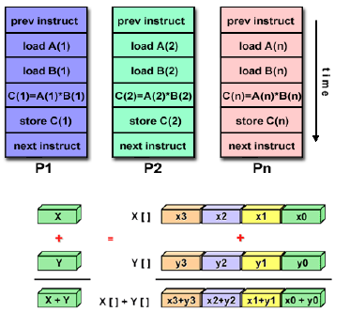
Single Instruction, Multiple Data (SIMD)
2. Contemporary hardware
A type of parallel computer.
Single Instruction:
→ All processing units execute the same instruction at
any given clock cycle.
Multiple Data:
→ Each processing unit can operate on a different data element.
Best suited for specialized problems
characterized by a high degree of regularity.
Most modern computers, particularly
those with graphics processor units (GPUs)
employ SIMD instructions and execution units.

Slide 41
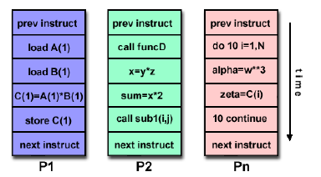
Multiple Instruction, Multiple Data (MIMD)
2. Contemporary hardware
2. Contemporary hardware
A type of parallel computer.
Multiple Instruction:
→ Every processor may be executing a different
instruction stream.
Multiple Data:
→ Every processor may be working with a different
data stream.
Currently, the most common type of
parallel computer ­ most modern
supercomputers fall into this category.
→ Note: many MIMD architectures also
include SIMD execution sub­components.

Slide 42
Speedup, Efficiency & Amdahl's Law
2. Contemporary hardware
T(p,N) := time to solve problem of total size N on p processors.
Parallel speedup: S(p,N) = T(1,N)/T(p,N)
→ Compute same problem with more processors in shorter time.
Parallel Efficiency: E(p,N) = S(p,N)/p
Amdahl's Law: T(p,N) = f * T(1,N) + (1-f) T(1,N)/p
f...sequential part of the code that can not be done in parallel.
S(p,N) = T(1,N)/T(p,N) = 1 / (f + (1-f)/p)
For p → infinity, speedup is limited by S(p,N) < 1/f

Slide 43
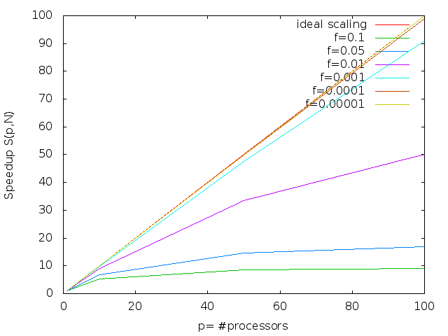
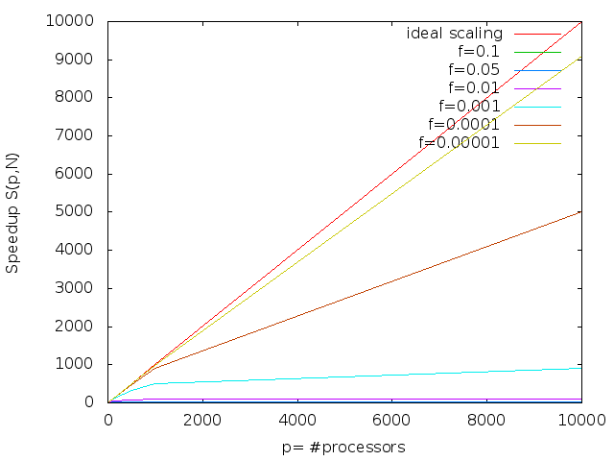
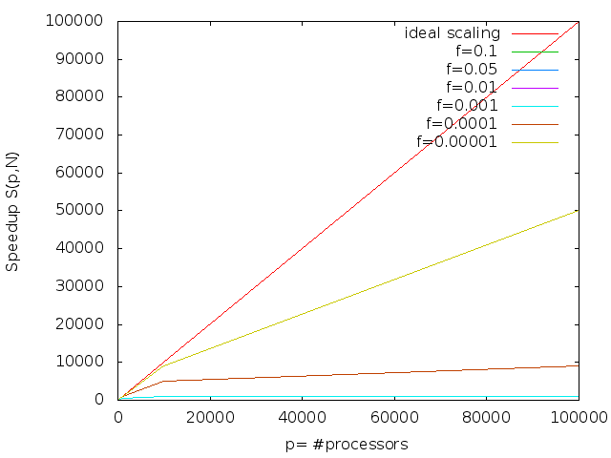
Amdahl's Law: Scaling is tough
2. Contemporary hardware
Work Station
~100 Cores
99.9% Parallel
99% Parallel
For p → infinity:
Speedup is limited by S(p,N) < 1/f
90% Parallel
University's
HPC Cluster
~10k Cores
Today's HPC
99.999% Parallel
→ 50% Efficiency

Slide 44
Weak versus strong scaling
2. Contemporary hardware
Strong scaling:
Is defined as how the solution time varies with the number of processors for a fixed total problem size.
Weak scaling:
Is defined as how the solution time varies with the number of processors for a fixed problem size per processor.

Slide 45
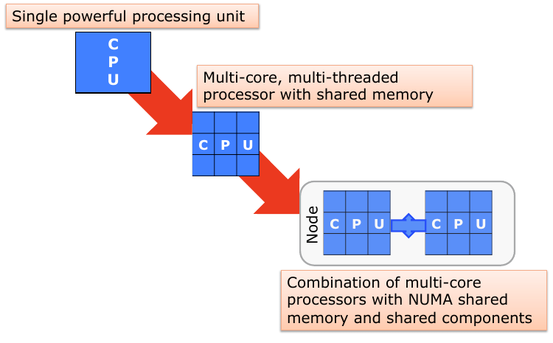
HPC systems: off-shelve components
2. Contemporary hardware
Your “Desktop”
Virtually all stand-alone computers today
are parallel from a hardware perspective.

Slide 46
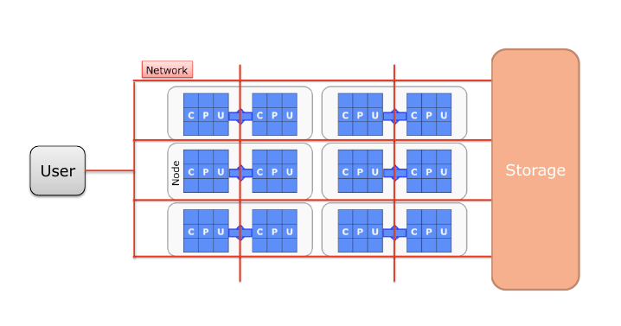
HPC systems
2. Contemporary hardware
→ Each compute node is a multi-processor parallel computer itself.
→ Multiple compute nodes are networked together.
→ Building blocks need to communicate (via the network) and give feedback (User/Storage).

Slide 47
Strengths of Commodity Clusters
2. Contemporary hardware
- Excellent performance to cost.
- Exploits economy of scale.
→ Through mass-production of components
→ Many competing cluster vendors
- Flexible just-in-place configuration.
→ Scalable up and down
- Rapid tracking of technology.
→ First to exploit newest components
- Programmable.
→ Uses industry standard programming languages and tools
- User empowerment.
→ Low cost, ubiquitous systems
→ Programming systems make it relatively easy to program for expert users
- nearly all of TOP-500 deployed systems commodity clusters.

Slide 48
Limitations of Commodity Clusters
2. Contemporary hardware
- Not ideal for all workload classes.
- Reduced efficiencies for many problems.
→ Compared to MPPs (Massively Parallel Processing)
→ Due to networks exhibiting lower bandwidth and higher latencies & overheads
- Lower space density
→ Takes up more room (floor space) than comparable peak performance MPP

Slide 49
Two problems with this model
2. Contemporary hardware
1. pure CPU-systems are becoming too expensive:
- Power consumption.
- Cooling and infrastructural costs (can be O(mio $/year) ).
→e.g. one Olympic swimming pool per hour cooling water needed.
2. It is hard to increase the performance:
- Speed-up the processor.
- Increase network bandwidth.
- Make I/O faster.
- ...

Slide 50
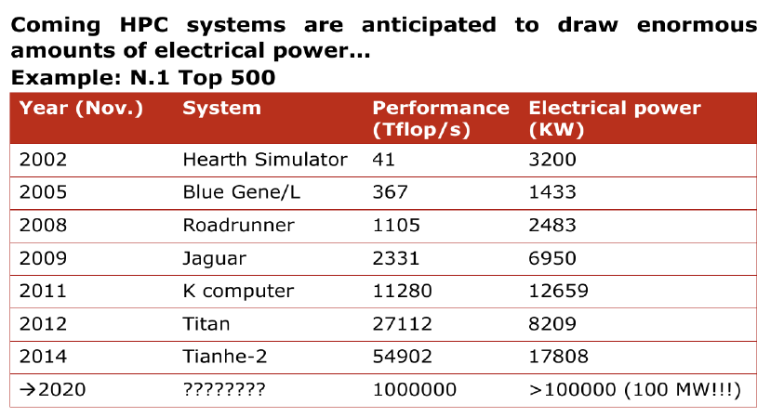
HPC system's power consumption
2. Contemporary hardware
...how to get 1000x more performance without building a nuclear power plant next to your HPC? (J. Shalf, September 09, Lausanne/Switzerland)
→ Not sustainable

Slide 51
Improving performance: multi & many-cores
2. Contemporary hardware
Adding more and more “classical” cores can increase the computing power without having to increase the clock speed. However:
→ Hardware strongly limits the scalability.
Progressively, a new generation of processors with less general, more specialized architecture, capable superior performance on a narrower range of problems, is growing:
Many-core accelerators:
→Nvidia Graphics Processor Units (GPUs).
→Intel Xeon Phi Many Integrated Cores (MIC) architecture.
→TPU (Tensor Processing Units)
→...
They all support a massively parallel computing paradigm.

Slide 52
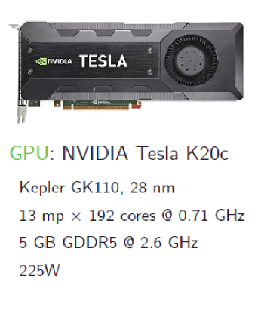
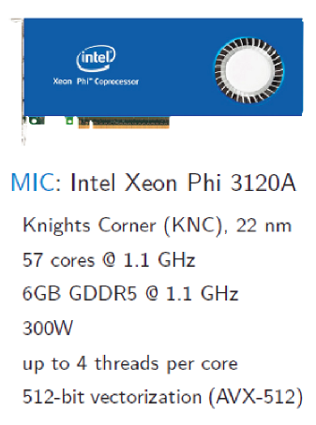
2 types of “Accelerators”
2. Contemporary hardware
→ Devices can have O(Teraflops)
Slide from D. Mikushin

Slide 53
Why accelerators are more efficient than CPUs?
2. Contemporary hardware
A few reasons:
→ Lower frequencies of GPU clocks.
→ More of the transistors in a GPU are working on
the computation. CPUs are more general purpose.
They require energy to support such flexibility.
→ Single Instruction Multiple Data (SIMD) approach,
which leads to a simpler architecture and instruction set.

Slide 54



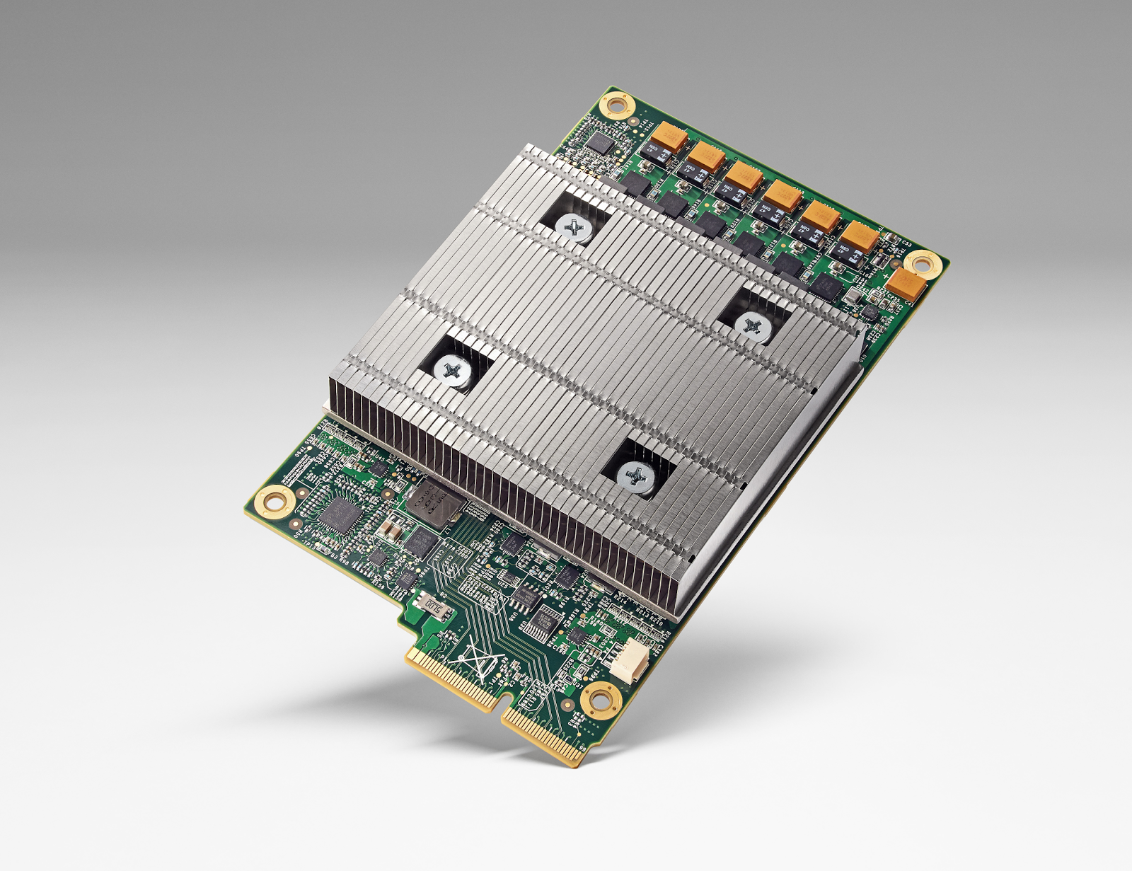




More hardware accelerators for ML*
2. Contemporary hardware
FPGA – field programmable gate arrays
TPU – Tensor Processing Unit
GPU
Lake Crest

Slide 55
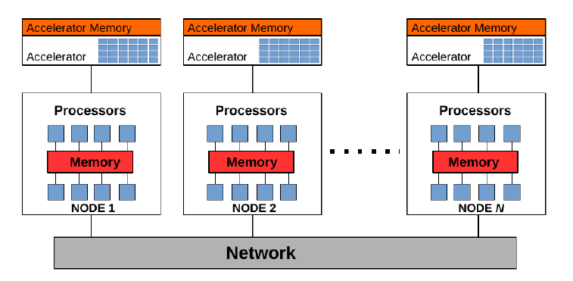
Today's HPC systems
2. Contemporary hardware

Slide 56
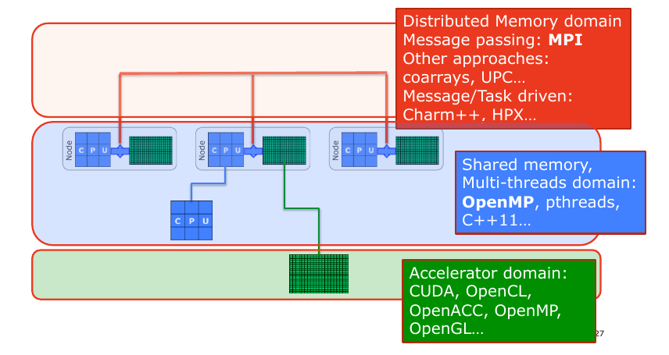
Overall picture of programming models
2. Contemporary hardware
(Slide from C. Gheller)

Slide 57
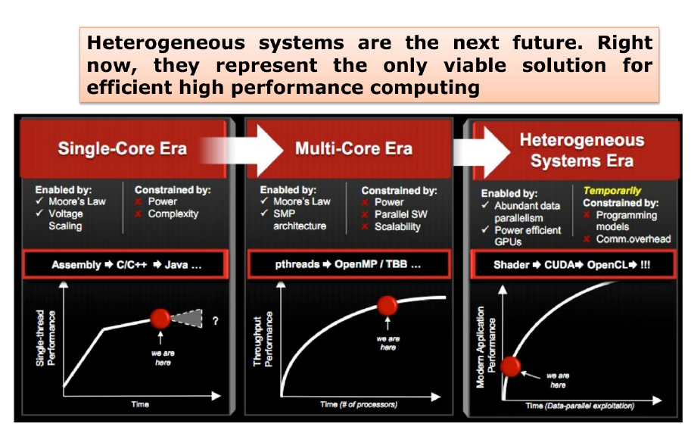
Where are we going?
2. Contemporary hardware
(Slide from C. Gheller)

Slide 58
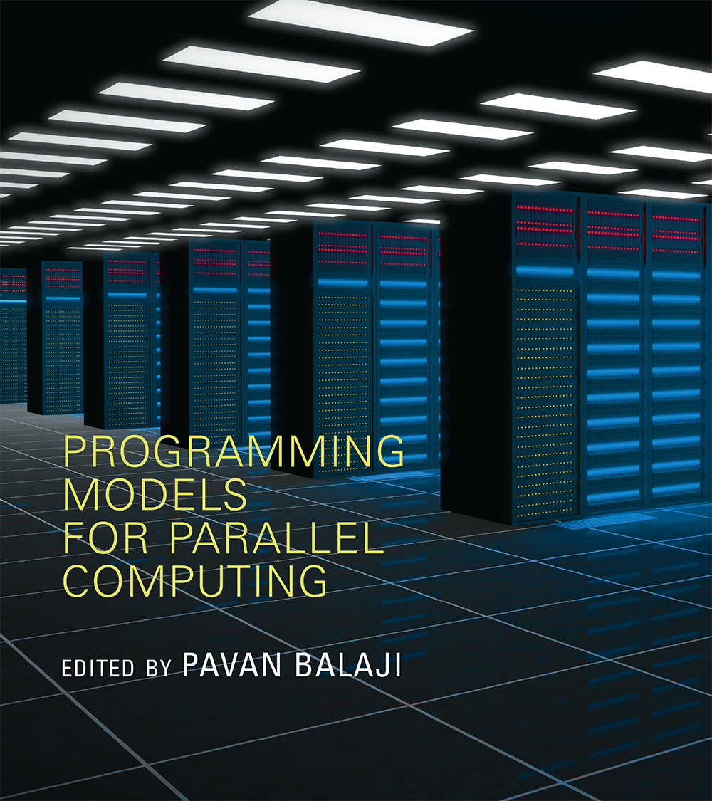
3. Programming Models

Slide 59
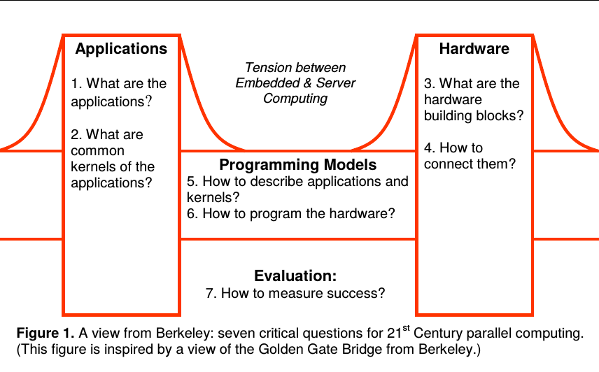
Questions for parallel programming
3. Programming models
Asanovic et. al. (2006) – The landscape of Parallel Computing Research: A View from Berkeley

Slide 60
Programming models: Overview
3. Programming models
There are several parallel programming models in common use:
1. Shared Memory (without threads)
2. Threads
3. Distributed Memory / Message Passing
4. Data Parallel
5. Hybrid
6. Single Program Multiple Data (SPMD)
7. Multiple Program Multiple Data (MPMD)
Parallel programming models exist as an abstraction above hardware and memory architectures.
Although it might not seem apparent, these models are NOT specific to a particular type of machine or memory architecture. In fact, any of these models can (theoretically) be implemented on any underlying hardware.
Which model to use?
This is often a combination of what is available and personal choice. There is no "best" model, although there certainly are better implementations of some models over others.

Slide 61
Parallel program design: Understand the problem
3. Programming models
- The first step in developing parallel software is to first understand the
problem that you wish to solve in parallel.
- Before spending time in an attempt to develop a parallel solution for a
problem, determine whether or not the problem is one that can actually be
parallelized.
→ Example of Parallelizable Problem: Monte Carlo integration
→ Example of a Non-parallelizable Problem: Calculation of the Fibonacci series
(0,1,1,2,3,5,8,13,21,...) by use of the formula: F(n) = F(n-1) + F(n­-2)
This is a non-parallelizable problem because the calculation of the Fibonacci
sequence as shown would entail dependent calculations rather than independent ones.
The calculation of the F(n) value uses those of both F(n-1) and F(n-2). These three
terms cannot be calculated independently and therefore, not in parallel.
- Identify hotspots (where is the real work being done?)
- Identify bottlenecks in the program
→ are there disproportionally slow regions in code, e.g. I/O; can restructuring of program help?

Slide 62
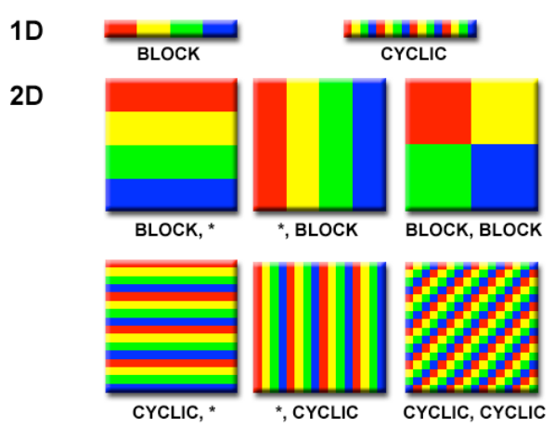
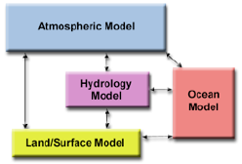
Decomposition of Problem
3. Programming models
https://computing.llnl.gov/tutorials/parallel_comp/
e.g. domain decomposition (e.g. for PDEs)
Functional decomposition
(e.g. for climate modelling)

Slide 63
Communication
3. Programming models
Is communication needed?
The need for communication between tasks depend upon your problem
→ you don't need communications: embarrassingly parallel (e.g. Monte Carlo)
→ you need communications
e.g. stencil computation in a finite difference scheme (data dependency)
→ Cost of communication (e.g. transmit data implies overhead)

Slide 64
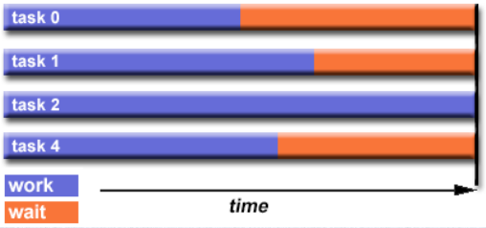
Load balancing
3. Programming models
https://computing.llnl.gov/tutorials/parallel_comp/
- Load balancing refers to the practice of distributing work among tasks so
that all tasks are kept busy all of the time.
- It can be considered a minimization of task idle time.
- Load balancing is important to parallel programs for performance reasons. For example,
if all tasks are subject to a barrier synchronization point, the slowest task will
determine the overall performance.

Slide 65
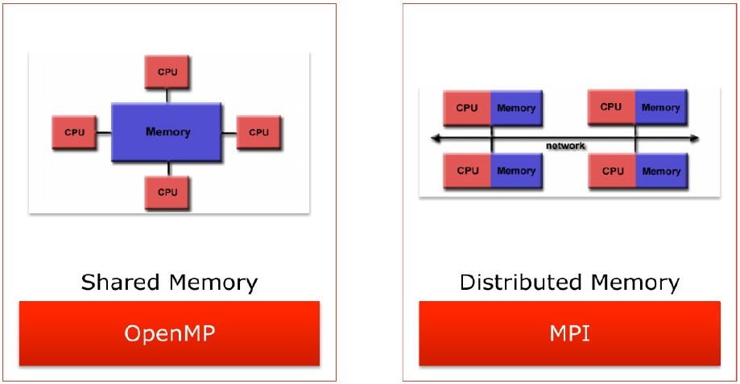
We will consider mainly OpenMP* & MPI**
3. Programming models
*https://computing.llnl.gov/tutorials/openMP/ (Open Multi Processing)
**https://computing.llnl.gov/tutorials/mpi/ (Message Passing Interface)

Slide 66
Using SIMD instruction sets→ Vectorization
3. Programming models
Vectorization performs multiple operations in parallel on a core with a single instruction (SIMD – single instruction multiple data).
Data is loaded into vector registers that are described by their width in bits:
-256 bit registers: 8 x float, or 4x double
-512 bit registers: 16x float, or 8x double
Vector units perform arithmetic operations on vector registers simultaneously.
Vectorization is key to maximising computational performance.

Slide 67
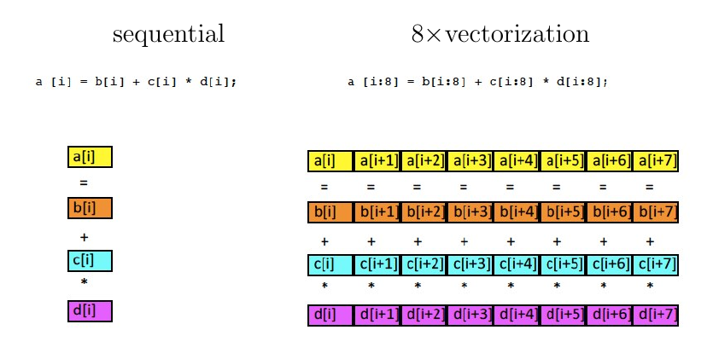
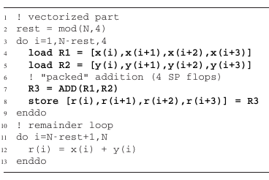
Vectorization illustrated
3. Programming models
In an optimal situation all this
is carried out by the compiler
automatically. Compiler directives
can be used to give hints as to
where vectorization is safe and/or
beneficial.

Slide 68

Advanced Vector Extensions (AVX)
3. Programming models

Slide 69



Shared memory systems
3. Programming models
- Process can access same GLOBAL memory
- Uniform Memory Access (UMA) model
    Access time to memory is uniform.
    Local cache, all other peripherals
    are shared.
- Non-Uniform Memory Access (NUMA) model
    Memory is physically distributed among processors.
    Global virtual address spaces accessible from
    all processors.
    Access time to local and remote data is different.
→ OpenMP, but other
solutions available (e.g. Intel's TBB).
N-

Slide 70
Shared Memory – Pro's & Con's
3. Programming models
Pro's
Global address space provides a user­friendly
programming perspective to memory.
Data sharing between tasks is both fast and uniform due to
the proximity of memory to CPUs.
Con's
Lack of scalability between memory and CPUs. Adding more CPUs
geometrically increases traffic on the shared memory-CPU path...
Programmer responsibility for synchronization constructs that ensure
"correct" access of global memory.

Slide 71


Distributed-memory parallel programming (with MPI)
3. Programming models
- We need to use explicit message passing,
i.e., communication between processes:
→ Most tedious and complicated but also
the most flexible parallelization method.
- Message passing is required if
a parallel computer is of distributed-memory
type, i.e., if there is no way for one processor
to directly access the address space of another.
- However, it can also be regarded
as a programming model and used
on shared-memory or hybrid systems as well.
→Message Passing Interface (MPI).

Slide 72
Parallel programming with MPI
3. Programming models
The Message Passing Interface Standard (MPI) is a message passing library standard based on the consensus of the MPI Forum, which has over 40 participating organizations, including vendors, researchers, software library developers, and users.
The goal of the MPI is to establish a portable, efficient, and flexible standard for message passing that will be widely used for writing message passing programs. As such, MPI is the first standardized, vendor independent, message passing library.
Several MPI implementations exist (Mpich, OpenMPI, IntelMPI, CrayMPI, …).
The current MPI standard currently defines over 500 functions, and it is beyond the scope of this introduction even try to cover them all. Here, I will concentrate on the important concepts of message passing and MPI in particular, and provide some knowledge that will enable you to consult more advanced textbooks and tutorials.

Slide 73

Message Passing Interface (MPI)
3. Programming models
- Resources are LOCAL (different from shared memory).
- Each process runs in an “isolated” environment. Interactions requires
Messages to be exchanged
- Messages can be: instructions, data, synchronization.
- MPI works also on Shared Memory systems.
- Time to exchange messages is much larger than accessing local
memory.
→ Massage Passing is a COOPERATIVE
Approach, based on 3 operations:
SEND (a message)
RECEIVE (a message)
SYNCHRONIZE

Slide 74
MPI availability
3. Programming models
- MPI is standard defined in a set of documents compiled by a
consortium of organizations : http://www.mpi-forum.org/
- In particular the MPI documents define the APIs
for C, C++, FORTRAN77 and FORTRAN 90.
- Bindings available for Perl, Python, Java...
- In all systems MPI is implemented as a library of
subroutines/functions over the network drivers and primitives.

Slide 75

GPU Programming
3. Programming models

Slide 76

GPU Programming II
3. Programming models

Slide 77
Degrees of Parallelism
3. Programming models
Current supercomputers are hybrid.
There are 4 main degrees of parallelism on multi-core
(HPC) systems.
Parallelism among nodes/sockets (e.g. MPI).
Parallelism among cores in a socket (e.g. OpenMP).
Vector units in each core (e.g. AVX).
Accelerators...
→ All should be exploited at once (→lecture next week)

Slide 78

Your competitors in the US
3. Programming models
http://cowles.yale.edu/news/cowles-funds-special-access-high-performance-computing

Slide 79

Questions?

