Slide 1
Big Data Management & Analytics
BAIS:6110 Fall 2020
Master’s in Business Analytics

Slide 2
Outline
Hive Tables
Create Hive Tables in Databricks
Exercise #1

Slide 3
Preparation
Login at Databricks.
We will use it soon.
https://adb-7288810862666674.14.azuredatabricks.net/

Slide 4
Creating Table using Databricks
Create a table like this in HIVE
5 columns, 5 rows, using the file “employee.txt” under /users/<your hawkid>
See Part I slides if you don’t know where to find it.
eid | Name | Salary | Title | Dept
S001 | Alexis Sanchez | 80000 | Manager | Sales
S002 | Santi Carzola | 40000 | Sr. Sales Rep | Sales
S003 | Alex Iwobi | 30000 | Sales Rep | Sales
A001 | Luis Suarez | 80000 | Manager | Accounting
A002 | Theo Walcott | 40000 | Accountant | Accounting

Slide 5
Creating Tables
Databricks format
Hive format
use xunzhou;
DROP TABLE employee;
CREATE TABLE employee
(eid string,
name string,
salary double,
title string,
dept string)
USING CSV
LOCATION ‘/users/xunzhou/’;
Column definitions
Input data format
Path to files

Slide 6
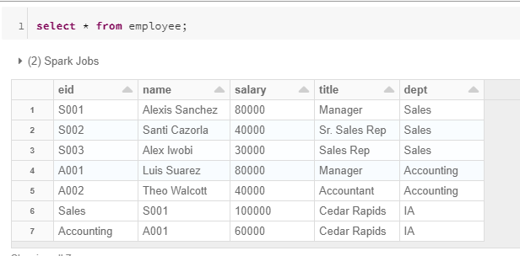
Creating Tables
This command is used for batch loading
All the files in the same directory will be loaded into the table
CREATE TABLE employee
(eid string,
name string,
salary double,
title string,
dept string)
USING CSV
LOCATION '/users/xunzhou/';

Slide 7
Creating Tables
Databricks format
Hive format
use xunzhou;
DROP TABLE employee;
CREATE TABLE IF NOT EXISTS employee
(eid string,
name string,
salary double,
title string,
dept string)
ROW FORMAT DELIMITED
FIELDS TERMINATED BY ','
LINES TERMINATED BY '\n'
STORED AS TEXTFILE;
Column definitions
The fields are delimited in each row.
Field and Line separators
How the table is physically stored

Slide 8
Hive Table vs. MySQL/Oracle Table
Relational Database: data validated when “written into the table”
Hive: data validated when data “read from the table”
When you define a table, you should define how the data to be read
A Hive table is simply a file containing data + metadata
Table Schema
eid | Name | Salary | Title
Linked when loading data
Whether data fits the schema or not is not checked
Data file

Slide 9
Populating Data into Hive Tables
Data From a file in dbfs
Data From other tables

Slide 10
Populating Data into Hive Tables
Data From a file in dbfs
Use the Load command
Load data inpath "/users/xunzhou/employee.txt" into table employee;
Change to the dbfs path of your own file

Slide 11
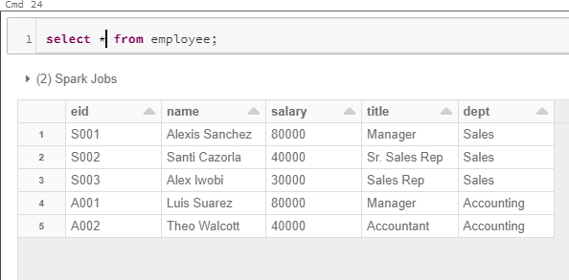
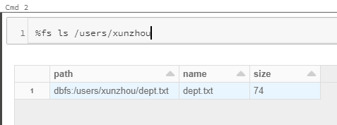
Data Loaded
The file will be “moved” to Hive’s data warehouse directory. The file will no longer be in its original dbfs directory.
!!!

Slide 12
Load Data
Overwrite option: remove existing data and load new data
No primary key or integrity constraints
Duplicated records allowed.
Load data inpath "/users/xunzhou/employee.txt" OVERWRITE into table employee;
Note: change the path to your actual path. Make sure you copy the file to this path again before testing this command

Slide 13
Summary
Use the Databricks format if
You have multiple files in the same folder with the same schema
You want to load all of them into the same table (batch loading).
Use the Hive format if
You have different files in the same folder and you only want to load one of them
You don’t need to keep a copy of the original file in dbfs
What if you need to create a table with a single file but still keep it in dbfs?
Create a folder and put only this file into the folder
Use this folder’s path in the Databricks format code

Slide 14
Drop a table
Drop Table employee;
You can also delete data from Hive tables. But directly dropping the table would be much easier. Create the table again.
DELETE/UPDATE operations are not supported
INSERT is supported

Slide 15
Inserting data into a table
INSERT INTO employee values ('L001', 'No name', 50000, 'CEO', 'NA');
Same as SQL.
You can also insert multiple records in the same command.
INSERT INTO employee values ('L002', 'No name too', 60000, 'CTO', 'NA'), ('L003', 'No name again', 70000, 'CFO', 'NA');

Slide 16
Quick Exercise (no submission needed)
Create a new table called department using Hive format code
use dept.txt in your own directory
CREATE TABLE IF NOT EXISTS department (name string, mgreid string, budget int, city string, state string)
ROW FORMAT DELIMITED
FIELDS TERMINATED BY ','
LINES TERMINATED BY '\n'
STORED AS TEXTFILE;
Name | MgrEid | Budget | City | State
Sales | S001 | 100000 | Cedar Rapids | IA
Accounting | A001 | 60000 | Cedar Rapids | IA
Load data inpath "/users/xunzhou/dept.txt" into table department;
Change it to your own path

Slide 17
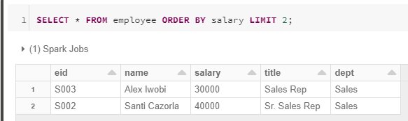
Writing Queries
Simple Queries are the same as SQL
SELECT, FROM, WHERE, GROUP BY, HAVING, ORDER BY
LIMIT N : select the top N rows in result
SELECT * FROM employee ORDER BY salary LIMIT 2;

Slide 18
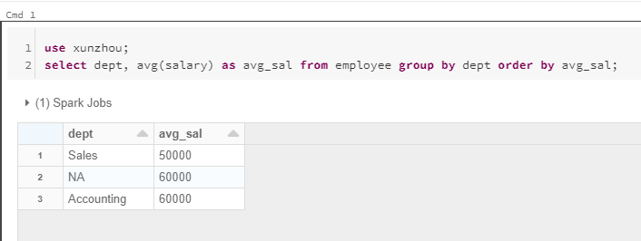
Writing SQL Queries
Calculate the average salary of employees in each department. Order the results by average salary in ascending order

Slide 19
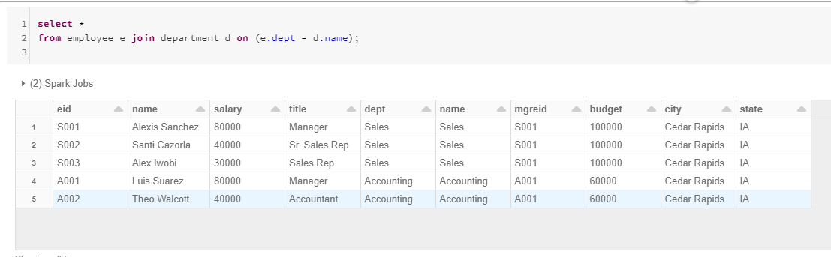
Join
Almost Same as SQL
Use Keyword JOIN ON. Can do INNER/LEFT/RIGHT/FULL JOIN
select *
from employee e join department d on (e.dept = d.name);

Slide 20
Subqueries
Sub-queries are limited in HIVE
In SQL you can write subqueries in FROM, WHERE, and HAVING.
In HIVE you can (up to the recent version)
Write a SELECT subquery in the FROM Clause
The temporary table must have a new name
Not available in other form in WHERE or HAVING

Slide 21
Hive Subquery
Find which department(s) has an average salary more than 50000. Show the department name and the average salary of these departments.
select * From
(select e.dept, avg(salary) as avg_sal from department d join employee e on (d.name=e.dept) group by e.dept) as sal_stat
where avg_sal > 50000;
Select * from sal_stat where avg_sal > 50000;
Replace with a query

Slide 22
IN keyword
The IN keyword is supported in HIVE
In SQL you can write this:
SELECT distinct Name
FROM department WHERE Mgreid IN (Select eid From Employee Where Salary > 50000);
In HIVE you can also do this
But you can only use a single column before the IN keyword

Slide 23
Exercise #1 (Submit on ICON)
Find the nyc_taxi.csv file under dbfs:/datasets/taxi/
Create a table in your own database called nyc_taxi using the UI manually.
A description of the columns can be found next slide.
The file contains a header line. Make sure to handle that.
The file contains yellow taxi trip transactions in NYC in the first week of August 2014. (around 3 million)

Slide 24
Columns and Suggested Data Types
vendor_id String, vendor of the GPS device. 3-character code
pickup_datetime timestamp, time of the pick up time. YYYY-MM-DD HH:MI:SS
dropoff_datetime timestamp, time of the drop off time. YYYY-MM-DD HH:MI:SS
passenger_count int, number of passengers
trip_distance double, trip distance
pickup_longitude double, pickup location longitude coordinate
pickup_latitude double, pickup location latitude coordinate
rate_code int, rate code of the trip, e.g., flat fate, special rate, etc.
store_and_fwd_flag string, a flag that is not useful to us.
dropoff_longitude double, pickup location longitude coordinate
dropoff_latitude double, pickup location latitude coordinate
payment_type string 3-letter code. CRD = Credit, CSH = Cash
fare_amount double,
surcharge double,
mta_tax double,
tip_amount double,
tolls_amount double,
total_amount double
Amounts of fare tax, fees, tips and total charges in US Dollar

Slide 25
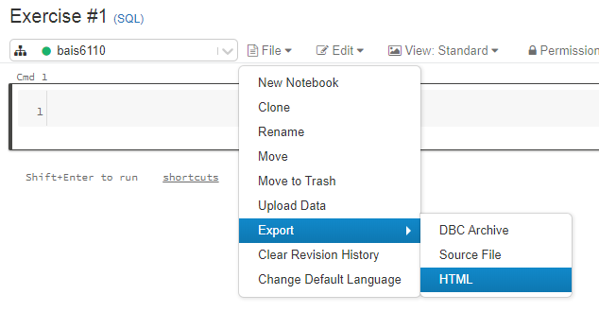
Exercise #1 (Submit on ICON)
Write a query to count the total number of rows in the table.
Write a query to show 10 rows of the table.
Submit your notebook (export as an html file) with the output of the queries
Name it as “Exercise #1”

Slide 26
To Do for this week
1. Submit exercise #1 on ICON.
2. HW1 due in 2 weeks
3. Continue looking for teammates for the project.

