Slide 1
Advanced Hive and Databricks SQL
BAIS:6110 Fall 2020
Master’s in Business Analytics

Slide 2
Reminders
1. Exercise #1, Team formation due today (9/9)
2. HW1 due next week.
3. Project dataset choice due next week.

Slide 3
Preparation
Login at Databricks.
We will use it soon.
https://adb-7288810862666674.14.azuredatabricks.net/

Slide 4
Hive Review
Data Types
Create table and load data, insert, drop table (Hive/Databricks formats)
SQL queries
SELECT, FROM, WHERE, GROUP BY, HAVING, ORDER BY
JOIN
Sub-queries

Slide 5
Exercise #1 (Submit on ICON)
Find the nyc_taxi.csv file under dbfs:/datasets/taxi/
Create a table in your own database called nyc_taxi using the UI manually.
A description of the columns can be found next slide.
The file contains a header line. Make sure to handle that.
The file contains yellow taxi trip transactions in NYC in the first week of August 2014. (around 3 million)

Slide 6
Columns and Suggested Data Types
vendor_id String, vendor of the GPS device. 3-character code
pickup_datetime timestamp, time of the pick up time. YYYY-MM-DD HH:MI:SS
dropoff_datetime timestamp, time of the drop off time. YYYY-MM-DD HH:MI:SS
passenger_count int, number of passengers
trip_distance double, trip distance
pickup_longitude double, pickup location longitude coordinate
pickup_latitude double, pickup location latitude coordinate
rate_code int, rate code of the trip, e.g., flat fate, special rate, etc.
store_and_fwd_flag string, a flag that is not useful to us.
dropoff_longitude double, pickup location longitude coordinate
dropoff_latitude double, pickup location latitude coordinate
payment_type string 3-letter code. CRD = Credit, CSH = Cash
fare_amount double,
surcharge double,
mta_tax double,
tip_amount double,
tolls_amount double,
total_amount double
Amounts of fare tax, fees, tips and total charges in US Dollar

Slide 7
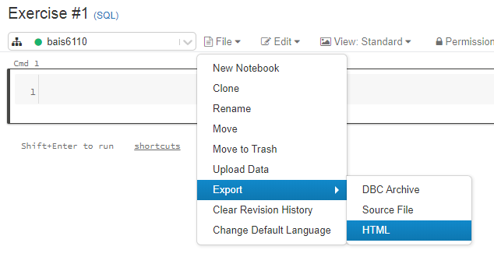
Exercise #1 (Submit on ICON)
Write a query to count the total number of rows in the table.
Write a query to show 10 rows of the table.
Submit your notebook (export as an html file) with the output of the queries
Name it as “Exercise #1”

Slide 8
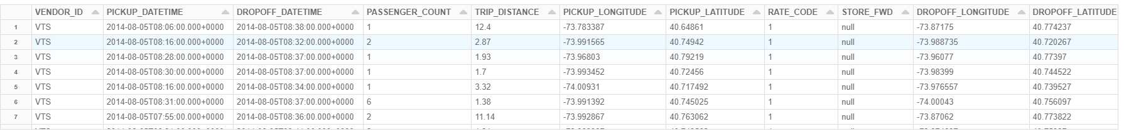

Exercise #1
select * from nyc_taxi limit 10;
select count(*) from nyc_taxi;

Slide 9
Additional Things for Hive Create Table
Loading data into tables
Skip the headings of columns: add at the end of the table definitions
tblproperties ("skip.header.line.count"="2");
CREATE TABLE IF NOT EXISTS employee
(eid char(4),
name string,
salary decimal,
title String,
dept string)
ROW FORMAT DELIMITED
FIELDS TERMINATED BY ','
LINES TERMINATED BY '\n'
STORED AS TEXTFILE
tblproperties ("skip.header.line.count"="2");
Number of rows to skip at the beginning of file

Slide 10
Creating New Tables using Query
Create a new table from a query
Calculate the average salary of each department and save the results as a new table called sal_stat
Create Table sal_stat
ROW FORMAT Delimited
STORED AS textfile
AS
select e.dept, avg(salary) as avg_sal from department d join employee e on (d.name=e.dept) group by e.dept;
Hive format/Databricks format
using CSV

Slide 11
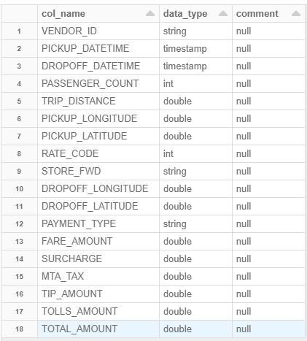
Inspect the table structure
Describe a table structure
describe nyc_taxi;

Slide 12
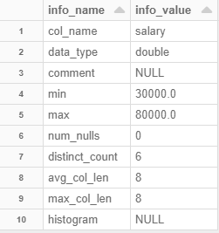
Computing Statistics of Columns
How many unique values are there in salary?
What are the min/max salaries? How many unique values?
First use the compute statistics key words
analyze table employee compute statistics for columns salary;
describe formatted employee salary;
describe formatted [table] [column]

Slide 13
Set Operations
UNION and UNION ALL
UNION is the same as in SQL
Duplicated rows will be removed
Select_statmenet A UNION Select_Statement B;
UNION ALL does not remove duplicated rows
The number and names of columns returned by each select_statement have to be the same
select * from employee where eid like ‘S%’
Union
Select * from employee where eid like ‘A%’

Slide 14
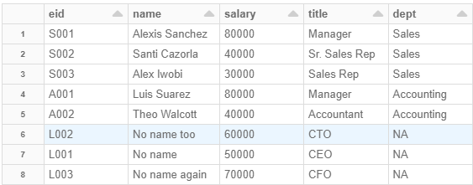
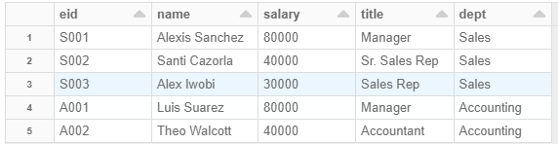

Semi-Join and Anti-Join
Semi-Join: Select only rows from the side of the SEMI JOIN where there is a match. If one row matches multiple rows, only the first match is returned.
employee
select * from employee e left semi join department d on e.dept = d.name;
department

Slide 15

Semi-Join and Anti-Join
Anti-Join: Select only rows from the left side that match no rows on the right side.
employee
select * from employee e left anti join department d on e.dept = d.name;
department

Slide 16
Some Useful Functions in Hive
String Functions
Arithmetic functions
Data and Time functions

Slide 17
Useful Functions
Arithmetic Functions
Round(X): round X to the nearest integer
Ceil(X): get the smallest integer no smaller than X. Ceil (2.5) = 3
Floor(X): get the largest integer no larger than X. Floor (2.5) = 2
rand(X): get a column of random numbers

Slide 18
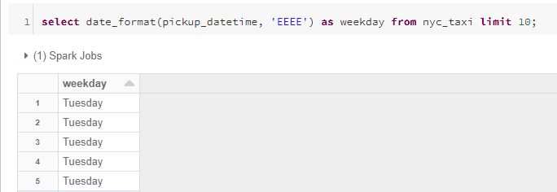
DateTime Functions in HIVE
TM = ‘2016-10-15 09:34:27’ (timestamp)
Year(TM) = 2016
Month(TM) = 10
Day(TM) = 15
Hour(TM) = 9
Minute(TM) = 34
Second(TM) = 27
dayofyear(TM) = 289
Dayofweek(TM) = 7
date_format(TM, 'EEEE') = ‘Saturday’
1 = Sunday, 2 = Monday, …, 7 = Saturday

Slide 19
String Functions
length(‘abc’) = 3
trim(‘ abc ‘) = ‘abc’ : remove whitespaces around the string
ltrm() and rtrim(): trim whitespaces on the left/right of the input string
concat(‘abc’, ‘def’) = ‘abcdef’ concatenate input strings (input can include multiple strings)
substr(‘abcdef’, 3, 2) = ‘cd’
Find the substring in position (3) with length (2)
instr(‘abcdef’, ‘def’) = 4
The position of the substring in the main string. 0 for no matching

Slide 20
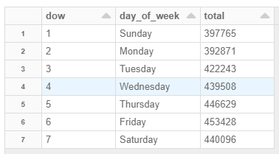
Quick Exercise
Write a query to calculate the total number of trips started on each day of week in the data. Sort the results by day of week (Sunday -> Saturday)
select dayofweek(pickup_datetime) as dow, date_format(pickup_datetime, 'EEEE') as day_of_week, count(*) as total from nyc_taxi
group by dayofweek(pickup_datetime), date_format(pickup_datetime, 'EEEE')
order by dayofweek(pickup_datetime);

Slide 21
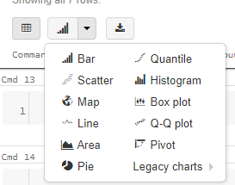
Visualization of Results
Query results can be visualized directly in notebooks
Bar/Pie/Line/Area charts
Stats: Quantile, Q-Q plot, Box Plot, Histogram
Map (only World Countries or U.S. States)

Slide 22
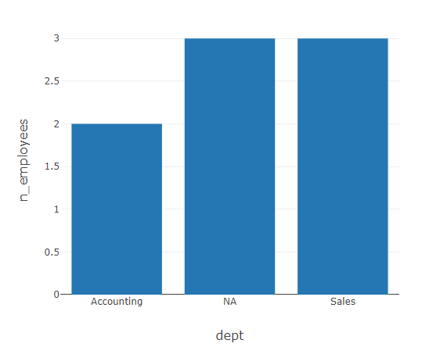
Visualization of Results
Bar/Pie/Line/Area charts
Query should return at least two columns
Use a bar chart to how the number of employees in each department
select dept, count(*) as n_employees from employee
group by dept
order by dept;

Slide 23
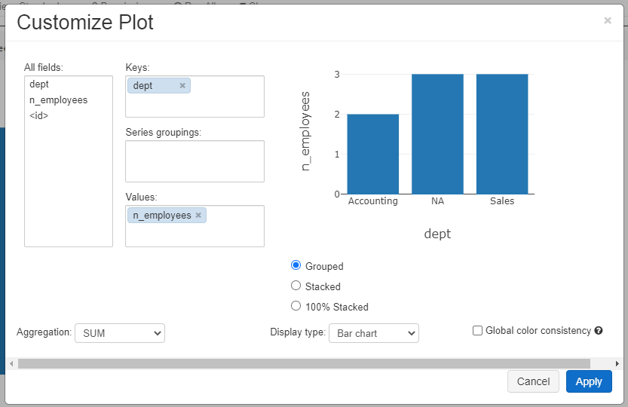

Visualization of Results
Bar/Pie/Line/Area charts
Query should return at least two columns
Use a bar chart to how the number of employees in each department
select dept, count(*) as n_employees from employee
group by dept
order by dept;
Change configurations

Slide 24
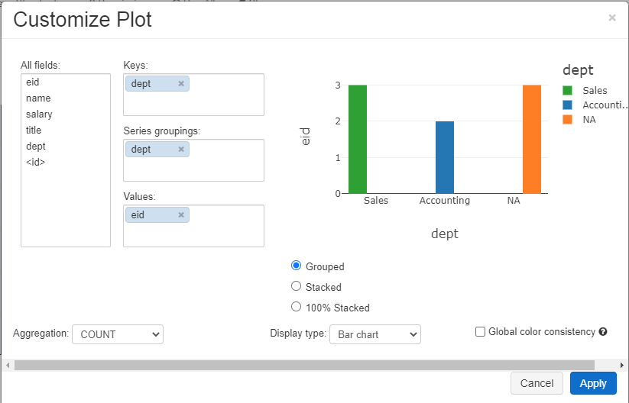
Visualization of Results
Bar/Pie/Line/Area charts
Simple aggregation can be done in the plot as well
Select * from employee;
x-axis
Select all fields without group by in the query
group by column
y-axis
COUNT, SUM. AVG, MIN, MAX

Slide 25
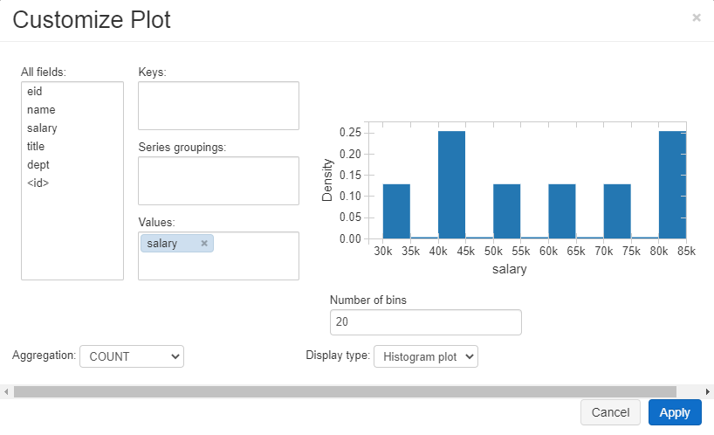
Statistical Plots
Histogram: show value distribution of a column
Select * from employee;

Slide 26
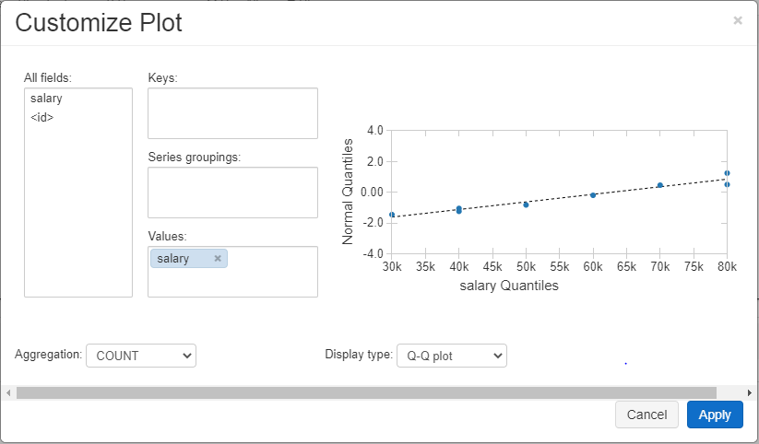
Statistical Plots
Q-Q plot: test if the data follows a normal distribution
select salary from employee;
Points fitting the straight line better
-> data close to normal distribution

Slide 27
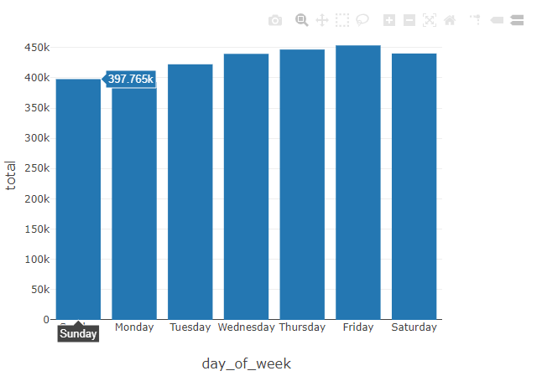
Quick Exercise
Repeat the previous exercise and use a bar chart to visualize the total number of trips on each day of week. Your x-axis should be “Sunday, Monday, … Saturday”.
Plot options

Slide 28
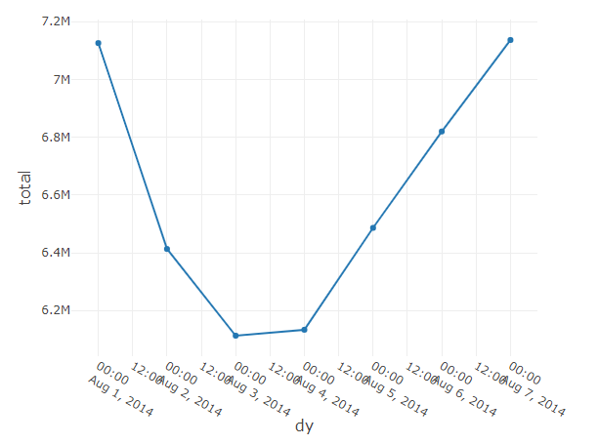
Another Exercise
Show the total revenue of all the taxi drivers over each day (full date) using a line chart.
select round(sum(total_amount),2) as total, date(pickup_datetime) as dy
from nyc_taxi
group by date(pickup_datetime)
order by dy;

Slide 29
To Do for this week
1. Watch Lecture 3 Part 2. Submit Exercise 2.
Partitioned tables
Buckets
2. Finish HW1
3. Pick your project topic.

