Slide 1
Spark and SparkR
BAIS:6110 Fall 2020
Master’s in Business Analytics

Slide 2
Reminders
1. Exercise #2 due today.
2. HW1 due today.
3. Project topic due today (9/9).

Slide 3
Preparation
Login at Databricks.
We will use it soon.
https://adb-7288810862666674.14.azuredatabricks.net/

Slide 4
Review: partitioned table
Static partitioning
Define a “partition column” when create the table (extra column)
Specify partition name (value of the column) when loading the data
Load data from files or other tables into each partition
Load data inpath “/users/xunzhou/employee_sales.txt” into table employee_p partition (dept = ‘Sales’);
Insert into table employee_p partition(dept = 'Sales') select * from employee where dept = ‘Sales';

Slide 5
Review: partitioned table
dynamic partitioning
“Create table” is the same as that for static partitions
Load data only from other tables through a select statement
Last column(s) in SELECT must be the partition column(s)
INSERT OVERWRITE TABLE employee_p Partition (dept)
SELECT eid, Name, Salary, Title, dept as dept_no_query, dept FROM employee;

Slide 6
Exercise #2 (please submit on ICON)
Use the nyc_taxi table created in exercise #1.
Create another table with partitions (nyc_taxi_p). Partition the data by hour of day of the pickup time (dynamic partitioning). There should be 24 partitions. Call this partition column hr.
Load the data from the nyc_taxi table into this new table using a query. Make sure to load each portion of the data into the correct partition. Ignore data with missing pickup_datetime value (null).
Show the total number of rows loaded into each partition using a query. Note: you need to group by hr on the new table. Draw a bar chart to visualize the result with x-axis being hr (in ascending order).
Submit your notebook (named Exercise #2) on ICON.

Slide 7
Exercise #2
CREATE EXTERNAL TABLE IF NOT EXISTS NYC_Taxi_p
(
vendor_id String,
pickup_datetime timestamp,
dropoff_datetime timestamp,
passenger_count int,
trip_distance double,
pickup_longitude double,
pickup_latitude double,
rate_code int,
store_and_fwd_flag char(1),
dropoff_longitude double,
dropoff_latitude double,
payment_type CHAR(3),
fare_amount double,
surcharge double,
mta_tax double,
tip_amount double,
tolls_amount double,
total_amount double
)
Partitioned by (hr int)
ROW FORMAT DELIMITED
FIELDS TERMINATED BY ','
LINES TERMINATED BY '\n'
STORED AS TEXTFILE
Solution 1: Hive format
All the columns from the nyc_taxi table
Partition column, int type

Slide 8
Exercise #2
Solution 1: Hive format
insert into table taxi_nyc_p partition(hr) select *, hour(pickup_datetime) as hr from nyc_taxi;
All the existing columns in nyc_taxi table
Select an additional column as the values for the partition columns
This column contain the hour of each trip. The trips will be grouped into 24 partitions automatically

Slide 9
Exercise #2
Solution 2: Databricks format
No column definitions (automatically inferred from the select query)
Use AS to connect a select query
CREATE TABLE NYC_Taxi_p
USING CSV
Partitioned by (hr)
AS
Select *, hour(pickup_datetime) as hr from nyc_taxi;
No partition column data type, only name

Slide 10
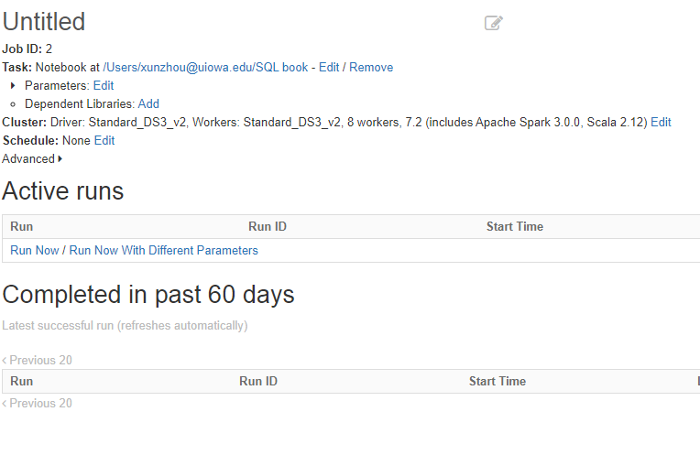
Schedule Jobs (Jobs tab on menu)
If you finished a script but would rather run it at a different time:
Create a job and submit it.
Results will be saved into the notebook.
Run now or at a scheduled time (may repeat)
All the cells will run one by one
Limits on the output:
20MB for the entire script
8MB for each cell.

Slide 11

Spark and SparkR
Spark is an application on top of HDFS for data analysis
Data analysis functions are converted to Map-Reduce algorithms
Databricks re-implements Spark with a Hive data warehouse supporting it

Slide 12




Spark
Spark DataFrames
R data frames
Programming in Spark (API)
Java, Python, Scala, R
Spark SQL
Use SQL-like queries on data frames
Load data from HIVE tables
R package to work with Spark (SparkR)
Hive Tables
Data files

Slide 13
R – Quick Review
A statistical programming language
R data types:
character
numeric (real or decimal)
integer
Logical (Ture/False)
Complex
Use the class() function to show the data type.
R data structure
atomic vector: a sequence of objects of the same type (e.g., numeric or character)
List: a sequence of objects with mixed data types
Matrix: 2-D numeric vectors.
data frame: 2-D tabular data with row names and column names (optional). Mixed data types across columns.
Factors
Keywords and variable names are CASE SENSITIVE (different from SQL)!

Slide 14
R – Quick Review
A variable in R can store an atomic vector, group of atomic vectors or a combination of many Robjects.
A valid variable name consists of letters, numbers and the dot or underline characters. The variable name starts with a letter or the dot not followed by a number
var_name2 valid
var_name% invalid
.var_name. valid
.2var_name invalid
_var_name invalid

Slide 15
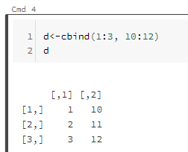
R – Quick Review
Basic elements
sequential statements, value assignment
a = 1
m <- matrix(nrow = 2, ncol = 2)
d <- cbind(1:3, 10:12)
Differences between <- and = ???
Display the value(s) of a variable: simply type the name of the variable

Slide 16
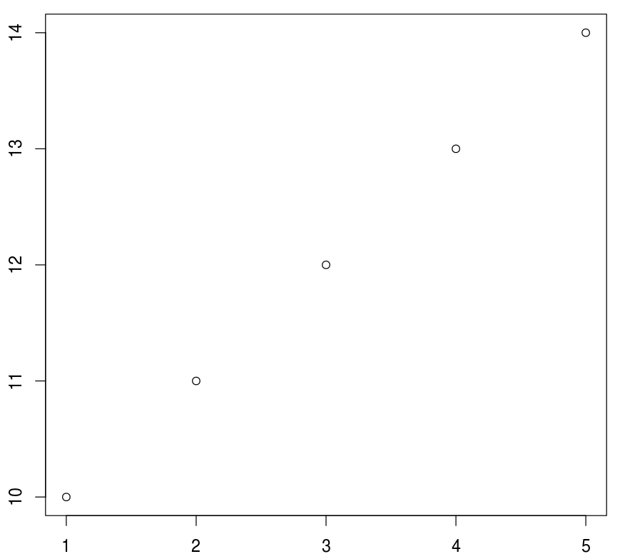
R – Quick Review
Use functions.
R function: function_name(input parameter list).
Case sensitive
Parameters have names and orders. Some are required, others are optional
Return value: the output of the function (optional)
x <- sum(1:5)
print(x)
plot(x=1:5, y=10:14, type=‘p')

Slide 17
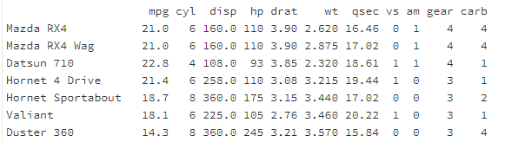
R – Quick Review
A data frame in R is used for storing data tables. It is a list of vectors of equal length.
> n = c(2, 3, 5) > s = c("aa", "bb", "cc") > b = c(TRUE, FALSE, TRUE) > df = data.frame(n, s, b)
Built-in data frames: mtcars
> mtcars[1,2]
> mtcars["Mazda RX4", "cyl"]
> mtcars[1]
> mtcars[1, ]
> mtcars[, 2]
> mtcars$cyl

Slide 18
R – Quick Review
Basic elements
Control statements
if (test_expression) {
statement
}
for (val in sequence)
{
statement
}
x <- 5
if(x > 0){
print("Positive number")
}
x <- c(2,5,3,9,8,11,6)
count <- 0
for (val in x) {
if(val %% 2 == 0) count = count+1
}
print(count)

Slide 19
R – Quick Review
Use packages
Packages are pre-installed and do not need to be installed in databricks.
load packages before calling any functions in these libraries.
library(ggplot2)
call qplot() to draw a figure

Slide 20
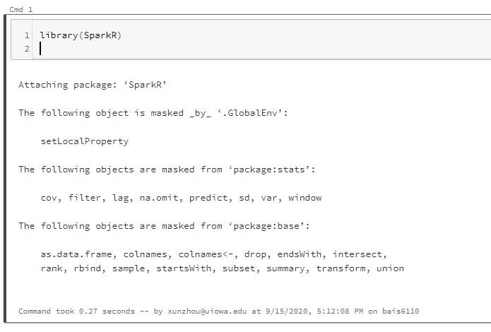
Loading SparkR
Create a notebook with R as the default language.
Load the SparkR package
Attach to the Spark cluster

Slide 21
DataFrame in Spark
The basic data structure of Spark and SparkR is Spark DataFrame
Different from R data frame.
Spark DataFrame is a distributed data structure on top of Hadoop
You cannot directly apply R functions on Spark dataframes

Slide 22
Creating a SparkR DataFrame
You can create a SparkR DataFrame from different sources
A local R data frame
A Hive Table
A Spark data file previously saved
> df <- as.DataFrame(mtcars)
> head(df)
> showDF(df)
Creating a Spark dataframe from a R data frame
R data frame. mtcars is a default dataset in R
head() shows the column names and the first few lines of a Spark dataframe
showDF() shows the entire data frame

Slide 23
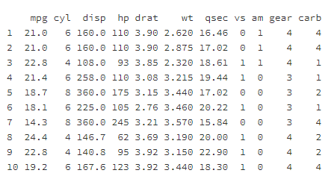
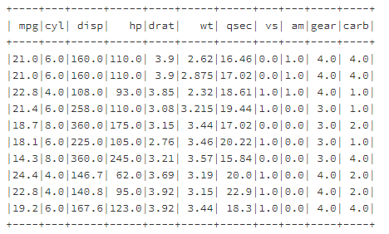

Loading Data from R Data Frame
Create a SparkR data frame from a local R data frame
df <- as.DataFrame(mtcars)
class(df)
Creating a Spark dataframe from a R data frame
head(df, 10)
showDF(df, 10)
head(df, 10) shows the column names and the first 10 lines of a Spark dataframe
showDF(df, 10) shows the first 10 rows of the data frame

Slide 24
Loading Data From Hive Tables
Load data from a hive table
sql() command
sql(“use xunzhou”)
employee <- sql(“SELECT * FROM employee”)
showDF(employee)
Use sql() command to issue SQL query
Quote the query
No semi-colon “;”
employee is the resulting Spark DataFrame containing the output of the SQL command
You need to use showDF() function to show its content.
By default, showDF() will only show 20 rows. Use showDF(DF, n) to show n rows.

Slide 25
Control Hive from SparkR
You can issue SQL from SparkR
Create tables, load data, etc. No need to put semi-colon.
sql(“Create Table ….”)
sql( “Load Data inpath ….”)

Slide 26
Basic DataFrame functions
printSchema(df): show the structure of the columns
The schema is represented as a tree structure to accommodate json data
This is similar to the colnames() in R and DESCRIBE in Hive
> printSchema(employee)
root
|-- eid: string (nullable = true)
|-- name: string (nullable = true)
|-- salary: decimal(10,0) (nullable = true)
|-- title: string (nullable = true)
|-- dept: string (nullable = true)

Slide 27
Exercise-1
Use the nyc_taxi table.
Find the total number of passengers during each hour using SQL
Load the result into R
Show the schema of the data, and the content of the result.
query = “SELECT hour(pickup_datetime) as hr, sum(passenger_count) FROM nyc_taxi group by hour(pickup_datetime) order by hr”
Total_passenger <- sql(query)
printSchema(Total_passenger)
showDF(Total_passenger, 24)

Slide 28
Spark DataFrame Materialization
Like Hive Tables, Spark DataFrames are not generated until queried
query = “SELECT hour(pickup_datetime) as hr, sum(passenger_count) FROM nyc_taxi group by hour(pickup_datetime) order by hr”
Total_passenger <- sql(query)
printSchema(Total_passenger)
showDF(Total_passenger, 24)
This is when the dataframe is actually generated
Need to run Hive query

Slide 29
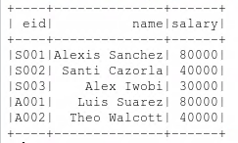
DataFrame Functions(1)
You can “query” the Spark DataFrames like database tables
“Select”, “Where” functions can be applied on Spark DFs
Show the “eid”, “name”, and “salary” columns of the employee DF
> employee <- sql(“SELECT * FROM employee”)
> showDF(select(employee, employee$eid, employee$name, employee$salary))
The original DataFrame
Columns to “SELECT”
SELECT() will generate a new DataFrame. You still need to use showDF to display its content.

Slide 30
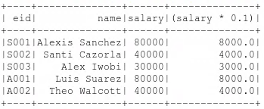
DataFrame Functions(1)
Show the “eid”, “name”, and “salary” columns of the employee DF
Also show the income tax (assuming 10%) of every employee
> showDF(select(employee, employee$eid, employee$name, employee$salary, employee$salary*0.1))
A “derived” column based on original DF
> showDF(select(employee, “eid”, “name”, “salary”))

Slide 31

DataFrame Functions(2)
Use the where() function to filter data
Show the employees with salary above 50,000
here equal is “==” instead of “=”.
“==” is to test if LHS equals RHS. Outcome is True or False.
AND: & OR: | Not:~
> showDF(where(employee, employee$salary>50000))
Where clause condition

Slide 32
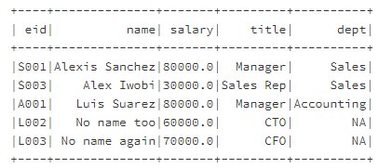
DataFrame Functions(2)
The filter() function can do the same thing
> showDF(filter(employee, employee$salary>50000 | employee$salary<=30000))

Slide 33
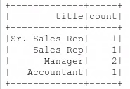
DataFrame Functions(3)
groupBy() function.
Find the number of employees with each title.
This command is equivalent to
SELECT title, count(*) FROM employee GROUP BY title;
showDF(count(groupBy(employee, "title")))

Slide 34
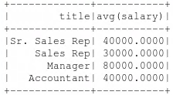
DataFrame Functions(4)
groupBy with other aggregate functions
avg(groupBy(employee, “title”))
Calculate the average of ALL the numeric columns grouped by title
In our data, there is only one numeric column: salary

Slide 35
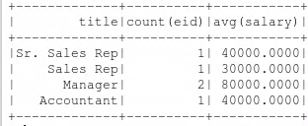
DataFrame Functions(5)
groupBy with other aggregate functions
Aggregate by more than one column
show the number of employees and the average salary of each title
showDF(agg(groupBy(employee, “title"), salary="avg", eid = “count") )
aggregate
List of groupby columns
Average on salary count on eid
Equivalent to:
SELECT title, count(*), avg(salary) FROM employee GROUP BY title;

Slide 36
To Do for this week
1. Watch Lecture 4 Part 2. Submit Exercise 3.
2. Start working on project
3. Start working on HW2 (due 9/30)

