Slide 1
Spark and SparkR Part 2
BAIS:6110 Fall 2020
Master’s in Business Analytics

Slide 2
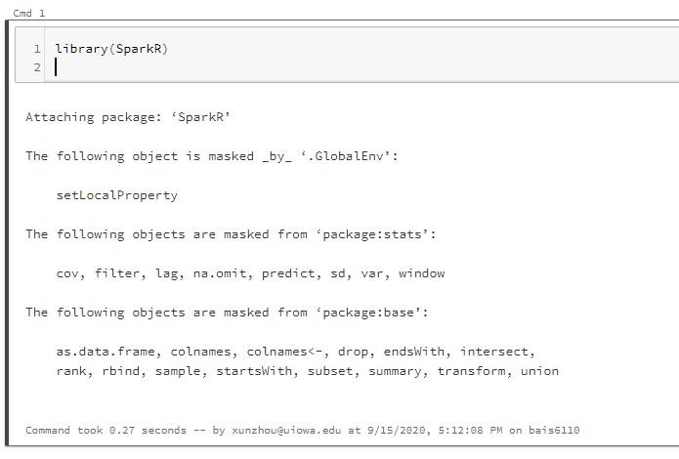
Loading SparkR
Create a notebook with R as the default language.
Load the SparkR package
Attach to the Spark cluster

Slide 3
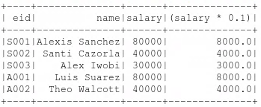
DataFrame Functions(1)
Show the “eid”, “name”, and “salary” columns of the employee DF
Also show the income tax (assuming 10%) of every employee
> showDF(select(employee, employee$eid, employee$name, employee$salary, employee$salary*0.1))
A “derived” column based on original DF
> showDF(select(employee, “eid”, “name”, “salary”))

Slide 4

DataFrame Functions(2)
Use the where() function to filter data
Show the employees with salary above 50,000
here equal is “==” instead of “=”.
“==” is to test if LHS equals RHS. Outcome is True or False.
AND: & OR: | Not:~
> showDF(where(employee, employee$salary>50000))
Where clause condition

Slide 5
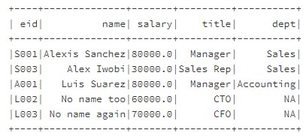
DataFrame Functions(2)
The filter() function can do the same thing
> showDF(filter(employee, employee$salary>50000 | employee$salary<=30000))

Slide 6
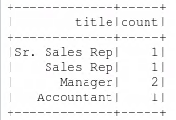
DataFrame Functions(3)
groupBy() function.
Find the number of employees with each title.
This command is equivalent to
SELECT title, count(*) FROM employee GROUP BY title;
showDF(count(groupBy(employee, "title")))

Slide 7
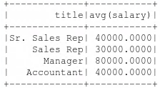
DataFrame Functions(4)
groupBy with other aggregate functions
avg(groupBy(employee, “title”))
Calculate the average of ALL the numeric columns grouped by title
In our data, there is only one numeric column: salary

Slide 8
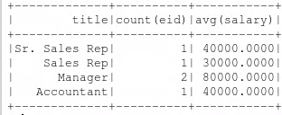
DataFrame Functions(5)
groupBy with other aggregate functions
Aggregate by more than one column
show the number of employees and the average salary of each title
showDF(agg(groupBy(employee, “title"), salary="avg", eid = “count") )
aggregate
List of groupby columns
Average on salary count on eid
Equivalent to:
SELECT title, count(*), avg(salary) FROM employee GROUP BY title;

Slide 9
DataFrame Functions(6)
List of aggregate functions in SparkR
Other functions to use (very similar to Hive)
Datetime functions: year, month, day, hour, minute, second, quarter,…
String functions: substr, length, instr…
Math functions: floor, ceil, round…
countDistinct, count, first, last, max, mean, min, stddev, skewness; stddev_pop, stddev_samp, sumDistinct, sum var_pop, var_samp, var, variance…
dayofmonth()
dayofyear()
dayofweek()

Slide 10
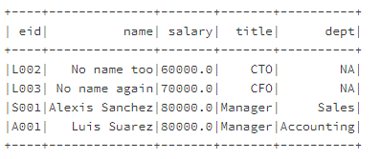
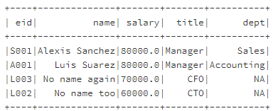
DataFrame Functions(7)
The orderBy() function
Sort data by the value of a column
orderBy(x, col)
Add minus for descending order
employee_filtered_df <- where(employee, employee$salary>50000)
employee_filtered_df_sorted <- orderBy(employee_filtered_df, -employee_filtered_df$salary)

Slide 11
Exercise #3 (submit on ICON)
Use SparkR to perform the following analysis on the taxi dataset
Load the nyc_taxi data into a sparkR DataFrame. You must use sparkR functions rather than the sql() command for the next two questions.
(a) Show the total number of passengers taking taxi in each day of August.
(b) Show the total number of trips in each hour of August 1st.
Order the results by time (day / hour)

Slide 12
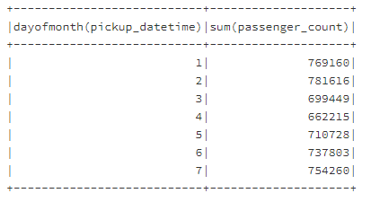
Solution
Show the total number of passengers taking taxi in each day of August.
sql(“use xunzhou”)
taxi_df <- sql(“select * from nyc_taxi”)
passenger_day_df<-agg(groupBy(taxi_df, dayofmonth(taxi_df$pickup_datetime)), passenger_count = "sum")
showDF(orderBy(passegner_day_df, colnames(passegner_day_df)[1]))

Slide 13
Solution
Show the total number of trips in each hour of August 1.
sql(“use xunzhou”)
taxi_df_Aug <- sql(“select * from nyc_taxi”)
taxi_df_Aug1 <- where(taxi_df_Aug, dayofmonth(taxi_df_Aug$pickup_datetime) == 1)
trip_hr_df <- count(groupBy(taxi_df_Aug1, hour(taxi_df_Aug1$pickup_datetime)))
showDF(orderBy(trip_hr_df, colnames(passegner_day_df)[1]), 24)

Slide 14
createOrReplaceTempView
Use the createOrReplaceTempView() to save a dataframe into Hive as a temporary table
Temporary table will be removed once the Spark session ends
sql(“use xunzhou”)
createOrReplaceTempView(employee, “employee_table”)
showDF(sql("show tables"))

Slide 15
Converting SparkR DataFrame to R data frame
Using the collect() function or directly do: as.data.frame()
employee_r <- collect(employee)
> class(employee)
[1] "DataFrame"
attr(,"package")
[1] "SparkR"
> employee_r <- collect(employee)
> class(employee_r)
[1] "data.frame"
> employee_r
eid name salary title
1 S001 Alexis Sanchez 80000 Manager
2 S002 Santi Cazorla 40000 Sr. Sales Rep
3 S003 Alex Iwobi 30000 Sales Rep
4 A001 Luis Suarez 80000 Manager
5 A002 Theo Walcott 40000 Accountant

Slide 16
Converting SparkR DataFrame to R data frame
Then you can use R functions on the data frame
Note: SparkR dataframes can be large. Be careful when you collect the entire SparkR dataframe into R
Plot the salary histogram with binwidth=20000 (number of employees with salary in each of the 20000 bin)
Make sure to check the column data type before plotting

Slide 17
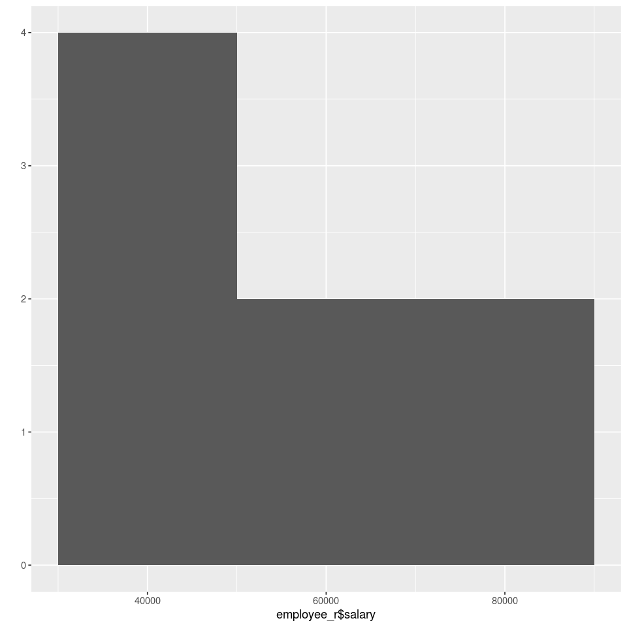
Converting SparkR DataFrame to R data frame
> class(employee_r$salary)
[1] "list"
If salary is not in numeric class
You need to do a conversion (not observed in databricks)
> class(employee_r$salary)<- "numeric"
> class(employee_r$salary)
[1] "numeric"
geom:
“point”, “histogram”, “line”, “path”
library(ggplot2)
qplot(employee_r$salary, geom="histogram", binwidth = 20000)
For “histogram”, only a data column is needed
For “point”, “line”, etc., both x and y columns are needed.
qplot() function
qplot(x, y, data, facets, margins, geom, xlim, ylim, log, main, xlab, ylab, asp, stat, position)

Slide 18
Reading and Writing DataFrames
The default data format in Spark is called “parquet”: a column-based file structure
Save a Spark DataFrame into a parquet file
Load a Spark DataFrame from a parquet file
saveDF(employee,“/users/xunzhou/employee.parquet", "parquet")
File name
Spark DataFrame
File format

Slide 19
Reading and Writing DataFrames
The default data format in Spark is called “parquet”: a column-based file structure
Save a Spark DataFrame into a parquet file
Load a Spark DataFrame from a parquet file
employee<- loadDF(“/users/xunzhou/employee.parquet")

Slide 20
Save DataFrame as a Hive Table
Use command “saveAsTable()
saveAsTable(DataFrame, “table name")
sql(“use xunzhou”)
df <- createDataFrame(mtcars)
saveAsTable(df, "mtcars")
showDF(sql("select * from mtcars"))

Slide 21
Overall Exercise
Use the NYC Taxi Dataset
Load the data into a Spark DataFrame. Then use R to do the analysis:
Plot a line chart to show the number of trips during each hour of August 1
Plot a histogram to show the distribution of trip length (bin width = 1 mile) in the data.
Details will be discussed next week.

Slide 22
Solution Q1
library(SparkR)
sql("use xunzhou")
taxi_day1_df <- sql("select * from nyc_taxi where day(pickup_datetime) = 1")
trip_hr_day1_df <- count(groupBy(taxi_day1_df, hour(taxi_day1_df$pickup_datetime)))
trip_hr_day1_df_r<- collect(trip_hr_day1_df)
colnames(trip_hr_day1_df_r)[1]="hour"
library(ggplot2)
qplot(trip_hr_day1_df_r$hour, trip_hr_day1_df_r$count, geom="line", xlab = 'hour of day', ylab = 'passenger_count')

Slide 23
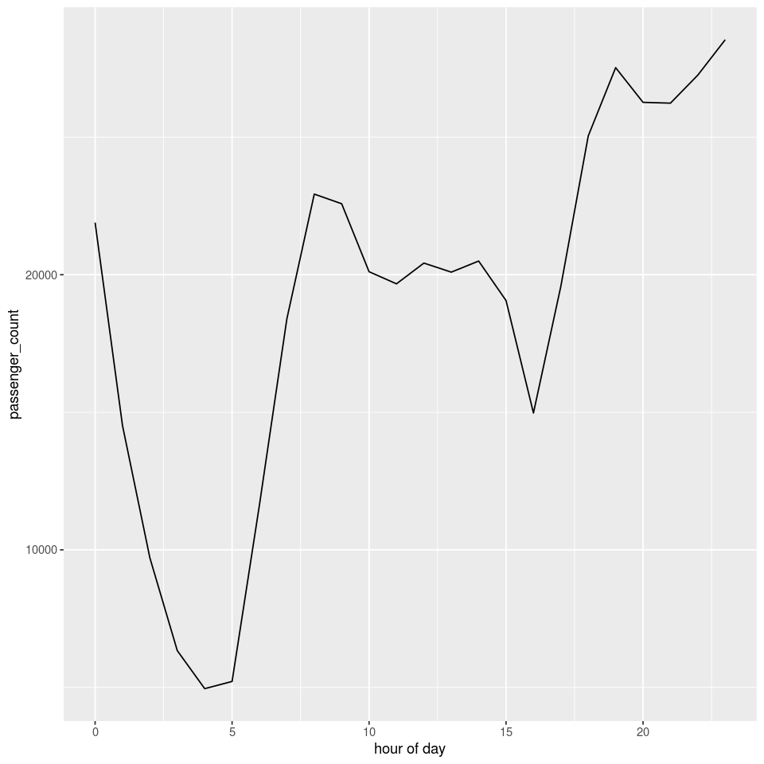
Solution

Slide 24
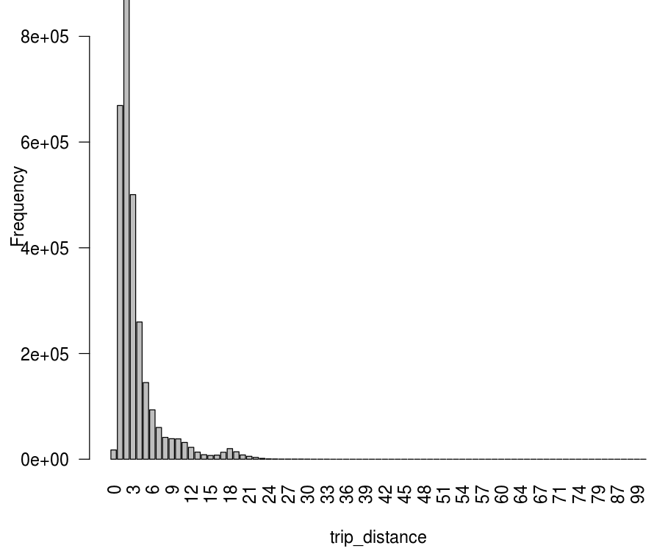
Solution Q2
taxi_df <- sql(“select * from nyc_taxi”)
trip_stat_df_r <- collect(count(groupBy(taxi_df, ceil(taxi_df$trip_distance))))
trip_stat_df_r_sorted <- trip_stat_df_r[order(trip_stat_df_r[1]), ] library(ggplot2)
barplot(trip_stat_df_r_sorted$count, names.arg = trip_stat_df_r_sorted$bin, xlab = "trip_distance", ylab = "Frequency", las=2)
Generate counts for each bin
Plot (bin, count) as bars
qplot() can only generate histograms. Here we just need
a bar chart for each bin. Use the barplot() function

Slide 25
To Do for this week
1. Start working on project
2. Start working on HW2

