Slide 1
Spark and SparkR
BAIS:6110 Fall 2020
Master’s in Business Analytics

Slide 2
Reminders
1. Exercise #3 due today.
2. HW2 due next week
3. Exercise #1, #2, HW1 graded. Solutions posted.

Slide 3
Preparation
Login at Databricks.
We will use it soon.
https://adb-7288810862666674.14.azuredatabricks.net/

Slide 4
Review
Spark basics:
DataFrame: a distributed data structure in Spark
ShowDF: show the contents of a Spark DataFrame
Spark DataFrame manipulation functions:
select, where/filter, groupBy, agg, orderBy
aggregate functions, math, string and time functions
save tables, save and load files

Slide 5
Exercise #3 (submit on ICON)
Use SparkR to perform the following analysis on the taxi dataset
Load the nyc_taxi data into a sparkR DataFrame. You must use sparkR functions rather than the sql() command for the next two questions.
(a) Show the total number of passengers taking taxi in each day of August.
(b) Show the total number of trips in each hour of August 1st.
Order the results by time (day / hour)

Slide 6
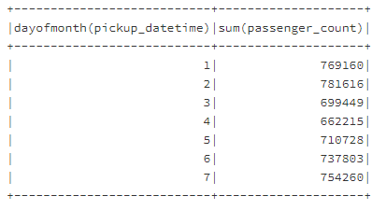
Solution
Show the total number of passengers taking taxi in each day of August.
sql(“use xunzhou”)
taxi_df <- sql(“select * from nyc_taxi”)
passenger_day_df<-agg(groupBy(taxi_df, dayofmonth(taxi_df$pickup_datetime)), passenger_count = "sum")
showDF(orderBy(passenger_day_df, colnames(passenger_day_df)[1]))

Slide 7
Solution
Show the total number of trips in each hour of August 1.
sql(“use xunzhou”)
taxi_df_Aug <- sql(“select * from nyc_taxi”)
taxi_df_Aug1 <- where(taxi_df_Aug, dayofmonth(taxi_df_Aug$pickup_datetime) == 1)
trip_hr_df <- count(groupBy(taxi_df_Aug1, hour(taxi_df_Aug1$pickup_datetime)))
showDF(orderBy(trip_hr_df, colnames(trip_hr_df)[1]), 24)

Slide 8
Overall Exercise
Use the NYC Taxi Dataset
Load the data into a Spark DataFrame. Then use R to do the analysis:
Plot a line chart to show the number of trips during each hour of August 1
Plot a histogram to show the distribution of trip length (bin width = 1 mile) in the data.

Slide 9
Solution Q1
library(SparkR)
sql("use xunzhou")
taxi_day1_df <- sql("select * from nyc_taxi where day(pickup_datetime) = 1")
trip_hr_day1_df <- count(groupBy(taxi_day1_df, hour(taxi_day1_df$pickup_datetime)))
trip_hr_day1_df_r<- collect(trip_hr_day1_df)
colnames(trip_hr_day1_df_r)[1]="hour"
library(ggplot2)
qplot(trip_hr_day1_df_r$hour, trip_hr_day1_df_r$count, geom="line", xlab = 'hour of day', ylab = 'passenger_count')

Slide 10
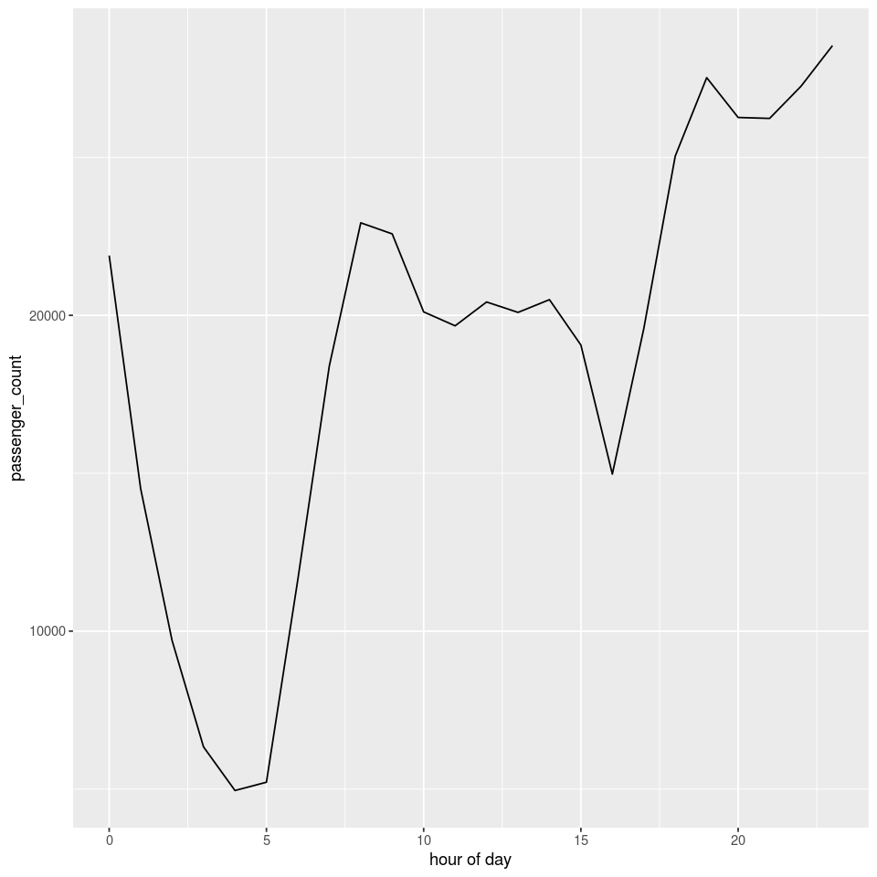
Solution

Slide 11
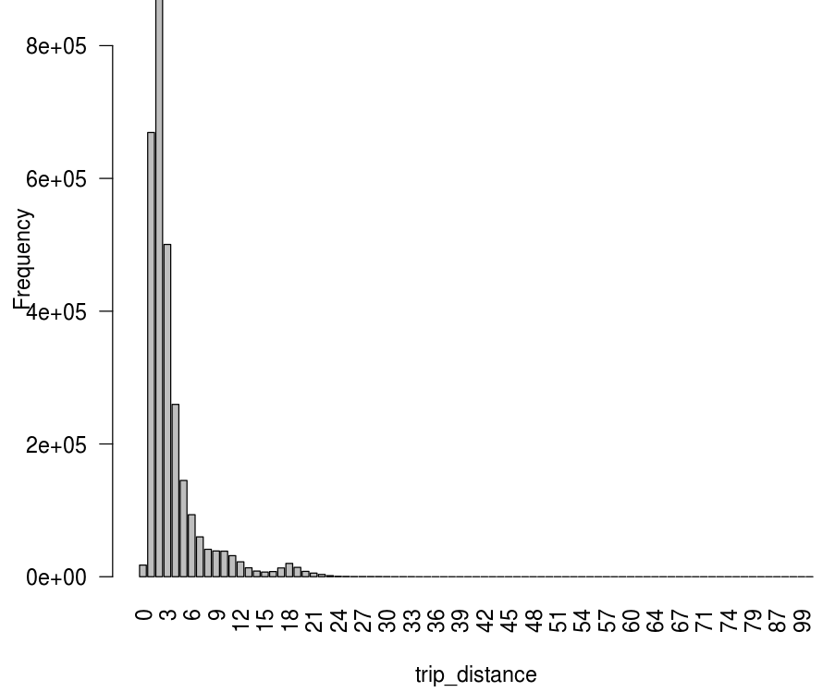
Solution Q2
taxi_df <- sql(“select * from nyc_taxi”)
trip_stat_df_r <- collect(count(groupBy(taxi_df, ceil(taxi_df$trip_distance))))
trip_stat_df_r_sorted <- trip_stat_df_r[order(trip_stat_df_r[1]), ] library(ggplot2)
barplot(trip_stat_df_r_sorted$count, names.arg = trip_stat_df_r_sorted$bin, xlab = "trip_distance", ylab = "Frequency", las=2)
Generate counts for each bin
Plot (bin, count) as bars
qplot() can only generate histograms. Here we just need
a bar chart for each bin. Use the barplot() function

Slide 12
The Histogram function
We can also use the histogram function
histStats <- histogram(df, col, nbins = 10)
The output is an R data.frame.
SparkDataFrame
Name of column to generate histogram

Slide 13
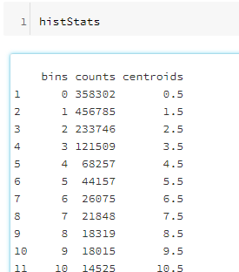
The Histogram function
Plot a histogram to show the distribution of trip length (bin width = 1 mile) in the data.
histStats <- histogram(taxi_df, taxi_df$trip_distance, nbins = 100)
histStats
barplot(histStats$counts, names.arg = histStats$bins, xlab = "trip_distance", ylab = "Frequency", las=2)

Slide 14
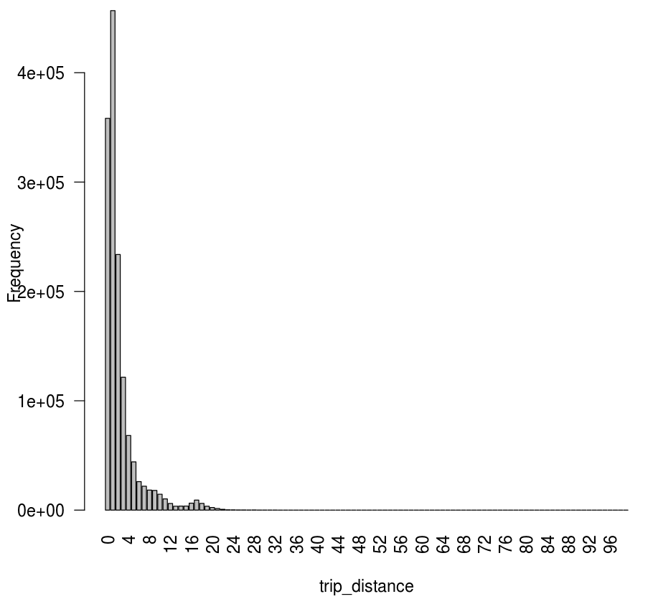
The Histogram function

Slide 15
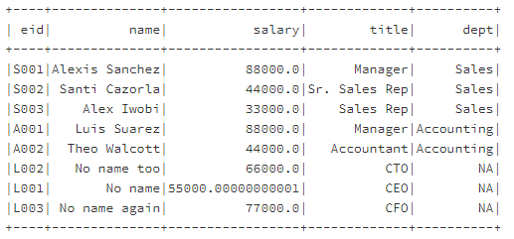
Operating on Columns
Arithmetic operations can be applied directly on columns
employee_2 <- employee
employee$salary <- employee_2$salary * 1.1

Slide 16
Spark DataFrame Join
'inner', 'cross', 'outer', 'full', 'fullouter', 'full_outer', 'left', 'leftouter', 'left_outer', 'right', 'rightouter', 'right_outer', 'semi', 'leftsemi', 'left_semi', 'anti', 'leftanti', 'left_anti'.
Similar to SQL join
desult_df <- join(x, y, joinExpr = NULL, joinType = NULL)
Equi-join by default
join(df1, df2, df1$col1 == df2$col2)
join(df1, df2, df1$col1 == df2$col2, ‘left_outer’)
sql(“use xunzhou”)
employee <- sql(“select * from employee”)
dept <- sql("select * from department")
result_left_outer <- join(employee, dept, employee$dept ==dept$name, ‘left_outer’)
showDF(result_left_outer)

Slide 17
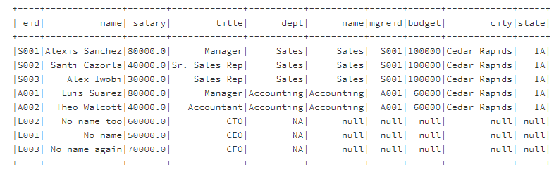
Spark Join

Slide 18
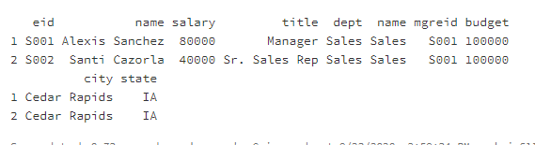
Take
take(x, num)
Take the first num rows of SparkDataFrame x and return an R data.frame
take(result_left_outer, 2)

Slide 19
The dapply function
Apply a function to each partition of a SparkDataFrame
SparkDataFrames can be partitioned (e.g., loaded from partitioned Hive tables)
Output is a new Spark DataFrame
df1 <- dapply(df, function(x) {…}, schema)
Input df
Function definition
Only one input parameter
Output must be an R data.frame
The schema of output SparkDataFrame

Slide 20
The dapply function
Example:
Load the employee table into a SparkDataFrame.
Add a new column in the data: tax
Tax is 10% for salary > 50000, and 5% for others.
schema <- structType(structField(“eid", “string"),
structField(“name", “string"),
structField(“salary", "double"),
structField(“title", “string"),
structField(“dept", “string"),
structField(“tax", "double"))
structType: a structured object in Spark to defined DataFrame schema
structField: “colname”, “type” pair

Slide 21
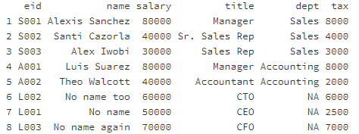
The dapply function
sql("use xunzhou")
employee <- sql("select * from employee")
df_tax <- dapply(employee, function(x){
if(x$salary>50000)
{y<-cbind(x, x$salary*0.1)}
else
{y<-cbind(x, x$salary*0.05)}
}, schema)
collect(df_tax)

Slide 22
The gapply function
Groups the SparkDataFrame using the specified columns and applies the R function to each group.
The output is a new Spark DataFrame
df2 <- dapply(df, function(key, x) {…}, schema)
The schema of output SparkDataFrame
Function definition
Two input parameters
key is the value of the grouped column
x is a data frame of each group
Output must be an R data.frame
Input df

Slide 23

The gapply function
Example:
Load the employee table into a SparkDataFrame.
Calculate the maximum salary of each department. Show the output

Slide 24
The gapply function
schema <- structType(structField("dept", "string"),
structField("max_sal", "double"))
df_max_sal <- gapply(employee, employee$dept, function(key, x){z<-data.frame(key, max(x$salary))}, schema)
collect(df_max_sal)
Sales
Accounting
NA

Slide 25

Quick Exercise
For each department in the employee table, calculate the total tax based on the rules defined below.
For departments with 3 or more people, the tax_rate = 6%,
Otherwise 9%
Total tax = (total salary in group)*tax_rate
Use the gapply function.

Slide 26
Solution
schema <- structType(structField("dept", "string"),
structField("total_tax", "double"))
df_total_tax <- gapply(employee, employee$dept,
function(key, x){if(nrow(x)>=3) y<-data.frame(key, sum(x$salary)*0.06) else y<-data.frame(key, sum(x$salary)*0.09)}, schema)
collect(df_total_tax)

Slide 27
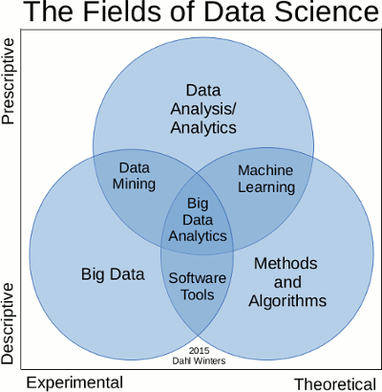
Data Mining / Machine Learning Algorithms
Prediction (classification, regression)
Clustering
Association Rule Mining
Collaborative filtering
Other statistical tools
One opinion on the relationship between DM and ML

Slide 28
To Do for this week
1. Watch Lecture 4 Part 2. Submit Exercise 3.
2. Start working on project
3. Start working on HW2 (due 9/30)

