Slide 1
Spark Machine Learning (1)
BAIS:6110 Fall 2020
Master’s in Business Analytics

Slide 2
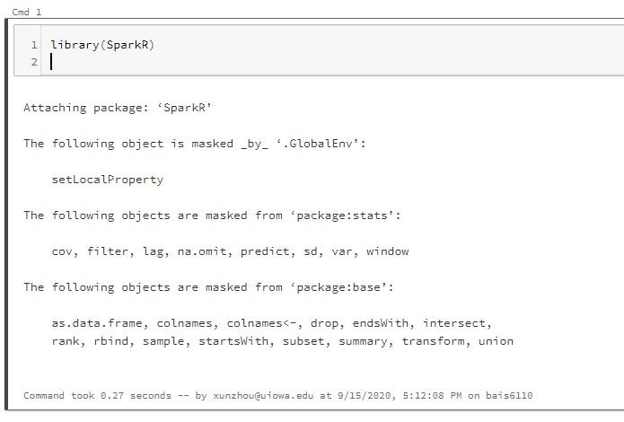
Loading SparkR
Create a notebook with R as the default language.
Load the SparkR package
Attach to the Spark cluster

Slide 3
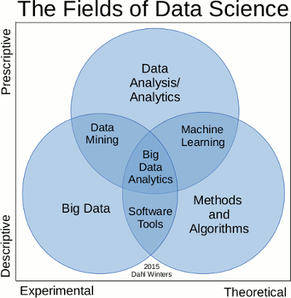
Data Mining / Machine Learning Algorithms
Prediction (classification, regression)
Clustering
Association Rule Mining
Collaborative filtering
Other statistical tools
One opinion on the relationship between DM and ML

Slide 4
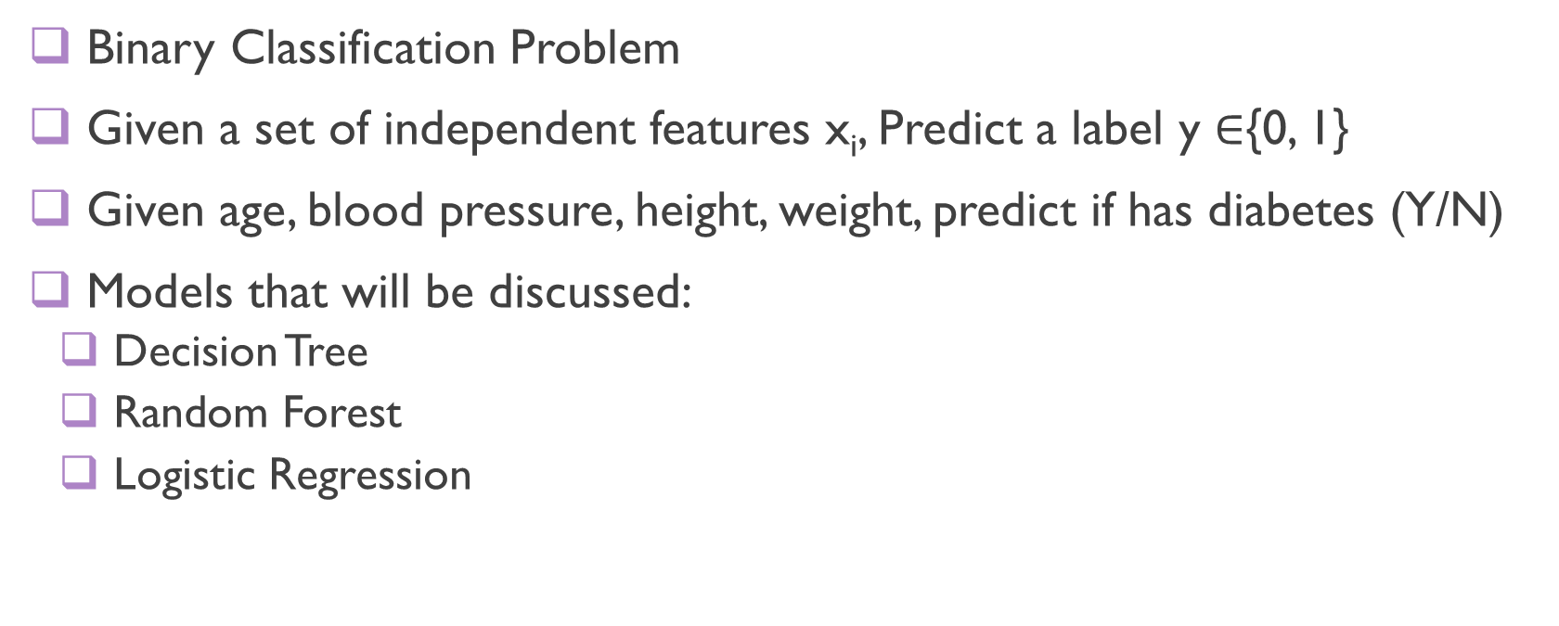
Machine Learning Algorithms for SparkR
Binary Classification Problem
Given a set of independent features x_{i}, Predict a label y $∈${0, 1}
Given age, blood pressure, height, weight, predict if has diabetes (Y/N)
Models that will be discussed:
Decision Tree
Random Forest
Logistic Regression

Slide 5
Training and Testing
Record Number | Age | Income | Gender | iphone
1 | 25 | 30000 | F | Y
2 | 30 | 40000 | M | N
3 | 44 | 60000 | F | Y
4 | 38 | 25000 | M | N
Do prediction
Record Number | Age | Income | Gender | iphone
5 | 33 | 70000 | F | ?
6 | 27 | 40000 | M | ?
7 | 54 | 30000 | M | ?
8 | 22 | 15000 | F | ?
Learn a Model

Slide 6
Decision Tree
What is a decision tree?
Record 1: Age 20, income 30000, gender: M, Label: uses iphone
Record 2: Age 31, income 45000, gender: F, Label: not iphone
………
Record X: Age 44, income 59100, gender: F, Label: ?
Gender = F ?
Y
N
Income > 30000
Age>40
Y
N
Y
N
Iphone
N/ iphone
N/ iphone
iphone

Slide 7
Decision Tree
Build a tree model for prediction
Each node is a feature, and each brunch is a decision on that feature
Goal: maximize class purity at leaf nodes
A female with 25000 income → ?
A male at age 54 → ?
Gender = F ?
Y
N
Income > 30000
Age>40
Y
N
Y
N
Iphone
N/ iphone
N/ iphone
iphone

Slide 8
Building a decision tree
For the training set S
Find the attribute A (and threshold x if numeric) that minimizes the Gini index or maximizes the Information Gain in the subsequent partitions.
Label the current node with A (and x)
Split the training set S by A (and x) into two subsets
For each of the two subsets
Repeat this process until
max depth reached or
leaf has 100% purity
Label the leaf with the class of the majority

Slide 9
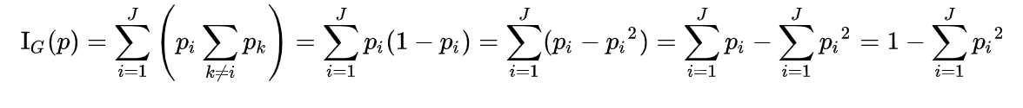
Purity measure
Gini impurity:
J: number of classes
pi: fraction of items labeled with class i
1,1,1,0,0,0
1,1,1,1,1,1
1,1,1,1,0, 0
p₀ = ½
p₀ = 0
p₀ = 1/3
p₁ = ½
p₁ = 1
p₁ = 2/3
I_{G}(p) = ½
I_{G}(p) = 0
I_{G}(p) = 4/9 = 0.44
Highest gini impurity – worst purity
Lowest gini impurity – best purity

Slide 10
The Gini Index
Given an attribute A (and a threshold x) on a set
The Gini index is calculated as the weighted sum of gini impurity of the resulting subsets
Training samples: 0,0,0, 0, 1,1,1,1
Training samples: 0, 0, 0, 0, 1,1,1,1
Better split
A > x₁
A > x₂
Y
N
Y
N
0,0,0,1
0, 1,1,1
0,1,1
0, 0, 0,1,1
Gini impurity = 1-[(1/4)² + (3/4)²] = 0.375
Gini impurity = 1-[(1/4)² + (3/4)²] = 0.375
Gini impurity = 1-[(1/3)² + (2/3)²] = 0.44
Gini impurity = 1-[(2/5)² + (3/5)²] = 0.48
Gini Index = (4/8)*0.375+(4/8)*0.375 = 0.375
Gini Index = (3/8)*0.44+(5/8)*0.48= 0.465

Slide 11

Purity measure
Entropy:
I_{E}(p) =
J: number of classes
pi: fraction of items labeled with class i
1,1,1,0,0,0
1,1,1,1,1,1
p₀ = ½
p₀ = 0
p₁ = ½
p₁ = 1
I_{E}(p) = 1
I_{G}(p) = 0
Highest entropy – worst purity
Lowest entropy – best purity

Slide 12

The Information Gain
Given an attribute A (and a threshold x) on a set
The Information Gain is calculated as: entropy of the original set – weighted entropy of the two subsets
Training samples: 0,0,0, 0, 1,1,1,1
Parent entropy = -2*(1/2)log(1/2)=1
A > x₁
Y
N
0,0,0,1
0, 1,1,1
Children weighed entropy = (4/8)*0.81+(4/8)*0.81 = 0.81
Entropy = -(1/4)log(1/4)-(3/4)log(3/4) = 0.81
Gini impurity = -(1/4)log(1/4)-(3/4)log(3/4) = 0.81
Information Gain for = 1-0.81 = 0.19

Slide 13
SparkR Decision Tree
Data Preparation:
The label column must be string or numeric
Use the mtcars dataset. Make a copy and replace the mpg column with a binary label: 1( mpg >= 20) and 0 (mpg <20)
mtcars_dt <- mtcars
mtcars_dt$mpg <- ifelse(mtcars_dt$mpg >=20, 1, 0)
mtcars_dt_df <- as.DataFrame(mtcars_dt)
Learn a model to predict if the mpg of a car is high (1) or low (0)

Slide 14
Decision Tree in SparkR
spark.decisionTree(
data,
formula,
type = c("regression", "classification"),
maxDepth = 5,
maxBins = 32,
impurity = NULL,
seed = NULL,
minInstancesPerNode = 1,
minInfoGain = 0,
checkpointInterval = 10,
maxMemoryInMB = 256,
cacheNodeIds = FALSE,
handleInvalid = c("error", "keep", "skip")
)
Training Spark DataFrame
Specify target variable and input variables
Type of analysis (use “classification” for now)
Max depth of the tree
# bins to discretize numeric variables for split
“gini” or ”entropy”
Maximum memory used for tree building
Set larger for large datasets
How to handle unseen labels or null values

Slide 15
Learn the model
model_dt <- spark.decisionTree (mtcars_rf_df, mpg ~ . , "classification")
Use mpg ~ cyl + disp + hp + wt to include only these four columns in the model
A list of columns to use in the model
“.” means all the other columns
The label column to predict
The input spark DataFrame

Slide 16
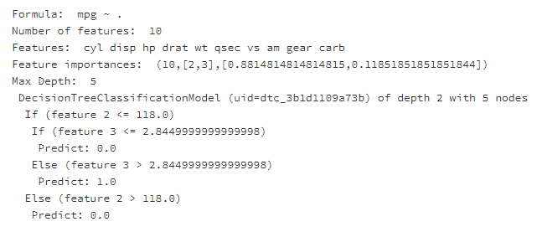
Output
Check the model:
summary(model_dt)
Feature 2: Gross horsepower
Feature 3:Rear axle ratio
hp<=118.0
Y
N
Drat <=2.845
Low(0)
Y
N
Low (0)
High (1)

Slide 17
Do Prediction
Run the prediction model on a test dataset.
Input: a test dataset in spark DataFrame format and a trained DT model
It must have the all the columns used in the training but the class label column
For example: test on the original mtcars dataset
Output <- predict(model_dt, mtcars_dt_df)
showDF(Output)

Slide 18
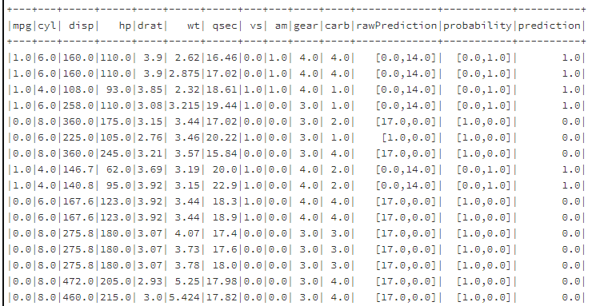
Output
This is “cheating” since the training and testing are on the same dataset

Slide 19

Random Forest
One decision tree sometimes is less accurate and may have some bias
Trees trained with different data might have different structures
Random Forest:
Training: randomly sample from training data and generate N decision trees
Testing: let each tree predict and use the result of the majority
Advantage: avoid random error, avoid over fitting
Overfitting: model too perfect for the training data (even for noise data) and can’t achieve good performance on testing set.

Slide 20
Random Forest
Tree 1
Age < 20 ?
Y
N
iphone
Income< 25000
Test data:
Gender = Male, age = 45, income = 35000
Y
N
Prediction: iphone
No iphone
iphone
Prediction: iphone
Tree 2
Tree 3
Prediction: No iphone
Gender = F ?
Income > 30000?
Y
N
Final prediction: iphone (2/3)
Y
N
Income > 30000
Age>40
Male?
Age < 30
Y
N
Y
N
Y
N
Y
N
Iphone
No iphone
No iphone
iphone
Iphone
No iphone
No iphone
iphone

Slide 21
SparkR Random Forest
Data Preparation:
The label column must be string or numeric
Use the mtcars dataset. Make a copy and replace the mpg column with a binary label: 1( mpg >= 20) and 0 (mpg <20)
mtcars_rf <- mtcars
mtcars_rf$mpg <- ifelse(mtcars_rf$mpg >=20, 1, 0)
mtcars_rf_df <- as.DataFrame(mtcars_rf)
Learn a model to predict if the mpg of a car is high (1) or low (0)

Slide 22
Learn the model
model_rf <- spark.randomForest(mtcars_rf_df, mpg ~ . , "classification", numTrees = 20, maxDepth = 5)
Use mpg ~ cyl + disp + hp + wt to use only these four columns in the model
A list of columns to use in the model
“.” means all the other columns
The label column to predict
Max depth of each tree. Too deep may cause overfitting
The input spark DataFrame

Slide 23
Random Forest
Check the model learned from the data
summary(model_rf)
> summary(model_rf)
Formula: mpg ~ .
Number of features: 10
Features: cyl disp hp drat wt qsec vs am gear carb
Feature importances: (10,[0,1,2,3,4,5,6,7,9],[0.08772267853629748,0.24254907176494692,0.21080086770590203,0.01394000736106,0.36852809116070673,0.06080658547463887,0.0030303030303030307,0.004589160839160838,0.00803323412698413])
Max Depth: 5
Number of trees: 20
Tree weights: 1 1 1 1 1 1 1 1 1 1 1 1 1 1 1 1 1 1 1 1

Slide 24
Summary of the model
All the decision trees learned will be displayed.
Tree 0 (weight 1.0):
If (feature 4 <= 3.215)
If (feature 0 <= 6.0)
Predict: 1.0
Else (feature 0 > 6.0)
Predict: 0.0
Else (feature 4 > 3.215)
Predict: 0.0
Wt<=3.215
Y
N
Cyl<=6.0
Low
Y
N
high
low

Slide 25
Do Prediction
Run the prediction model on a test dataset.
A test dataset in spark DataFrame format and a trained model
It must have the all the columns used in the training (but not the label column)
For example: test on the original mtcars dataset
Output <- predict(model_rf, mtcars_rf_df)
showDF(Output)

Slide 26
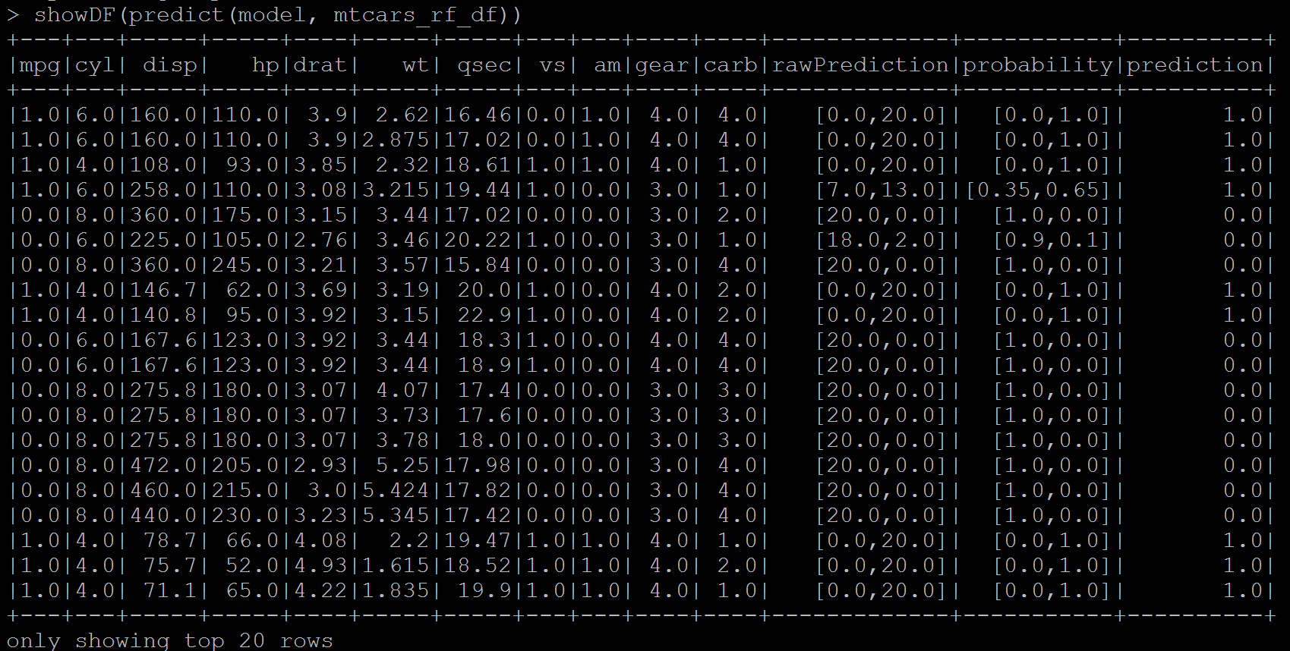
Result
This is “cheating” since the training and testing are on the same dataset

Slide 27
Evaluation
1. Training set and testing set
2. Accuracy of the model, precision, recall

Slide 28
Additional Issues for Predictive models
1. Building training vs. testing set
Randomly split the dataset into training vs. testing at a ratio.
Build a model on Training set and run prediction on Testing set
> mtcars_rf <- mtcars
> mtcars_rf$mpg <- as.numeric(mtcars_rf$mpg >=20)
> mtcars_rf_df <- as.DataFrame(mtcars_rf)
> df_list <- randomSplit(mtcars_rf_df, c(7,3), 2)
> training_df <- df_list[[1]]
> testing_df <- df_list[[2]]
Split the mtcars_DF dataframe into training (70%) and testing (30%) sets
“2” is a seed for random sampling (you could put any number)

Slide 29
Additional Issues for Predictive models
2. Selecting features to include in the model
model_rf <- spark.randomForest(training_df, mpg ~ . , "classification", numTrees = 20, maxDepth = 5)
Use + to include features
Use – to exclude features
“.” Represents all the features
Use all the features but vs and am
model_rf <- spark.randomForest(training_df, mpg ~ . - vs - am , "classification", numTrees = 20, maxDepth = 5)

Slide 30
Additional Issues for Predictive models
3. Evaluating Accuracy
If mpg == prediction Then
correct
Else
incorrect
Accuracy = correct/(correct + incorrect)
Correct <- nrow(where(Output, Output$mpg == Output$prediction))
Total <- nrow(Output)
Accuracy = Correct/Total
Output <- Predict(model_rf, testing_df)
This is the “logic”
not code

Slide 31
Exercise #4 (submit on ICON)
Bring back the NYC Taxi dataset. Use trips started and ended both between 7pm and 8pm on August 1. Save the data in a Spark DataFrame from Hive.
Remove any record with NA value (use the dropna() function):
df_new <- dropna(df_old)
Add a new column called fare_label. Label trips with fare_amount > $15 as positive 1 , others as negative 0.
Split the data into training and testing at 7:3.

Slide 32
Exercise
Train a random forest model to predict this label column, with the following columns:
pickup lat/long, dropoff lat/long, rate_code, and trip_distance
Tree depth = 10, number of trees = 20
handleInvalid = “skip”.
calculate accuracy of the prediction

Slide 33
To Do for this week
1. Submit Exercise #4
2. Finish HW2

