Slide 1
Spark Machine Learning (II)
BAIS:6110 Fall 2020
Master’s in Business Analytics

Slide 2
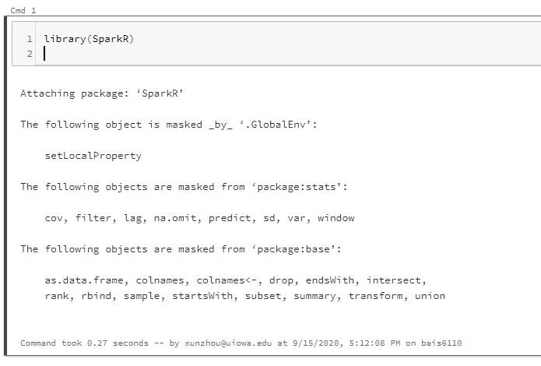
Loading SparkR
Create a notebook with R as the default language.
Load the SparkR package
Attach to the Spark cluster

Slide 3
Quick Review
Decision Tree / Random Forest
Train and Test
Performance Evaluation

Slide 4
Exercise #4 (submit on ICON)
Bring back the NYC Taxi dataset. Use trips started and ended both between 7pm and 8pm on August 1. Save the data in a Spark DataFrame from Hive.
Remove any record with NA value (use the dropna() function):
df_new <- dropna(df_old)
Add a new column called fare_label. Label trips with fare_amount > $15 as positive 1 , others as negative 0.
Split the data into training and testing at 7:3.

Slide 5
Exercise
Train a random forest model to predict this label column, with the following columns:
pickup lat/long, dropoff lat/long, rate_code, and trip_distance
Tree depth = 10, number of trees = 20
handleInvalid = “skip”.
calculate accuracy of the prediction

Slide 6
Solution
sql("use xunzhou")
taxi_df <- sql("select * from nyc_taxi where hour(pickup_datetime) = 19 and hour(dropoff_datetime)=19 and day(pickup_datetime) =1")
taxi_df <- dropna(taxi_df)
taxi_df$fare_label <- ifelse(taxi_df$fare_amount>15, 1, 0)

Slide 7
Solution
df_list <- randomSplit(taxi_df, c(7,3), 2)
training_df <- df_list[[1]]
testing_df <- df_list[[2]]
model <- spark.randomForest(training_df, fare_label ~ PICKUP_LATITUDE + PICKUP_LONGITUDE + DROPOFF_LATITUDE + DROPOFF_LONGITUDE + RATE_CODE + TRIP_DISTANCE, "classification", numTrees=20, maxDepth=10, handleInvalid = "skip")
summary(model)

Slide 8
Solution
showDF(output)
correct <- nrow(where(output, output$fare_label == output$prediction))
total <- nrow(output)
accuracy = correct/total
accuracy
[1] 0.9572072

Slide 9
Prediction Performance Measure
Accuracy is not the only measure
Imbalanced datasets.
Testing set: 1000 samples.
Positive (1): 10 (1%).
Negative (0): 990 (99%)
A model that always predicts 0 will have a 99% accuracy.
Is it a good model?

Slide 10
Other performance measures
 | Actually Negative (0) | Actually Positive (1)
Predict as Negative (0) | True Negative (TN) | False Negative (FN)
Predict as Positive (1) | False Positive (FP) | True Positive (TP)
Precision, Recall
Precision = TP/(TP+FP)
Recall = TP/(TP+FN)
What % of your “positive” predictions are actually positive
 | Actually Negative (0) | Actually Positive (1)
Predict as Negative (0) | True Negative (TN) | False Negative (FN)
Predict as Positive (1) | False Positive (FP) | True Positive (TP)
What % of the actual positives are successfully predicted by the model

Slide 11
Other measures
 | Actually Negative (0) | Actually Positive (1)
Predict as Negative (0) | True Negative (TN) | False Negative (FN)
Predict as Positive (1) | False Positive (FP) | True Positive (TP)
Precision, Recall
Confusion Matrix
Iphone = Positive -1
No iphone= Negative - 0
John is using iphone but predicted as no (False Negative)
Alice is not using iphone but predicted as yes (False Positive)
High TP and TN are desired. Low FN and FP are desired.
Accuracy = (TP+TN) / (TP+FN+FP+TN)

Slide 12
Predictive models
mtcars_rf <- mtcars
mtcars_rf$mpg <- as.numeric(mtcars_rf$mpg >=20)
mtcars_rf_df <- as.DataFrame(mtcars_rf)
df_list <- randomSplit(mtcars_rf_df, c(7,3), 2)
training_df <- df_list[[1]]
testing_df <- df_list[[2]]
model_rf <- spark.randomForest(training_df, mpg ~ . , "classification", numTrees = 20, maxDepth = 5)
Output <- predict(model_rf, testing_df)

Slide 13
Calculating Precision and Recall
TP <- nrow(where(Output, Output$mpg == 1 & Output$prediction == 1))
FP <- nrow(where(Output, Output$mpg == 0 & Output$prediction == 1))
Precision = TP/(TP+FP)
FN <- nrow(where(Output, Output$mpg == 1 & Output$prediction == 0))
Recall = TP/(TP+FN)

Slide 14
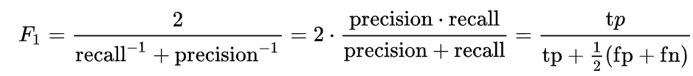
F-1 Score
Average performance based on precision and recall.
The F₁ score is the harmonic mean of the precision and recall.
F1 score can be used to evaluate the performance of different models.

Slide 15
Quick Exercise
Calculate the precision, recall and F1 score of the model in Exercise #4
Show these numbers

Slide 16
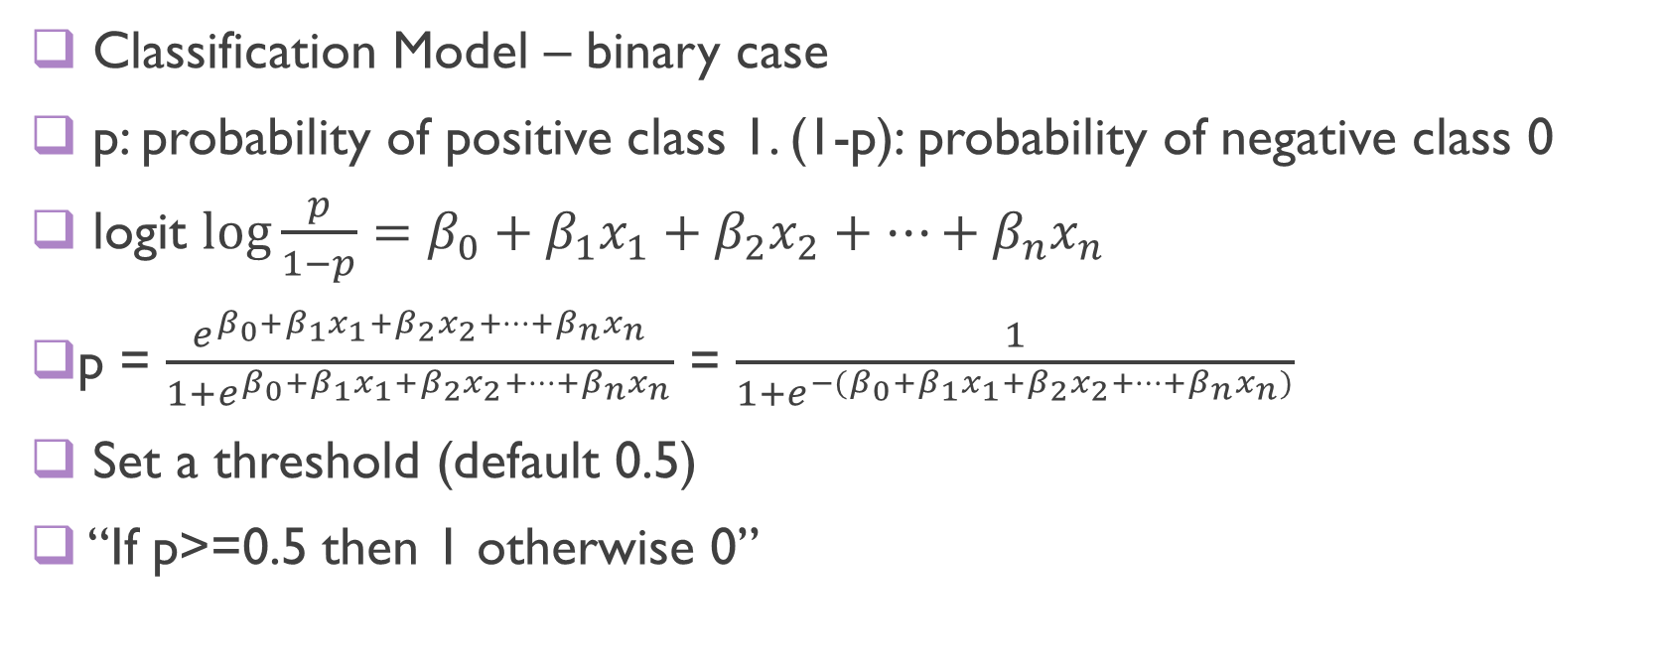
Logistic Regression Model
Classification Model – binary case
p: probability of positive class 1. (1-p): probability of negative class 0
logit $log\frac{p}{1−p}=β_{0}+β_{1}x_{1}+β_{2}x_{2}+…+β_{n}x_{n}$
p = $\frac{e^{β_{0}+β_{1}x_{1}+β_{2}x_{2}+…+β_{n}x_{n}}}{1+e^{β_{0}+β_{1}x_{1}+β_{2}x_{2}+…+β_{n}x_{n}}}$ = $\frac{1}{1+e^{−(β_{0}+β_{1}x_{1}+β_{2}x_{2}+…+β_{n}x_{n})}}$
Set a threshold (default 0.5)
“If p>=0.5 then 1 otherwise 0”

Slide 17
Logistic Regression
mtcars_log <- mtcars
mtcars_log$mpg <- as.numeric(mtcars_log$mpg >=20)
mtcars_log_df <- as.DataFrame(mtcars_log)
df_list <- randomSplit(mtcars_log_df, c(7,3), 2)
training_df <- df_list[[1]]
testing_df <- df_list[[2]]

Slide 18
Logistic Regression
model_log <- spark.logit(training_df, mpg~., regParam = 0.5, family = "auto", thresholds = 0.5, handleInvalid = "skip")
Regularization parameter
Type of classification
Thresholds: probability threshold
Training df
Formula
“auto”: automatically detect
"binomial“: binary classification
"multinomial“: multi-class classification

Slide 19
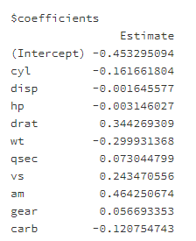
Logistic Regression
summary(model_log)

Slide 20
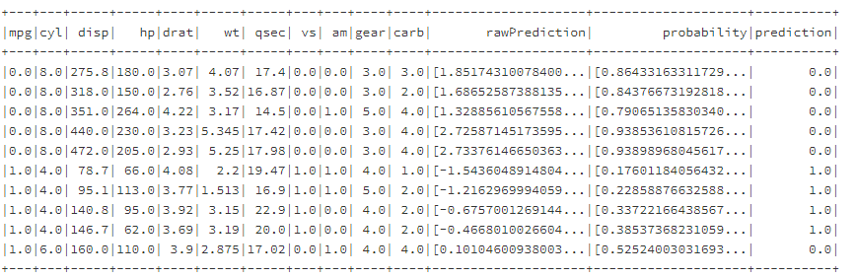

Logistic Regression
output <- predict(model_log, testing_df)
showDF(output)
RawPrediction: $β_{0}+β_{1}x_{1}+β_{2}x_{2}+…+β_{n}x_{n}$

Slide 21
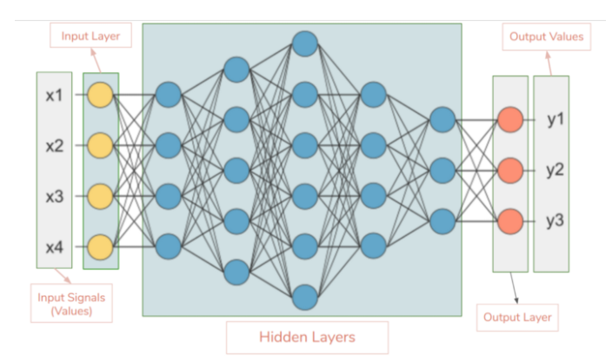
Another Classification Model
Multilayer Perceptron (MLP)
Feedforward Neural Networks
Input layer: all the input features
Hidden layers:
intermediate results as linear combinations of values in previous layer
Output layer:
Raw prediction score between 0 and 1
Number of nodes = number of target variables (two nodes for binary prediction)

Slide 22



MLP Model in Spark
Hidden layers: logistic functions as activation function
z_{i} =
Output layer: Softmax function
$$b+w_{1}x_{1}+w_{2}x_{2}+…+w_{n}x_{n}$$

Slide 23

MLP Model in Spark
f ₁ = logit($b+w_{11}^{1}x_{1}+w_{12}^{1}x_{2}+w_{13}^{1}x_{3}+w_{14}^{1}x_{4}$)
Each node is initialized with different parameter
values
Parameters to learn for each node
f₁
Fully-connected: each node in layer i is connected to each node in layer i+1

Slide 24
Model Training
Back propagation:
For each samples, calculate the loss between the current prediction and ground truth
Update the parameters of each layer from right to left based on all the samples in a (mini)-batch
Epoch: passing the entire training set once
Batch: # of samples fed together
Iteration: number of batches for each epoch
x₁
x₂
x₃

Slide 25
Databricks mlp function
model <- spark.mlp(mtcars, mpg~., layers = c(10, 20, 2), maxIter = 100, stepSize=0.03, seed = 1, handleInvalid=“skip”)
output <- predict(model, testing_df)
showDF(output)
Number of nodes in each layer
1st = input layer (should = # input features in formula)
Last = output layer (must = # of categorical values, 2 for binary)
Categorical features need pre-processing
Maximum number of iterations before stop training
Here iteration = epoch
Learning rate. How aggressively update the weights
Seed to randomly initialize the weights

Slide 26
To Do for this week
1. Submit Exercise #5

