Slide 1
Spark Machine Learning (II)
BAIS:6110 Fall 2020
Master’s in Business Analytics

Slide 2
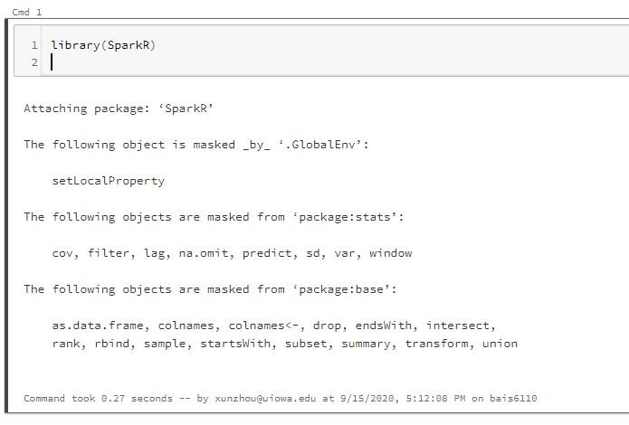
Loading SparkR
Create a notebook with R as the default language.
Load the SparkR package
Attach to the Spark cluster

Slide 3
Outline
Additional Classification Models
Regression Models
Evaluation of regression models

Slide 4
Additional Classification Models
Naïve Bayes
Linear SVM

Slide 5
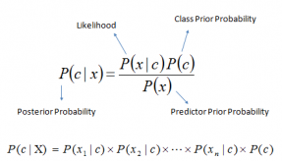
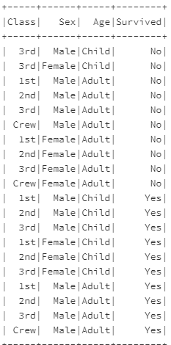
Naïve Bayes
A family of simple probabilistic, multiclass classifiers based on applying Bayes’ theorem with strong (naive) independence assumptions between every pair of features.
P(yes|3rd, female, Child) =?
P(1st|yes) = 3/10
P(2nd|yes) = 3/10
P(3rd|yes) = 3/10
P(crew|yes) =1/10
P(1st|no) = 1/5
P(2nd|no) = 1/5
P(3rd|no) = 2/5
P(crew|no) =1/5
P(Child|yes) = 3/5
P(Adult|yes) = 2/5
P(Child|no) = 1/5
P(Adult|no) = 4/5
P(yes|3rd, female, Child) ~P(3rd|yes)P(female|yes)P(Child|yes)P(yes)= 27/500
P(No|3rd, female, Child) ~P(3rd|no)P(female|no)P(Child|no)P(no)= 1/50
P(Male|yes) = 7/10
P(Femal|yes) = 3/10
P(Male|no) = 1/2
P(Female|no) = 1/2
P(yes) = 1/2, P(no) = 1/2

Slide 6
Naïve Bayes
A family of simple probabilistic, multiclass classifiers based on applying Bayes’ theorem with strong (naive) independence assumptions between every pair of features.
model <- spark.naiveBayes(
data,
formula,
smoothing = 1,
handleInvalid = c("error", "keep", "skip")
)
Smoothing parameter for categorical data. 0 for all numeric input
SparkR only uses a Bernoulli naïve Bayes model (input parameters should be binary)

Slide 7
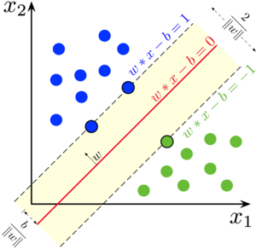
Support Vector Machine
A support vector machine constructs a hyperplane or set of hyperplanes in a high- or infinite-dimensional space, which have the largest distance to the nearest training sample.
model <- spark.svmLinear(data, formula, regParam = 0, maxIter = 100, tol = 1e-06, standardization = TRUE, threshold = 0, handleInvalid = c("error", "keep", "skip")
)

Slide 8
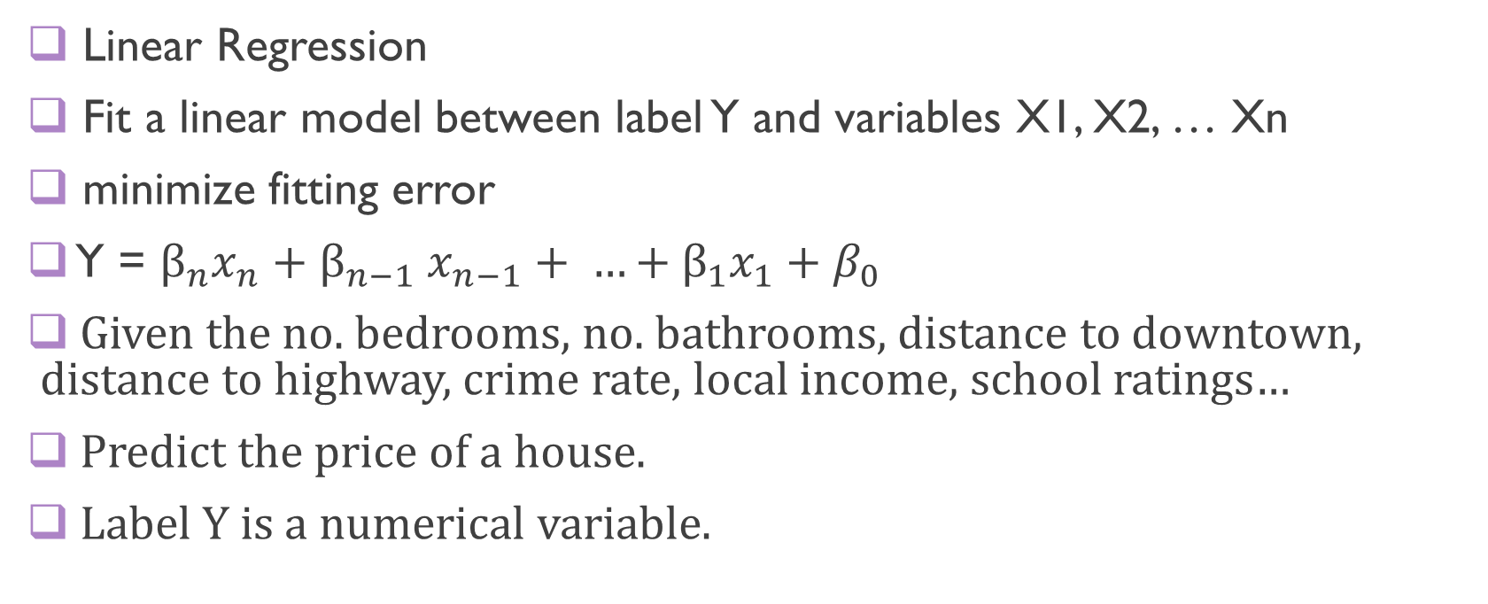
Generalized linear Model
Linear Regression
Fit a linear model between label Y and variables X1, X2, … Xn
minimize fitting error
Y = $β_{n}x_{n}{+ β}_{n−1}x_{n−1}+ …+β_{1}x_{1}+β_{0}$
Given the no. bedrooms, no. bathrooms, distance to downtown, distance to highway, crime rate, local income, school ratings…
Predict the price of a house.
Label Y is a numerical variable.

Slide 9
Example
Given all the features, predict mpg of cars (numeric)
> mtcars_DF <- as.DataFrame(mtcars)
> df_list <- randomSplit(mtcars_DF, c(7,3), 2)
> training <- df_list[[1]]
> testing <- df_list[[2]]
Training DataFrame
Gaussian: the error term of the model follows Gaussian (normal) distribution
Other options: Poisson, …
Most common type of linear regression
model <- spark.glm(training, mpg ~ ., family = "gaussian")
Equation: label ~ feature1+feature2+feature3
Use + to add features and use - to remove features
Use . to represent all the features

Slide 10
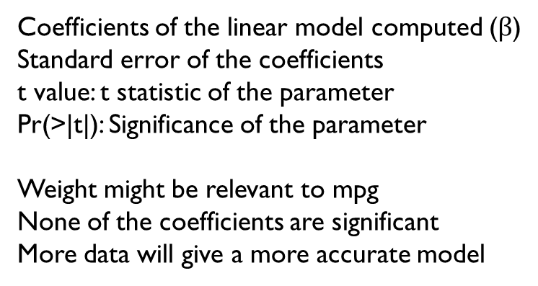
Model
summary(model)
Deviance Residuals:
(Note: These are approximate quantiles with relative error <= 0.01)
Min 1Q Median 3Q Max
-4.2275 -1.2509 -0.1709 1.6493 3.8180
Coefficients:
Estimate Std. Error t value Pr(>|t|)
(Intercept) -6.1954738 32.843652 -0.18864 0.85381
cyl 0.5996017 1.943880 0.30846 0.76350
disp 0.0179472 0.023975 0.74858 0.46981
hp -0.0093995 0.029630 -0.31723 0.75701
drat 3.1363382 2.930739 1.07015 0.30747
wt -3.0082753 2.420213 -1.24298 0.23972
qsec 0.6465848 0.849858 0.76081 0.46277
vs 2.0367272 3.173746 0.64174 0.53418
am 2.8328113 2.741496 1.03331 0.32364
gear 2.2452794 2.713227 0.82753 0.42553
carb -1.2188915 1.272100 -0.95817 0.35856
Residuals of your model on training set
Coefficients of the linear model computed ($β$)
Standard error of the coefficients
t value: t statistic of the parameter
Pr(>|t|): Significance of the parameter
Weight might be relevant to mpg
None of the coefficients are significant
More data will give a more accurate model

Slide 11
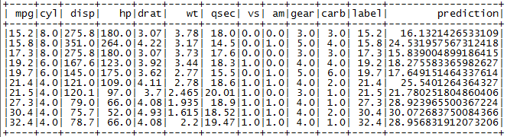
Prediction
> output <- predict(model, testing)
> showDF(output)

Slide 12
Random Forest Regression
You can also use the random forest to do regression (instead of binary classification). Each tree leaf node will give a numeric prediction.
> mtcars_rf <- mtcars
> mtcars_rf_df <- as.DataFrame(mtcars_rf)
> df_list <- randomSplit(mtcars_rf_df, c(7,3), 2)
> training_df <- df_list[[1]]
> testing_df <- df_list[[2]]
model <- spark.randomForest(mtcars_rf_df, mpg ~ . , “regression", numTrees = 20, maxDepth = 5)
output<-predict(model, testing_df)

Slide 13


Measuring Error
Many ways to measure the error
1. Mean Squared Error (MSE): mean of squared error in each row
$MSE= \frac{1}{N}\sum_{1}^{N}{{\left(yi−\hat{y_{i}}\right)}^{2}}$
showDF(select(output, avg((output$mpg-output$prediction)^2)))

Slide 14


Measuring Error
Many ways to measure the error
2. Root Mean Squared Error (RMSE): root square of MSE
$RMSE= \sqrt{\frac{1}{N}\sum_{1}^{N}{{\left(yi−\hat{y_{i}}\right)}^{2}}}$
showDF(select(output, sqrt(avg((output$mpg-output$prediction)^2))))

Slide 15
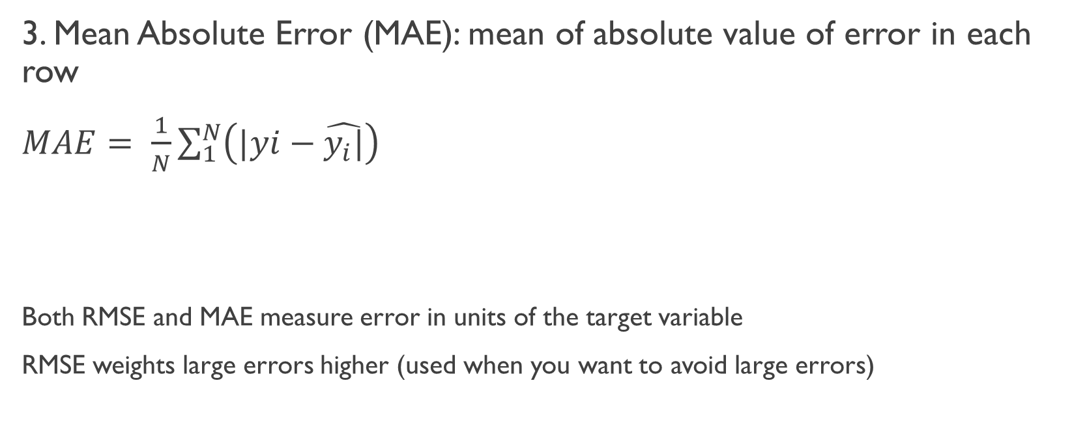
Mean Absolute Error (MAE)
3. Mean Absolute Error (MAE): mean of absolute value of error in each row
$MAE= \frac{1}{N}\sum_{1}^{N}{{\left(|yi−\hat{y_{i}|}\right)}^{}}$
Both RMSE and MAE measure error in units of the target variable
RMSE weights large errors higher (used when you want to avoid large errors)
showDF(select(output, avg(abs(output$mpg-output$prediction))))

Slide 16
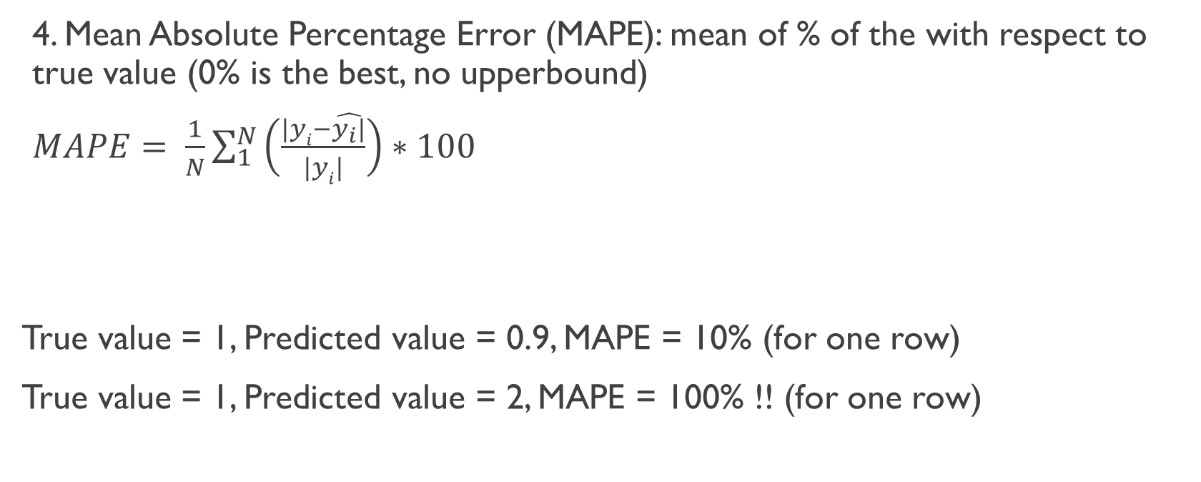
Mean Absolute Percentage Error (MAPE)
4. Mean Absolute Percentage Error (MAPE): mean of % of the with respect to true value (0% is the best, no upperbound)
$MAPE= \frac{1}{N}\sum_{1}^{N}{{\left(\frac{|yi−\hat{y_{i}|}}{|yi|}\right)∗100}^{}}$
True value = 1, Predicted value = 0.9, MAPE = 10% (for one row)
True value = 1, Predicted value = 2, MAPE = 100% !! (for one row)
showDF(select(output, avg(abs(output$mpg-output$prediction)/abs(output$mpg))))

Slide 17
Comparing the Measures
RMSE and MAE both at the target variable’s unit (error in predicted price is 10 dollars)
MSE is at the quadratic unit of target variable (error is in squared unit)
MAPE is in percentage and is not affected by the unit/scale of target variable (the error in predicted price is 5% of original value). Original value of the variable can’t be 0.

Slide 18
Summary
Model | Classification | Regression
Decision Tree | X | X
Random Forest | X | X
Logistic Regression | X
Multi-layer Perceptron | X
Naïve Bayes | X
Linear SVM | X
Generalized Linear Model |  | X

Slide 19
Exercise #5 Submit on ICON
Do the prediction again on the NYC_taxi data using trips started and ended both between 7pm and 8pm on August 1 (same as in Exercise #4). But this time use linear regression to predict the fare amount directly.
Only use the pickup lat/long, dropoff lat/long, trip_distance, and rate code.
Calculate MSE, RMSE, MAE and MAPE on the testing set
Show these numbers

Slide 20
To Do for this week
1. Submit Exercise #5

