Slide 1
Spark Machine Learning (III)
BAIS:6110 Fall 2020
Master’s in Business Analytics

Slide 2
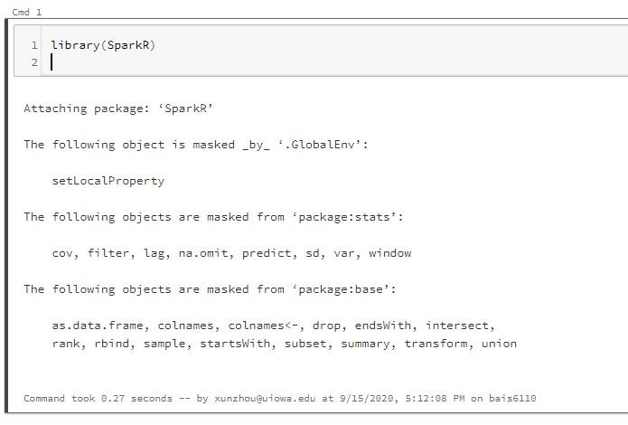
Loading SparkR
Create a notebook with R as the default language.
Load the SparkR package
Attach to the Spark cluster

Slide 3
Quick Review
Regression models
Linear regression
Decision Tree/Random Forest regression
Performance Evaluation
Mean Squared Error (MSE)
Root Mean Squared Error (RMSE)
Mean Absolute Error (MAE)
Mean Absolute Percentage Error (MAPE)

Slide 4
Exercise #5 Submit on ICON
Do the prediction again on the NYC_taxi data using trips started and ended both between 7pm and 8pm on August 1 (same as in Exercise #4). But this time use linear regression to predict the fare amount directly.
Only use the pickup lat/long, dropoff lat/long, trip_distance, and rate code.
Calculate MSE, RMSE, MAE and MAPE on the testing set
Show these numbers

Slide 5
Solution
sql("use xunzhou")
taxi_df <- sql("select * from nyc_taxi where hour(pickup_datetime) = 19 and hour(dropoff_datetime)=19 and day(pickup_datetime) =1")
taxi_df <- dropna(taxi_df)
df_list <- randomSplit(taxi_df, c(7,3), 2)
training_df <- df_list[[1]]
testing_df<-df_list[[2]]

Slide 6
Solution
model <- spark.glm(training_df, FARE_AMOUNT ~ PICKUP_LATITUDE
+DROPOFF_LATITUDE
+PICKUP_LONGITUDE
+DROPOFF_LONGITUDE
+TRIP_DISTANCE
+RATE_CODE, family="gaussian")
output<-predict(model, testing_df)

Slide 7
Solution
#MSE
showDF(select(output, avg((output$fare_amount-output$prediction)^2)))
#RMSE
showDF(select(output, sqrt(avg((output$fare_amount-output$prediction)^2))))
#MAE
showDF(select(output, avg(abs(output$fare_amount-output$prediction))))
#MAPE
showDF(select(output, avg(abs(output$fare_amount-output$prediction)/abs(output$fare_amount))))

Slide 8
Clustering
What is clustering?
Grouping data entries based on similarity
Intra-cluster similarity is minimized
Inter-cluster similarity is maximized
Unsupervised learning
There is no ground truth
Used in data exploration
Inter-cluster distances are maximized
Intra-cluster distances are minimized

Slide 9
Use cases
Topic Modeling: given a set of articles, group them based on topic
The topics are unknown. Similarity measured based on word frequency
Customer analysis
Based on the behavior of customers, group them into clusters
True group unknown
Id | Gas $ | Grocery $ | Restaurants $
1 | 50 | 120 | 300
2 | 50 | 140 | 320
3 | 30 | 100 | 350
4 | 200 | 400 | 20
5 | 50 | 20 | 10
6 | 200 | 500 | 0

Slide 10
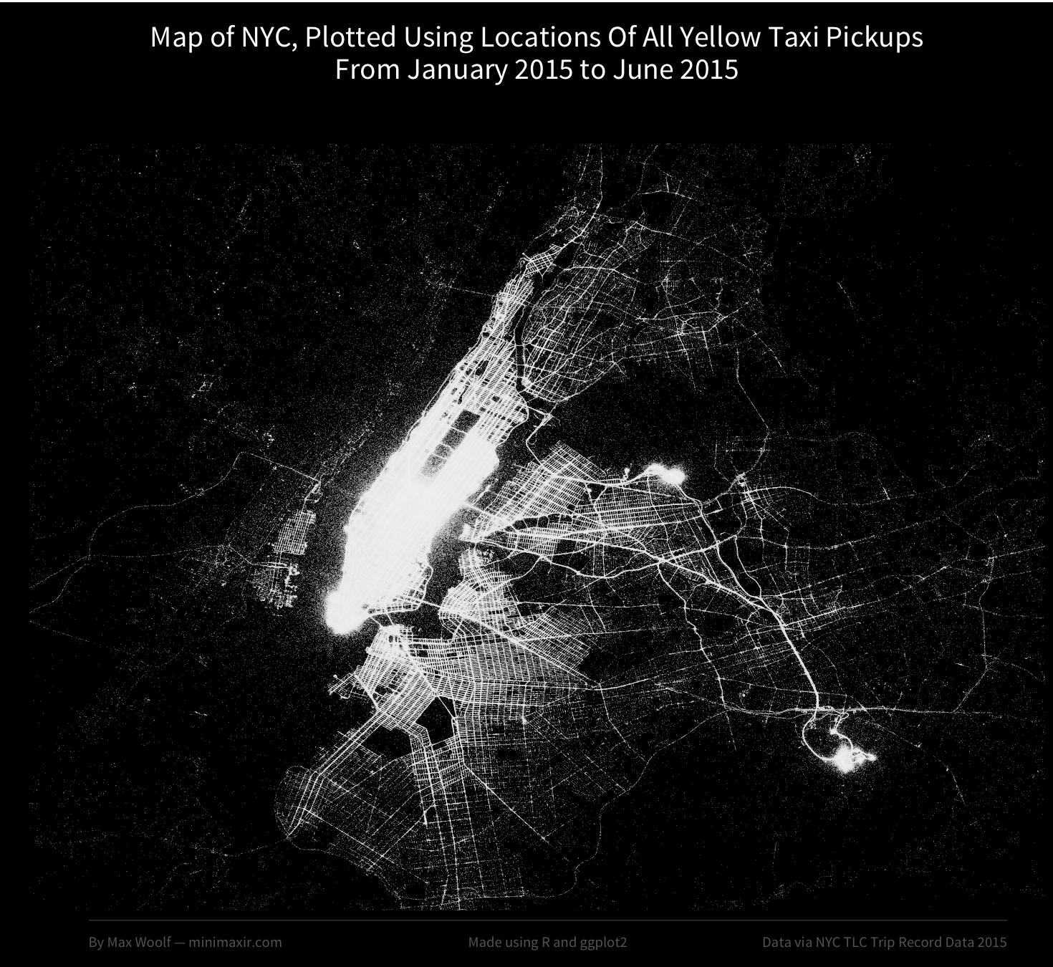
Spatial Clustering
Cluster points in 2-d plane (lat, long) to find patterns
Cluster the pickup locations of taxi trips to find popular regions

Slide 11
How to cluster data?
The input data:
Output:
ID | Attribute 1 | Attribute 2 | …
1 | 100 | 200
2 | 10 | 20
3 | 14 | 18
ID | Attribute 1 | Attribute 2 | … | Cluster #
1 | 100 | 200 |  | 1
2 | 10 | 20 |  | 2
3 | 14 | 18 |  | 2

Slide 12
K-Means Clustering
You need to provide a number K
The method will cluster the data into K groups
What is a centroid: calculate the average of each feature within group

Slide 13
How to cluster data?
The input data:
Output:
ID | Attribute 1 | Attribute 2 | …
1 | 100 | 200
2 | 10 | 20
3 | 14 | 18
ID | Attribute 1 | Attribute 2 | … | Cluster #
1 | 100 | 200 |  | 1
2 | 10 | 20 |  | 2
3 | 14 | 18 |  | 2
Centroid of cluster #2 : (12, 19)

Slide 14
Example

Slide 15
K-Means in SparkR
Maximum number of iterations before stop
How to find the initial centroids (usually random)
Function spark.kmeans()
model <- spark.kmeans(data, formula, k = 2, maxIter = 20, initMode = "random")
Although k-means is NOT a predictive model, the function still produces a “model”. You need to use the “Predict” function to generate the clusters
Number of clusters
A spark data frame
Which columns to use for clustering. Target variable is empty

Slide 16
Example
Use the mtcars dataset. Cluster the cars into 4 clusters.
mtcars_df <- as.DataFrame(mtcars)
model <- spark.kmeans(data = mtcars_df, ~ ., k=4, maxIter = 20, initMode = "random")
summary(model)
“ ~ .” means to use all the attributes to do clustering.
Target variable is always empty for clustering

Slide 17
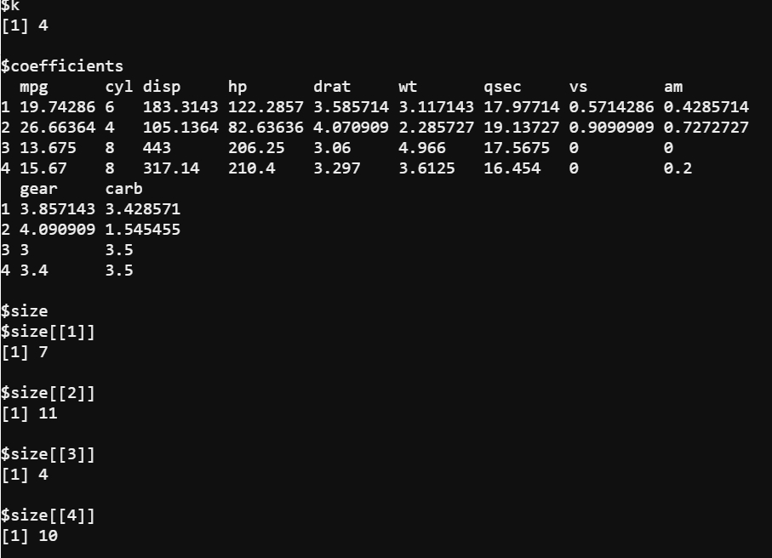
“Model”

Slide 18
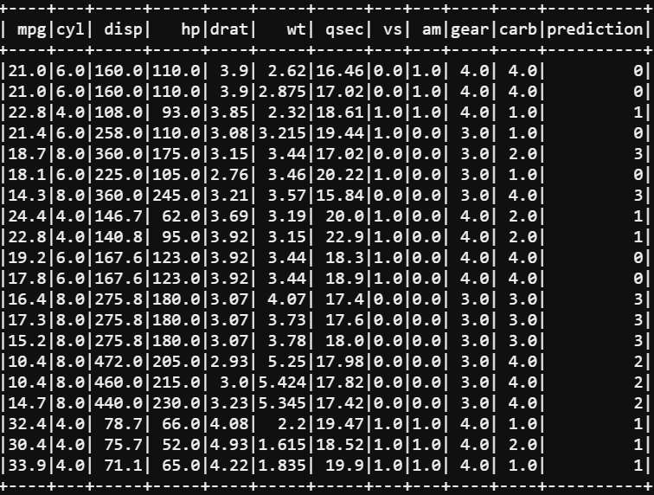
Show the fitted data
mtcars_df_fitted <- predict(model, mtcars_df)
showDF(mtcars_df_fitted, 20)
The “prediction” column is the
Cluster number assigned.

Slide 19
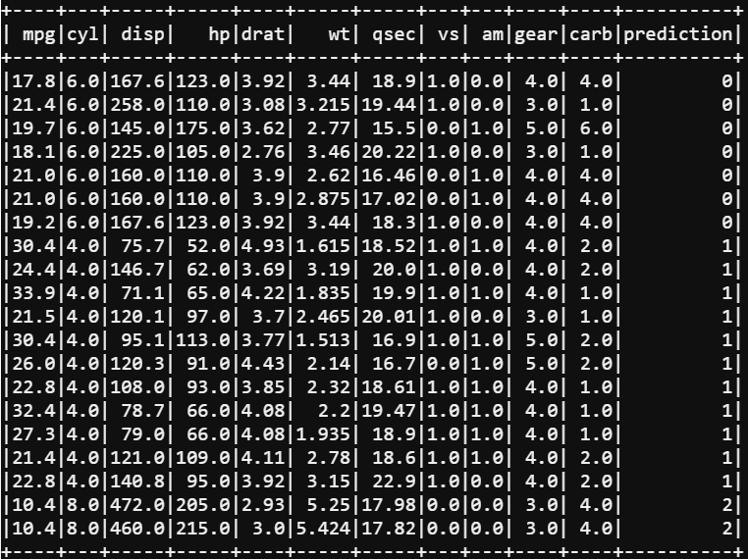
Sort results by cluster number
Use the orderBy function to sort SparkR dataframe
showDF(orderBy(output, output$prediction))
showDF(orderBy(output, -output$prediction))

Slide 20
K-means Clustering
All input features must be numeric
Categorical features (e.g., string) cannot be used as input

Slide 21
Exercise
Use the “iris” dataset in R (built-in data)
This dataset contains 150 different flowers, from one of three species
Setosa, versicolor, virginica
The features are width and length of petal and sepal of each flower、
Convert the dataset into a Spark DataFrame.
Use all the features but the “species” to cluster all the flowers into three groups. Check the results.

Slide 22
Exercise
df <- as.DataFrame(iris)
model <- spark.kmeans(data = df, ~ . -species, k=3, maxIter = 10, initMode = "random")
showDF(predict(model, df), 150)
# or you can do
showDF(fitted(model))

Slide 23
Use Spark K-Means as a “predictive” model
mtcars_df <-as.DataFrame(mtcars)
df_list <- randomSplit(mtcars_df, c(7,3), 2)
training_df <- df_list[[1]]
testing_df<-df_list[[2]]
model <- spark.kmeans(training_df, ~ ., k = 4, maxIter = 20, initMode = "random")
showDF(predict(model, testing_df))
Cluster 1
?
Cluster 2
Cluster 3
Similar to a K Nearest-Neighbor Classifier
Be careful when doing this because the “model” might not be very predictive.

Slide 24
Bisecting K-Means Clustering
A hierarchical clustering method
Faster than k-means but might generate different result
For each iteration, partition one of the existing clusters into two
Stop when k clusters are obtained.

Slide 25
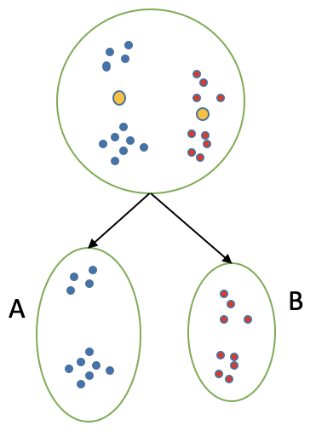

Bisecting K-Means Clustering
Step 1: set K. All data points in the same cluster
Step 2: Use k-means to split the data into two clusters

Slide 26

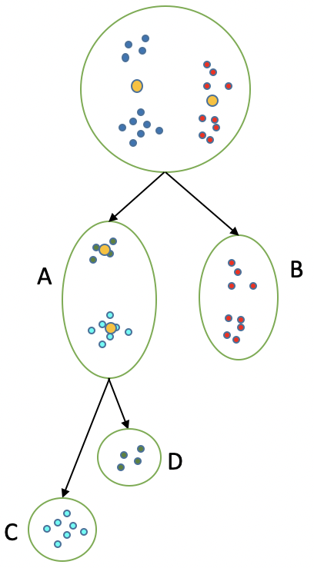
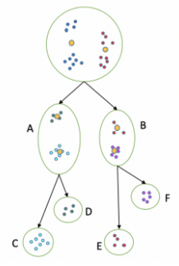
Bisecting K-Means Clustering
Step 3: Measure intra-class distance
Step 4: Select the cluster with the largest intra-class distance and repeat step 2-3
Stop until having K clusters.

Slide 27
Bisecting K-means in Spark
df <- as.DataFrame(iris)
model <- spark.bisectingKmeans(data = df, ~ . -species, k=3, maxIter = 10, seed=3, minDivisibleClusterSize = 1)
showDF(predict(model, df), 150)

Slide 28
Bisecting k-means Clustering
All input features must be numeric
Categorical features (e.g., string) cannot be used as input

Slide 29
To Do for this week
1. Submit Exercise #6
2. Finish HW3

