Slide 1
Spark Machine Learning (III)
BAIS:6110 Fall 2020
Master’s in Business Analytics

Slide 2
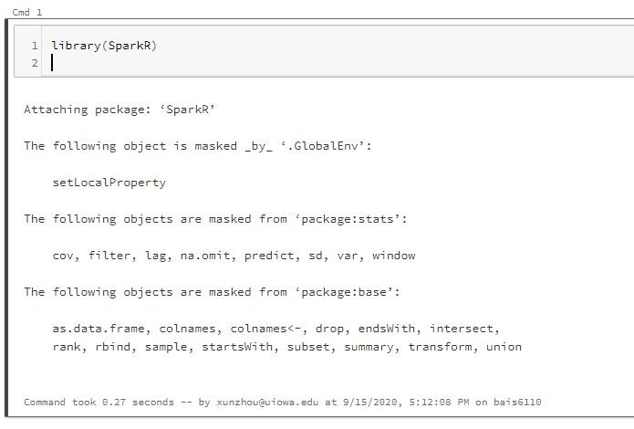
Loading SparkR
Create a notebook with R as the default language.
Load the SparkR package
Attach to the Spark cluster

Slide 3
Clustering
K-Means
Bisecting k-means
Gaussian Mixture Model

Slide 4
Bisecting K-Means Clustering
A hierarchical clustering method
Faster than k-means but might generate different result
For each iteration, partition one of the existing clusters into two
Stop when k clusters are obtained.

Slide 5
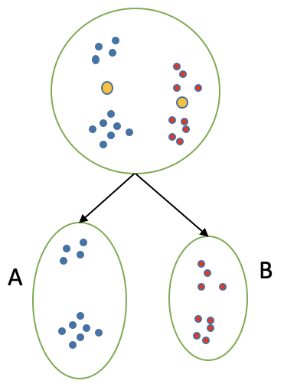

Bisecting K-Means Clustering
Step 1: set K. All data points in the same cluster
Step 2: Use k-means to split the data into two clusters

Slide 6

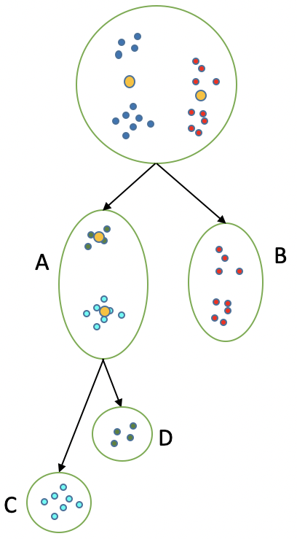
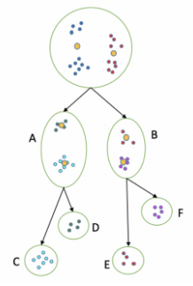
Bisecting K-Means Clustering
Step 3: Measure intra-class distance
Step 4: Select the cluster with the largest intra-class distance and repeat step 2-3
Stop until having K clusters.

Slide 7
Bisecting K-means in Spark
df <- as.DataFrame(iris)
model <- spark.bisectingKmeans(data = df, ~ . -species, k=3, maxIter = 10, seed=3, minDivisibleClusterSize = 1)
showDF(predict(model, df), 150)

Slide 8
Bisecting k-means Clustering
All input features must be numeric
Categorical features (e.g., string) cannot be used as input

Slide 9
Use bisecting k-means as a “predictive” model
iris_df <-as.DataFrame(iris)
df_list <- randomSplit(iris_df, c(7,3), 2)
training_df <- df_list[[1]]
testing_df<-df_list[[2]]
model <- spark.bisectingKmeans(data = training_df, ~ . -species, k=3, maxIter = 10, seed=3, minDivisibleClusterSize = 1)
showDF(predict(model, testing_df))
Be careful when doing this because the “model” might not be very predictive.

Slide 10
Gaussian Mixture Model
K-means will assign each data point a cluster number – hard clustering
Alternatively, we can assign each data point a set of “scores” for each cluster – soft clustering
Gaussian Mixture Model
Assume the data is a mixture of K Gaussian distributions
Calculate the most likely parameters of each cluster
Calculate the likelihood for each data point to belong to each cluster
Assign the data point to the cluster with the highest likelihood

Slide 11
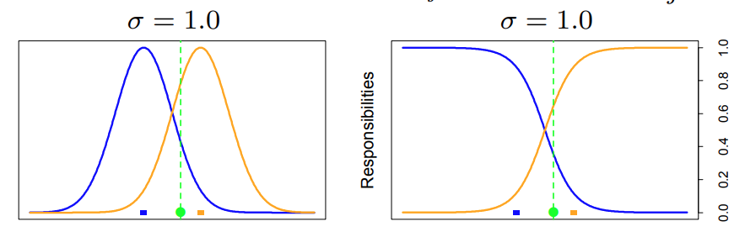

Gaussian Mixture Model
One dimensional example – two clusters
Data in each cluster follows a normal distribution ($μ_{1},σ_{1}^{2}), (μ_{2},σ_{2}^{2})$

Slide 12

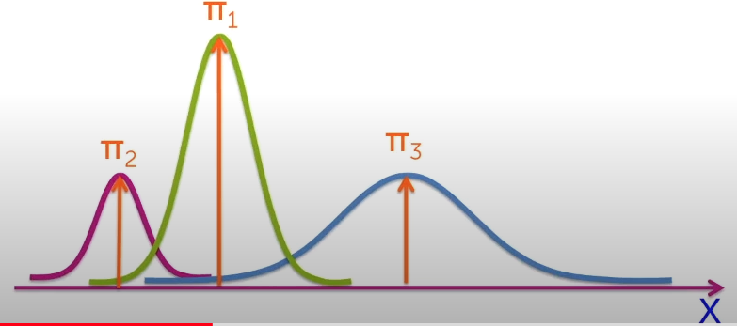

Gaussian Mixture Model
Zi is the cluster indicator of data point i
Xi is the observations (features) of data point i
$π_{k}$ is the relative proportion of each cluster in the data (sum up to one)
Assume this is a Gaussian distribution

Slide 13


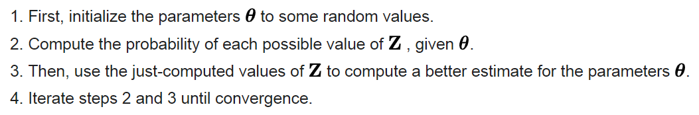

Gaussian Mixture Model
Expectation-Maximization (EM) algorithm
Parameters for the model: $θ=\{π, μ, Σ\}$, cluster assignment Z
What are the most likely values of the parameters given the data?
Maximize this log-likelihood function

Slide 14
EM Algorithm
(example from Wikipedia)
EM algorithm input must be numeric

Slide 15
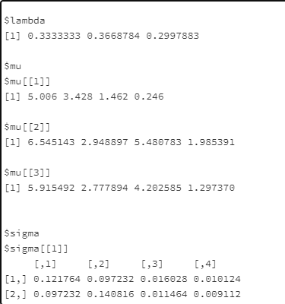
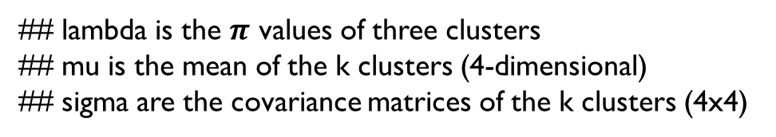
GMM model in Spark
df <- as.DataFrame(iris)
model <- spark.gaussianMixture(df, ~ .-Species, k = 3, maxIter = 100, tol = 0.01)
summary(model)
output <- predict(model, df)
## lambda is the $π$ values of three clusters
## mu is the mean of the k clusters (4-dimensional)
## sigma are the covariance matrices of the k clusters (4x4)

Slide 16
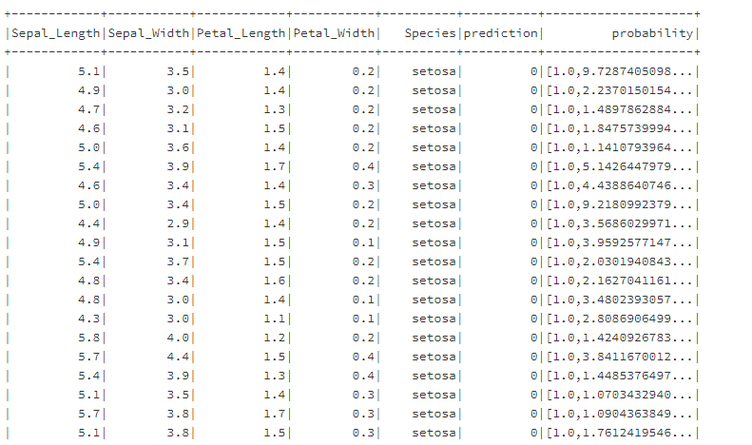
Gaussian Mixture Model
Output
Cluster #
Probability for each cluster

Slide 17
Using GMM as a predictive model
iris_df <-as.DataFrame(iris)
df_list <- randomSplit(iris_df, c(7,3), 2)
training_df <- df_list[[1]]
testing_df<-df_list[[2]]
model<-spark.gaussianMixture(training_df, ~ .-Species, k = 3, maxIter = 100, tol = 0.01)
showDF(predict(model, testing_df))

Slide 18
Exercise #6 (Submit on ICON)
Obtain all the trips from the NYC_Taxi table you created. Load all the trips on August 1 between 7pm and 8pm. Also only keep trips started and ended inside the NYC metropolitan area. You can use sql() to implement this step.
The region of NYC metro area is defined by
Latitudes [40.535049, 40.91959]
Longitudes [-74.259071, -73.697701]
Cluster the trips into 5 clusters using bisecting k-means with features:
pickup_latitude, pickup_longitude, dropoff_latitude, dropoff_longitude
maxIter set to 10. Each divisible cluster should have at least 10 trips.

Slide 19
Exercise #6 (Submit on ICON)
Summarize the learned model
Apply the clustering model on the same dataset and assign cluster labels to each trip.
Order the trips by the cluster number in ascending order
Show the top 20 rows of the final result.

Slide 20
To Do for this week
1. Submit Exercise #6
2. Finish HW3

