Slide 1
Spark Machine Learning (IV)
BAIS:6110 Fall 2020
Master’s in Business Analytics

Slide 2
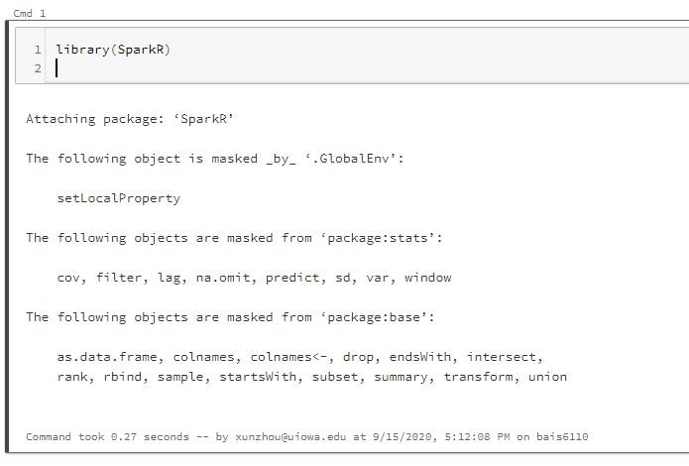
Loading SparkR
Create a notebook with R as the default language.
Load the SparkR package
Attach to the Spark cluster

Slide 3
Clustering
Exercise #6
Data Preprocessing
Latent Dirichlet Allocation (LDA)

Slide 4
Exercise #6 (Submit on ICON)
Obtain all the trips from the NYC_Taxi table you created. Load all the trips on August 1 between 7pm and 8pm. Also only keep trips started and ended inside the NYC metropolitan area. You can use sql() to implement this step.
The region of NYC metro area is defined by
Latitudes [40.535049, 40.91959]
Longitudes [-74.259071, -73.697701]
Cluster the trips into 5 clusters using bisecting k-means with features:
pickup_latitude, pickup_longitude, dropoff_latitude, dropoff_longitude
maxIter set to 10. Each divisible cluster should have at least 10 trips.

Slide 5
Exercise #6 (Submit on ICON)
Summarize the learned model
Apply the clustering model on the same dataset and assign cluster labels to each trip.
Order the trips by the cluster number in ascending order
Show the top 20 rows of the final result.

Slide 6
Solution
sql("use xunzhou")
taxi_df<-sql("select * from nyc_taxi where hour(pickup_datetime) =1 and hour(dropoff_datetime)=1 and day(pickup_datetime) =1 and pickup_latitude between 40.535049 and 40.91959 and dropoff_latitude between 40.535049 and 40.91959 and pickup_longitude between -74.259071 and -73.697701 and dropoff_longitude between -74.259071 and -73.697701")
model <- spark.bisectingKmeans(data = taxi_df, ~ PICKUP_LATITUDE+PICKUP_LONGITUDE+DROPOFF_LATITUDE+DROPOFF_LONGITUDE, k=5, maxIter = 10, seed=3, minDivisibleClusterSize = 10)
summary(model)
showDF(orderBy(output, output$prediction))

Slide 7
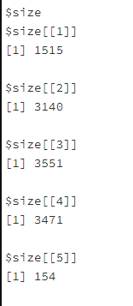
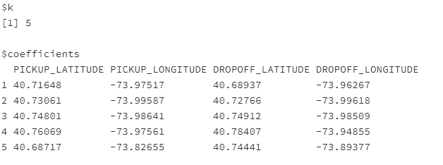

Solution

Slide 8
Data Preprocessing for Models
1. Load data into hive tables
Date or Timestamp format must be “yyyy-MM-dd HH:mm:ss AM” or “yyyy-MM-dd”
If a field has a different format, e.g., “09/01/2020” you should load it as a string format and later convert it to Date or Timestamp
Similarly, if you are unsure about the format of a numeric column, it is always safe to define it as “double”.

Slide 9
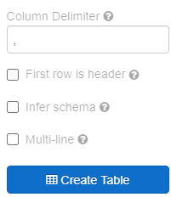
Data Preprocessing for Models
2. Load data into hive tables
Use manual mode if needed
multiple lines in text fields
text fields quoted and contain comma (separator)
Use “infer schema”

Slide 10
Converting data types of Spark DataFrame
3. Example: both columns are string
Convert OrderID to INT
Convert OrderTime to Date
df$OrderID <- cast(df$OrderID, “int”)
df$OrderTime <- cast(to_date(df$OrderTime, 'MM/dd/yyyy'), "date")
to_date() will parse a string into a date type based on the given template
to_timestamp() will parse a string into a timestamp type based on the given template
OrderID | OrderTime
1 | 09/01/2020
2 | 10/01/2020
2020-09-01
2020-10-01

Slide 11
Data Pre-processing
Functions to handle null and NaN values
null/NA is missing value
use isNull() or isNotNull() in SparkR to test if a value is null
dropna(): drop rows with any null value from a DataFrame
na.omit(): same as dropna.
NaN : not a number. Usually generated when dividing a number by 0
Use is.nan() to test if the value is NaN
A valid value in spark. Considered larger than any other values
Can be used for groupBy and join

Slide 12
Categorical vs. Numeric features
Some prediction/clustering models only takes numeric features
Model | Classification | Regression | Clustering | Input Feature in Spark
Decision Tree | X | X |  | Both
Random Forest | X | X |  | Both
Logistic Regression | X |  |  | Both
Multi-layer Perceptron | X |  |  | Numeric
Naïve Bayes | X |  |  | Categorical
Linear SVM | X |  |  | Numeric
Generalized Linear Model |  | X |  | Both
K-means |  |  | X | Both
Bisecting K-means |  |  | X | Both
Gaussian Mixture Model |  |  | X | Both

Slide 13
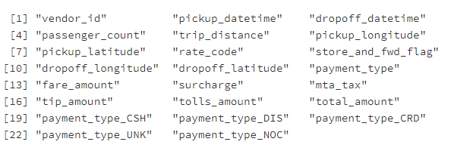
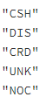
One-hot encoding
ID | Gender
1 | M
2 | F
ID | Gender_Male | Gender_Female
1 | 1 | 0
2 | 0 | 1
Automatically done in Spark when training most models (except mlp, svmLinear)
Number of unique values for such columns has an upper limit.
For mlp and svmLinear you need to manually do the conversion.
values = collect(distinct(select(taxi_df, taxi_df$payment_type)))
for (i in 1:nrow(values)){
v <- values$payment_type[i]
taxi_df$tmp <- ifelse(taxi_df$payment_type == v, 1, 0)
colnames(taxi_df)[length(colnames(taxi_df))] <- paste("payment_type_", v, sep="")
}

Slide 14
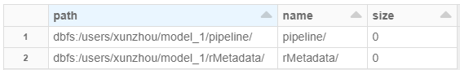
Saving & loading models
You can save/write DataFrames into files (introduced in Lecture 4)
saveDF(), readDF()
Save models trained into a file:
model <- spark.bisectingKmeans(….)
write.ml(model, “/users/xunzhou/model_1”, overwrite = FALSE)
model<-read.ml(“/users/xunzhou/model_1”)
A directory (not a file) to save the model
Change to TRUE when need to overwrite into an existing directory

Slide 15
Latent Dirichlet Allocation (LDA)
Topic modeling for text analytics
Cluster documents into “topics” based on their bags of words
Unsupervised methods (no ground truth)
Can be applied on other types of problems.

Slide 16
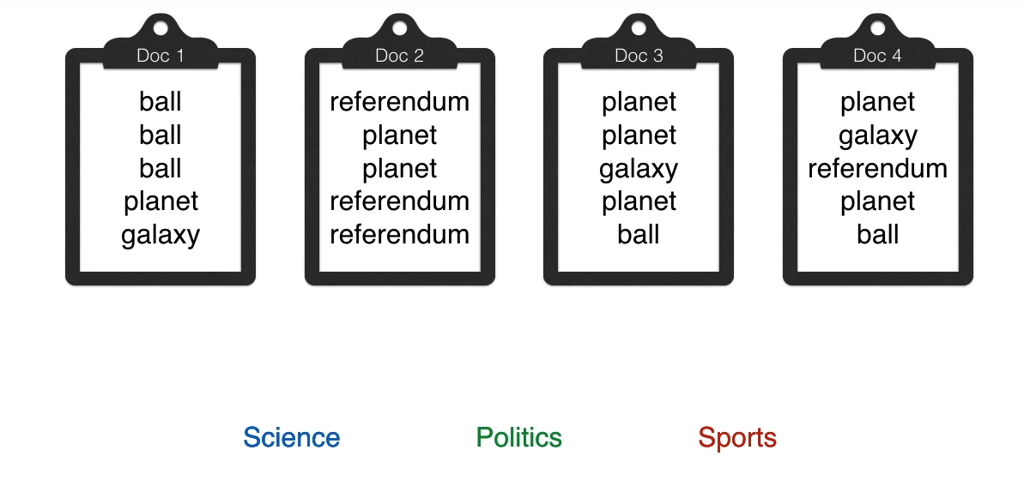
Latent Dirichlet Allocation (LDA)
Words only from a predefined vocabulary (each represented as symbol)
Each document = a bag of words (order is ignored)
Labels are unknown
Group documents into topics

Slide 17
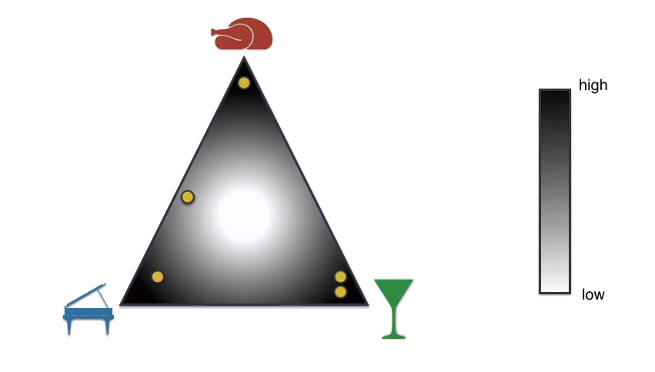
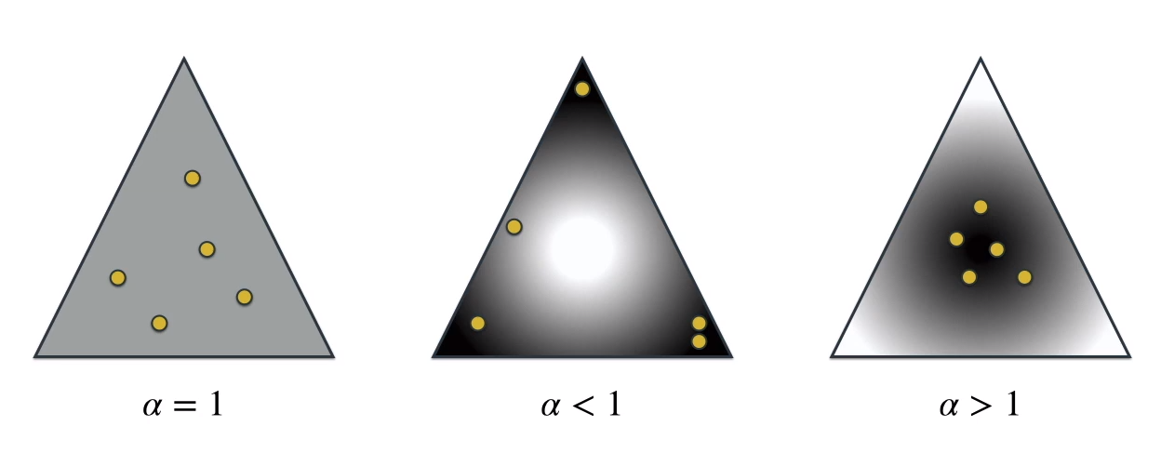

The Dirichlet Distribution
$α:$ concentration parameter
Source: https://www.youtube.com/watch?v=T05t-SqKArY

Slide 18
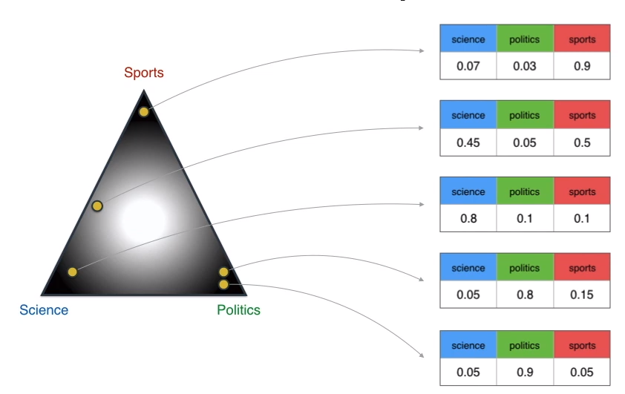
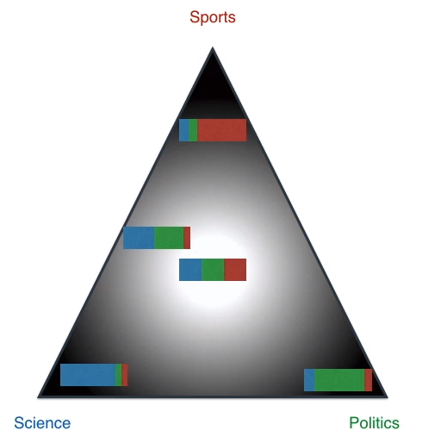
The Dirichlet Distribution (k=3)
Source: https://www.youtube.com/watch?v=T05t-SqKArY

Slide 19
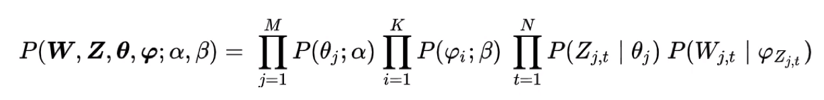
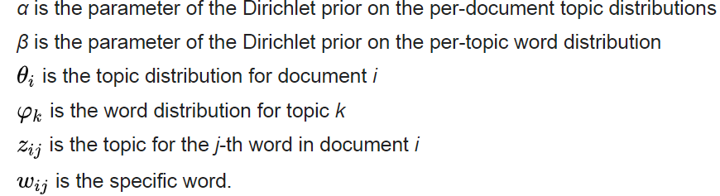
LDA model
Dirichlet distributions
Multinomial distributions
Probability of generating the documents under the parameters
M: number of documents
K: number of topics
N: number of words in a document

Slide 20
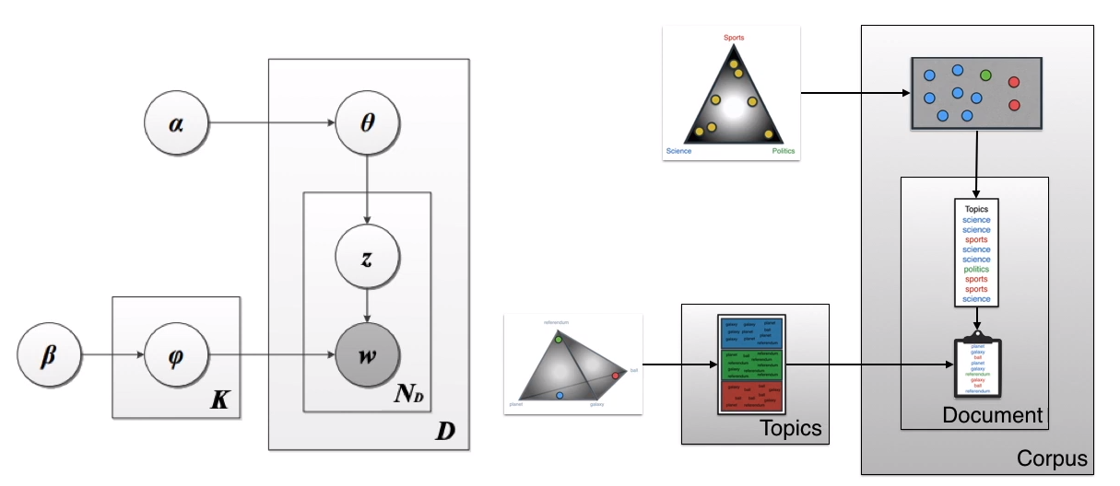

LDA model
Find parameters $α$ and $β$that maximize the value
Best parameters that are most likely to generate the
documents we observed

Slide 21
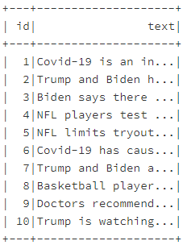
LDA model in Spark
Load a sample data file using the read.df function directly into a DataFrame
df<-read.df("/datasets/documents_1.txt", source="csv", header="true")
model <- spark.lda(data = df, features = "text", k =3, maxIter =20, optimizer = "em“)
Name of the column with the document text
Input DataFrame

Slide 22
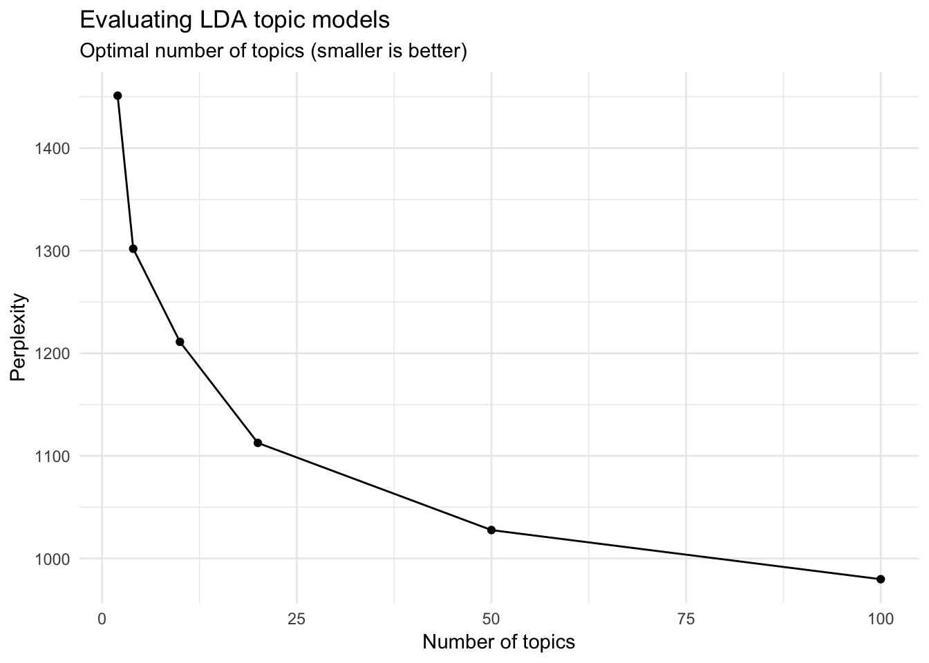
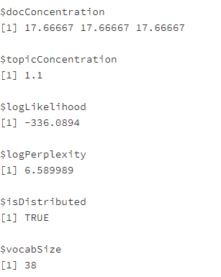
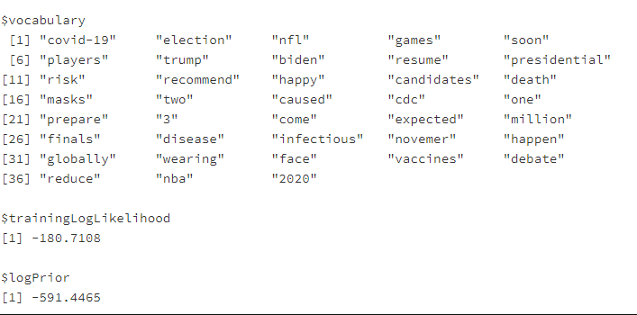
LDA model in Spark
summary(model)

Slide 23
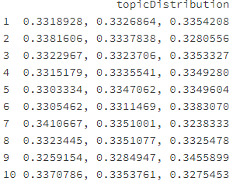
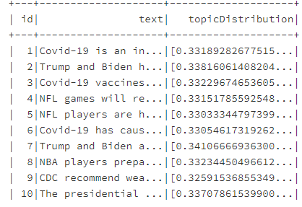
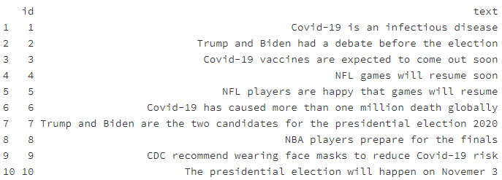
LDA model
posterior <- spark.posterior(model, df)
showDF(posterior)
collect(posterior)

Slide 24
To Do for this week
1. Submit Exercise #7
2. Start working on HW4
3. Project

