Slide 1
Spark Machine Learning (IV)
BAIS:6110 Fall 2020
Master’s in Business Analytics

Slide 2
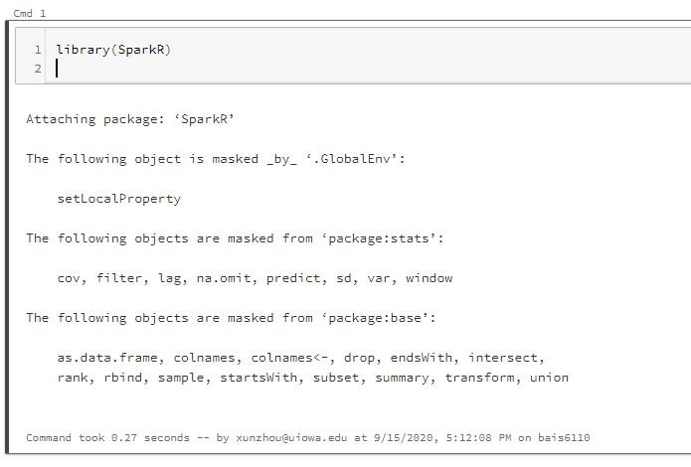
Loading SparkR
Create a notebook with R as the default language.
Load the SparkR package
Attach to the Spark cluster

Slide 3
Association Rule Mining
Basic concepts
Spark implementation
Exercises

Slide 4
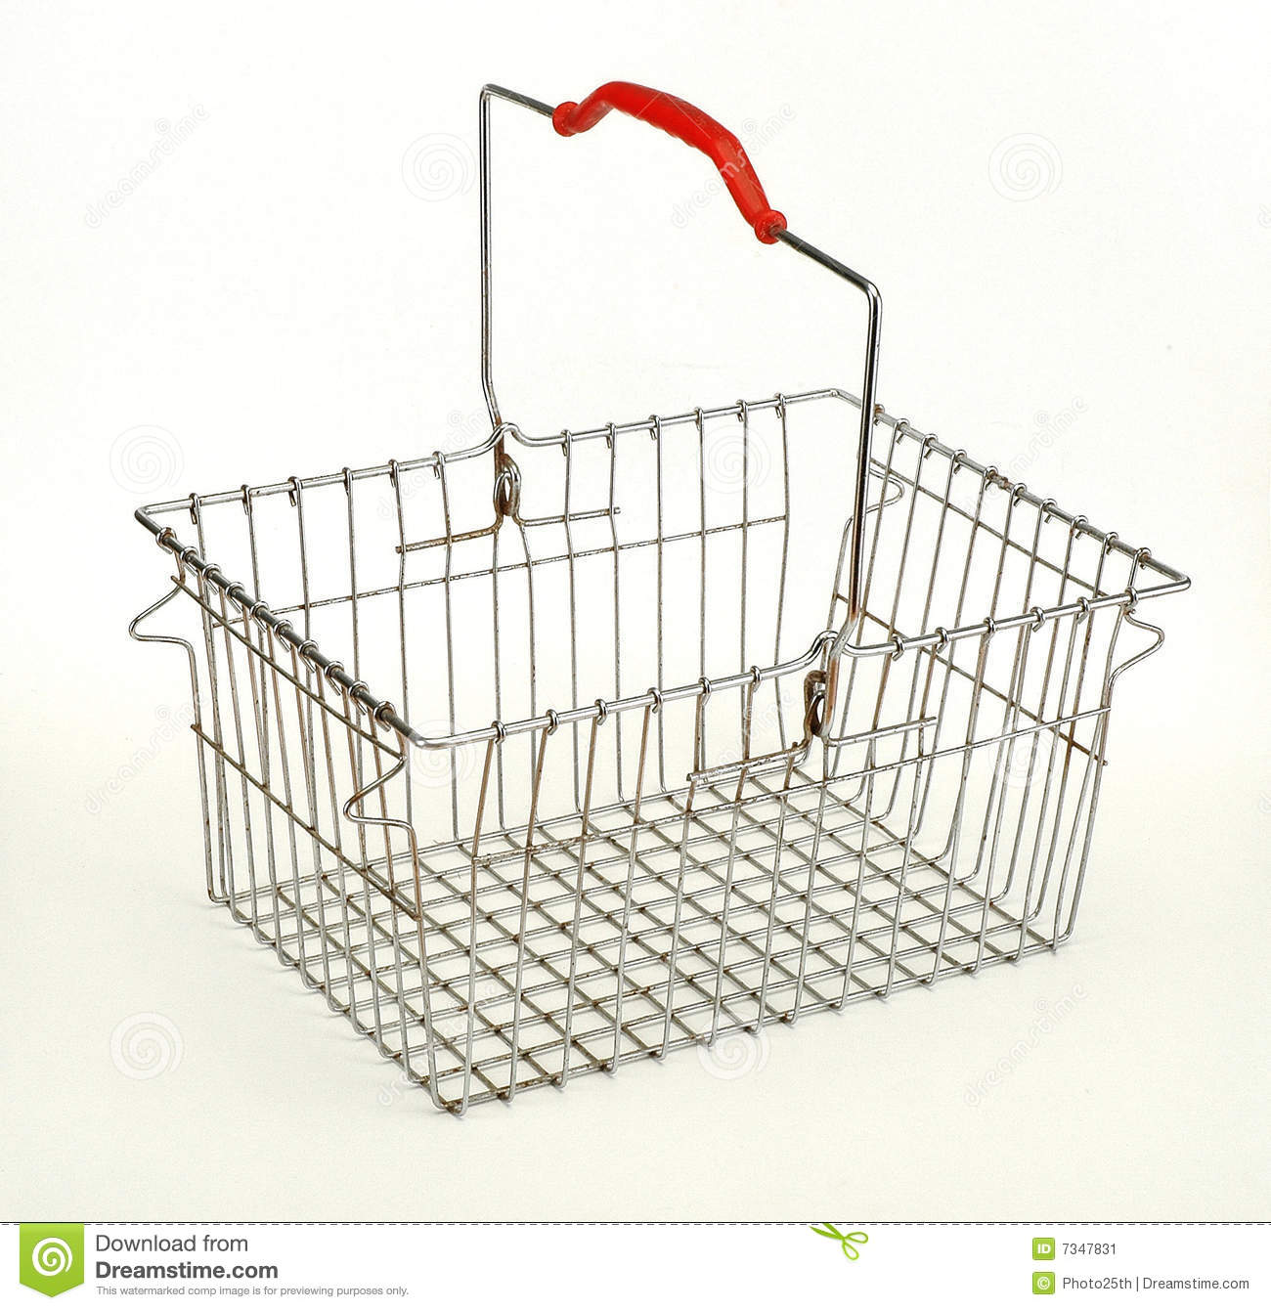
Association Rule Mining
Market Basket Data
Each transaction (receipt) contains a number of items
When you buy A, how likely that you also want to buy B?
Paper plates, plastic forks → napkins
Bread → butter
Computer Monitor -> Cable?
Some of them are trivial
Finding unknown groups may help improve sales!

Slide 5
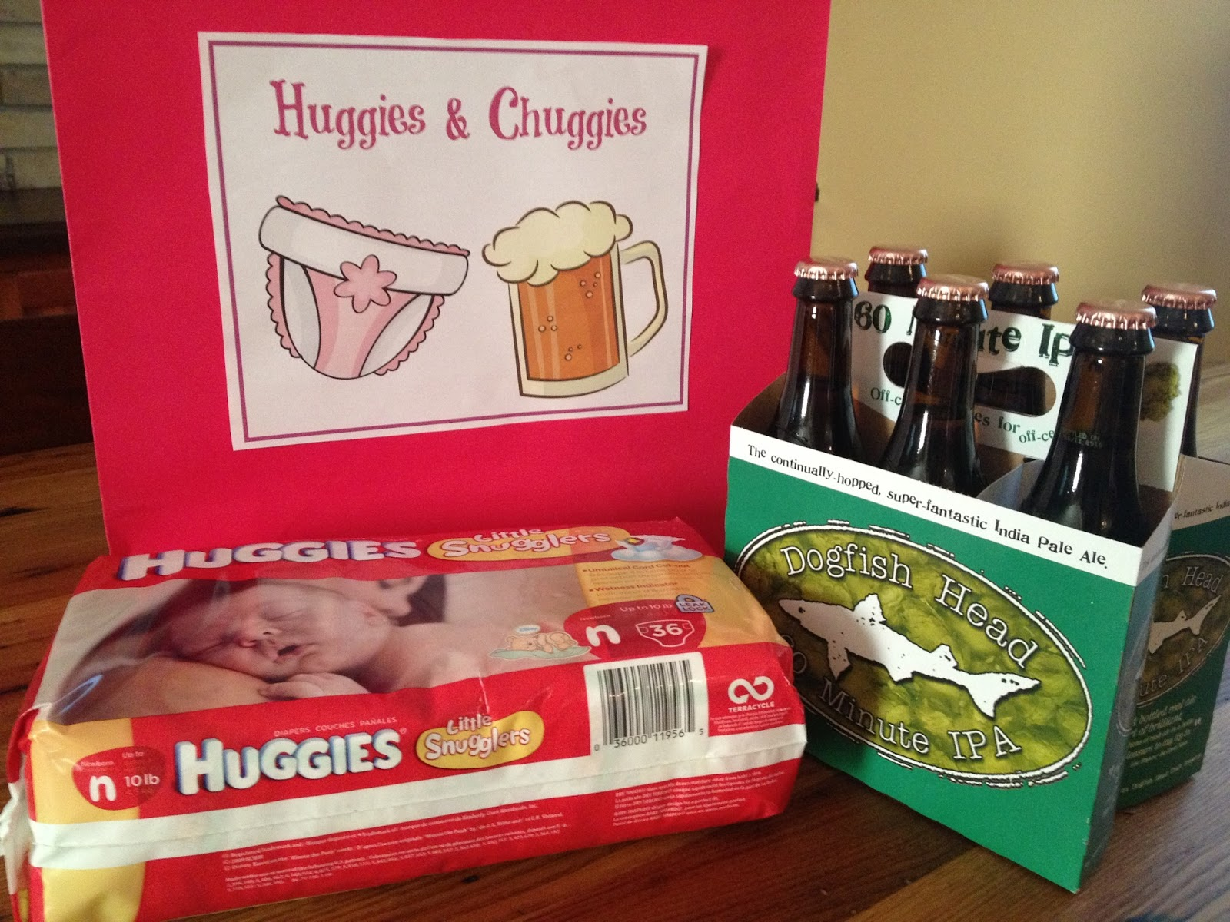
Diaper and Beer

Slide 6
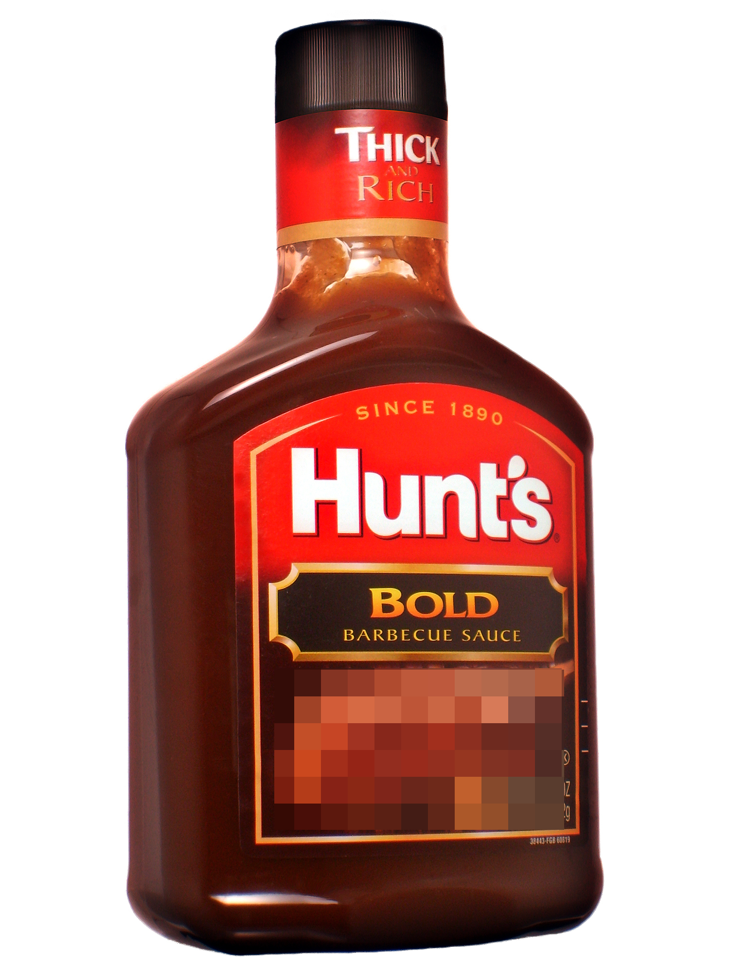
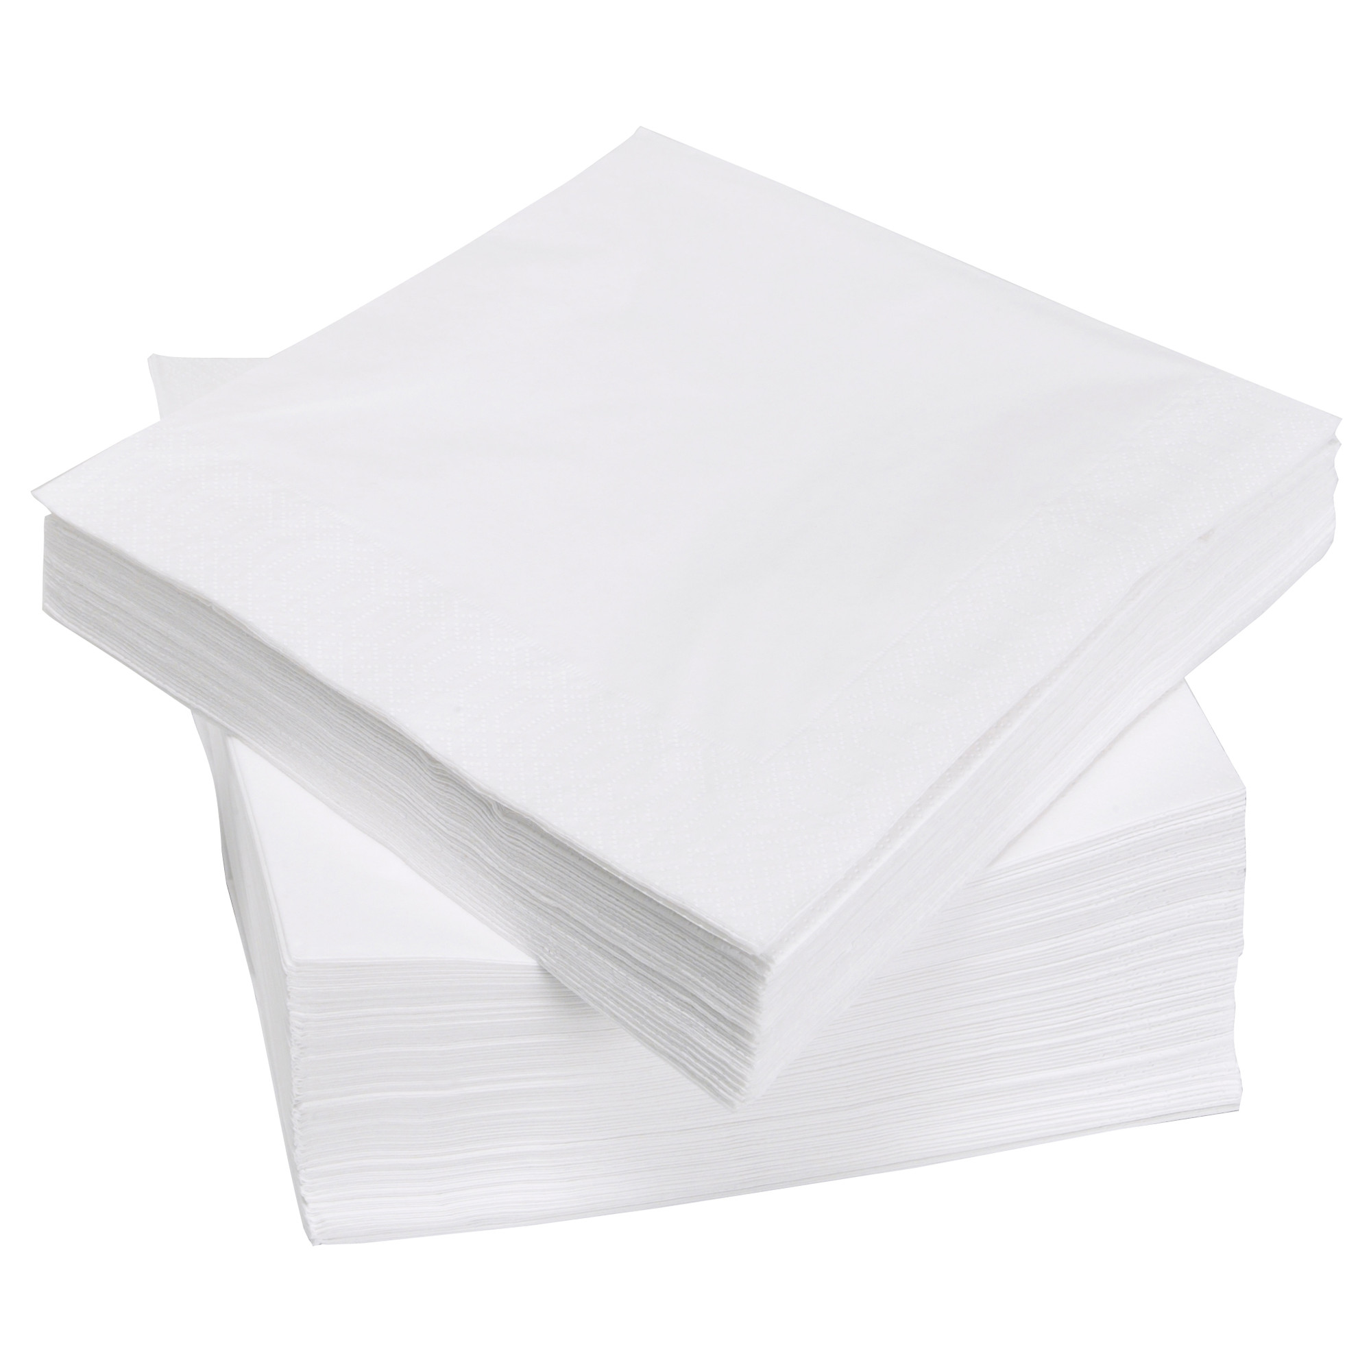
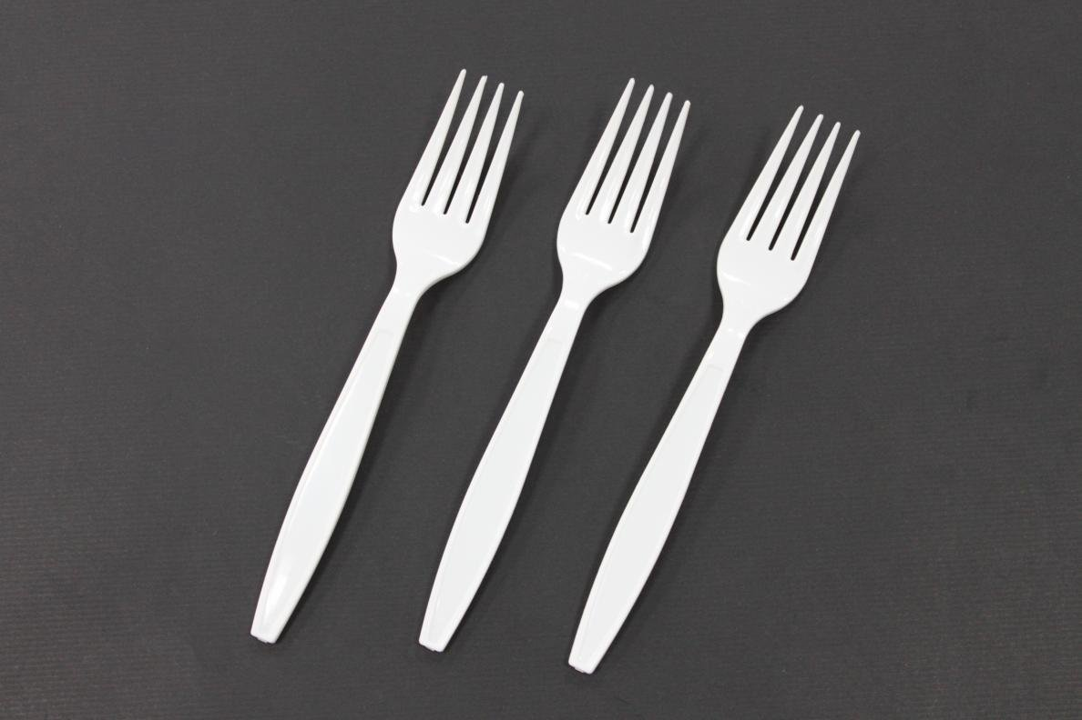
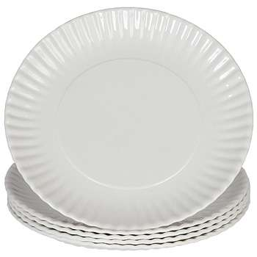
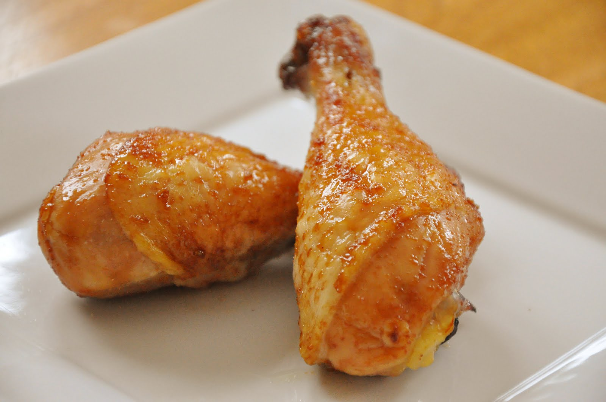
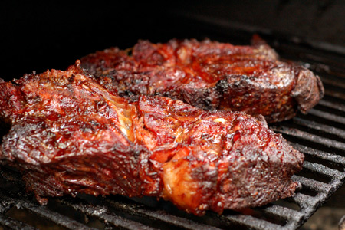
Association Rule Mining
Association Rule {A} → {B}
{A, B} show up together often enough (high “support”)
Association between them is also very strong
Whenever you see {A} in one transaction, it's very likely for you to observe B (high “confidence”)
Example
{BBQ Sauce, Paper Plates, Napkins, Plastic Forks}
{Chicken, BBQ Sauce, Napkins}
{Chicken, Plastic Forks}
{Beef, BBQ Sauce}
{Chicken, BBQ Sauce, Plastic Forks}

Slide 7
Association Rule Mining
Support: The support for an association rule A→B is the ratio/percentage of total transactions (e.g., orders) in the database that contain both A and B.
Confidence: The confidence for an association rule A→B is the number of transactions that contain both A and B as a percentage of the number of transactions that contain A.
Example
{chicken → BBQ sauce}
Support: 40%, confidence: 66.7%
{BBQ sauce →chicken }
Support: 40%, confidence: 50%
{Napkin → BBQ sauce}
Support: 40%, confidence: 100%
Minimum support: 30%
Minimum confidence: 60%

Slide 8
Association Rule Mining
Association Rule with 3 or more items ({A,B}→C)
{A, B, C} show up together often enough (high “support”)
Whenever you see {A, B} in one transaction, it is very likely that you also observe C (high “confidence”)
Example?
{Chicken, BBQ Sauce} → Napkins
Support: 20%
Confidence: 50%

Slide 9
Quick Exercise
Which one of these association rules has a support of at least 50%
and the highest confidence?
Item 3 → Item 5
Item 4 → Item 5
Item 2 → Item 1
Item 5 → Item 3

Slide 10
Association Rule Mining
1. Generate “Frequent Item Sets” with support >= threshold
2. Among these frequent item sets, identify association rules with high confidence.
Step 1 is challenging because the total possible combinations of items is exponentially large. For N items, the number of possible combination is 2^{N} -1
An algorithm called FP-Growth is implemented in SparkR

Slide 11
Data Preparation
A spark DataFrame with one column
Each row is a transaction array
“1,2,3”, “4,5”, “1,4,6”
first, create a R data frame with strings of transactions, then split them
df <- selectExpr(createDataFrame(data.frame(rawItems = c("3,5", "1,2,4", "1,2,5", "1,2,4", "1,2,3,5", "3,5", "", "1,4,5", "1,2", "1,4,5"))), "split(rawItems, ',') AS items")

Slide 12
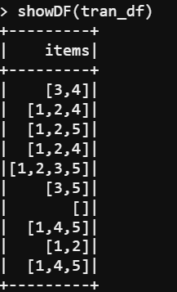
Transactional Data
One column with 1-D spark Array data type
Spark Array: An object, with multiple elements listed.
Elements should have the same data type (e.g., INT)

Slide 13
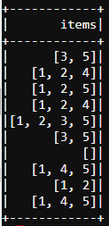
Frequent Item Set
Then run the FP-growth function
Give the DataFrame, column, and thresholds (support, confidence)
fpm <- spark.fpGrowth(df, itemsCol="items", minSupport=0.3, minConfidence=0.5)
showDF(spark.freqItemsets(fpm)) ## Check the frequent item set generated from the data
showDF(spark.associationRules(fpm)) ## Check the association rules generated from the data
showDF(predict(fpm, df)) ## Given a data frame, predict if anything else would be associated with each transaction

Slide 14
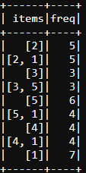
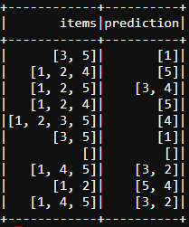
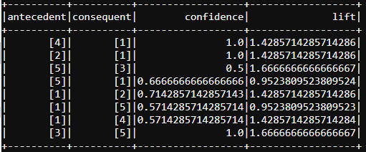

Output
1. Frequent item sets 2. Association rules 3. Predictions
For rule A-> B , we can use “lift” to evaluate if it is useful (lift > 1 means positive association)
Lift = Supp(A, B)/(Supp(A)*Supp(B)).
Lift = (4->1) = (4/10)/(4/10*7/10) = 10/7 = 1.42857
Larger lift suggests stronger association. Lift = 1 means no association (independent).

Slide 15
What if the items are in different rows?
df
OrderID | ItemID | Quantity
1001 | A | 2
1001 | B | 1
1002 | A | 1
1003 | B | 3
1003 | C | 1
1004 | A | 1
1004 | B | 1
1004 | C | 2
Pull the data into a spark DataFrame
We need to Group the data by OrderID and
aggregate all the ItemID into one array for each order
Use the collect_set() function
Use DataFrame Manipulation Function
df_agg<-agg(groupBy(df, df$OrderID), ItemID = “collect_set”)
collect_set() is an aggregate function in SparkR. It will convert a list of values into an array.

Slide 16
What if the items are in different rows?
Pull the data into a spark DataFrame suitable for association analysis
We need to Group the data by OrderID and
aggregate all the ItemID into one array for each order
Use the collect_set() function
Use DataFrame Manipulation Function
df_agg <- agg(groupBy(df, df$OrderID), ItemID = “collect_set”)
colnames(df_agg)[2] <- “items”
Then use the fpgrowth() function to perform associate rule mining on this DataFrame
OrderID | items
1001 | [A, B]
1002 | [A]
1003 | [B, C]
1004 | [A, B, C]

Slide 17
Exercise #7 (submit on ICON)
Preparation
Create a new Spark DataFrame by running the following command in R (use your own directory name):
df <- read.df("/datasets/orderline.txt", source = "csv")
This command directly loads the sample data in the file into a spark DataFrame.
Rename the first column of DataFrame as “OrderID” and the second column as “ProductID”
Convert the DataFrame into a suitable formats for association rule analysis. Each row of the new DataFrame should represent an order, where the first column is OrderID and the second column is an array of product id’s. The second column should be renamed as “items”.

Slide 18
Exercise #7
Perform an association rule analysis on the DataFrame you obtained with minSupport = 0.3 and minConfidence = 0.5
Show all the association rules you discovered.

Slide 19
To Do for this week
1. Submit Exercise #7
2. Start working on HW4
3. Project

