Slide 1
Spark Machine Learning (V)
BAIS:6110 Fall 2020
Master’s in Business Analytics

Slide 2
Logistic Issues
Exercise #7 due today.
Exercise #8 next week (last one)
HW4 due next week

Slide 3
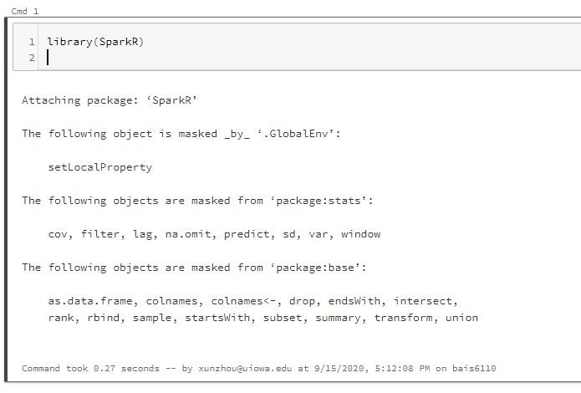
Loading SparkR
Create a notebook with R as the default language.
Load the SparkR package
Attach to the Spark cluster

Slide 4
Review
Association Rule Mining - additional
Spatial Association and Co-location
Others

Slide 5
Exercise #7 (submit on ICON)
Preparation
Create a new Spark DataFrame by running the following command in R (use your own directory name):
df <- read.df("/datasets/orderline.txt", source = "csv")
This command directly loads the sample data in the file into a spark DataFrame.
Rename the first column of DataFrame as “OrderID” and the second column as “ProductID”
Convert the DataFrame into a suitable formats for association rule analysis. Each row of the new DataFrame should represent an order, where the first column is OrderID and the second column is an array of product id’s. The second column should be renamed as “items”.

Slide 6
Exercise #7
Perform an association rule analysis on the DataFrame you obtained with minSupport = 0.3 and minConfidence = 0.5
Show all the association rules you discovered.

Slide 7
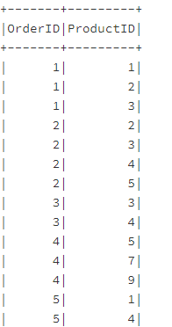
Exercise #7 Solutions
orderline <- read.df("/datasets/orderline.txt", source = "csv")
colnames(orderline)[1]<- "OrderID"
colnames(orderline)[2]<- "ProductID“
orderline$OrderID <- cast(orderline$OrderID, "INT")
orderline$ProductID <- cast(orderline$ProductID, "INT")

Slide 8
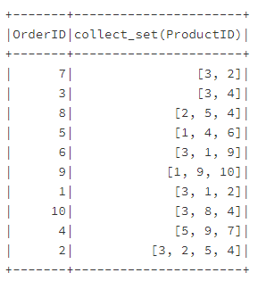
Solution
df_agg<-agg(groupBy(orderline, orderline$OrderID), ProductID = "collect_set")
colnames(df_agg)[2] <- "items“
fpm <- spark.fpGrowth(df_agg, itemsCol="items", minSupport=0.3, minConfidence=0.5)
showDF(spark.freqItemsets(fpm))
showDF(spark.associationRules(fpm))
showDF(predict(fpm, df_agg))

Slide 9
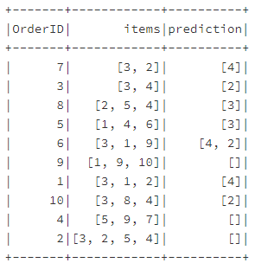
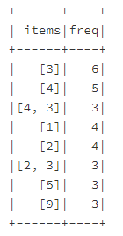
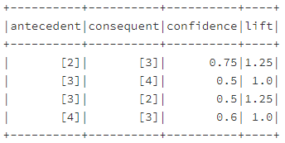
Solution

Slide 10
Broader Use of Association Rule Mining
In many other applications, you may apply this analysis
Movie database: how often some actors collaborate?
Social network: user groups who view/like/dislike the same posts
Variations
Spatio-temporal association patterns (co-location / cascading patterns)
Different stores often located in close proximity to each other.
Gas stations (Kum-Go vs. Casey's, competitors)
Walmart vs. Subways (collaborators)
Animals habitats
Bird nests + specific tree types
Predators and preys (fox vs. Rabbits)
Unknown associations......
Crimes: Bar closing --> crimes
Again: association rules do not necessarily indicate causality. We are observing high-frequency co-occurrences of events but that does not tell us if they are cause-effect related (although sometimes very likely)

Slide 11
Broader Use of Association Rule Mining
One can extract features from data as “items” and try to associate a group of features with a target feature for predictive power
For example: Congressman vote record (Courtesy: “Introduction to Data Mining”, Tan, SteinBach and Kumar pp.352-353).
Member# | Issue 1 ObamaCare | Issue 2 Immigrants | Issue 3 Syria | … | Party
1 | Y | N | Y | … | D
2 | Y | Y | Y | … | D
3 | N | Y | N | … | R
4 | N | Y | N | … | R
5 | N | N | N | … | R
{ObamaCare =no, Immigrants = yes} → Party = R, Support:40%, Confidence: 100%

Slide 12
Spatial Associations and Co-locations
If we observe a gas station in a neighborhood, are we likely to observe a 7-11 store in the same neighborhood?
How to define “transactions” here?
Use naturally defined zones (e.g., blocks, districts)
Partition the map into grids (how?)
Each block/zone/cell is a “transaction”
How to define “items” here?
Each type of point-of-interest (POI) is an item
Support { , } = 50%
Support { , } =?
Confidence{ → } = 66.7%
Confidence{ → } =?

Slide 13
Spatial partitioning and gridding
Partition a spatial region into grid cells (equal-sized)
A useful data processing step
Calculate distributions (e.g., number of pickups, crimes in each grid)
Generate heatmap
Spatial association analysis
Hotspot detection…

Slide 14
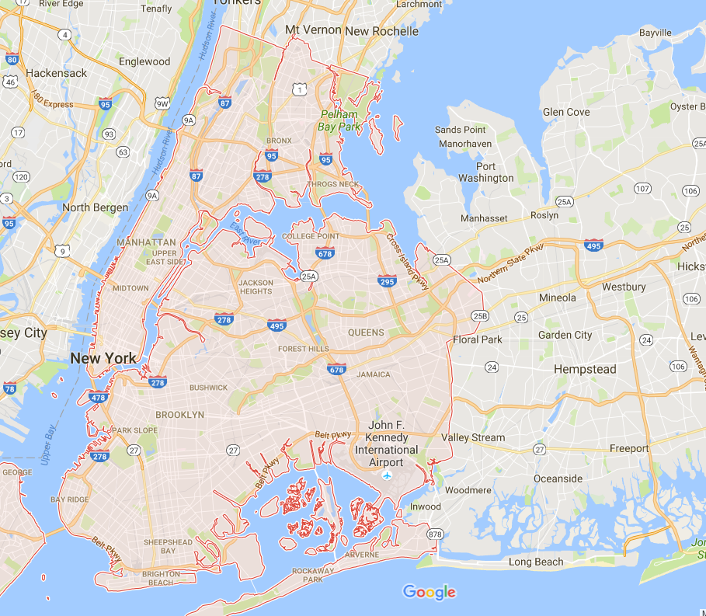
Study Region
Area:
Latitude: [40.55, 41]
Longitude: [-74.27, -73.70]
grid size: 0.005x0.005
Number of grids:
~ 100 x 120

Slide 15
Grouping Trips
Area:
Long, Lat -> grid_x, grid_y
(pickup_latitude - min_latitude)/grid_size
Get the integer part of this result
ceil() function
grid_y = ceil(pickup_latitude - min_latitude)/grid_size
grid_x = ceil(pickup_longitude - min_longitude)/grid_size
1 2 3 4 5 6 7 8 9 10 11 12 13 14 15 16
1 2 3 4 5 6 7 8 9 10 11 12 13 14 15 16 17 18

Slide 16
Grouping Trips
In Hive you can write this query:
select ceil((pickup_latitude-40.55)/0.005) lat_ind, ceil((pickup_longitude-(-74.27))/0.005) as long_ind, count(*)
from nyc_taxi
where pickup_longitude between -74.27 and -73.70 and pickup_latitude between 40.55 and 41
group by ceil((pickup_latitude-40.55)/0.005), ceil((pickup_longitude-(-74.27))/0.005)
order by 1,2;
1 2 3 4 5 6 7 8 9 10 11 12 13 14 15 16
1 2 3 4 5 6 7 8 9 10 11 12 13 14 15 16 17 18

Slide 17
Grouping Trips
In SparkR you can write this query:
sql(“use xunzhou”)
q= “select ceil((pickup_latitude-40.55)/0.005) lat_ind, ceil((pickup_longitude-(-74.27))/0.005) as long_ind, count(*)
from nyc_taxi
where pickup_longitude between -74.27 and -73.70 and pickup_latitude between 40.55 and 41
group by ceil((pickup_latitude-40.55)/0.005), ceil((pickup_longitude-(-74.27))/0.005)
order by 1,2”
pickup_stat<- collect(sql(q))
1 2 3 4 5 6 7 8 9 10 11 12 13 14 15 16
1 2 3 4 5 6 7 8 9 10 11 12 13 14 15 16 17 18

Slide 18
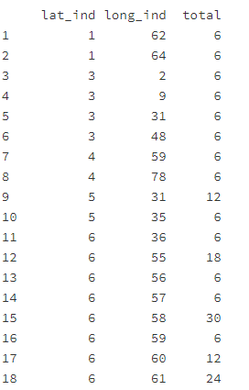
Grouping Trips
Rename 3rd column:
colnames(pickup_stat)[3] <-"total"
1 2 3 4 5 6 7 8 9 10 11 12 13 14 15 16
1 2 3 4 5 6 7 8 9 10 11 12 13 14 15 16 17 18

Slide 19
Quick Exercise
Use SparkR manipulation functions to repeat this process
Use agg(), groupBy(), and select() to generate the same results.
sql("use xunzhou")
taxi_df <- sql("select * from nyc_taxi")
pickup_counts <- count(groupBy(taxi_df, ceil((taxi_df$pickup_latitude-40.55)/0.005), ceil((taxi_df$pickup_longitude-(-74.27))/0.005)))
colnames(pickup_counts)[1] <- "lat_ind"
colnames(pickup_counts)[2] <- "lng_ind“
pickup_stat<- collect(pickup_counts)

Slide 20
Grouping Trips
The results are like:
pickup_map = matrix(0, 100, 120)
for (i in 1:nrow(pickup_stat)){
xind = pickup_stat[i,1]+1
yind = pickup_stat[i,2]+1
pickup_map[xind, yind] = pickup_stat[i,3]
}
image(t((pickup_map)), axes=FALSE, zlim=c(0,max(pickup_stat[,3])), col=rev(heat.colors(256)))
1 2 3 4 5 6 7 8 9 10 11 12 13 14 15 16
x
y
1 2 3 4 5 6 7 8 9 10 11 12 13 14 15 16 17 18

Slide 21
Use Image() to visualize a matrix
image(t(pickup_map), axes=FALSE, zlim=c(0,max(pickup_stat[,3])), col=rev(heat.colors(256)))
zlim shows the range of values being used to generate the heatmap
col specifies the color scheme used for the mapping
value ←→ Color

Slide 22
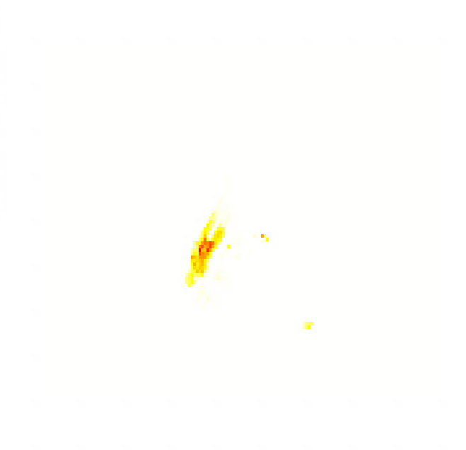
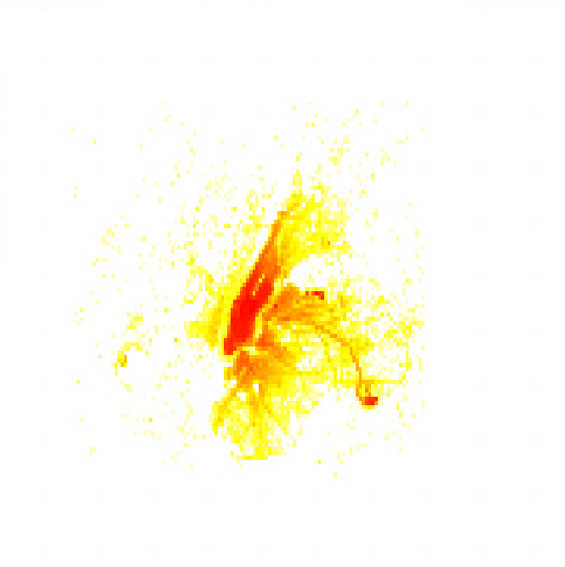
Heatmaps

Slide 23
Heatmaps
image(t(log(pickup_map)), axes=FALSE, zlim=c(0,log(max(pickup_stat[,3]))), col=rev(heat.colors(256)))
Use log-scale to tolerate extreme values

Slide 24
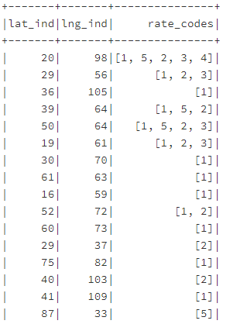
Spatial association analysis ideas
For each pickup grid cell in the nyc_taxi data, generate an array of possible trip rate codes.
output <- agg(groupBy(taxi_df, ceil((taxi_df$pickup_latitude-40.55)/0.005), ceil((taxi_df$pickup_longitude-(-74.27))/0.005)), rate_code = "collect_set")
colnames(output)[1] <- "lat_ind"
colnames(output)[2] <- "lng_ind"
colnames(output)[3] <- "rate_codes"

Slide 25
Possible spatial association analysis ideas
For the Chicago Crime dataset
Partition the city into grids (you need to define min/max of latitude and longitude, and also grid size).
For each grid, consider different types of crimes as “items”
List all the types of crimes observed in each grid as an array
Association rules might look like this:
Assaulting -> Robbery with support 0.05 and confidence 0.1

Slide 26
To Do for this week
1. Submit Exercise #8
2. Finish HW4
3. Project

