Slide 1
Spark Machine Learning (V)
BAIS:6110 Fall 2020
Master’s in Business Analytics

Slide 2
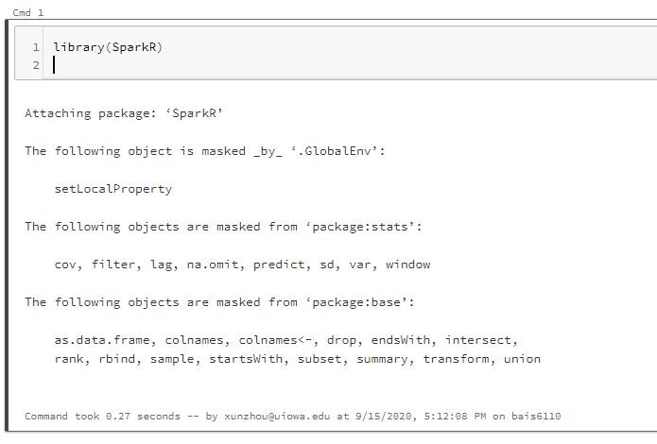
Loading SparkR
Create a notebook with R as the default language.
Load the SparkR package
Attach to the Spark cluster

Slide 3
Collaborative Filtering
Basic concepts
Spark implementation
Exercises

Slide 4
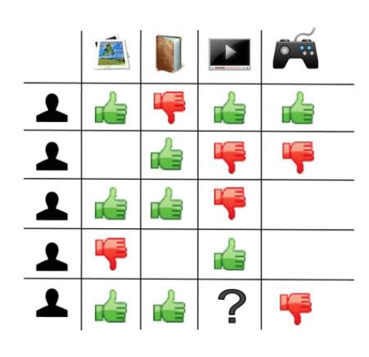
Collaborative filtering
Recommender systems
Components: users, items, and ratings
Users purchase
Reviewers give ratings to restaurants
Learn users’ personalized preferences towards items
Predict unknown ratings/preferences
Product recommendation on Amazon
Movie recommendations on Nexflix
News and article recommendations

Slide 5
Connections with other models
Classification models
Recommender systems also make predictions
But for recommender systems, features for each user are different
target variables are also different for each user
Association rule mining
We can also use association rules to make recommendations
No personalization. Same rules for all the users towards all the items.

Slide 6
Collaborative filtering
Filtering – making automatic predictions.
Idea: if a person A has the same opinion as a person B on an issue, A is more likely to have B's opinion on a different issue than that of a randomly chosen person (collaborative)

Slide 7
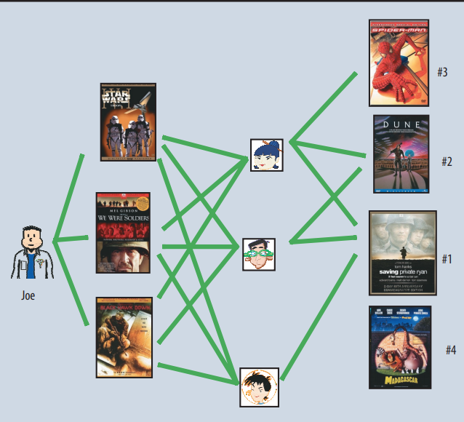
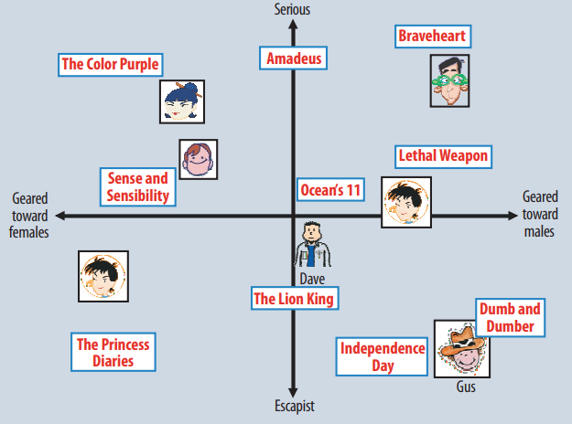
Collaborative Filtering
Major types of techniques
Neighborhood methods
Latent factor models

Slide 8
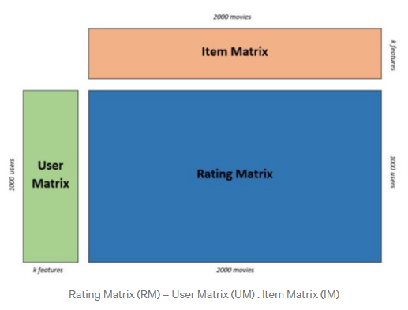
Matrix Factorization
Latent factor models
Rating matrix = User matrix [.] Item matrix
Item matrix
Use k latent factors to represent items
color, weight, type, price, …. (known or unknown)
Similar to topic modeling
Use k latent factors to represent users
preferences on the k factors of items

Slide 9
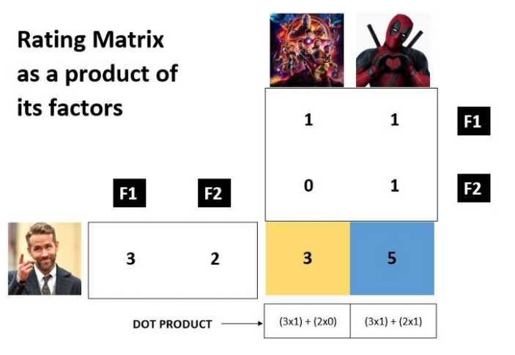
Matrix Factorization
Source: https://medium.com/sfu-cspmp/recommendation-systems-collaborative-filtering-using-matrix-factorization-simplified-2118f4ef2cd3

Slide 10

Matrix Factorization
For a given Rating matrix R = {r_{ui}}
Find the best item matrix Q = {q_{i}} and the best user matrix P = {p_{u}} that…
q_{i}
p_{u}
r_{ui}
Minimize the squared error compared to observed ratings
Regularization terms to avoid overfitting
Optimization algorithm: stochastic gradient decent
Source: https://medium.com/sfu-cspmp/recommendation-systems-collaborative-filtering-using-matrix-factorization-simplified-2118f4ef2cd3

Slide 11
Matrix Factorization
Prediction
Given P and Q matrices, calculate R
Some challenges of the method
Data sparsity (cold start)
Scalability
Shilling attacks
q_{i}
p_{u}
?
Source: https://medium.com/sfu-cspmp/recommendation-systems-collaborative-filtering-using-matrix-factorization-simplified-2118f4ef2cd3

Slide 12
Collaborative Filtering in Spark
Data preparation
In SparkR, you need a DataFrame with “user”, “item” and “rating” columns.
User and item must have INT type (as ID’s).
“Rating” could be explicit (e.g., rating scores), or implicit (# likes, clicks, etc.)
User | Item | Rating
1 | 1 | 2.0
1 | 2 | 3.0
2 | 3 | 5.0

Slide 13
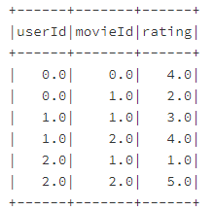
Collaborative Filtering in Spark
Data preparation
data <- list(list(0, 0, 4.0), list(0, 1, 2.0), list(1, 1, 3.0), list(1, 2, 4.0), list(2, 1, 1.0), list(2, 2, 5.0))
df <- createDataFrame(data, c("userId", "movieId", "rating"))
model <- spark.als(data=df, userCol = "userId", itemCol = "movieId", rank = 10, regParam = 0.01,
maxIter = 5, ratingCol = "rating")
User column
Item column
Rating column
ALS = Alternating Least Squares

Slide 14
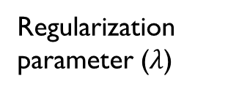
Collaborative Filtering in Spark
model <- spark.als(data=df, userCol = "userId", itemCol = "movieId", rank = 10, regParam = 0.01,
maxIter = 5, ratingCol = "rating“, implicitPrefs = FALSE)
Regularization parameter ($λ$)
Number of latent factors used to model the data
Maximum number of iterations for matrix factorization
Explicit Preference
ALS = Alternating Least Squares

Slide 15
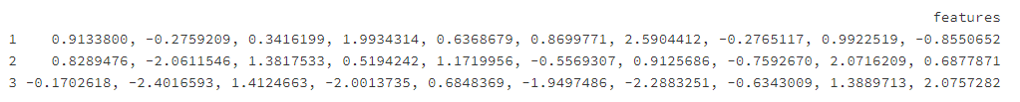
Collaborative Filtering in Spark
stats <- summary(model)
userFactors <- stats$userFactors
itemFactors <- stats$itemFactors
collect(userFactors)
collect(itemFactors)

Slide 16
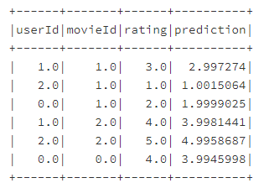
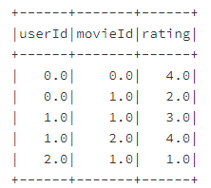
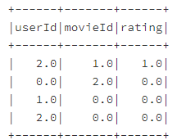
Collaborative Filtering in Spark
output <- predict(model, df)
showDF(output)
## train the model again with only first 5 rows
## test on the last row and three additional combinations
df_train
df_test
Unknown ratings. Put 0.0

Slide 17
Collaborative Filtering in Spark
data_train <- list(list(0, 0, 4.0), list(0, 1, 2.0), list(1, 1, 3.0), list(1, 2, 4.0), list(2, 1, 1.0))
df_train <- createDataFrame(data_train, c("userId", "movieId", "rating"))
data_test <- list(list(2, 1, 1.0), list(0, 2, 0.0), list(1, 0, 0.0), list(2, 0, 0.0))
df_test <- createDataFrame(data_test, c("userId", "movieId", "rating"))
Complete the following steps in Exercise #8

Slide 18
Exercise #8 (Submit on ICON)
Include the code on the last slide in your notebook.
Train a collaborative filtering model using the df_train DataFrame.
Use the same parameters as shown on Slide 14.
Show the userFactors and itemFactors of the trained model.
Make a prediction on the df_test DataFrame. Show the results.

Slide 19
To Do for this week
1. Submit Exercise #8
2. Finish HW4
3. Project

